Slide 1


Comparative Analysis of TF-IDF and BM25
Raunak Nandkumar More (101136778)

Slide 2
Introduction
Purpose of the Study:
The primary goal is to rigorously evaluate and compare the performance of two prominent ranking algorithms, TF-IDF and BM25, specifically in the domain of text analysis on Shakespeare's iconic work, Macbeth. The study aims to shed light on how these algorithms behave in retrieving relevant information given diverse queries.
Overview of TF-IDF and BM25:
Explanation of TF-IDF and BM25 algorithms and their application in information retrieval.

Slide 3
Overview of TF-IDF and BM25:
TF-IDF (Term Frequency-Inverse Document Frequency):
Calculation Method: TF-IDF is calculated by multiplying the term frequency (TF), which represents how often a word appears in a document, by the inverse document frequency (IDF). IDF is the logarithm of the total number of documents divided by the number of documents containing the word.
Scoring Mechanism: TF-IDF assigns higher scores to words that are specific and distinctive to a sentence, while giving lower scores to more common and generic words.

Slide 4
Overview of TF-IDF and BM25:
BM25 (Best Matching 25):
Extension of TF-IDF: BM25 is an extension of TF-IDF designed to address its limitations.
Incorporation of Document and Query Length: BM25 incorporates both document length and query length into its calculation, aiming to improve the performance of the ranking function.
Parameter Tuning: Introduces parameters like k1 and b to fine-tune term frequency and document length factors, respectively.
Issues Addressed by BM25:
Frequency Spamming: BM25 addresses the issue of frequency spamming, where higher scores are assigned to results with a higher frequency of the queried word.
Document Length Disparity: Introduces parameters (k1 and b) to handle variations in sentence lengths, ensuring fair evaluation

Slide 5
Literature Review
Existing studies indicate that BM25 tends to outperform TF-IDF for shorter and simpler queries.
However, the effectiveness of each algorithm is contingent on factors such as query complexity, text collection characteristics, and the choice of parameters
TF-IDF: Emphasizing its calculation based on term frequency and inverse document frequency and its susceptibility to frequency spamming.
BM25: Highlighting its extension of TF-IDF, addressing issues such as frequency spamming and document length disparities through parameters like k1, b, and epsilon.
Issues Addressed by BM25:
Frequency Spamming: Explaining how BM25 mitigates the problem of inflated scores for frequently occurring terms, by giving more importance to rare occurrences over frequent ones with a positively reducing scoring
Document Length Disparity: Describing how parameters like k1 and b are employed to handle variations in sentence lengths, by reducing negative punishing scoring with longer documents

Slide 6
Methodology
Data Collection:
Obtained Macbeth text from NLTK's Gutenberg corpus.
Data Preprocessing:
Tokenization into Sentences and Paragraphs.
Stopword Removal, Punctuation Removal, and Stemming.
Matrix Creation:
TF-IDF Matrix: Created using Scikit-learn's TfidfVectorizer. A sparse matrix representing 678 sentences and 3310 unique words.
BM25 Matrix: Formulated using TF matrix, IDF vector, and parameters k1, b, and epsilon (set to 1.2, 0.75, and 0.25 respectively).
Querying:
Three Queries Provided: Preprocessed by tokenization, filtering, and stemming.
Similarity and Ranking:
Cosine Similarity Calculation: Transforming queries into vectors and calculating similarity scores.
Top 5 Documents for Each Query: Sorted based on similarity scores.

Slide 7
Results
Examples of Query Results:
Query 1: "three witch magic death thunder." Both methods ranked documents with these words higher.
Query 2: "Macbeth knife wound red blood witch." TF-IDF emphasized "knife," "wound," and "blood," while BM25 prioritized "Macbeth."
Query 3: "Ruthless ambition king prophecies beast unmake fair." Specific terms impacting ranking.
Comparison of TF-IDF and BM25:
Similarities: Both ranked documents containing words like "thunder" and "three witches" higher for Query 1.
Differences: TF-IDF gave higher rank to a document with "knife," "wound," and "blood" for Query 2, while BM25 prioritized a document with "Macbeth."
Impact of Query Type and Length:
Performance varied based on the type and length of queries.

Slide 8
Outline
In this presentation, we will cover the following topics:
Data: We will describe the data source and the features of our dataset. We will also show some descriptive statistics and visualizations of our data.
Methodology: We will explain the steps and techniques we used to preprocess the data, split the data into training and testing sets, train the logistic regression model, and evaluate the model performance.
Conclusion: We will present the results of our analysis and model. We will discuss the accuracy, confusion matrix, and classification report of our model.We will summarize the main points and contributions of our project. We will also give some key takeaways and recommendations based on our project.

Slide 9
A bit about Data
The dataset contains the signs and symptom data of newly diabetic or would be diabetic patient. This has been collected using direct questionnaires from the patients of Sylhet Diabetes Hospital in Sylhet, Bangladesh and approved by a doctor.
The dataset consists of observations and 15 features(Age, Gender, Polyuria, Polydipsia, sudden weight loss, weakness, Polyphagia, Genital thrush, visual blurring, Itching, Irritability, delayed healing, partial paresis, muscle stiffness, Alopecia, Obesity) and 1 target variable class. The variables are a mix of binary, categorical, and numerical types.
By doing EDL it was found that dataset is imbalanced, as there are more positive cases (320) than negative cases (200) of diabetes.

Slide 10
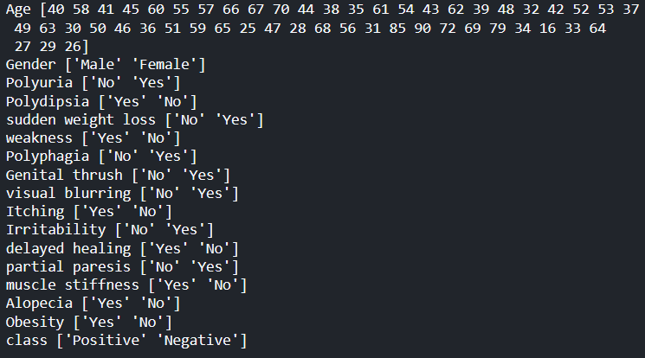
A bit about Data
The dataset had no missing values and the unique values were as shown

Slide 11
A bit about Data
Some of the features that are domain specific, so let’s look at their descriptions:
Polyuria: Whether the patient has excessive urination. It is a binary variable with two values: Yes or No.
Polydipsia: Whether the patient has excessive thirst. It is a binary variable with two values: Yes or No.
Polyphagia: Whether the patient has excessive hunger. It is a binary variable with two values: Yes or No.
Genital thrush: Whether the patient has genital infection. It is a binary variable with two values: Yes or No.
partial paresis: Whether the patient has muscle weakness. It is a binary variable with two values: Yes or No.
Alopecia: Whether the patient has hair loss. It is a binary variable with two values: Yes or No.

Slide 12
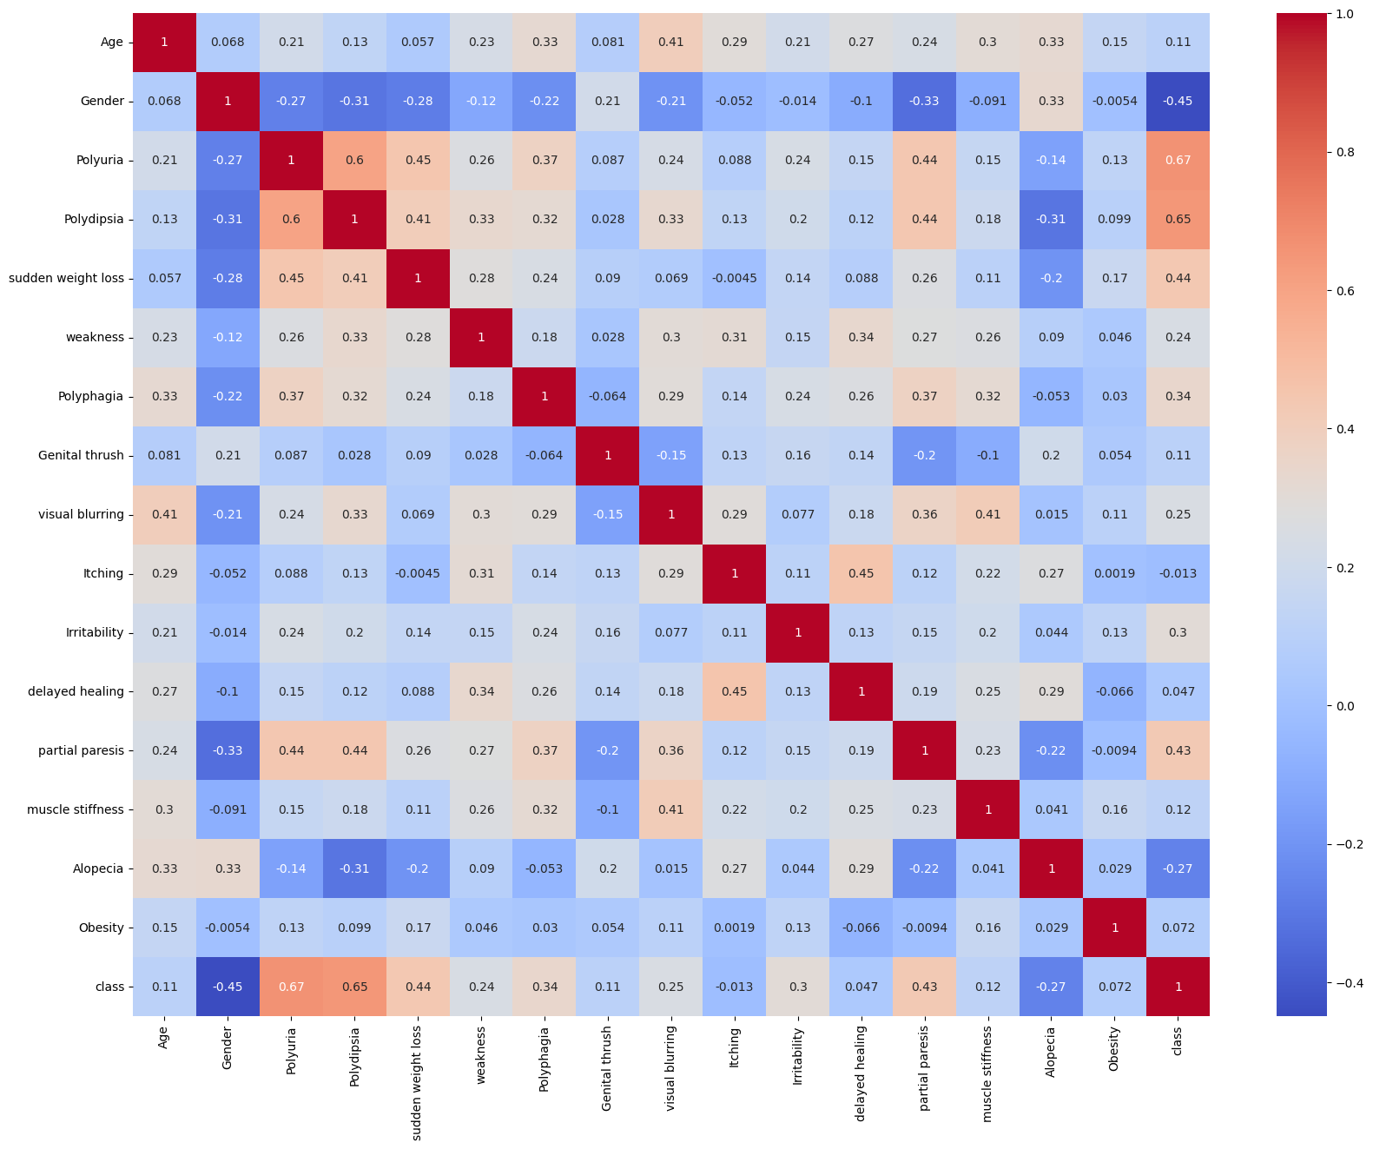
A bit about Data
By plotting heatmap of the correlation matrix we find the top 3 features that have high correlation with target class.

Slide 13
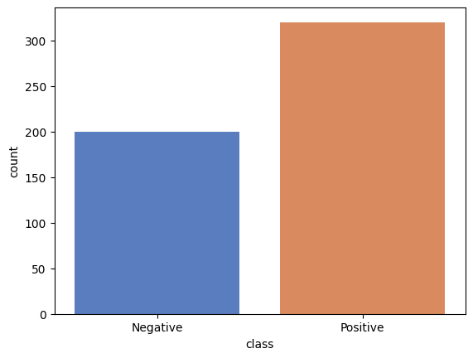
A bit about Data
Positive percentage: 38.46 % Negative percentage: 61.54 %
As seen here, we see there’s more positive cases than negative cases specifically,
Negative percentage: 38.46 % Positive percentage: 61.54 %

Slide 14
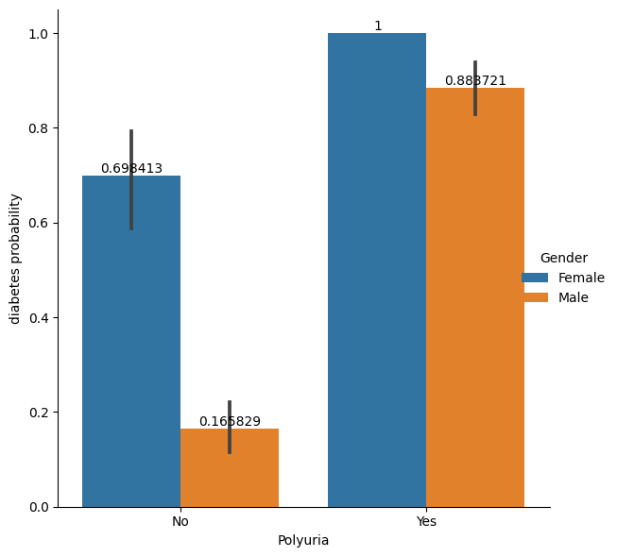
A bit about Data
The most important variable for predicting diabetes is ‘Polyuria’,This variable has the highest correlation with the class variable (0.67), and also the highest difference in proportions between the positive and negative groups (0.88 vs 0.16). This means that people who have polyuria are much more likely to have diabetes than those who do not.

Slide 15
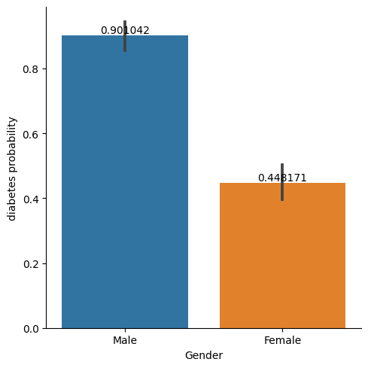
A bit about Data
The second most important variable is ‘Gender’, which has a correlation of 0.45 with the class variable. The proportion of males who have diabetes is 0.90, while the proportion of females who have diabetes is 0.44. This means that males are more than twice as likely to have diabetes than females.

Slide 16
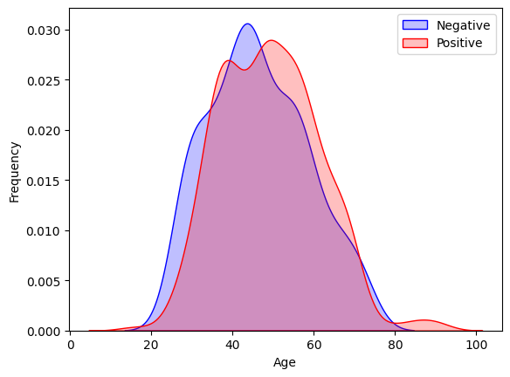
A bit about Data
The third most important variable is ‘Age’, which has a correlation of 0.42 with the class variable. The mean age of the positive group is 49.07, while the mean age of the negative group is 46.36. This means that older people are more likely to have diabetes than younger people. The age distribution of the dataset is skewed to the right, with most of the observations between 40 and 60 years old as seen in the plot here that shows frequency of different age groups among the patients, and the peak of the curve indicates the most common age range

Slide 17
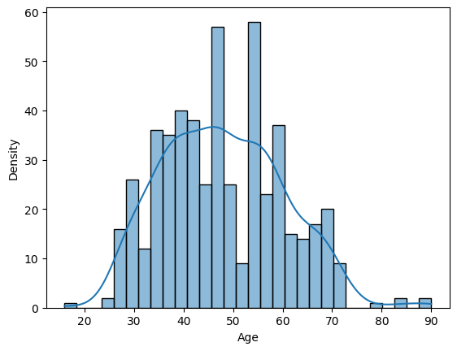
A bit about Data
Plot shows that the age distribution of the patients is skewed to the right, meaning that most of the patients are between 40 and 60 years old. The peak of the curve indicates the most common age range, which is around 50 years old. The plot also shows that there are some outliers in the data, such as the patients who are younger than 20 or older than 80 years old.

Slide 18
Methodology
Preprocessing the data:
Import necessary libraries, such as numpy, pandas, seaborn, matplotlib, sklearn, etc.
Read csv file containing the dataset using pandas
Find unique values of each column using a for loop and the unique() method.
Checking the number of missing values in each column using the isna().sum() method.
Encode the categorical variables using the LabelEncoder class from sklearn and apply fit_transform() method to each column of the data frame, converting the strings into numerical labels.
Check the mean, standard deviation, minimum, maximum, and quartiles of each variable using describe() method.

Slide 19
Methodology
Splitting the data:
Separate the target variable ‘class’ from the rest of the features using the drop() method.
Assign features to X and the target to y.
Use the train_test_split function from sklearn to split the data into training and testing sets with 80-20 split for training and testing respectively. We use stratify parameter as y, meaning that the proportion of positive and negative cases would be preserved in both sets. And used random state as 44552, meaning that the split would be reproducible.
Encode the categorical variables using the LabelEncoder class from sklearn and apply fit_transform() method to each column of the data frame, converting the strings into numerical labels.
We normalize Age as it is the only feature with values not between 0 and 1 which could cause a higher bias if trained as is.We use fit_transform and transform functions for train and test dataset respectively.
Then we create LogisticRegression model , fit data ,predict test data, and evaluate model for accuracy,confusion matrix and generate classification report

Slide 20
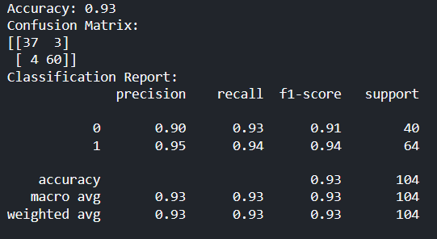
Conclusion
As seen, we get accuracy of 93%
Precision,recall,f1 scores are good for positive and negative cases both.
Since we had a mere 520 data points the model’s practical applicability is something that cannot be vouched for unless we feed it more data.

Slide 21

THANK You!

