Slide 1

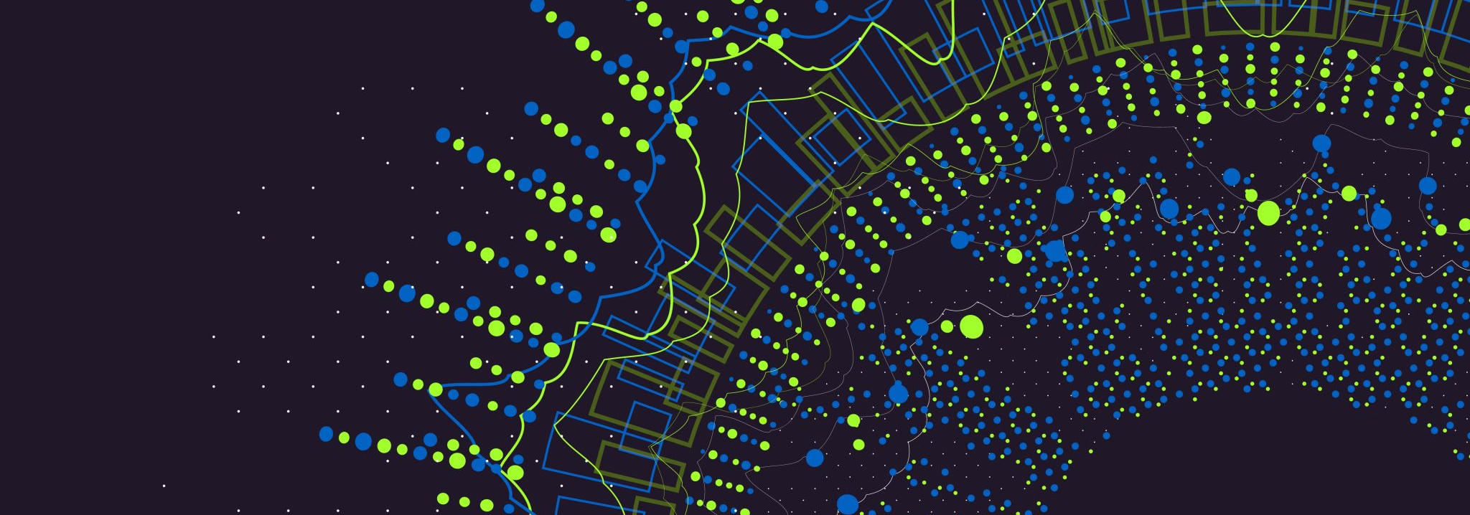
Comparative Analysis of TF-IDF and BM25
Raunak Nandkumar More (101136778)

Slide 2
Introduction
Purpose of the Study:
The primary goal is to rigorously evaluate and compare the performance of two prominent ranking algorithms, TF-IDF and BM25, specifically in the domain of text analysis on Shakespeare's iconic work, Macbeth. The study aims to shed light on how these algorithms behave in retrieving relevant information given diverse queries.
Overview of TF-IDF and BM25:
Explanation of TF-IDF and BM25 algorithms and their application in information retrieval.

Slide 3
Overview of TF-IDF and BM25:
TF-IDF (Term Frequency-Inverse Document Frequency):
Calculation Method: TF-IDF is calculated by multiplying the term frequency (TF), which represents how often a word appears in a document, by the inverse document frequency (IDF). IDF is the logarithm of the total number of documents divided by the number of documents containing the word.
Scoring Mechanism: TF-IDF assigns higher scores to words that are specific and distinctive to a sentence, while giving lower scores to more common and generic words.

Slide 4
Overview of TF-IDF and BM25:
BM25 (Best Matching 25):
Extension of TF-IDF: BM25 is an extension of TF-IDF designed to address its limitations.
Incorporation of Document and Query Length: BM25 incorporates both document length and query length into its calculation, aiming to improve the performance of the ranking function.
Parameter Tuning: Introduces parameters like k1 and b to fine-tune term frequency and document length factors, respectively.
Issues Addressed by BM25:
Frequency Spamming: BM25 addresses the issue of frequency spamming, where higher scores are assigned to results with a higher frequency of the queried word.
Document Length Disparity: Introduces parameters (k1 and b) to handle variations in sentence lengths, ensuring fair evaluation

Slide 5
Literature Review
Existing studies indicate that BM25 tends to outperform TF-IDF for shorter and simpler queries.
However, the effectiveness of each algorithm is contingent on factors such as query complexity, text collection characteristics, and the choice of parameters
TF-IDF: Emphasizing its calculation based on term frequency and inverse document frequency and its susceptibility to frequency spamming.
BM25: Highlighting its extension of TF-IDF, addressing issues such as frequency spamming and document length disparities through parameters like k1, b, and epsilon.
Issues Addressed by BM25:
Frequency Spamming: Explaining how BM25 mitigates the problem of inflated scores for frequently occurring terms, by giving more importance to rare occurrences over frequent ones with a positively reducing scoring
Document Length Disparity: Describing how parameters like k1 and b are employed to handle variations in sentence lengths, by reducing negative punishing scoring with longer documents

Slide 6
Methodology
Data Collection:
Obtained Macbeth text from NLTK's Gutenberg corpus.
Data Preprocessing:
Tokenization into Sentences and Paragraphs.
Stopword Removal, Punctuation Removal, and Stemming.
Matrix Creation:
TF-IDF Matrix: Created using Scikit-learn's TfidfVectorizer. A sparse matrix representing 678 sentences and 3310 unique words.
BM25 Matrix: Formulated using TF matrix, IDF vector, and parameters k1, b, and epsilon (set to 1.2, 0.75, and 0.25 respectively).
Querying:
Three Queries Provided: Preprocessed by tokenization, filtering, and stemming.
Similarity and Ranking:
Cosine Similarity Calculation: Transforming queries into vectors and calculating similarity scores.
Top 5 Documents for Each Query: Sorted based on similarity scores.

Slide 7
Results
Examples of Query Results:
Query 1: "three witch magic death thunder." Both methods ranked documents with these words higher.
Query 2: "Macbeth knife wound red blood witch." TF-IDF emphasized "knife," "wound," and "blood," while BM25 prioritized "Macbeth."
Query 3: "Ruthless ambition king prophecies beast unmake fair." Specific terms impacting ranking.
Comparison of TF-IDF and BM25:
Similarities: Both ranked documents containing words like "thunder" and "three witches" higher for Query 1.
Differences: TF-IDF gave higher rank to a document with "knife," "wound," and "blood" for Query 2, while BM25 prioritized a document with "Macbeth."
Impact of Query Type and Length:
Performance varied based on the type and length of queries.

Slide 8
Conclusion
Summary of Findings:
TF-IDF vs. BM25: BM25 generally performed similarly to TF-IDF for smaller queries, but outperformed it for larger queries.
Cosine Similarity Scores: BM25 consistently had better scores.
Recommendations for Future Work:
Consideration of other metrics (precision, recall, f1 scores), filtering small sentence results, and experimenting with BM25 hyperparameters.

Slide 9
Future Work
Experimentation with Hyperparameters for BM25:
Explore the impact of varying k, b, and epsilon values.
Handling Small Sentence Results:
Implement filtering mechanisms for small sentence results.
Implementation of Additional Evaluation Metrics:
Consider metrics beyond cosine similarity for a more comprehensive assessment.

Slide 10

THANK You!

