Slide 1

Prime Factorization of Large Numbers using Shor's Algorithm CSC 792: – Quantum Computing
Presented By:
Raunak Nandkumar more - 101136778
Sai Sriman Kudupudi - 101149245
Sai Neeraj Samineni - 101146451
Hansakrish Kuttuva Baskar - 101131081
Damareshwara Maddepalli - 101128329
Venkata Surya Deepak Lakshmipalli - 101143451
Kalainidhi Tirounavoucarassou - 101131680

Slide 2
1. Shor's Algorithm, proposed by Peter Shor in 1994, is a quantum algorithm that can efficiently factorize large numbers. 2. Traditional classical algorithms for factorization are computationally expensive for large numbers, making certain encryption methods secure. 3. Shor's Algorithm aims to overcome this challenge by utilizing the principles of quantum computation.
Shor's Algorithm Overview

Slide 3
• The code implementation we will discuss today is written in Python and utilizes the Qiskit library for quantum circuit simulation. It utilizes the power of quantum computing to factorize numbers and demonstrates the potential of quantum algorithms. • It consists of two main functions: period(a, N) and shors_breaker(N). • The period function calculates the period of a function using a quantum circuit. • The shors_breaker function attempts to factorize a number N using Shor's Algorithm.
Code Overview:

Slide 4
• This function takes two parameters: a and N. • It calculates the period of a function using a quantum circuit. • The function performs the following steps: 1. Checks if N is within the limit of the available qubits 2. Initializes quantum and classical registers for the circuit. 3. Generates a random initial value, x0, between 1 and N-1. 4. Converts N into its binary representation and prepares the qubits accordingly. 5. Enters a loop for the period-finding operations using quantum gates and measurements. 6. Executes the quantum circuit on a simulator backend and obtains measurement results. 7. Determines the most frequent measurement result, ie the period and returns it.
Explanation of the period(a, N) function

Slide 5
• Within the loop, the period-finding operations are performed using the following quantum gates: 1. X Gates(NOT): o In the period-finding loop, X gates are applied to specific qubits in the quantum circuit to manipulate the quantum state. 2. Controlled-X (CX) Gates(CNOT): o In the period-finding loop, CX gates are used for modular exponentiation and modular multiplication, which are fundamental operations in the period-finding algorithm. 3. Measurements: o Used at the end of each iteration to obtain the measurement results of the qubits. o The measurement results are stored in the classical register for further processing. By utilizing a combination of X gates, CX gates, and measurements, the period-finding operations are executed in the quantum circuit to create entanglement.
Explanation of the period(a, N) function(continued)

Slide 6
• This function attempts to factorize a number N using Shor's Algorithm. • It takes N as input and follows these steps: o Converts N to an integer. o Enters an infinite loop. o Generates a random value of a between 0 and N-1. o Calculates the greatest common divisor (gcd) of a and N. o If gcd is not 1 or N is 1, returns the factors (gcd and N/gcd). o If gcd is 1, finds the period using the period(a, N) function. o Checks if the period is even and if a^(period/2) modulo N is not -1. o If conditions are met, calculates potential factors using gcd(a^(period/2) ± 1, N). o If factors are valid, returns the factors. o Continues the loop until factors are found.
Explanation of the shors_breaker(N) function:

Slide 7
• Traditional Shor's Algorithm: o Shor's Algorithm, in its original form, requires complex quantum gates and specialized hardware. o Implementing the algorithm on physical quantum devices can be challenging due to noise and limited qubit coherence. • Simplified Implementation using Code: o The provided code simplifies the implementation of Shor's Algorithm using the Qiskit library. o It abstracts away the complexities of hardware-specific operations and provides a high-level interface for quantum circuit simulation. o This simplification enables easier understanding and experimentation with Shor's Algorithm. o Traditional Shor’s Algorithm running on Quantum Machine is susceptible to bit flips due to noise which isn’t present in simulation using Qiskit
Simplifying Shor's Algorithm Implementation:

Slide 8
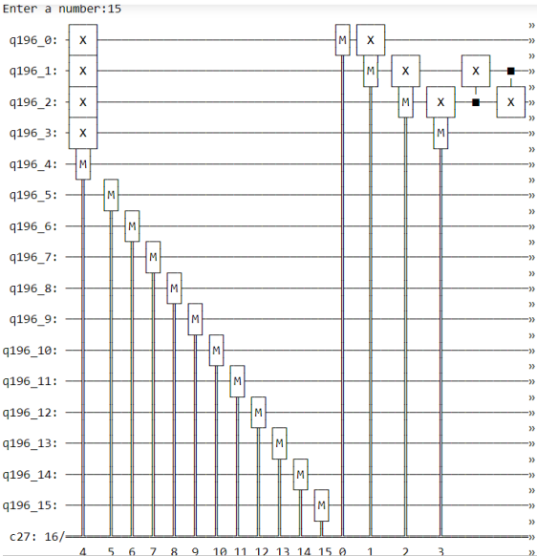
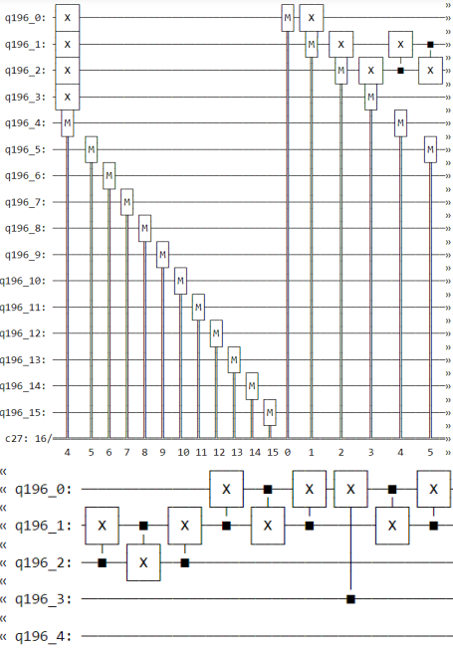
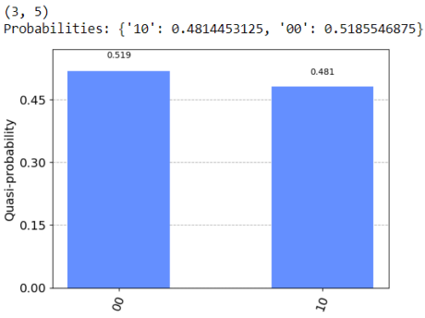
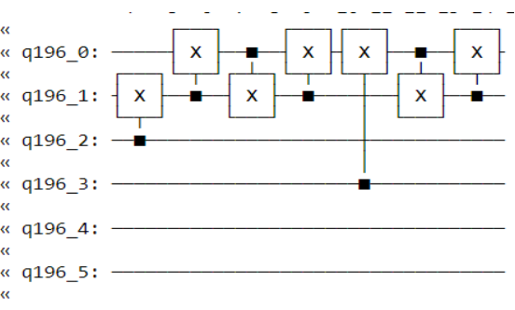
Quantum Circuit Design and Results:
Quasi Probability:

Slide 9
The code implementation simplifies the application of Shor's Algorithm, by making it more accessible and easier to comprehend. By leveraging the Qiskit library, researchers and developers can experiment with Shor's Algorithm using quantum circuit simulation. This simplified implementation promotes understanding, experimentation, and potential advancements in quantum computing and factorization algorithms.
Conclusion:

Slide 10
Thank You.

