Slide 1


Harnessing true potential of Multi Threading in Machine Learning Algorithms
Raunak Nandkumar More

Slide 2

Introduction
Usage of existing threading library in python to parallelize various operations in 3 machine learning algorithms logistic regression, Kmeans Clustering and CNN.
Usage of Emsemble Methods with logistic regression and Kmeans Clustering
Usage of Multiprocessing for preprocessing of data for CNN

Slide 3
Methodology for Logistic Regression
Inspired from the Ensemble technique, we were able to reduce execution time for Logistic regression.
Methodology used:
Two Synthetic datasets were created with sizes 1000 and 10 million data points. Seed value was kept same to ensure reproducibility of results
Threads Count was varied between 1 to 24
Logistic Regression model was set to run for a max of 1000 iterations.
Like in Ensemble methods, we divided the dataset into subsets corresponding to number of threads to be used
Then aggregate the models into a final model by combining the models and averages their coefficients and intercepts.
We plot Speedup and Efficiency vs Thread count for both scenarios

Slide 4
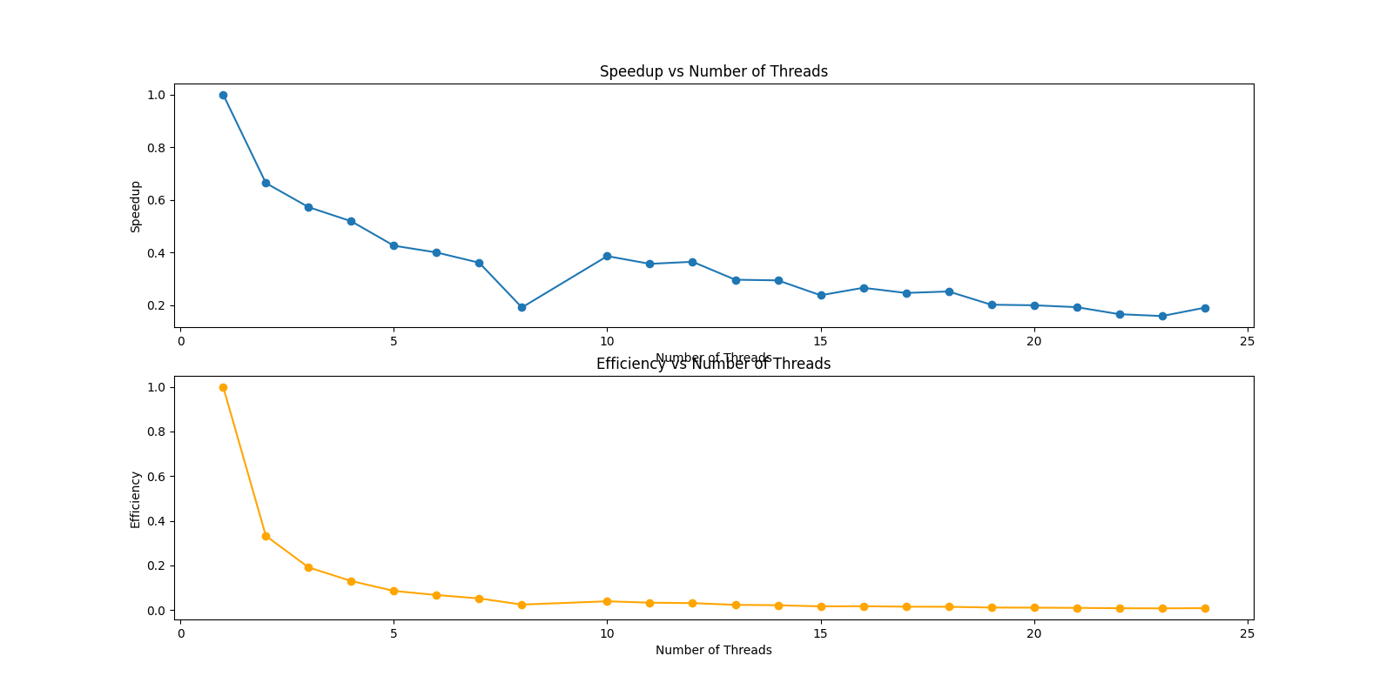
Results for Logistic Regression
On running for 1000 data points we find that Speedup decreases on increased thread count which directly relates to the overhead of thread creation and additional overhead of creating and combining models being much larger than the training work itself.

Slide 5
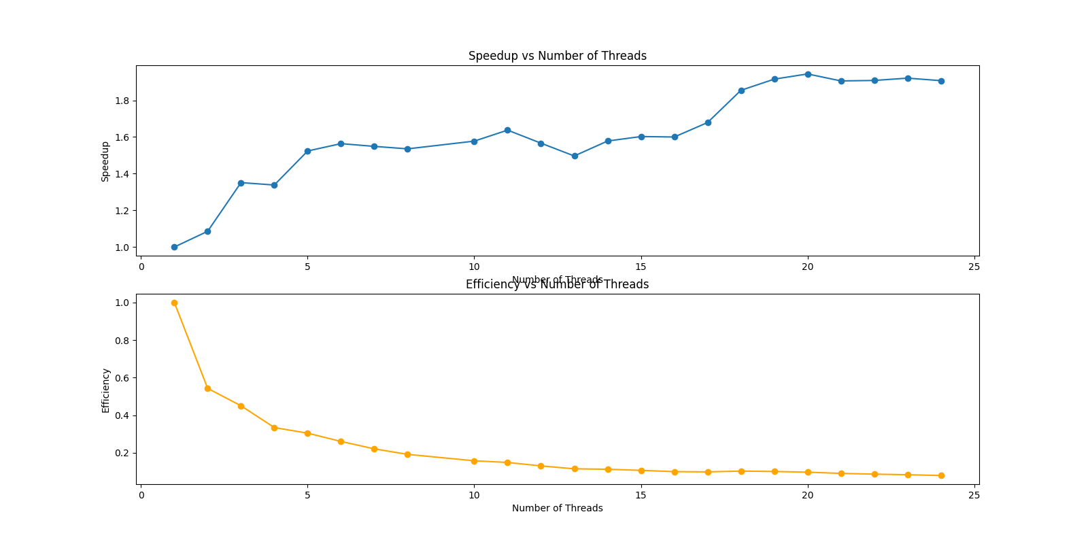
Results for Logistic Regression
On running for 10 million data points however we find that Speedup increases on increased thread count that aligns with the theoretical expected outcome

Slide 6
Methodology for MiniBatchKMeans
MiniBatchKMeans uses mini-batches ie subsets of randomly sampled input data. This by itself makes it possible to parallelize the algorithm effectively.
Methodology used: Two Synthetic datasets were created with sizes 10000 and 100 million data points. Seed value was kept same to ensure reproducibility of results.
Threads Count was varied between 1 to 24 and number of clusters was arbitrarily selected to be 3.
When multiple threads are calling the partial_fit method on the shared kmeans object which isnt thread-safe, we used thread locks to work around the issue.
Same data splitting methods used as previously discussed.
Difference here being the need to not aggregate the results on account of the working of Kmeans algorithm that works in iteratively finding better clusters every iteration.
We plot Speedup and Efficiency vs Thread count for both scenarios

Slide 7
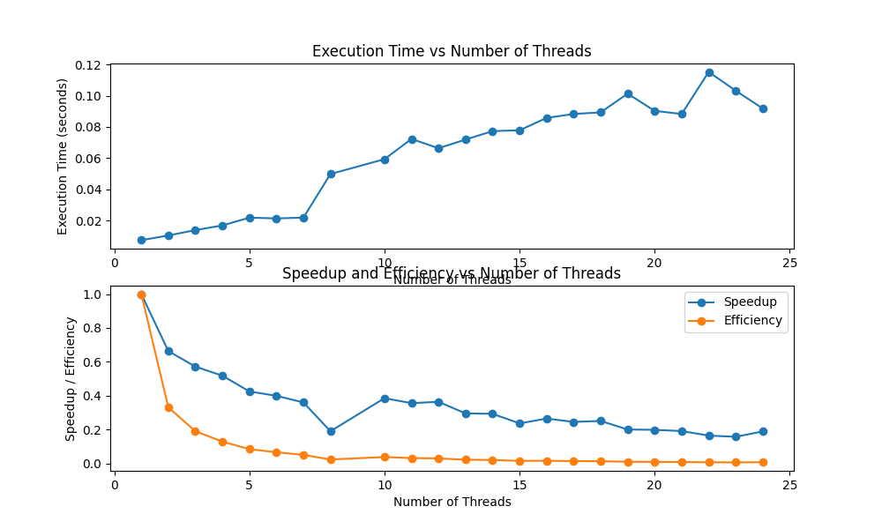
Results for MiniBatchKMeans
On running for 10000 data points we find that Speedup decreases on increased thread count as seen previously

Slide 8
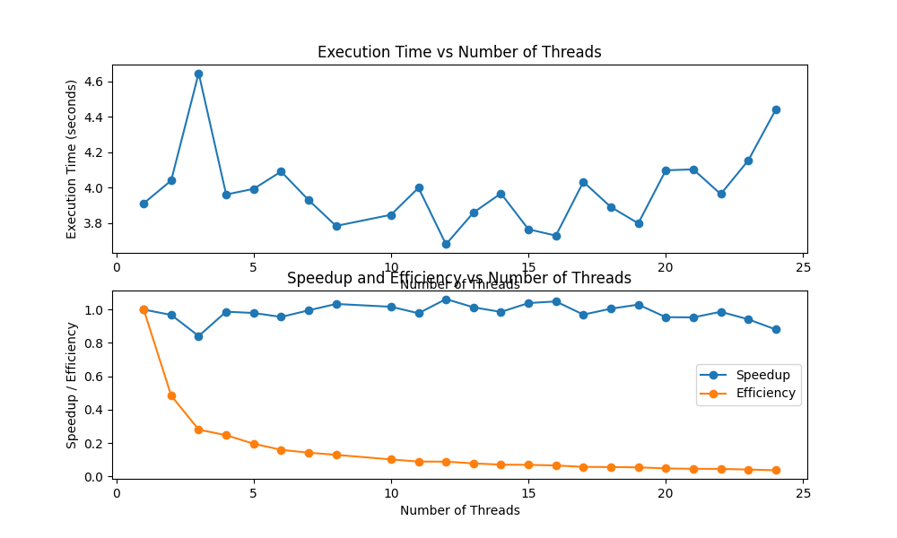
Results for MiniBatchKMeans
Even on running for 100 million data points however we find that Speedup doesn’t improve much with thread count increase. We found this was because of usage of thread locks to ensure that only one thread can update the kmeans object at a time, which prevents race conditions, but also forces other threads to wait and for the lock to be released.

Slide 9
Methodology for CNN
Our motive with CNN was to introduce multi processing of the data preprocessing part of the algorithm.
Methodology used:
Dataset used was fashion_mnist which contains 60000 images.
Threads Count was varied from 1, 2, 3, 4, 5, 6, 7, 8, 10, 12 ,24
We used ImageDataGenerator for multi threading for data augmentation like scaling, rotating, flipping images. This is used to create batches of images parallelly which is controlled using the workers parameter that sets the number of threads to be used for the process

Slide 10
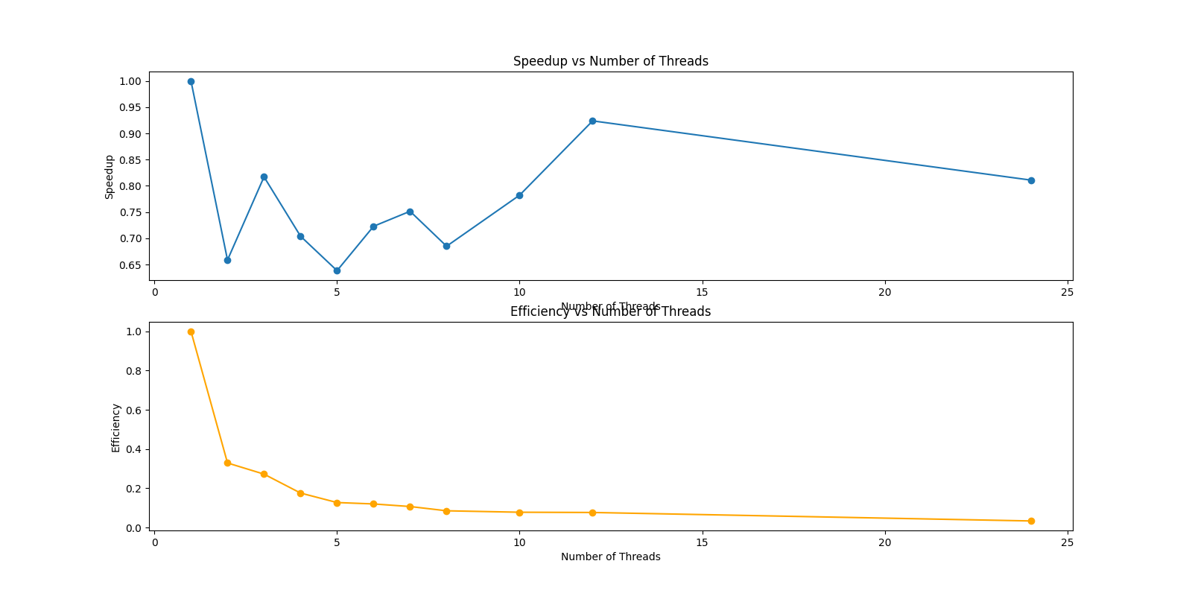
Results for CNN
Executing CNN model training without multiprocessing for data preprocessing showed negative results with increased number of threads.
Keras will create multiple threads to run the data generator in parallel, which should also speed up the data loading, but with less overhead than processes
However, this also requires the data generator to be thread-safe, meaning that it can handle concurrent access to shared resources without causing errors or inconsistencies and uses thread synchronization that might attribute to speedup decrease.

Slide 11
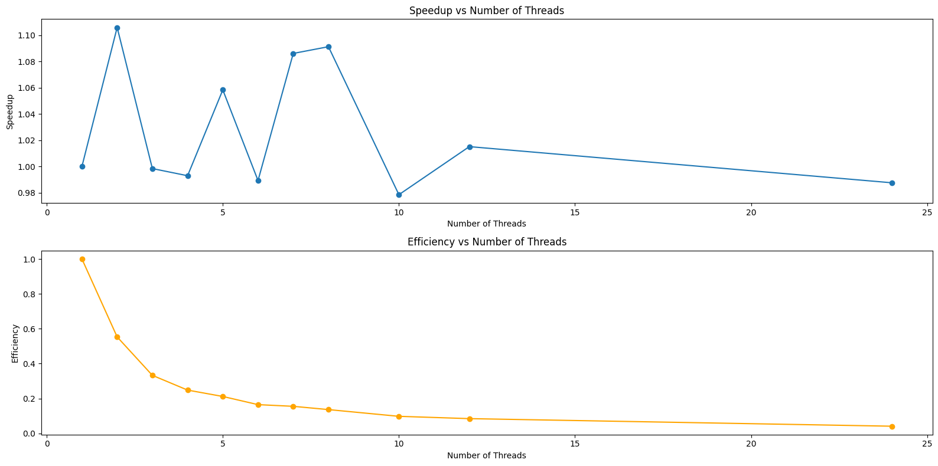
Results for CNN
Running this with multiprocessing for data preprocessing showed improvement with increased number of workers upto a point after which the overhead of inter process communication attributes to loss in speedup
This requires more inter-process communication mechanisms to exchange data between the processes.
This is different from the previous experiment where we used threads whereas here we create processes instead, which do not need to be thread safe.

Slide 12

THANK You!

