Slide 1
NODE2VEC
Scalable Feature Learning for Networks
Raunak Seksaria

Slide 2
Problem trying to be solved
mapping of nodes to a low-dimensional space of features that maximizes the likelihood of preserving network neighborhoods of nodes
Any supervised machine learning algorithm requires a set of informative, discriminating, and independent features.

Slide 3
Problems with current approaches
Hand engineering : domain knowledge
downstream prediction task : complexity
eigendecomposition of the appropriate data matrix which is expensive for large real-world networks. Moreover, the resulting latent representations give poor performance on various
prediction tasks over networks.

Slide 4
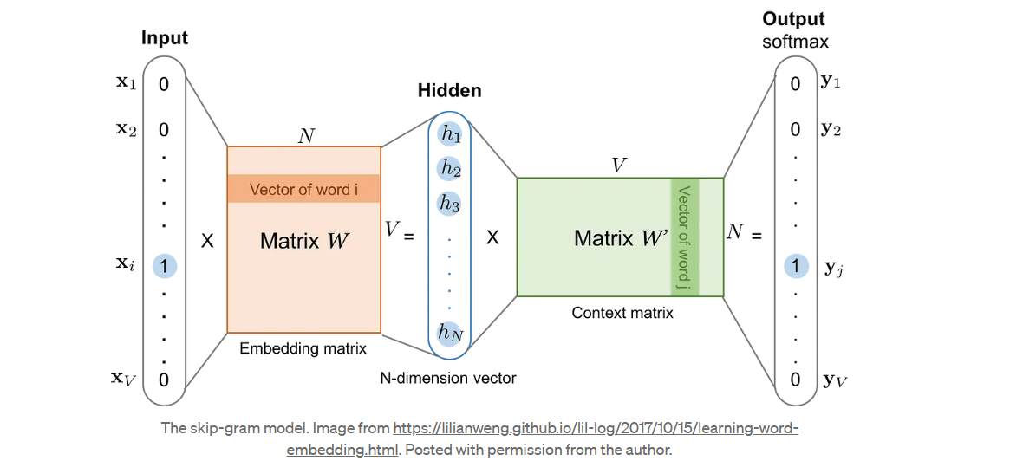
Word2vec : skipgram
Word2vec uses a trick where we aren’t interested in the output vector of the neural network, but rather the goal is to learn the weights of the hidden layer. The weights of the hidden layer are actually the word embedding we are trying to learn. The number of neurons in the hidden layer will determine the embedding dimension or the size of the vector representing each word in the vocabulary.

Slide 5
Key features
Semi supervised
Scalable(parallelizable)
Stochastic gradient descent
Random walk 2nd degree

Slide 6
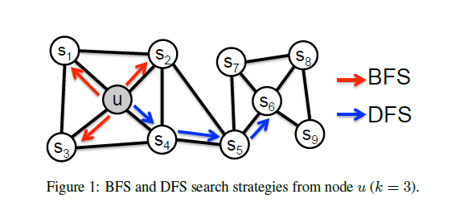
Homophily and structural equivalence

Slide 7


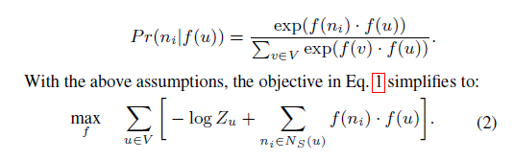
Objective function
Return parameter p
In-out parameter q

Slide 8
Negative weights
Updating several thousand weights for every input-context training pair is very expensive. Negative sampling solves this performance issue by having each training sample modify only a small subset of the weights rather than all of them. With negative sampling, a “negative” word is one for which we want the neural network to output a 0, meaning that it is not in the context of our input term. We will still update the weights for our “positive” context word.

Slide 9

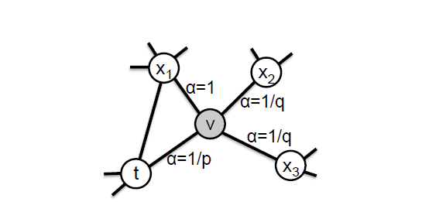
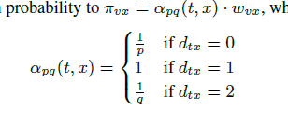
2nd order random walk

Slide 10
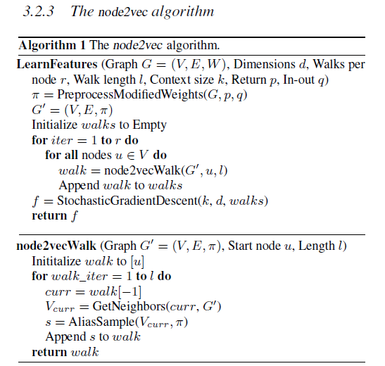
The actual algorithm

Slide 11
limitations
First of all, the node2vec algorithm does not differentiate between node or relationship types. If your graph has many node or relationship types, the node2vec algorithm will not consider that. Secondly, node properties or features cannot be added to the algorithm input. The resulting node embeddings are only affected by the network topology and not node properties or attributes.
transductive node embedding algorithm, meaning that, it needs the whole graph to be available to learn the node embeddings. You cannot run the node2vec algorithm separately on your test and training data. Similarly, when a new node is added to your graph, you need to rerun the node2vec algorithm on the whole graph if you want to generate embedding for the new node.

