Slide 1

Distributed Chat with Leader Election
Mini-project presentation
Computer Networks Laboratory (CSE20110)
Department of Computer Engineering and Technology
Raunak Yadav-1262242203 Chinmay Kulkarni- Prit Jain-
Group: to be filled Panel: H1 Batch: 1
Faculty: to be confirmed
Academic Year: 2026–2027
Presentation date: to be filled
Computer Networks Laboratory CSE20110
15 seconds
Notes:
Opening (about 15 seconds): “Our mini-project is Distributed Chat with Leader Election. It is a three-server TCP chat prototype that demonstrates cross-server messaging, a replicated active-user directory, heartbeat-based failure suspicion and leader election. The browser UI is an optional layer over the existing TCP backend.” Replace the student, panel, batch, faculty and date fields before presenting.

Slide 2
Problem and Objectives
Problem
Clients connected to different servers need to find one another and exchange messages.
The cluster also needs to coordinate registry changes and elect a new leader when failure is suspected.
Objectives
1. Support global chat and private messaging across three TCP servers.
2. Maintain a global active-user directory and prevent duplicate active usernames.
3. Detect suspected server failures and elect the highest-ID reachable server.
Computer Networks Laboratory CSE20110
40 seconds
Notes:
Problem and objectives (40 seconds): Explain that a private-message sender cannot route to a remote recipient without a user-to-server directory. The leader helps coordinate registry operations, while normal private messages can route directly between servers. Mention that this is a prototype and that failure detection is based on heartbeat timeouts, so it indicates suspicion rather than proof.

Slide 3
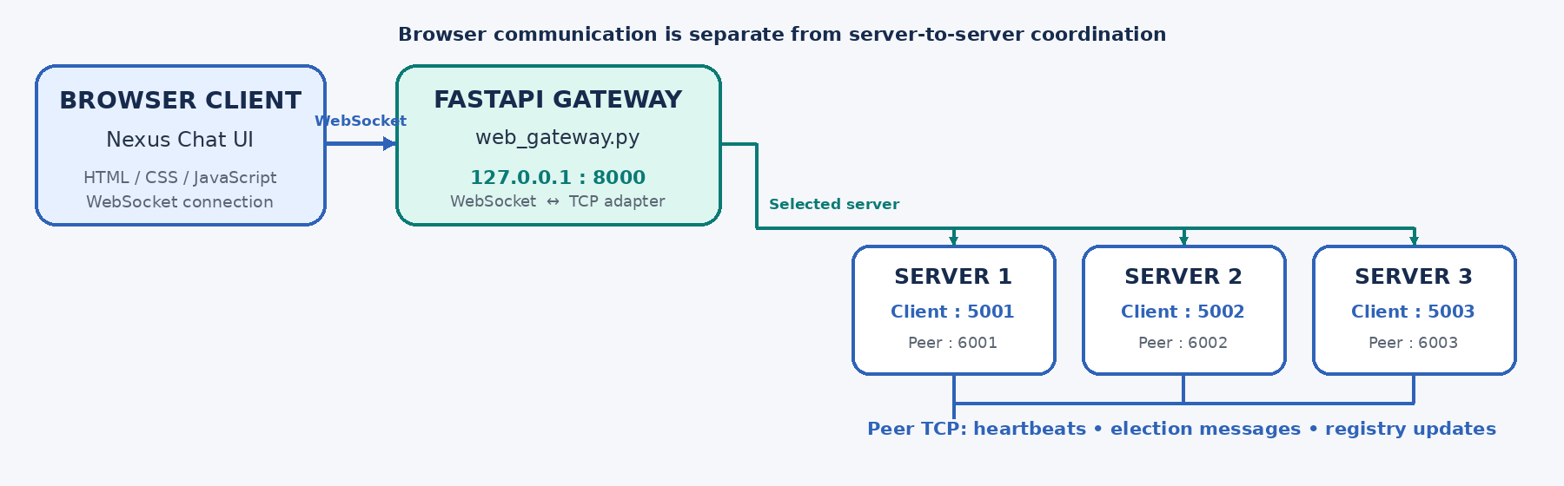
Proposed Design and Tools
Tools: Python 3.x, socket library, FastAPI/Uvicorn, HTML/CSS/JavaScript
Protocols: TCP for chat/peer links; WebSocket between browser and gateway
Ports: clients 5001–5003; peer servers 6001–6003; gateway 8000 (localhost)
Computer Networks Laboratory CSE20110
45 seconds
Notes:
Design and tools (45 seconds): Trace browser → WebSocket gateway → selected TCP server. Explain that the three server processes also communicate with one another over peer ports for heartbeat, election and registry synchronization. The gateway uses port 8000; backend client-facing ports are 5001–5003 and peer ports are 6001–6003. The diagram describes the intended architecture; verify the gateway’s message parser against the actual backend wire format.

Slide 4
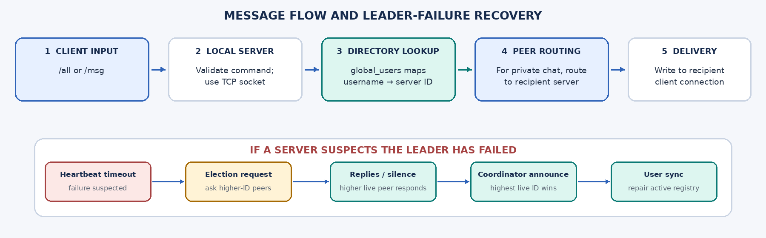
Implementation and Working
Implementation: three server IDs, client handlers, global_users, heartbeats and election logic.
Working: /all broadcasts; /msg uses the directory and routes directly to the recipient’s server.
Troubleshooting: PowerShell uses Windows activation syntax; Uvicorn startup was observed, but gateway chat integration needs a final end-to-end test.
Computer Networks Laboratory CSE20110
55 seconds
Notes:
Implementation (55 seconds): For /all, the chat path broadcasts to the cluster. For /msg, the sender’s server looks up the target username in global_users and routes directly to the target’s server. Heartbeat timeouts trigger an election; the highest-ID live server should announce itself coordinator. Mention the actual Windows issue: `source` is not a PowerShell command; using the Windows venv Python directly worked far enough for the Uvicorn application to report startup complete. Do not claim browser chat works until it is tested against the backend message framing.

Slide 5
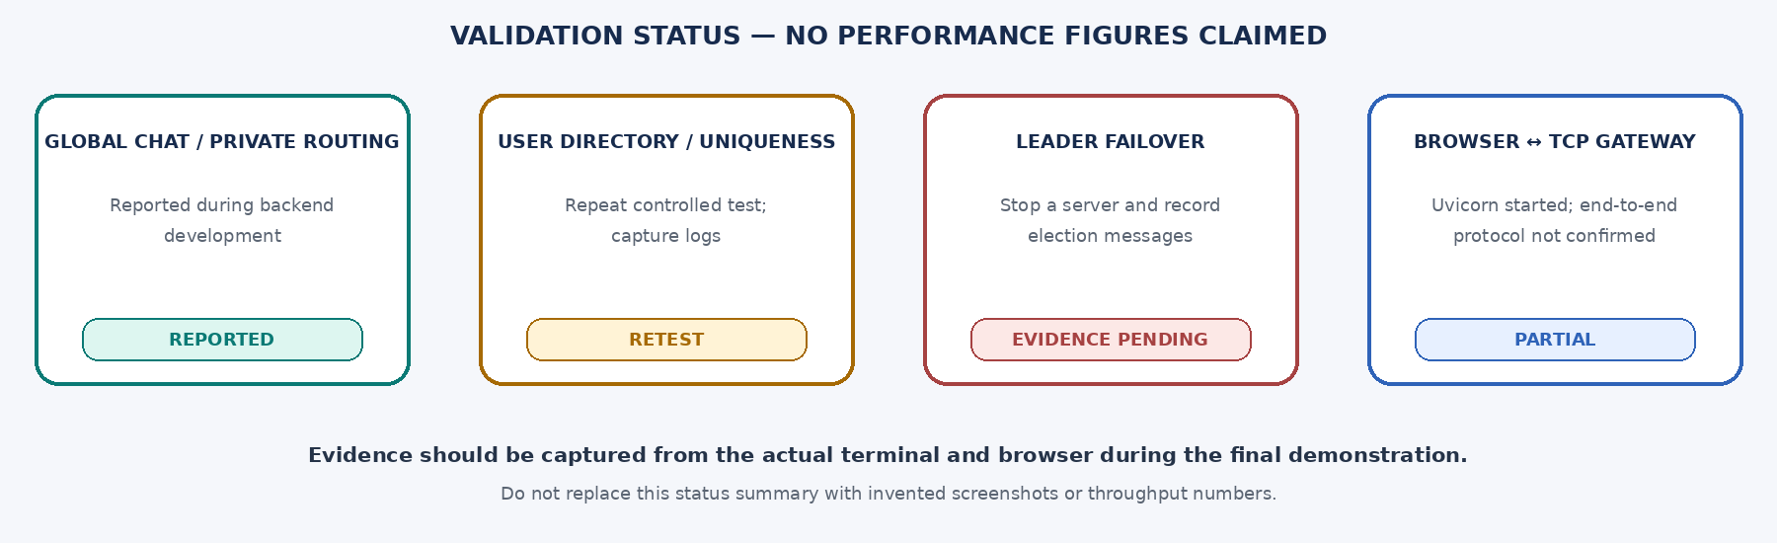
Testing and Results
Test: multi-server /all, cross-server /msg, duplicate username, controlled leader stop.
Expected: correct delivery, one active username mapping, and coordinator re-election.
Observed: backend features were reported working during development; raw logs were not supplied here.
Observed: Uvicorn reached “Application startup complete”; end-to-end gateway messaging remains unverified.
Computer Networks Laboratory CSE20110
50 seconds
Notes:
Testing and results (50 seconds): Carefully distinguish reported development status from evidence collected for this deliverable. Do not present the status graphic as a raw console screenshot. The gateway’s startup log verifies that the ASGI app started; it does not prove that browser JSON, TCP command framing and backend response parsing all match. Before submission, capture actual terminal screenshots for /all, /msg and a controlled leader failover, and update statuses according to what is observed.

Slide 6
Working Demonstration
Function to demonstrate
Three-server messaging and leader election
1. Start python server.py 1, python server.py 2, and python server.py 3 in three terminals.
2. Connect clients to different servers; test /all Hello and /msg username Hello.
3. Stop the current leader and show heartbeat/election messages, then inspect /leader or /status.
Success criterion: expected recipients receive messages and the highest-ID reachable server becomes leader after a controlled election.
Computer Networks Laboratory CSE20110
65 seconds
Notes:
Demonstration (65 seconds): Prepare the servers before the presentation timer starts. Show one global chat message and one private message between clients connected to different servers. Then stop the current leader or highest-ID server and observe the surviving cluster’s election and coordinator announcement. If time is short or the controlled failure is risky, use a prepared recording only if you clearly identify it as recorded evidence. Never invent an output or claim a failover that was not observed.

Slide 7
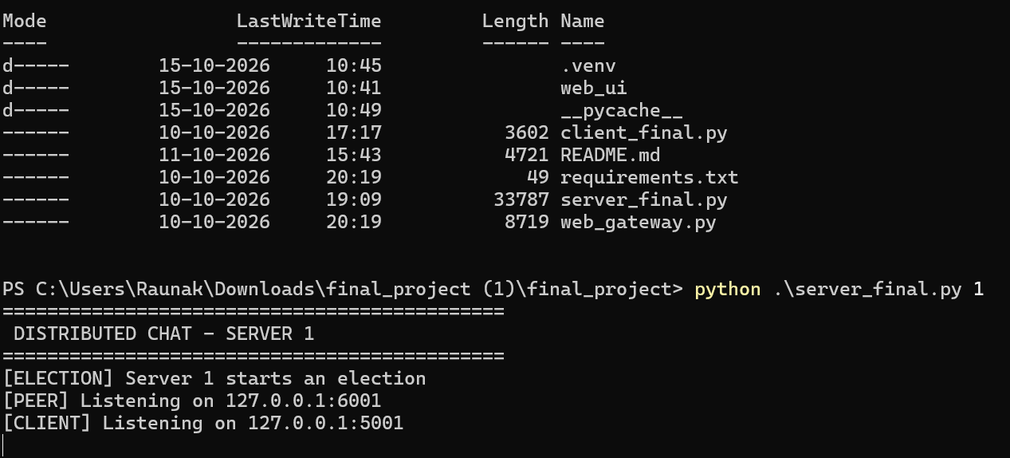
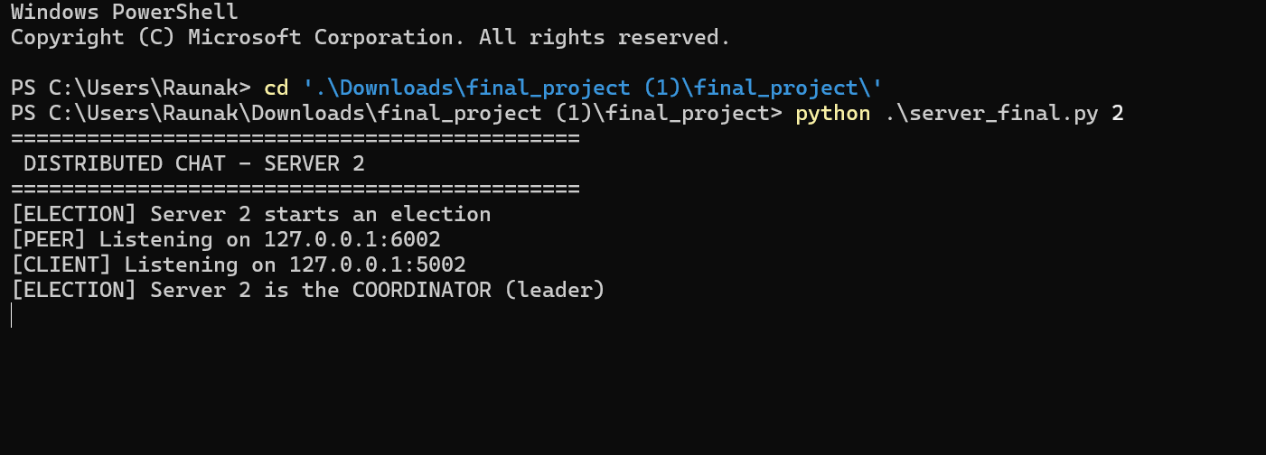

Slide 8
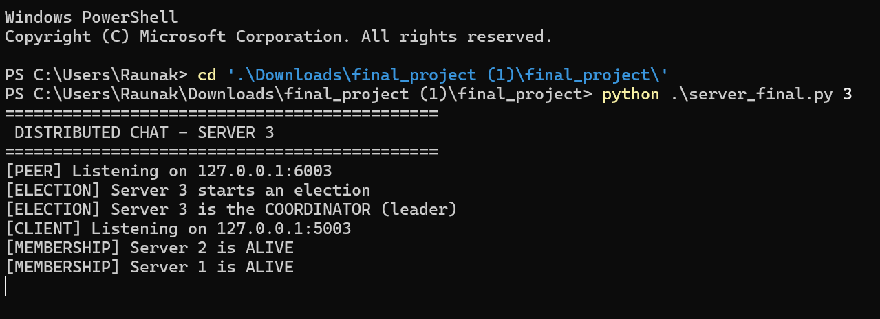
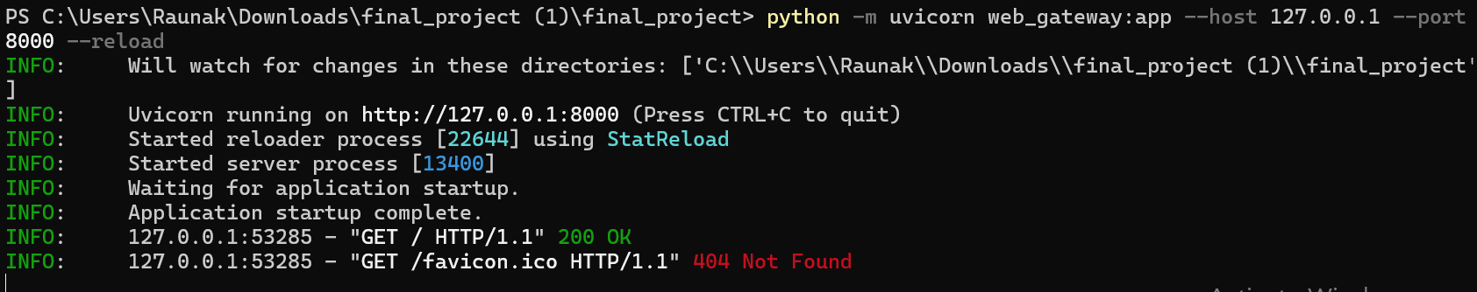

Slide 9
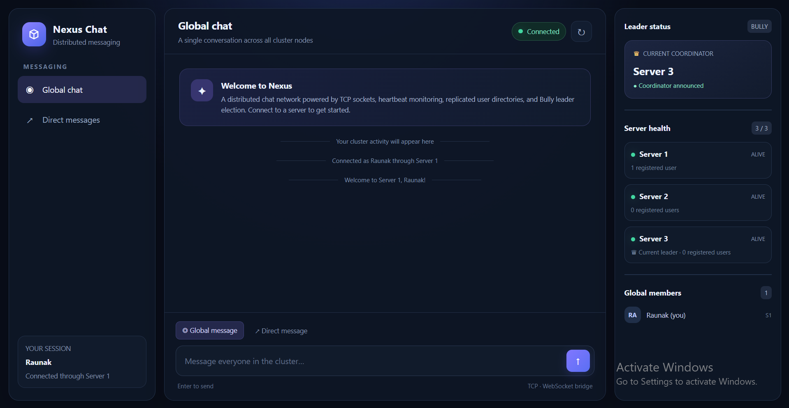

Slide 10
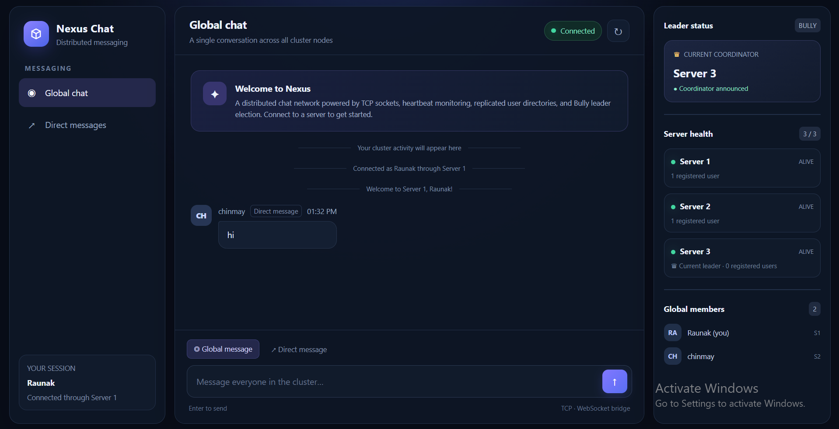

Slide 11
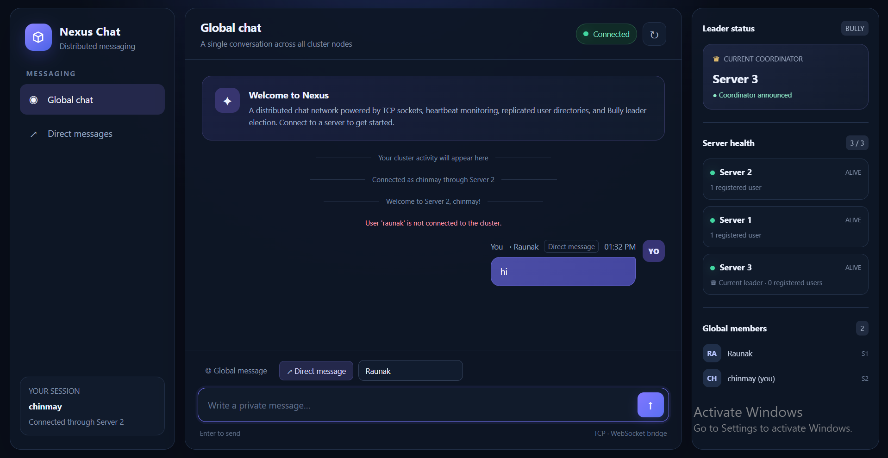

Slide 12
Proposed Design and Tools
Tools: Python 3.x, socket library, FastAPI/Uvicorn, HTML/CSS/JavaScript
Protocols: TCP for chat/peer links; WebSocket between browser and gateway
Ports: clients 5001–5003; peer servers 6001–6003; gateway 8000 (localhost)
Computer Networks Laboratory CSE20110
45 seconds
Notes:
Design and tools (45 seconds): Trace browser → WebSocket gateway → selected TCP server. Explain that the three server processes also communicate with one another over peer ports for heartbeat, election and registry synchronization. The gateway uses port 8000; backend client-facing ports are 5001–5003 and peer ports are 6001–6003. The diagram describes the intended architecture; verify the gateway’s message parser against the actual backend wire format.

Slide 13
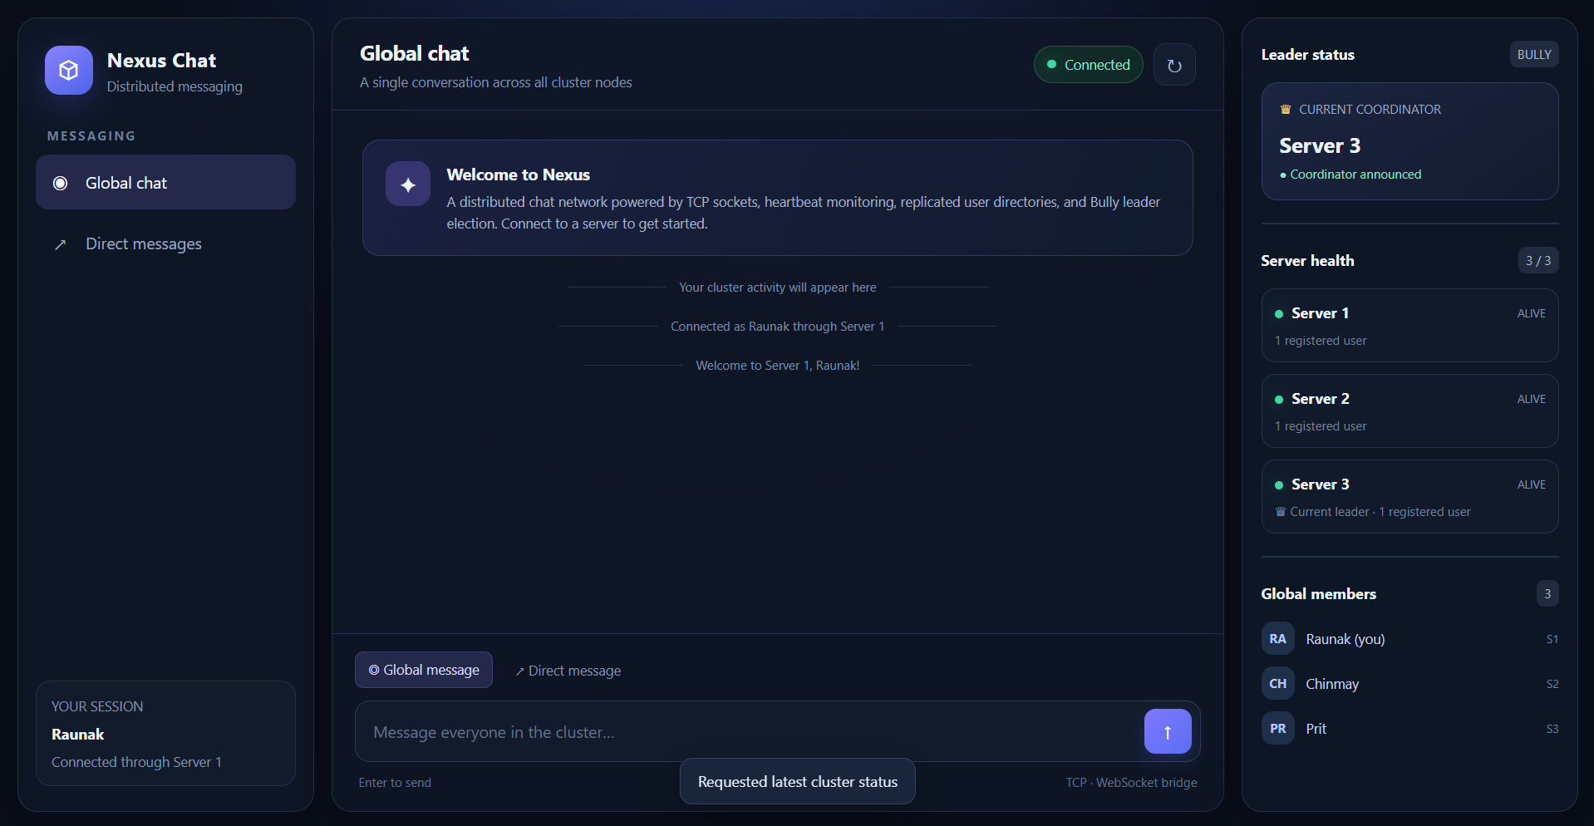
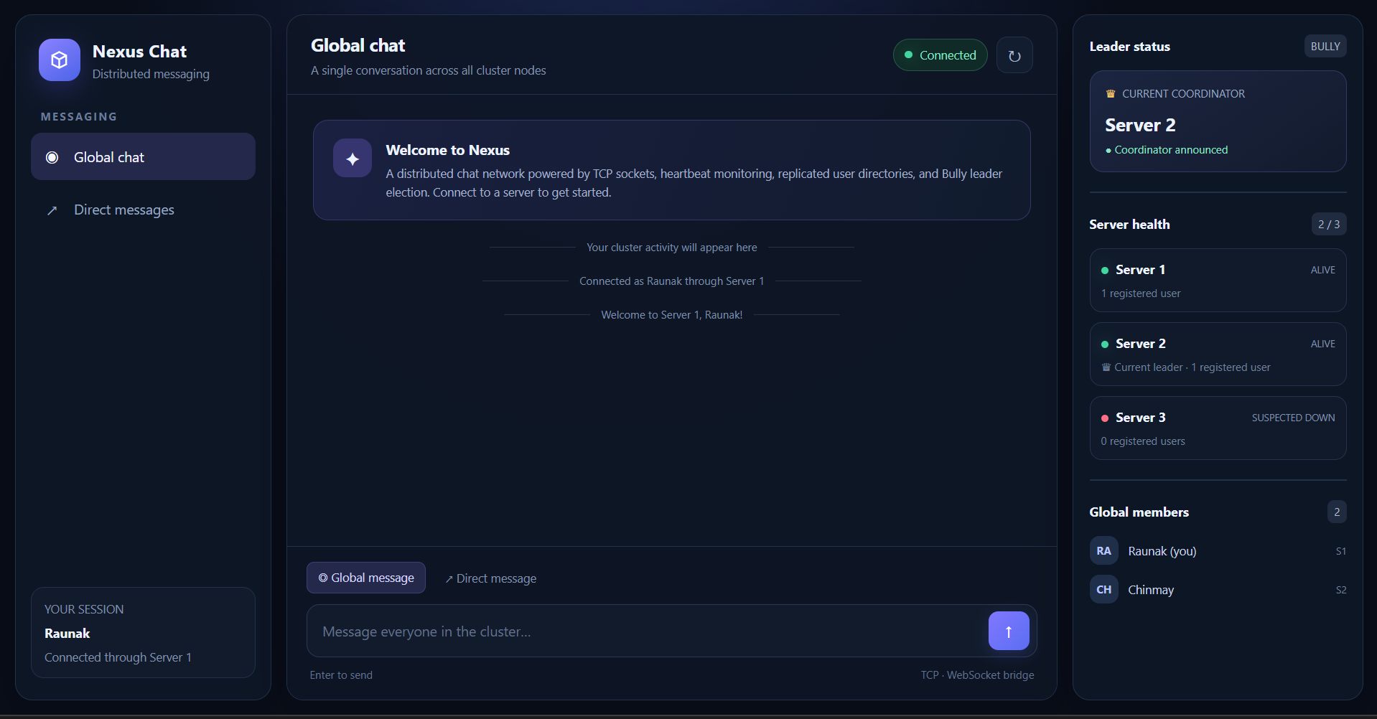
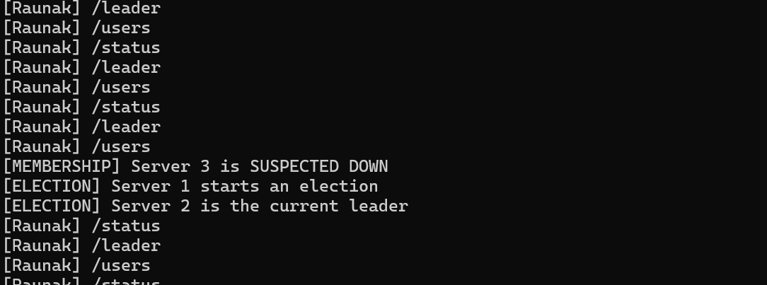
Leader Election in Action
Bully algorithm: the highest-ID reachable server becomes coordinator
1 | HEALTHY CLUSTER
2 | AFTER SERVER 3 FAILURE
Server 3 is coordinator; all 3 servers are alive.
Server 3 is suspected down; Server 2 takes over.
3 | ELECTION CONSOLE TRACE
Heartbeat timeout → election starts → Server 2 is announced as leader
Computer Networks Laboratory CSE20110
45 seconds

Slide 14
Leader Election
Our program uses the Bully Leader Election Algorithmto select a coordinator among three servers (Server 1, Server 2, and Server 3).
Each server sends periodic heartbeat messages to check whether the other servers are responsive. If a server does not respond within the timeout period, it is marked as suspected down, and an election is initiated.
The algorithm prioritizes the server with the highest ID among the reachable servers, so Server 3 is normally the leader when all three servers are active. If Server 3 fails, the remaining servers conduct an election and Server 2 becomes the new leader.
The elected leader coordinates global username registration and directory updates, helping the distributed chat system maintain coordination when server failures occur.

Slide 15
1 | HEALTHY CLUSTER

Slide 16
2 | AFTER SERVER 3 FAILURE

Slide 17
3 | ELECTION CONSOLE TRACE

Slide 18
Conclusion and Contributions
Outcome: three-server TCP chat prototype with global/private messages and coordinator election.
Application: teaching demo for LAN collaboration and distributed systems.
Limitation: in-memory directory; clients on a failed server may disconnect.
Future scope: persistence, state transfer, reconnection and automated integration tests.
Raunak Yadav-Server Logic,Testing,Ideation of project
Chinmay Kulkarni - UI design,Testing,Report Work
Prit Jain- PPT
Computer Networks Laboratory CSE20110
30 seconds
Notes:
Conclusion (30 seconds): Summarize the technical objectives—cross-server messaging, global user lookup and dynamic coordinator election. State the main limitations: in-memory directory, possible inconsistency and client reconnection after a server failure. Give a concrete future improvement such as durable state transfer. Replace team responsibility placeholders with the actual contributions. Disclose that AI tools helped draft the text and that the team is responsible for validating it.

Slide 19
References
[1] H. Garcia-Molina, “Elections in a Distributed Computing System,” IEEE Trans. Computers, vol. C-31, no. 1, pp. 48–59, Jan. 1982. doi:10.1109/TC.1982.1675885.
[2] W. Eddy, ed., “Transmission Control Protocol (TCP),” RFC 9293, IETF, Aug. 2022. rfc-editor.org/rfc/rfc9293
[3] Python Software Foundation, “Socket Programming HOWTO,” docs.python.org/3/howto/sockets.html.
[4] FastAPI, “WebSockets,” fastapi.tiangolo.com/advanced/websockets/. Accessed 17 Oct. 2026.
Computer Networks Laboratory CSE20110
Backup slide
Notes:
Backup slide for questions. The Bully-style election design is motivated by the distributed election literature [1]. TCP behaviour is specified in RFC 9293 [2]. Python socket and FastAPI WebSocket documentation support the networking APIs used [3], [4].

