Slide 1
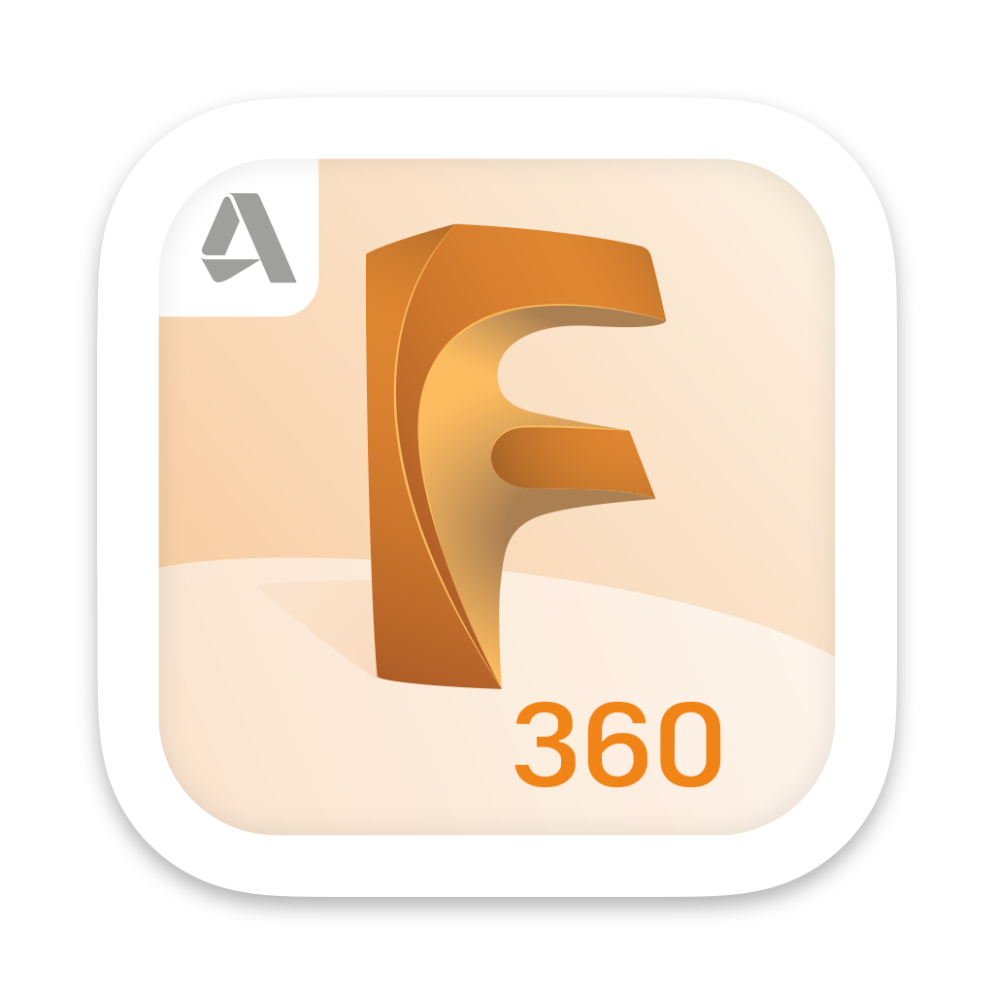


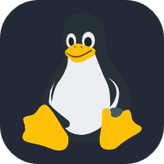




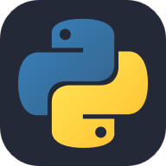



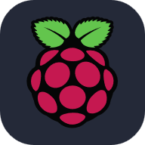
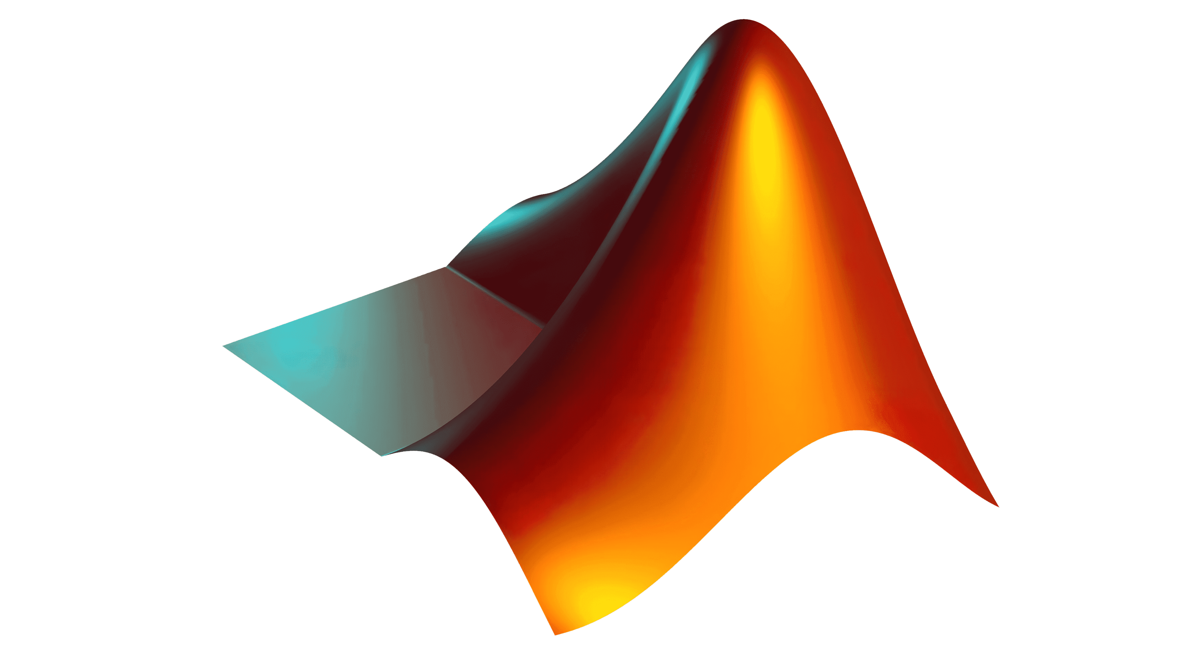

Fusion 360
ROS
Gazebo
Linux
VS code
ESP 32
Intel NUCs
Jetson Boards
Python
OpenCV
Arduino
GitHub
RaspberryPi
MATLAB
TensorFlow

Slide 2

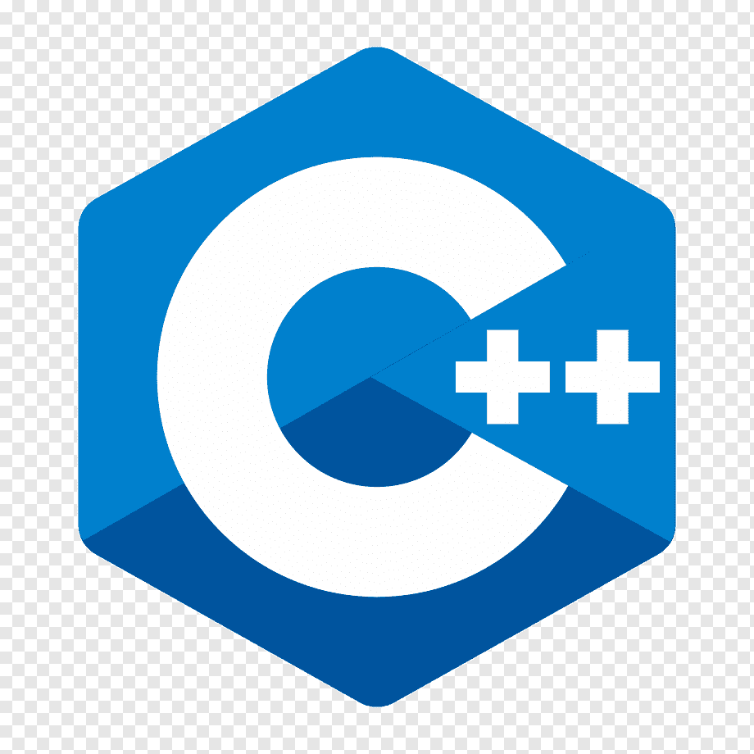
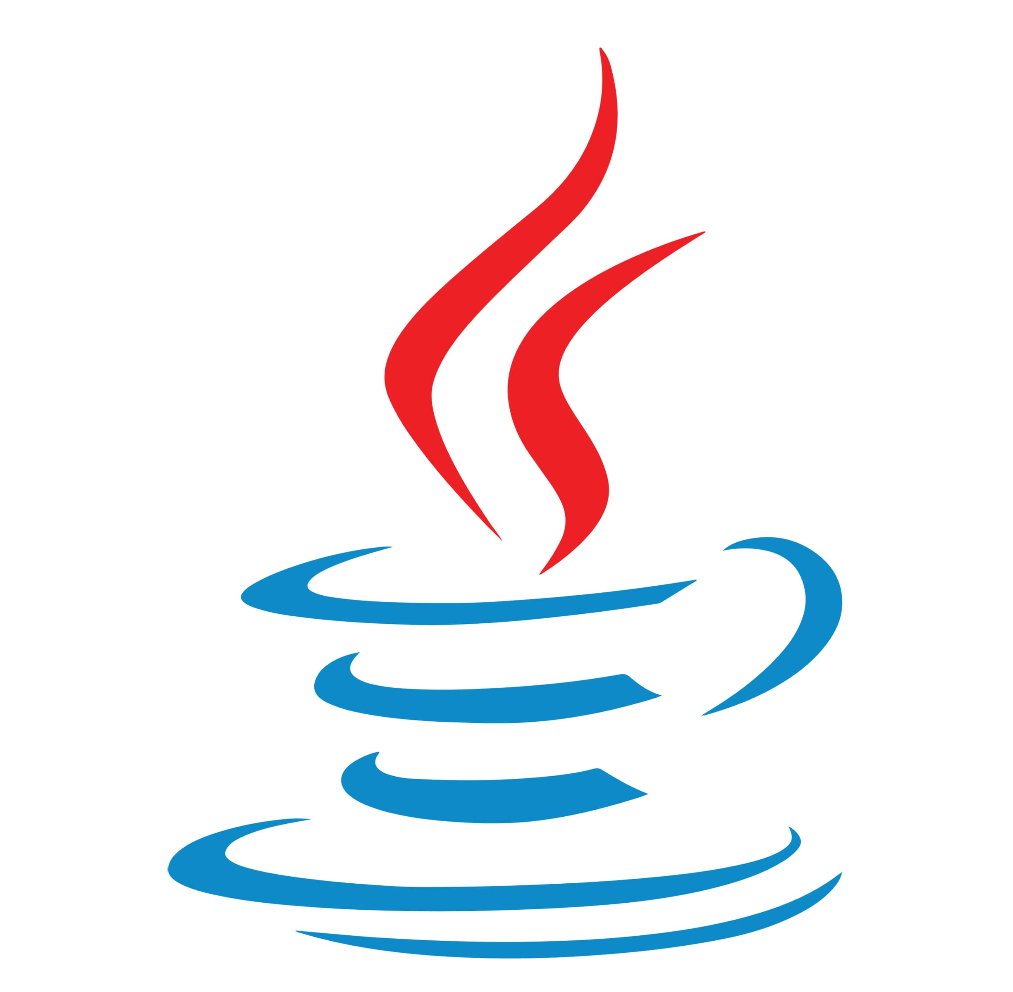







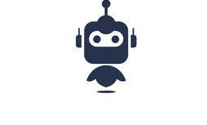

Reinforcement
Learning
C
C++
Java
PyTorch
Blender
CUDA
Docker
GUI
ISAAC SIM
Robot
Development
Training is any
of the above
domain

