Slide 1
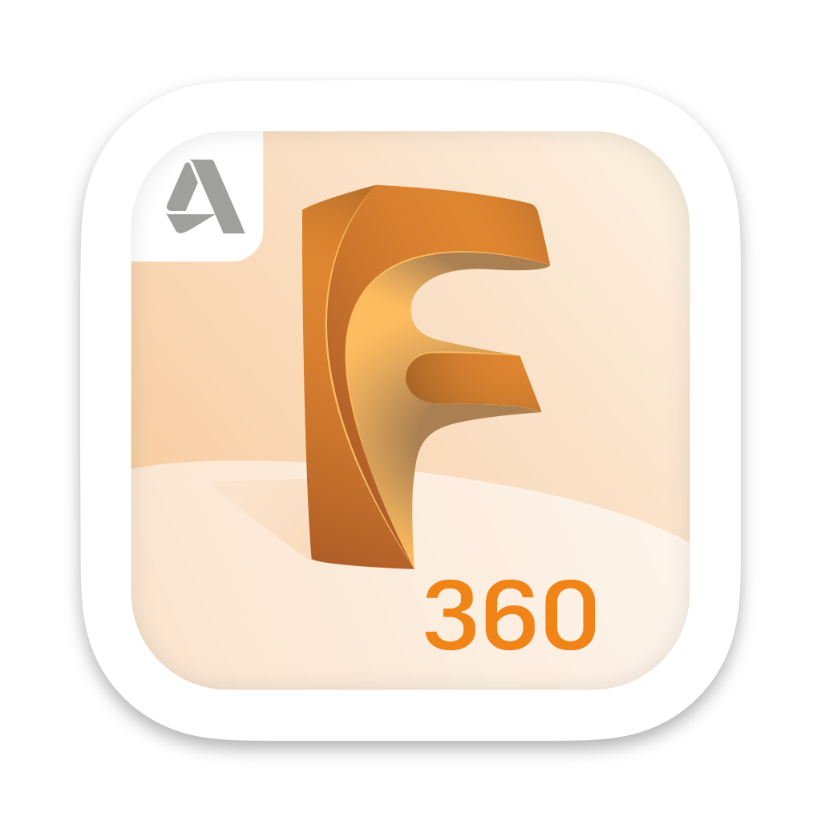


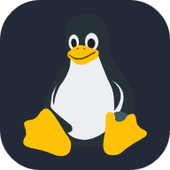


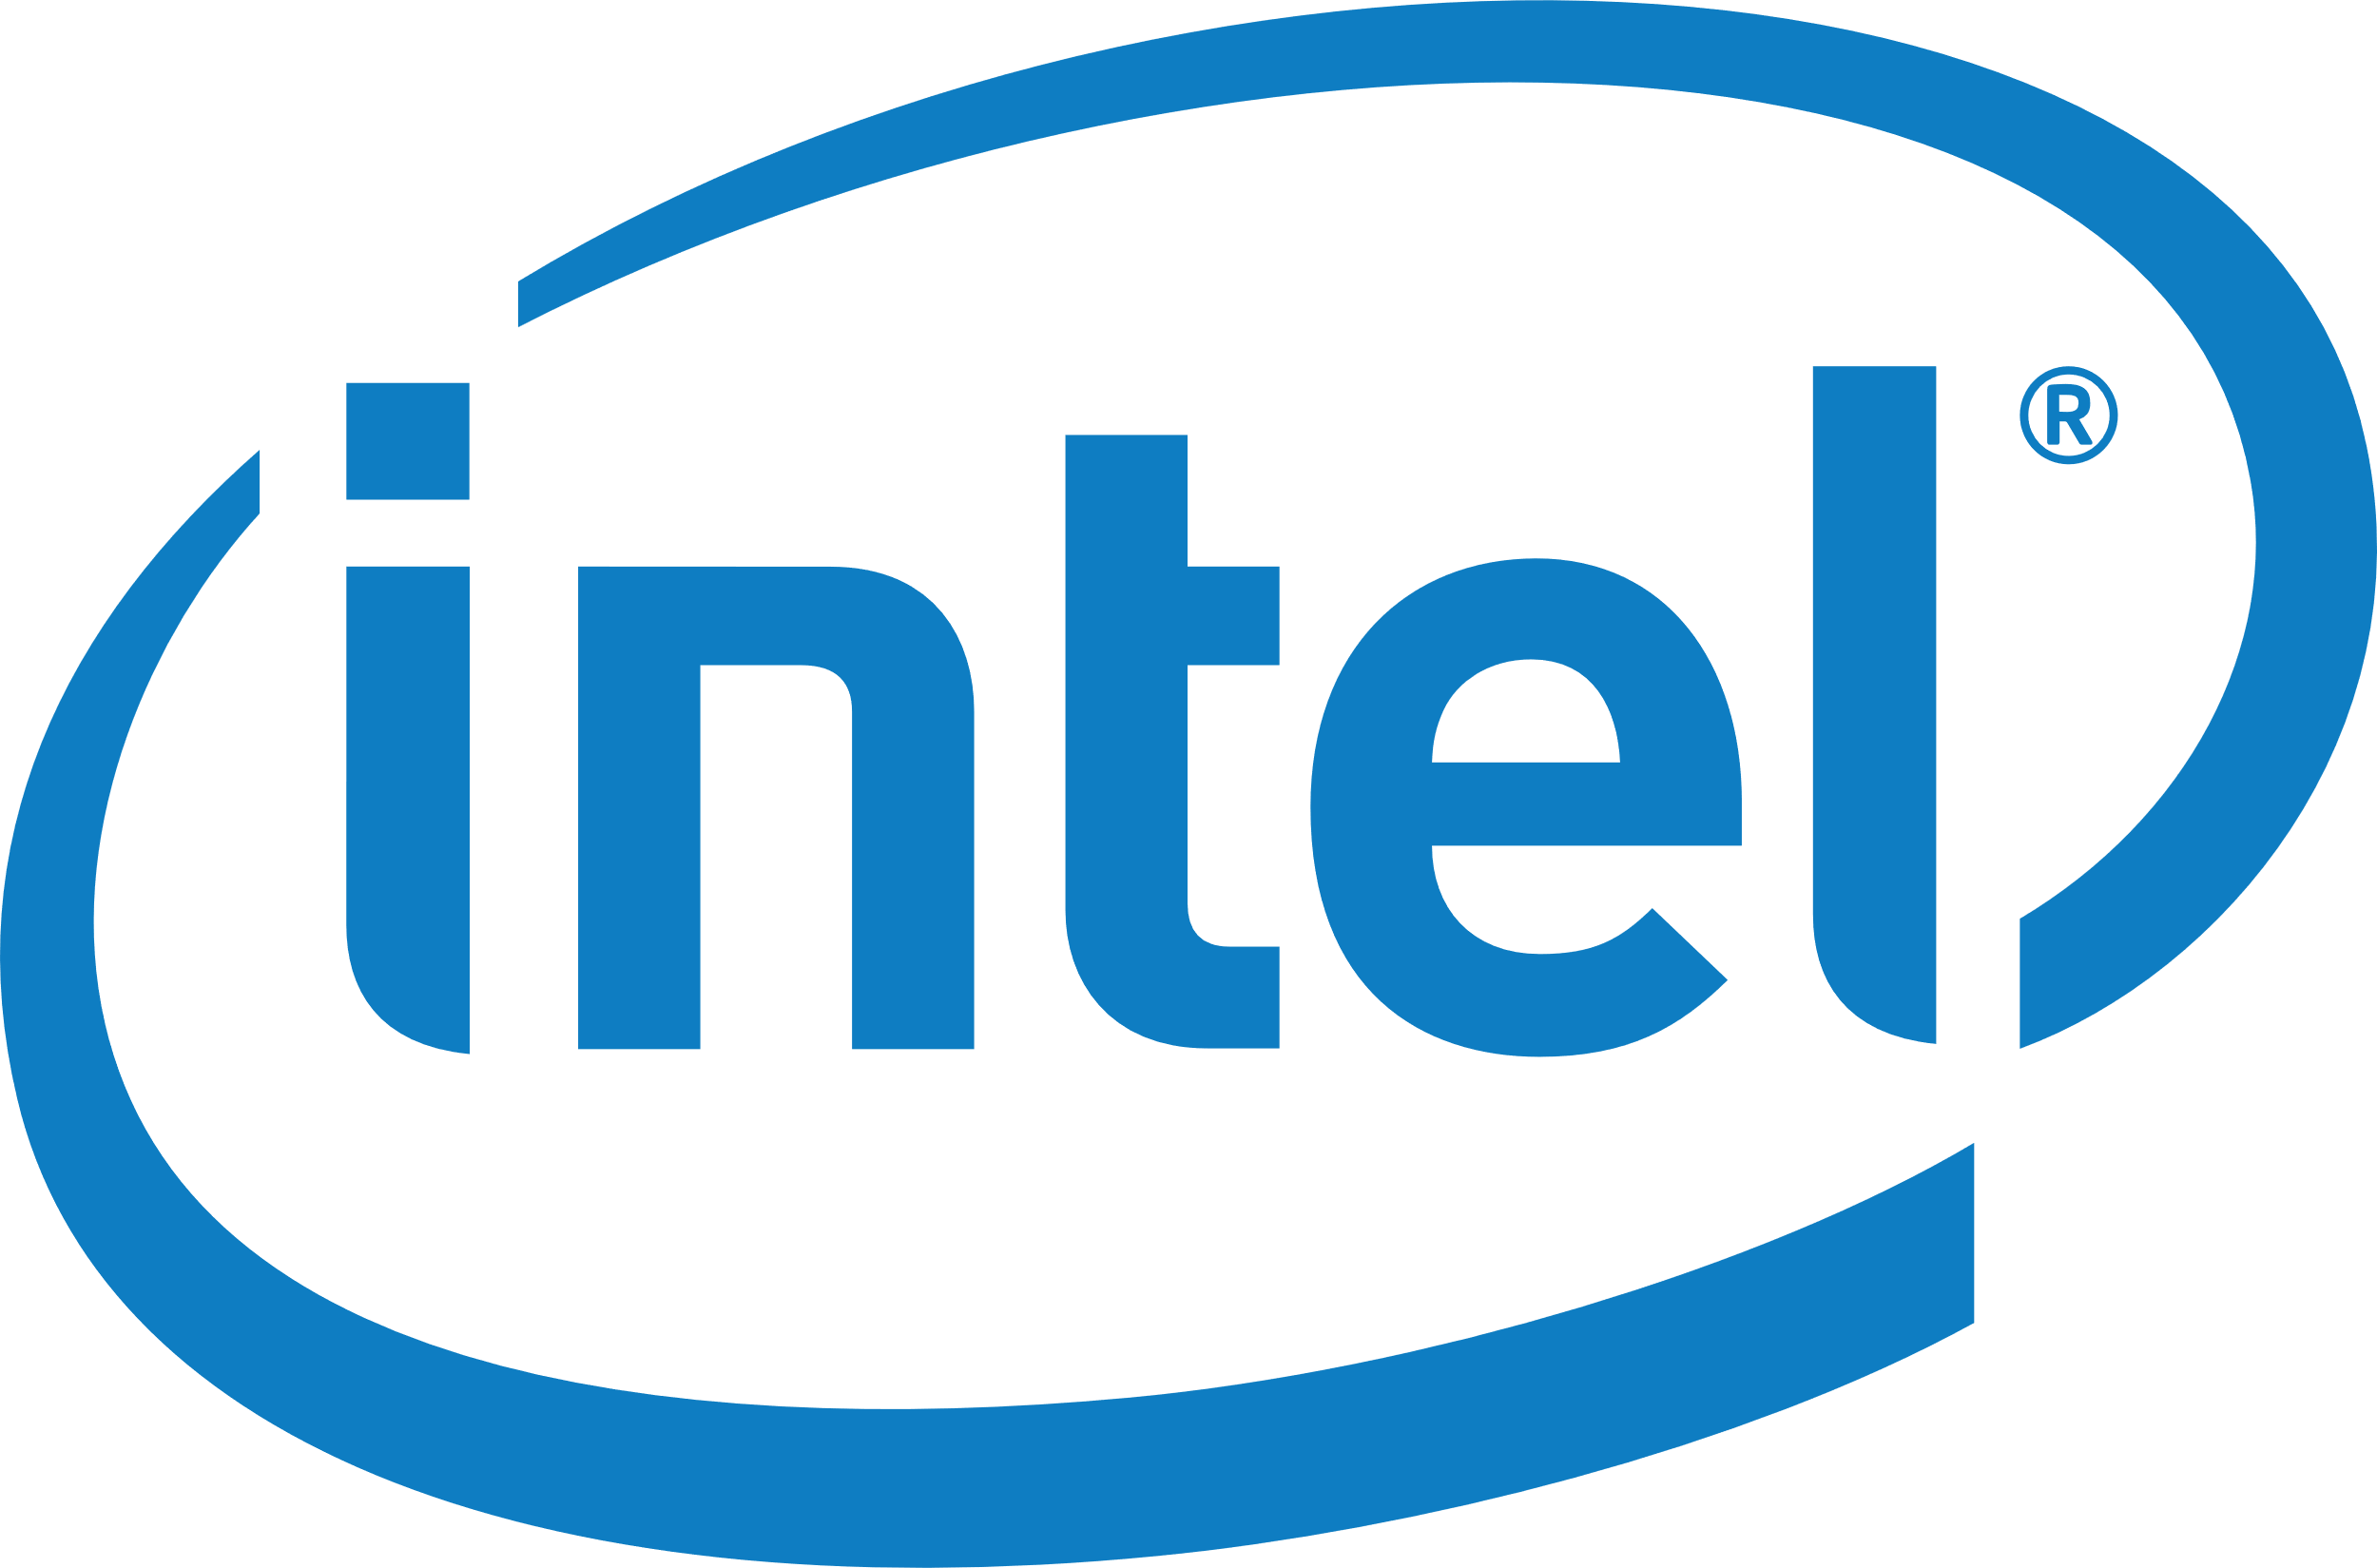

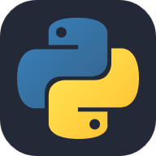



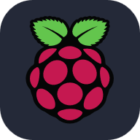
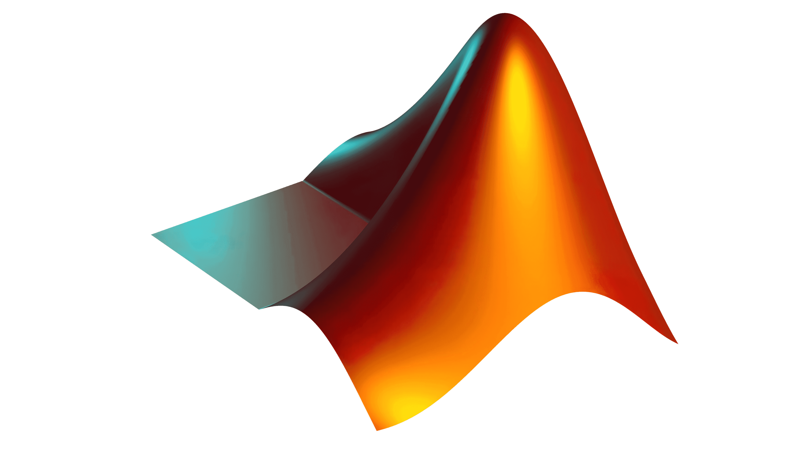

Fusion 360
ROS
Gazebo
Linux
VS code
ESP 32
Intel NUCs
Jetson Boards
Python
OpenCV
Arduino
GitHub
RaspberryPi
MATLAB
TensorFlow

