Slide 1

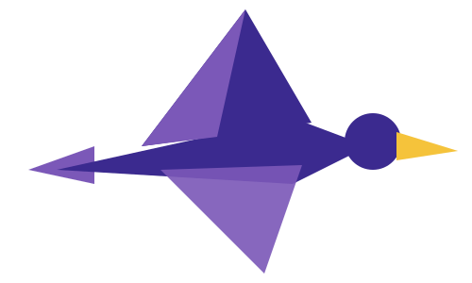
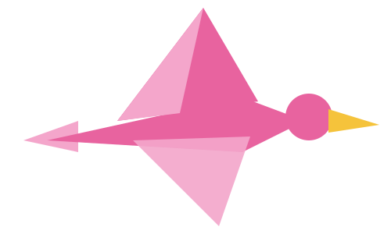

PARTICIPANT PRESENTATION
Participant Details
Qiskit
Fall Fest
2026
PROJECT TITLE
Q-Day Time Machine
TRACK
Quantum Cryptography & Security
TEAM NAME
Straw Hat Pirates
TEAM LEADER
Raunak Kumar Gupta
EMAIL / CONTACT
raunakg2005@gmail.com
Hackathon · Team Details
TEAM MEMBERS
Raunak Kumar Gupta · Krish Jain
INSTITUTION / ORGANISATION
KJ Somaiya College Of Engineering
COUNTRY
India

Slide 2
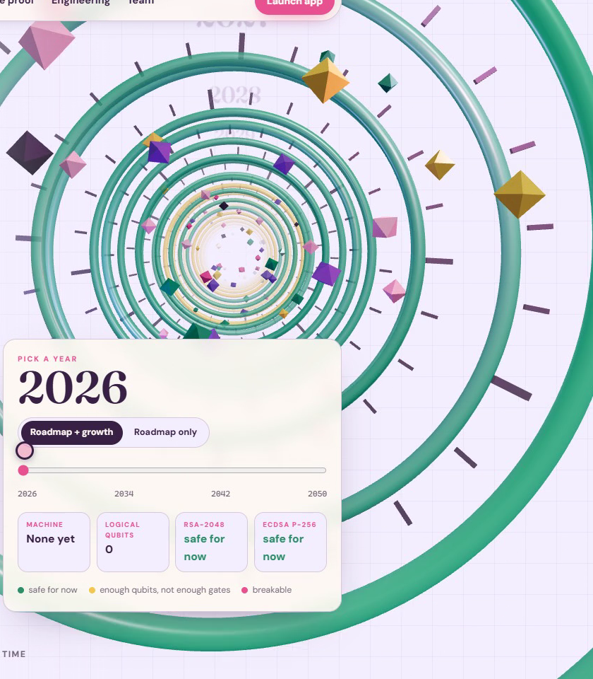
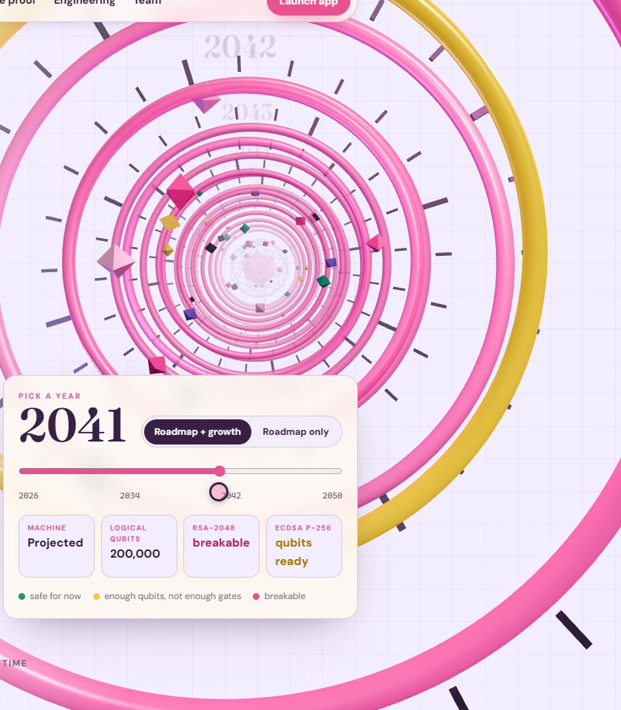



Problem Statement
HARVEST NOW, DECRYPT LATER
Record today
Encrypted traffic, 2026
Store for years
Storage is cheap
Decrypt on Q-Day
RSA-2048 ≈ 2037
No team can answer:
Which systems break first?
In what year?
Is today's data at risk?
2026 · safe today
every ring green
2041 · breakable
RSA and ECC rings turn pink
2035
NIST draft retires
RSA and ECC
1,399
logical qubits to
break RSA‑2048
Our Time Machine: each ring is one year on IBM's quantum roadmap.
Notes:
The problem
Shor's algorithm breaks the RSA and elliptic-curve cryptography that protects today's logins, payments and signatures.
Attackers can already record encrypted traffic and decrypt it later: "harvest now, decrypt later".
The gap
Organisations cannot answer the questions that drive decisions:
Which of my systems break first?
In what year do they break?
Is the data I send today already at risk?
Inventory tools list where cryptography is used. They do not turn that list into a timeline, a priority order or a proof.
Why it matters
NIST's draft transition plan (IR 8547) disallows RSA and elliptic-curve cryptography by 2035, and migrations take years.
Data with a long shelf life (health records, finance, identity) is already exposed if it is recorded today.
Teams need to know where to start, and why to believe the timeline.
Track / Category
Online · Track 1 · Quantum Cryptography & Security
Problem statement: Q-Day Time Machine

Slide 3











Objectives & Novelty
WHAT IT DOES
WHAT'S NEW
A timeline, not just an inventory
Scan
Websites + code, 8 languages
Inventory
CycloneDX 1.6 CBOM
Forecast
A break year per algorithm
Hardware tests pre-registered in code
Circuits never encode the answer
Second simulator: quantum-debugger
Prioritise
Mosca's rule + harvest window
Prove
Shor & Grover on IBM QPUs
Fix
ML-KEM & ML-DSA, live
Detects hybrid post-quantum TLS
Notes:
Objectives
Scan live TLS endpoints and source code (eight languages) for quantum-vulnerable cryptography
Inventory it as a CycloneDX 1.6 Cryptography Bill of Materials (CBOM)
Forecast a break year for every algorithm from published attack costs vs IBM's roadmap
Prioritise with Mosca's inequality and a harvest-now window
Prove the threat with Shor and Grover attacks on real IBM quantum hardware
Fix it: show NIST post-quantum ML-KEM-768 and ML-DSA-65 working live
Novelty
A timeline, not just an inventory: checks logical qubits and Toffoli-gate counts year by year
Pre-registered hardware tests: rules (strict-v1) fixed in code before the runs; Grover secrets drawn blind at submit time
Honest circuits: modular multipliers are synthesised for any constant, so the circuit never encodes the answer
Independent check: a second simulator (quantum-debugger) agrees with Qiskit to 3 × 10-13
Live detection of the hybrid post-quantum group X25519MLKEM768

Slide 4
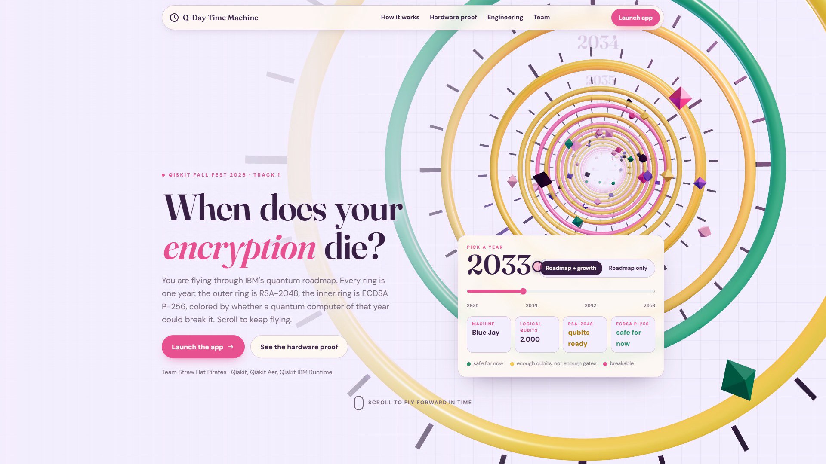
Solution & Quantum Advantage
Scan
TLS + code
CBOM
CycloneDX 1.6
Time Machine
IBM roadmap
Risk
Mosca's rule
Prove it
IBM hardware
Migrate
ML-KEM, ML-DSA
Fast
√N
≈ 2037
Shor's algorithm
polynomial time: breaks RSA and ECC
Grover's search
halves symmetric key strength
RSA-2048 falls
1,399 qubits, 6.5×10⁹ gates
Notes:
Solution: six steps from inventory to proof
Scan: TLS certificates, key-exchange groups and source code
CBOM: CycloneDX 1.6 inventory with a quantum-security level per algorithm
Time Machine: year slider against IBM's roadmap (Starling 2029, Blue Jay 2033+)
Risk: Mosca's inequality and the harvest-now window
Prove it: Shor and Grover in Qiskit on IBM hardware, stepped through gate by gate
Migrate: hybrid X25519 + ML-KEM-768 and ML-DSA-65 beside RSA-2048 and ECDSA P-256
Quantum advantage
Shor's algorithm: polynomial-time order finding breaks factoring and discrete logs. RSA-2048 needs about 1,399 logical qubits and 6.5 × 109 Toffoli gates; ECC P-256 about 2,330 qubits and 1.3 × 1011.
Grover's search: about (π/4)·√(2n) oracle calls instead of up to 2n trials, halving symmetric key strength, which is why AES-256 is advised over AES-128.
Forecast: RSA-2048 is qubits-ready in 2033 but short on operations; breakable about 2037 with continued growth (hypothetical). ECC P-256 about 2042.

Slide 5
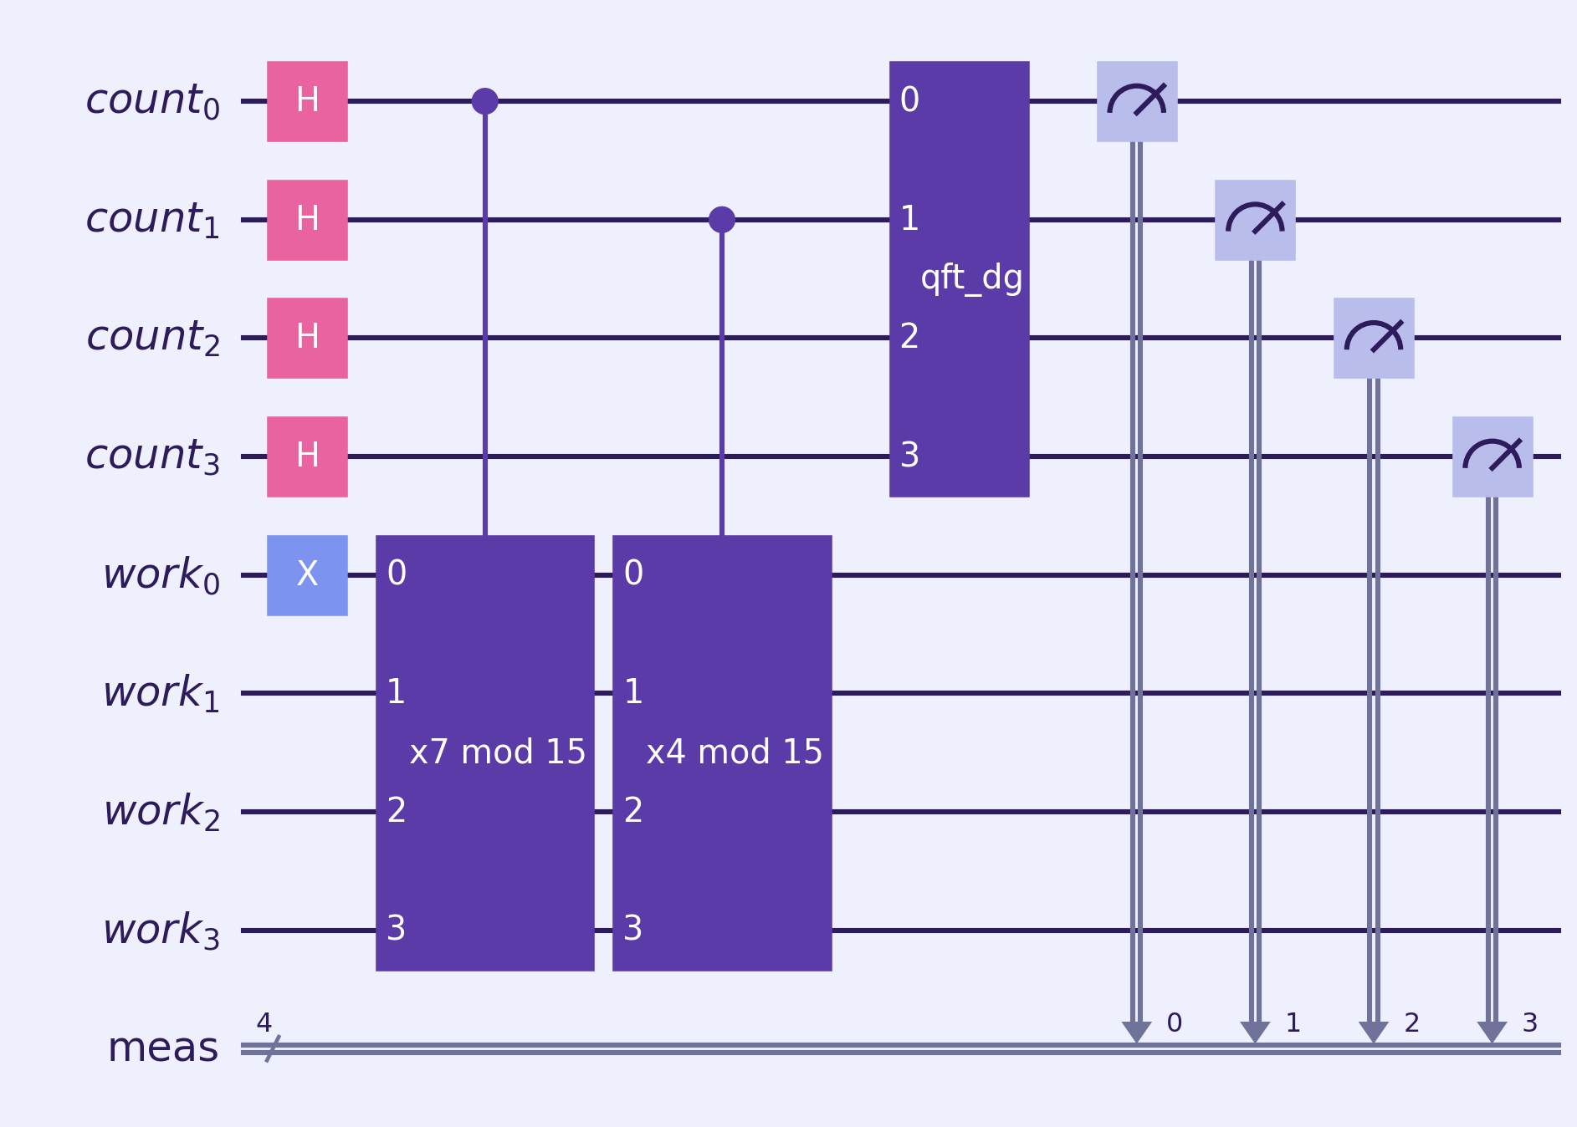
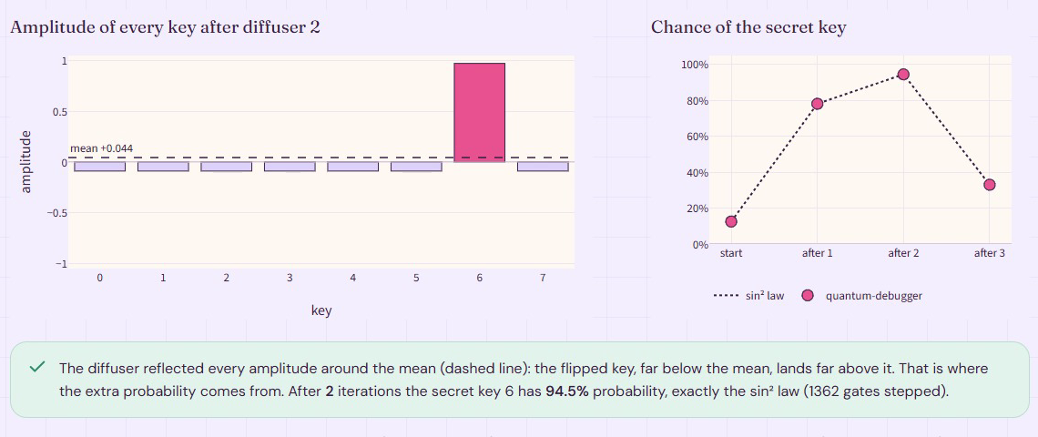
Algorithm & Circuit Design
SHOR · ORDER FINDING
Superpose
aˣ mod 15
QFT⁻¹
period r = 4
15 = 3 × 5
GROVER · KEY SEARCH
Shor order finding for N = 15, a = 7 (4 counting + 4 work qubits)
Oracle flips the key's sign · diffuser amplifies it
Notes:
Shor: order finding
Phase estimation on f(x) = ax mod N: counting qubit j controls multiply by a^(2^j) mod N
Inverse QFT, then continued fractions give the period r and gcd(ar/2 ± 1, N) the factors
N = 15: multipliers are bit rotations plus NOT (173 two-qubit gates)
Grover: key search
Toy cipher Ek(p) = S(p XOR k) with PRESENT's 4-bit S-box (3-bit on hardware)
Oracle flips the phase of keys with Ek(p) = c; diffuser reflects about the mean
About (π/4)·√(2n) iterations; success follows sin2((2i+1)θ)

Slide 6





Implementation & Tech Stack
INPUTS
OUTPUTS
Websites (TLS)
qday engine
Dashboard + 3D site
Scanner
Forecast
CLI · CI gate
Source code
Quantum core
Post-quantum
CBOM file
STACK
969
Python 3.11+
Qiskit 2.1 + Aer
IBM Runtime
quantum‑debugger
ML‑KEM + ML‑DSA
Streamlit
pytest + Hypothesis
Docker + CI
automated tests · 96% coverage
Notes:
Implementation
Python package qday with a CLI: scan, cbom, forecast, shor, grover, pqc
Scanner: TLS handshake via ssl and openssl s_client; regex rules extract key sizes and curves
Quantum core: Shor and Grover circuits transpiled and run with SamplerV2 on IBM backends
Statistics: Wilson intervals, exact binomial and chi-square tests, Hellinger fidelity
Streamlit dashboard (Scan, Time Machine, Prove it, Migrate, Sources) with a three.js landing page
969 tests at 96% coverage; CI on Python 3.11 and 3.12; non-root Docker image
Tech stack
Language: Python 3.11+
Quantum: Qiskit ≥ 2.1, Aer, IBM Runtime (SamplerV2)
Hardware: ibm_fez, ibm_kingston, ibm_marrakesh
Post-quantum: kyber-py and dilithium-py (FIPS 203 / 204), cryptography
Debugging: quantum-debugger (independent state-vector check)
Data and UI: NumPy, SciPy, pandas, Streamlit, Plotly, aiohttp, three.js, GSAP
Quality: pytest, Hypothesis, ruff, GitHub Actions, Docker

Slide 7
Results & Analysis
45 / 45
validation tests passed on 3 IBM quantum computers
24 / 24
strict Shor tests: every machine, every placement
14 / 14
every pre-registered rule on ibm_kingston
Notes:
Simulator (ideal)
Shor factors 15 (every base) and 21; Grover recovers all 16 four-bit and all 8 three-bit keys, matching theory (P = 0.961 and 0.945)
Real IBM hardware
17 circuits × 4,000 shots on ibm_fez, ibm_kingston and ibm_marrakesh: 45 / 45 tests pass, both controls behave
Top Shor outcomes are exactly the ideal peaks y = 0, 2, 4, 6
Pre-registered strict suite
Shor 24 / 24; Grover 10 / 18 (placement matters); ibm_kingston passes all 14 / 14 tests

Slide 8
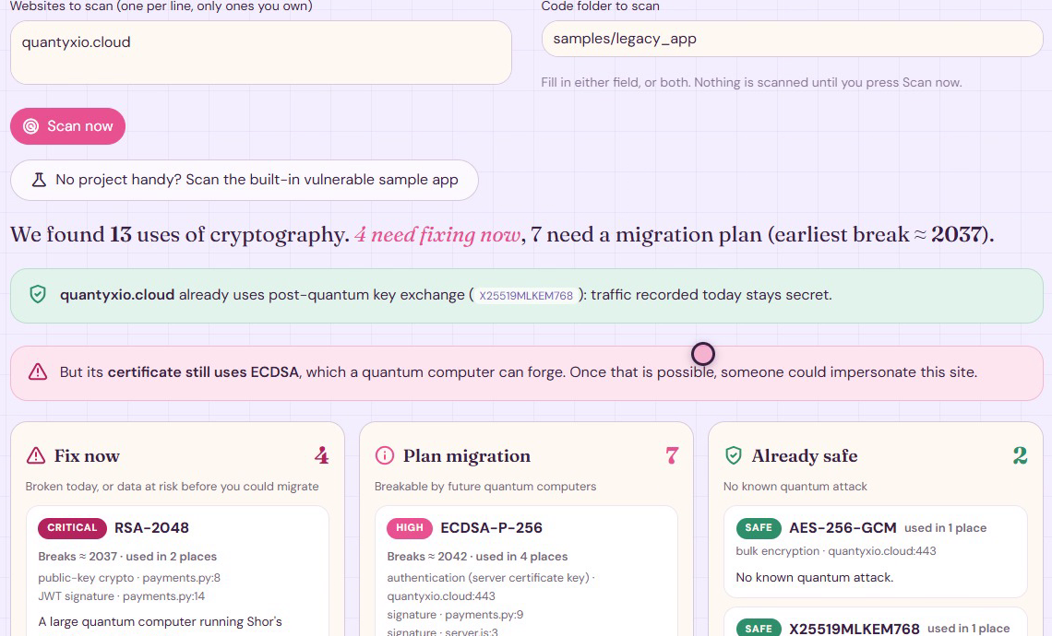






Impact & Real-World Applications
WE SCANNED OUR OWN WEBSITE FIRST
WHO NEEDS IT
Banks & payments
RSA and ECC in every login
Health & identity
Long-lived data, harvested now
Enterprises
A CBOM to plan the 2035 move
DevSecOps
qday scan --fail-on critical
Educators
Shor & Grover, live on real QPUs
Key exchange: post-quantum
Certificate: ECDSA, breakable
Notes:
Impact
Turns a crypto inventory into a timeline: every finding gets a break year, a risk level and a replacement
Shows teams what to fix first, and why to trust the date
Shows that recorded traffic is a risk today, not only after the quantum break
Real case: our own site (quantyxio.cloud) already negotiates X25519MLKEM768, so recorded traffic is protected, but its ECDSA P-256 certificate is not: impersonation becomes possible once such signatures can be forged
Real-world applications
Banks and payments: RSA and ECC in logins, payments and signatures
Healthcare, finance, identity: long-lived data exposed to harvest-now attacks
Enterprise migration: CBOM inventory to plan the NIST IR 8547 transition
DevSecOps: qday scan --fail-on critical as a CI gate
Security teams and educators: a live demo that Shor and Grover are real algorithms on real machines

Slide 9



Challenges & Future Scope
CHALLENGES
FUTURE SCOPE
22% vs 64%
Grover success on two qubit sets of one chip
Now
Error suppression and smarter qubit placement
Next
Reachability analysis in the code scanner
173 vs 6,500
two-qubit gates for
N = 15 vs N = 21
2029
IBM Starling: larger attack instances
Toy keys
N = 15, 21 and 3–4-bit keys today
2033+
Blue Jay: fault-tolerant runs
Notes:
Challenges
Noise: Grover's ~140 two-qubit gates lose signal; on ibm_marrakesh, placement gave 22% vs 64% success
Scale: N = 21 compiles to ~6,500 two-qubit gates (N = 15 needs 173), so it ran on simulators only
Toy instances: N = 15, 21 and 3 to 4-bit keys, not production keys
Forecasts rest on published estimates and IBM's stated roadmap; after 2033 they are extrapolations
Scanner is pattern-based: findings are leads, not proof of reachability
Future scope
Run larger instances on fault-tolerant machines (IBM Starling 2029, Blue Jay 2033+)
Update forecasts with newer elliptic-curve estimates, which are lower than the 2017 bound used here
Use error suppression and better qubit placement to lift Grover's hardware success
Add reachability analysis to the code scanner to cut false leads
Repeat-run checks on ibm_fez and ibm_marrakesh, as already done on ibm_kingston

Slide 10
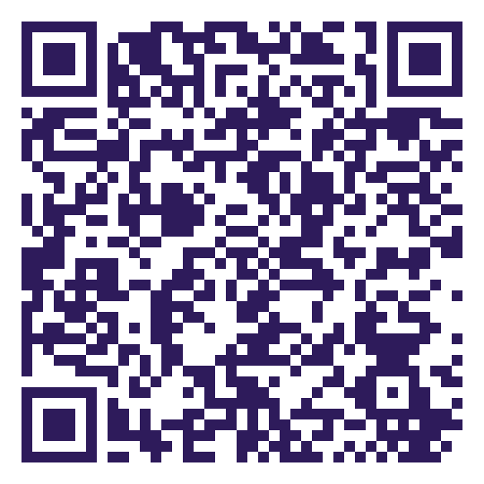

CLOSING
Thank You
Questions?
Inspiring Minds. Shaping Tomorrow.
GITHUB REPOSITORY
vtu-qiskit-fall-fest-2026/vtu-hc-straw-hat-pirates at feature/q-day-time-machine
DEMO VIDEO LINK
https://youtu.be/8AHgcPisYlE
Scan for
GitHub
Scan for
Demo on YouTube

