Slide 1
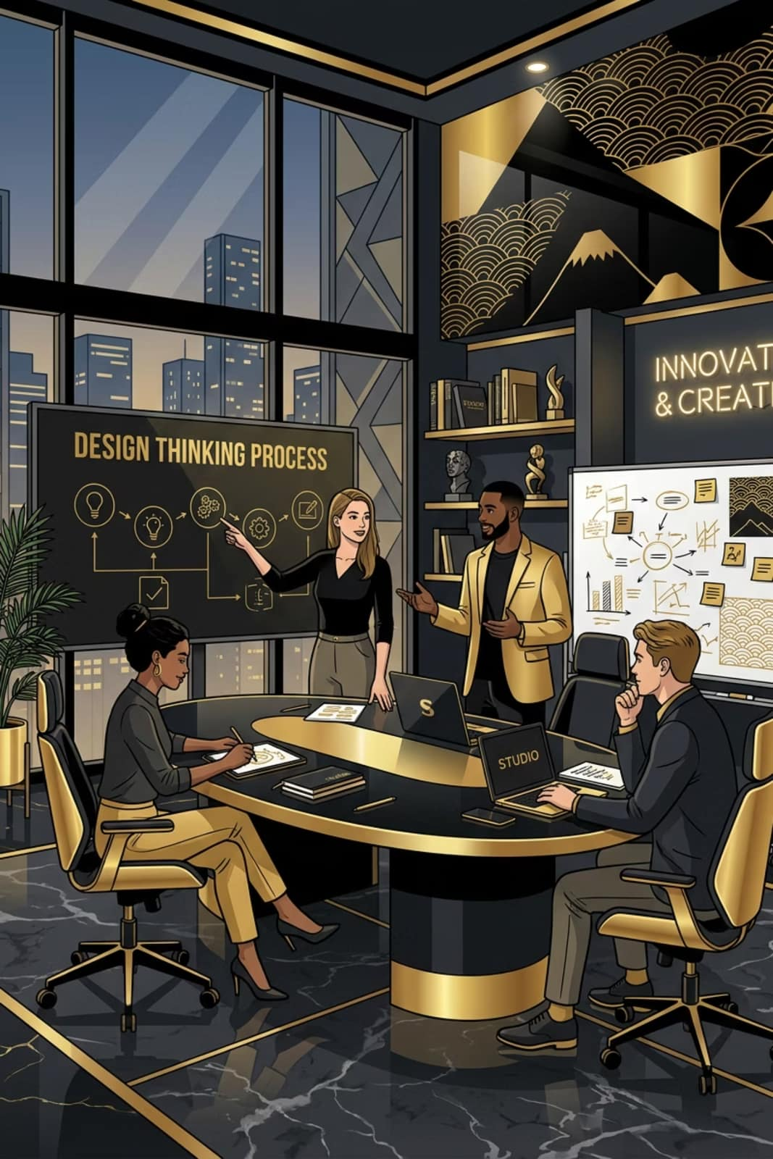
Design Thinking & Innovation
Case Studies of Nike, Airbnb, and Oral B
Presented By: Siddhartha Singh, Shivam Singh, Satyam Kumar, Rahul Sharma, Raunak Sahay, Parnashree Paul,, Pratyush Hazra
Guru Nanak Institute of Technology, Department of Information Technology

Slide 2

What is Design Thinking?
Design Thinking is a human-centered approach to innovation that focuses on deeply understanding user needs and solving problems creatively. This methodology helps organizations create products and services that truly resonate with their customers by placing user experience at the center of every decision.
It's not just a process—it's a mindset that combines empathy with experimentation to drive meaningful innovation.

Slide 3
Five Stages of Design Thinking
01
02
03
Empathize
Define
Ideate
Understand user needs through observation and engagement
Identify and articulate the core problem to solve
Generate a wide range of creative ideas and solutions
04
05
Prototype
Test
Build tangible sample solutions for testing
Evaluate solutions with users and refine the approach

Slide 4

Objective of This Study
Understand Innovation
Explore how design thinking drives innovation across different industries
Analyze Case Studies
Examine real-world examples from leading companies
Learn Best Practices
Extract actionable insights that can be applied to future projects

Slide 5
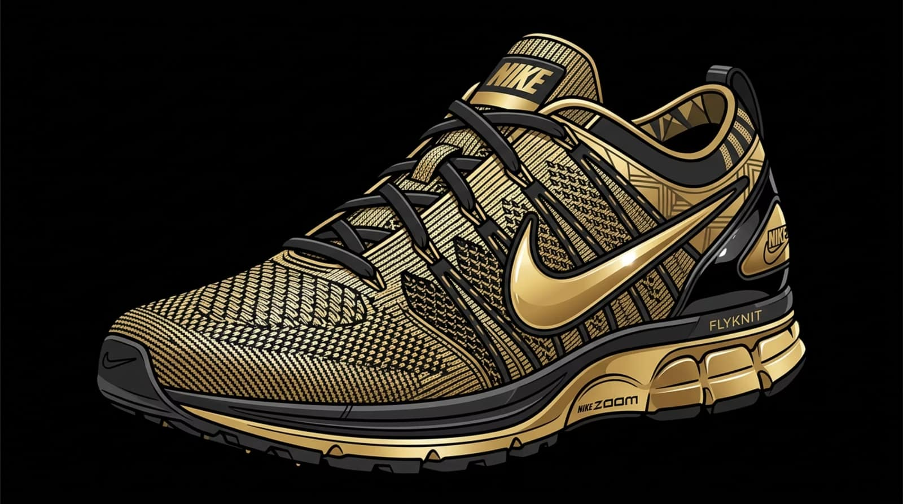
Case Study 1: Nike
Transforming Footwear Through Innovation
The Challenge
Traditional shoes used a cut and sew method that created heavy footwear with excessive material waste and discomfort for athletes.
The Goal
Create a shoe that feels like "second skin" — lightweight, form-fitting, and high-performing.

Slide 6
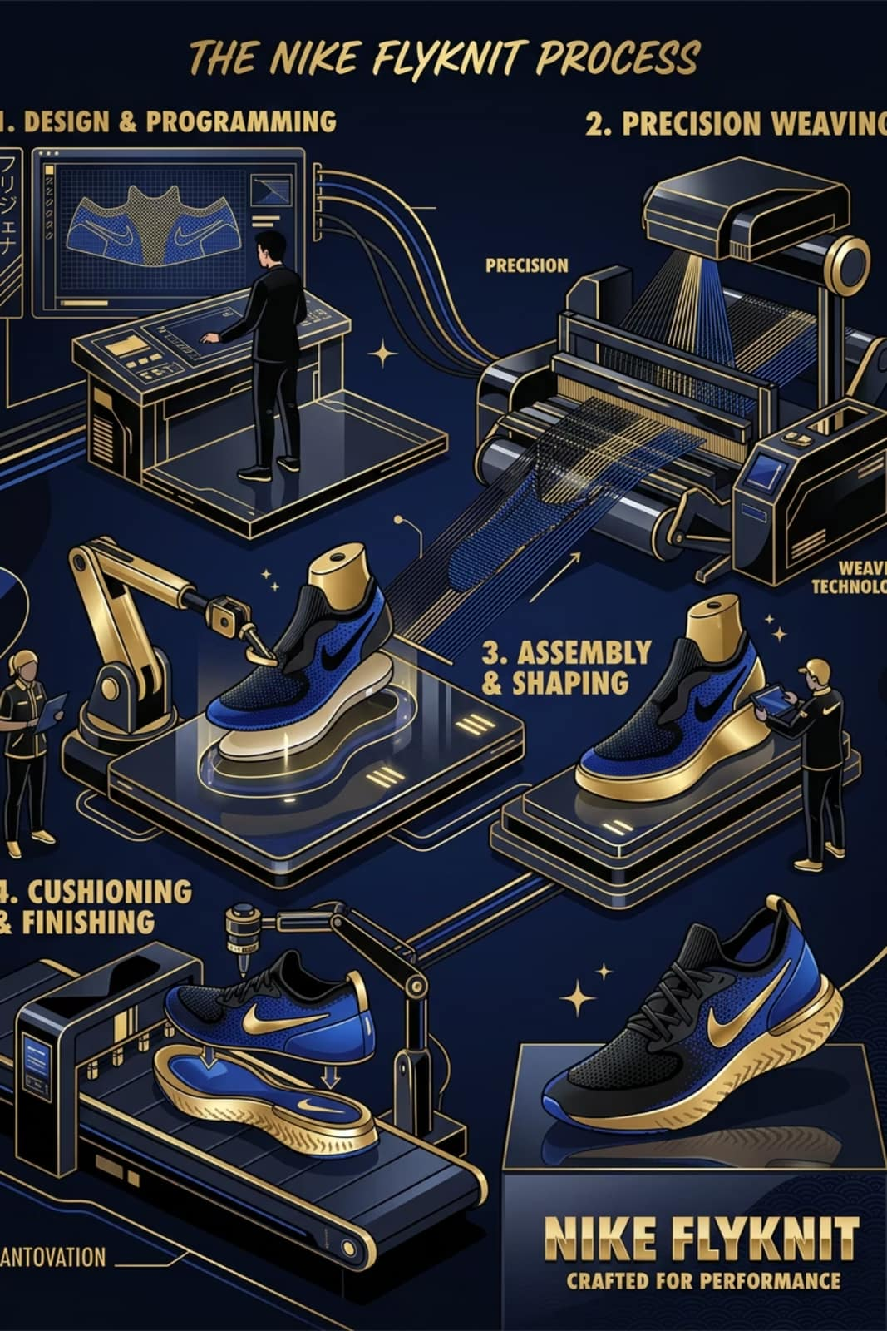
Nike's Flyknit Technology
60%
40%
100%
Less Waste
Lighter Weight
Custom Fit
Significantly reduced material waste compared to traditional manufacturing
Dramatic weight reduction for enhanced athletic performance
Engineered to conform precisely to the athlete's foot shape
Nike Flyknit revolutionized athletic footwear by weaving the upper from a single thread, creating shoes that are lighter, more sustainable, and better performing.

Slide 7

Case Study 2: Airbnb
From $200/Week to Global Success
The Crisis (2009)
Extremely low bookings
Revenue of only $200 per week
Users didn't trust listings
Poor quality photos
The Insight
Founders discovered that bad photography was preventing bookings — users couldn't visualize themselves staying in the spaces.

Slide 8




Airbnb's Photography Solution
Field Research
Founders personally visited hosts to understand the problem
Professional Photos
Took high-quality photos that showcased the best features
Revenue Growth
Bookings increased dramatically and business took off
By focusing on the user's need to visualize and trust the space, Airbnb transformed from a struggling startup into a global phenomenon.

Slide 9

Case Study 3: Oral B
Designing for Little Hands
The Problem
Children couldn't properly hold traditional thin toothbrush handles, leading to ineffective brushing and frustration.
The Solution
Designers created the "Squish Gripper" toothbrush with a thick, ergonomic handle that fits comfortably in small hands.
The Result
Better grip and more effective brushing for children, turning a daily chore into a positive experience.

Slide 10






Key Insights & Conclusion
User-Centered Design
Creative Solutions
Business Impact
All three companies succeeded by deeply understanding their users' real needs
Innovation came from observing behavior and identifying genuine problems
Focusing on user needs drives both product excellence and commercial success
Design Thinking helps create better, more innovative products by keeping user needs at the center of every decision. Nike, Airbnb, and Oral B demonstrate how this approach transforms challenges into opportunities for breakthrough innovation.

