Slide 1
TASK 5 — Final Report, Automation & Presentation
Sales Performance Analysis | ApexPlanet Software Pvt. Ltd.
Dataset: Sample Superstore (8,827 cleaned records)
Tools: Python, Pandas, Excel, Power BI, GitHub Actions
Deliverables: Report + Automation + Presentation + Documentation

Slide 2
Executive Summary
Total Sales: $819,718.06
Total Profit: $98,850.43
Total Orders: 4,725
Total Customers: 790
Profit Margin: 12.06%

Slide 3
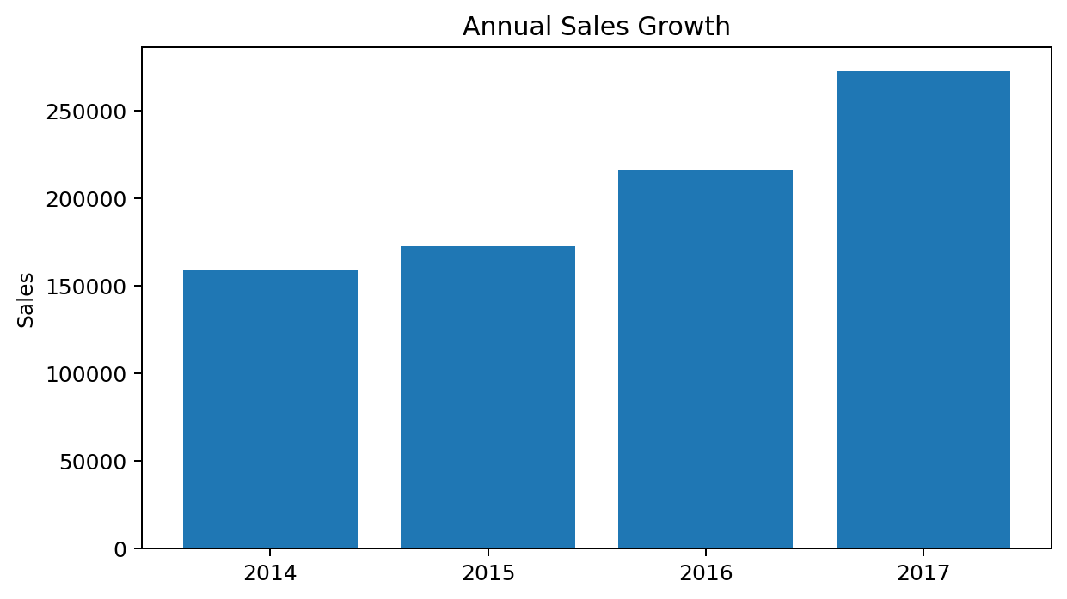
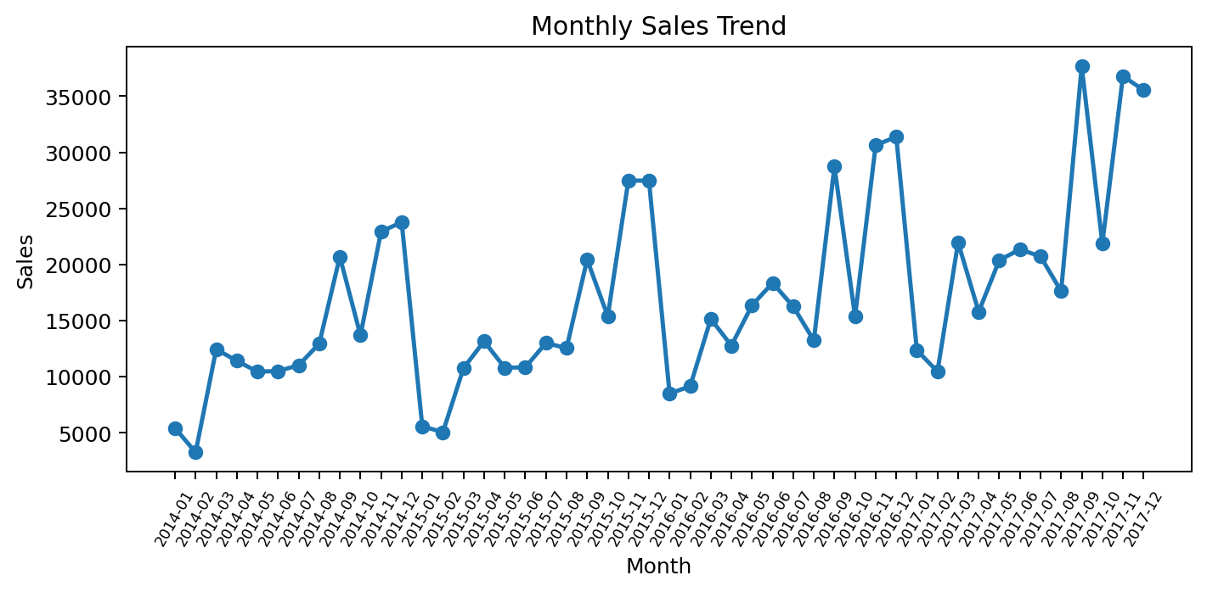
Sales Trend

Slide 4
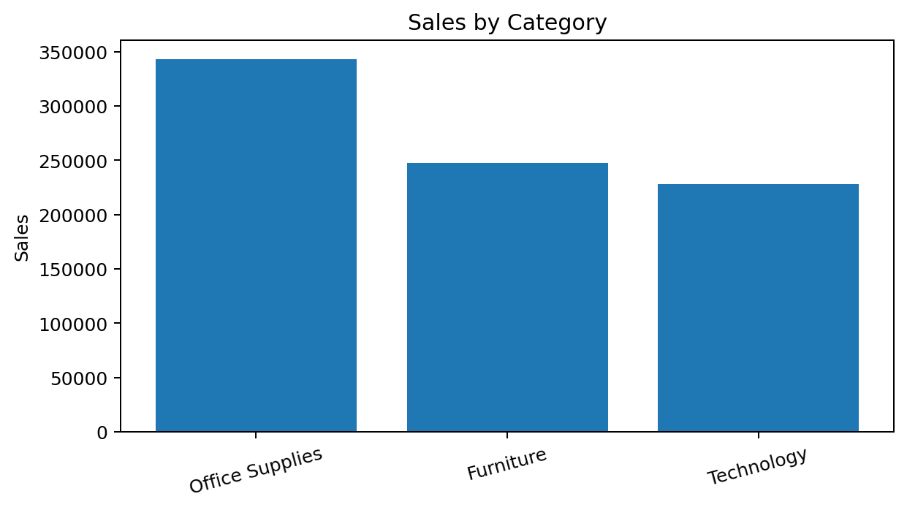
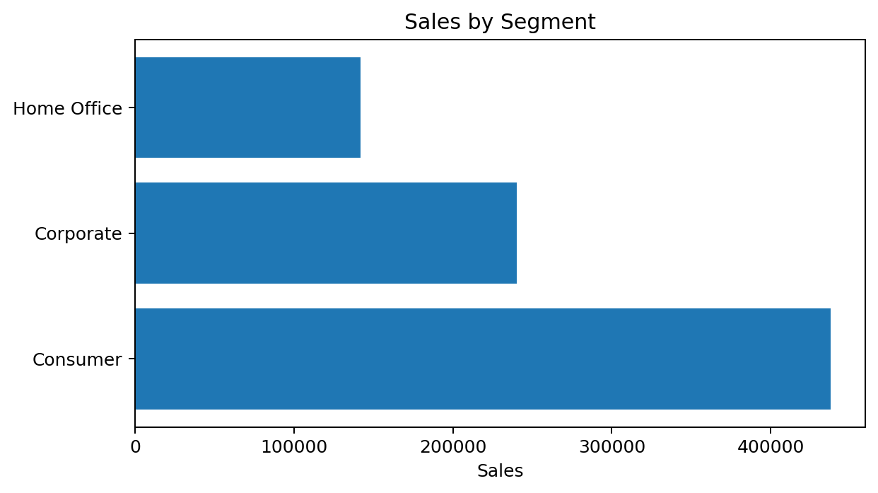
Category & Segment Performance

Slide 5
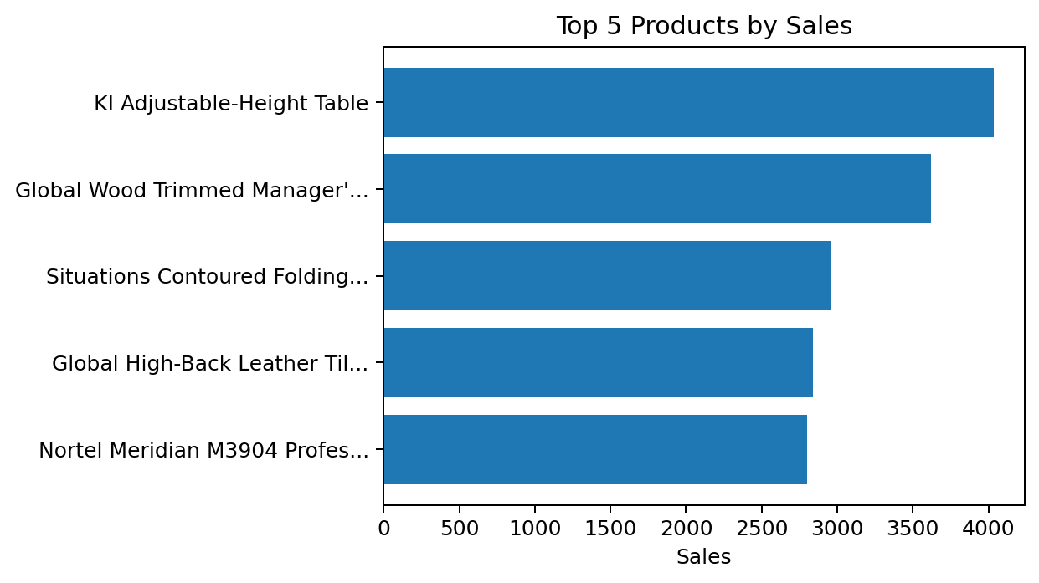
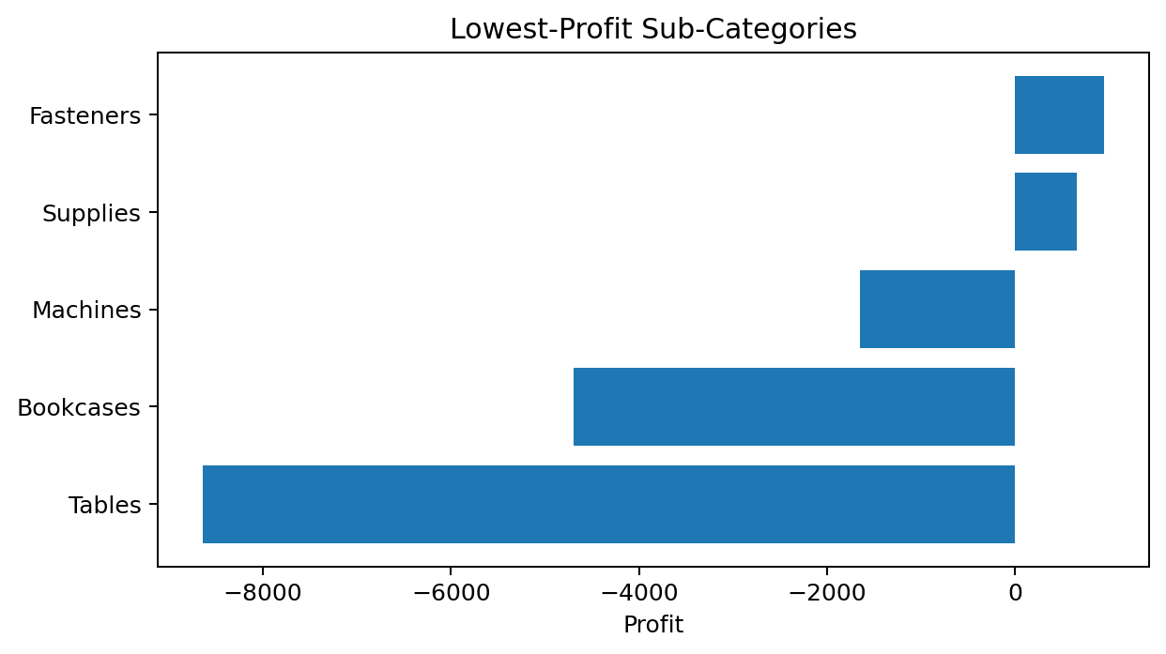
Top Products & Profitability

Slide 6
Top 5 Insights
West leads regional sales: $275,810
Consumer leads segment sales: $437,711
Office Supplies leads category sales: $343,425
Tables has the lowest sub-category profit: $-8,636
Annual sales rose to $272,538 in 2017

Slide 7
Automation Pipeline
1. Load raw CSV
2. Clean and validate data
3. Calculate KPIs
4. Export Excel analysis
5. Generate charts and KPI summary
6. Schedule with GitHub Actions
7. Upload outputs as workflow artifacts

Slide 8
Business Recommendations
Review pricing and discount strategy for low-profit sub-categories.
Scale successful practices from the West region and Consumer segment.
Use scheduled automation for regular KPI monitoring and faster decisions.
Keep the Power BI dashboard as the executive-facing visualization layer.

Slide 9
Final Submission
✓ Final Report PDF
✓ Automation Script
✓ requirements.txt + README
✓ Processed Excel Workbook
✓ GitHub Actions Workflow
✓ LinkedIn Post Content
✓ Final Presentation

