Slide 1
POWER BI • HR ANALYTICS
1,470
Dashboard Charts
Explained
EMPLOYEES
238
ATTRITION CASES
What each visual represents • how it is built • what insight it gives
16.1%
ATTRITION RATE
Based on the supplied dashboard screenshot

Slide 2
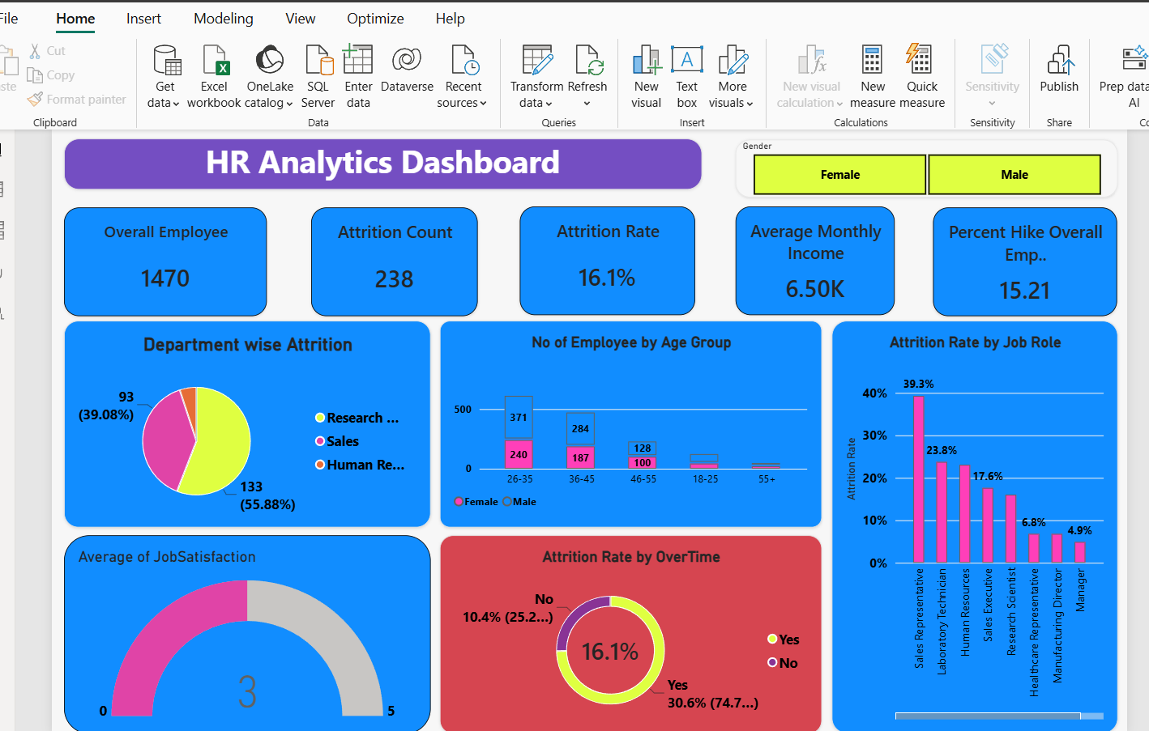
Dashboard Overview — What Each Visual Does
OVERVIEW
Dashboard components: slicer (Gender), KPI cards, department pie chart, age/gender stacked columns, job-role bar chart, job satisfaction gauge and overtime doughnut chart.
HR ANALYTICS • POWER BI CHART EXPLAINER
02

Slide 3
How to Read and Build the Report
POWER BI WORKFLOW
1
Load data
Get Data → Excel/CSV or source file
2
Clean data
Transform Data → check types, blanks and categories
3
Create measures
Total Employees, Attrition Count, Attrition Rate and averages
4
Add visuals
Choose visual type and drag fields into its wells
5
Format & filter
Set titles, labels, colors, slicers and interactions
Tip: keep measures separate from raw columns so the same KPI can respond consistently to slicers and filters.
HR ANALYTICS • POWER BI CHART EXPLAINER
03

Slide 4
Visual 1 — KPI Cards
CARDS
1,470
238
16.1%
6.50K
15.21
Overall employees
Attrition count
Attrition rate
Average monthly income
Average percent hike
What this visual represents
How to create in Power BI
Cards highlight single headline measures so viewers can understand workforce size, exits, attrition percentage and compensation averages quickly.
1. Select Card visual.
2. Drag one measure into the data field.
3. Set display units, decimal places and title.
4. Duplicate for each KPI and keep formatting consistent.
Example measures (adjust names to match your model): Total Employees = DISTINCTCOUNT(Employee[EmployeeNumber]); Attrition Count = count employees where Attrition = Yes.
HR ANALYTICS • POWER BI CHART EXPLAINER
04

Slide 5
Visual 2 — Gender Slicer
FILTERS
Gender
What it represents
Female
Male
A slicer is an interactive filter. Selecting Female or Male should filter the visuals on the report page that are connected to it.
How to build it
Insight / interpretation
1. Select Slicer from Visualizations.
2. Drag Gender into the slicer field.
3. Choose tile/button style if desired.
4. Use Edit interactions to confirm which visuals respond.
The slicer itself does not show a finding; it lets the audience compare KPIs and charts for different gender selections. Compare rates as well as counts.
HR ANALYTICS • POWER BI CHART EXPLAINER
05

Slide 6
Visual 3 — Department-wise Attrition (Pie Chart)
DEPARTMENT
What it represents
The pie chart compares the distribution of attrition cases across departments. Slice size shows each department's share of the total shown in this visual.
Department
share
Insight from your screenshot
R&D is the largest visible slice (133; 55.88%), Sales is next (93; 39.08%), and HR is the smallest visible slice (approximately 12; 5.04%). Verify exact counts in the PBIX.
How to build it
Choose Pie chart → Department to Legend → Attrition Count to Values. Turn on data labels for count and/or percent.
Important: these are shares of displayed attrition cases, not department-specific attrition rates. For rates, divide each department's attrition count by its employee headcount.
HR ANALYTICS • POWER BI CHART EXPLAINER
06

Slide 7
Visual 4 — Employee Count by Age Group and Gender
DEMOGRAPHICS
What it represents
A stacked column chart shows total employee count for each age band, with each column split into Female and Male segments.
How to build it
Choose Stacked column chart → Age Group to X-axis → Employee Count to Y-axis → Gender to Legend. Sort age bands in the intended order.
26–35
36–45
46–55
18–25
55+
Female
Male
Visible pattern: 26–35 is the largest displayed age band, followed by 36–45. This chart is a headcount view, not an attrition-rate view.
HR ANALYTICS • POWER BI CHART EXPLAINER
07

Slide 8
Visual 5 — Attrition Rate by Job Role (Column Chart)
JOB ROLE
What it represents
How to build it
39.3%
A column chart compares a numeric measure (attrition rate) across categories (job roles). Taller columns indicate higher displayed rates.
Choose Clustered column chart → Job Role to X-axis → Attrition Rate measure to Y-axis. Sort descending and enable data labels.
23.8%
23.0%
17.6%
16.0%
6.8%
6.5%
4.9%
Sales Rep.
Lab Tech.
Human Res.
Sales Exec.
Research Sci.
Health Rep.
Mfg. Dir.
Manager
Insight: Sales Representative is the clearest high-rate signal at 39.3%; investigate role demands and employee experience before assuming a cause.
HR ANALYTICS • POWER BI CHART EXPLAINER
08

Slide 9
Visual 6 — Average Job Satisfaction (Gauge)
SATISFACTION
3
What it represents
A gauge places one value against a minimum and maximum. Your screenshot displays an average satisfaction value of 3 on a 0–5 style scale.
0
5
Average Job Satisfaction
How to build it
Choose Gauge → Average Job Satisfaction measure to Value → set Minimum = 0 and Maximum = 5. Add a target only if your project defines one.
Interpretation: an average of 3 is a mid-scale score. Break it down by role, department, overtime and attrition status to identify low-satisfaction groups.
HR ANALYTICS • POWER BI CHART EXPLAINER
09

Slide 10
Visual 7 — Attrition Rate by Overtime (Doughnut Chart)
WORK CONDITIONS
What it represents
A doughnut chart shows category proportions as ring segments. In your report, overtime Yes/No are compared and labels show attrition rates.
16.1%
overall
How to build it
Choose Doughnut chart → Overtime to Legend → relevant attrition metric to Values. If you want rates, use a measure that calculates attrition rate within each overtime group.
Screenshot labels: Overtime = Yes 30.6%; No 10.4%. This suggests an association worth investigating, not proof that overtime causes employees to leave.
HR ANALYTICS • POWER BI CHART EXPLAINER
10

Slide 11
Behind the Visuals — Measures and Field Mapping
DAX & DATA MODEL
Common measures you may need
Example DAX (adapt table/column names to your PBIX)
Why measures matter
Total Employees =
DISTINCTCOUNT(Employee[EmployeeNumber])
Attrition Count =
CALCULATE(
DISTINCTCOUNT(Employee[EmployeeNumber]),
Employee[Attrition] = "Yes"
)
Attrition Rate =
DIVIDE([Attrition Count], [Total Employees], 0)
Average Monthly Income =
AVERAGE(Employee[MonthlyIncome])
Average Percent Hike =
AVERAGE(Employee[PercentSalaryHike])
Measures recalculate as slicers and filters change. This makes cards and charts interactive.
Check before using
Your PBIX may use different table names or a different attrition-rate denominator. Confirm the existing measures rather than replacing them blindly.
The formulas are illustrative templates, not a claim that they exactly match the model in your file.
HR ANALYTICS • POWER BI CHART EXPLAINER
11

Slide 12
Formatting, Slicers and Cross-Filtering
REPORT DESIGN
Consistent visual language
Slicer interactions
Tooltips & labels
Use the same colors for gender/category labels throughout. Keep titles descriptive and data labels readable.
Select a slicer → Format ribbon / Edit interactions → decide which charts should filter or highlight.
Use tooltips for supporting details; avoid too many labels when categories are crowded.
Recommended final checks
• Check each visual's field wells: Axis, Legend, Values and Tooltips.
• Verify that age groups are sorted logically, not alphabetically.
• Check percentages and decimal places against the source measures.
• Test Female/Male slicer selections and clear all filters before presenting.
• Add alt-text or a subtitle when a chart needs context.
HR ANALYTICS • POWER BI CHART EXPLAINER
12

Slide 13
What the Dashboard Insights Mean
SUMMARY
KPI cards
Give an at-a-glance summary of headcount, attrition and averages.
Department pie
Shows which departments contribute the largest share of recorded attrition cases.
Age/gender stacked columns
Shows workforce composition by age and gender; compare rates separately for retention.
Job-role columns
Highlights roles with higher displayed attrition rates; Sales Representative is the strongest visible signal.
Satisfaction gauge
Summarizes the average score but can hide low-scoring subgroups.
Overtime doughnut
Shows different attrition rates for overtime groups; investigate workload and role mix.
HR ANALYTICS • POWER BI CHART EXPLAINER
13

Slide 14
A good dashboard answers three questions
What do we see?
The visual compares categories or summarizes a measure.
01
How was it built?
Fields, measures, visual type, labels and filters determine the result.
02
What should we do?
Use the pattern to form a question, validate it and test a targeted HR action.
03
Validate the exact measures and chart labels in the PBIX before making business claims.
THANK YOU

