Slide 1
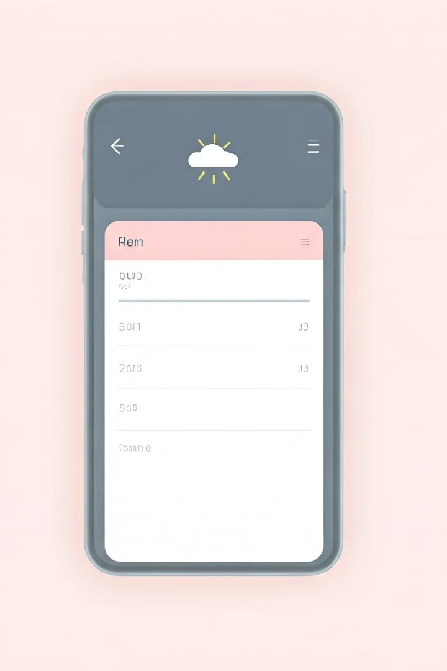
MLSA Full Stack Web Development:
Weather App & Todo List
This presentation details a weather app and to-do list. Built using HTML, CSS, and JavaScript. It leverages APIs and local storage.
Made By Raunak Kushwaha

Slide 2

Introduction
1
Project Overview
2
Key Features
Combines weather information with task management.
Real-time weather updates and to-do list functionality.
3
Technologies Used
HTML, CSS, JavaScript, and relevant APIs.

Slide 3
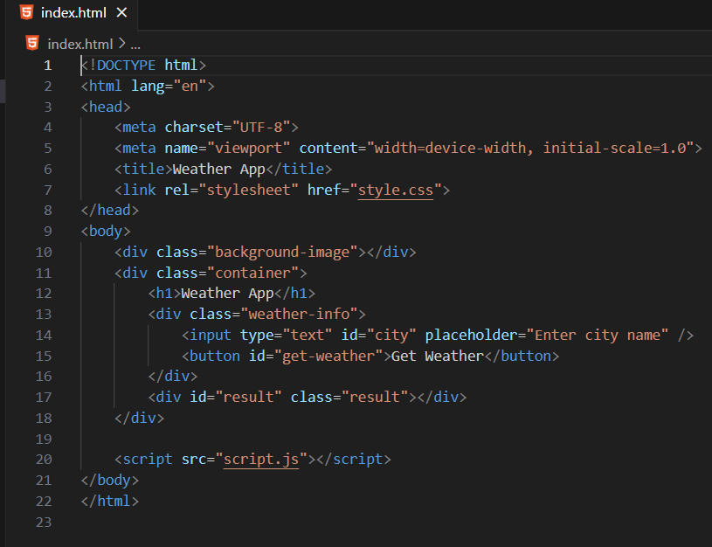
HTML Structure
Weather Section
To-Do Section
Divs for location, temperature, and conditions.
Input field, list display, and buttons.

Slide 4
CSS Styling
Color Palette
Typography
Layout
Consistent colors throughout the application.
Clear and readable fonts for better UX.
Responsive design for various screen sizes.

Slide 5
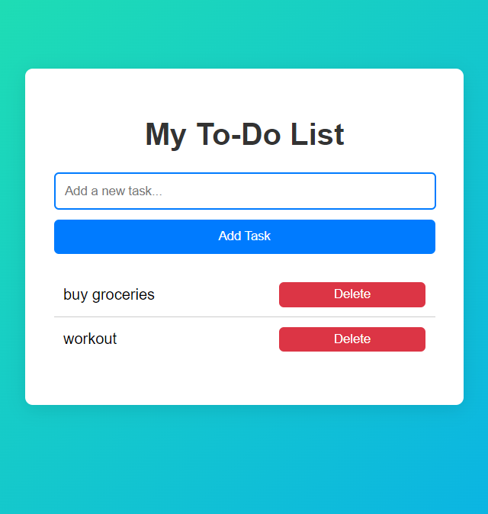



JavaScript Functionality
Weather API Call
Retrieves weather data and updates the UI.
To-Do List Logic
Adds, removes, and manages to-do items.
Event Handling
Responds to user interactions smoothly.

Slide 6
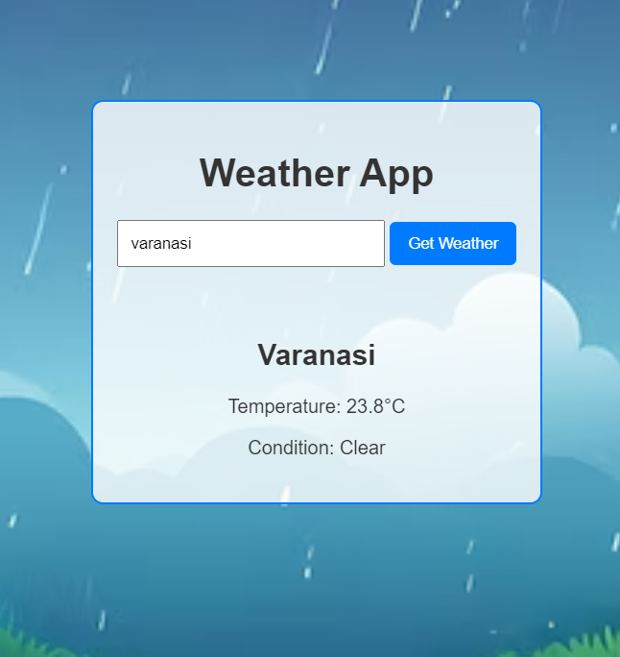
API Integration (Weather)
1
API Selection
Choosing a suitable weather API.
2
API Key
Obtaining and securely storing the API key.
3
Data Fetching
Retrieving and parsing weather data.
4
UI Update
Displaying the fetched data in the app.

Slide 7
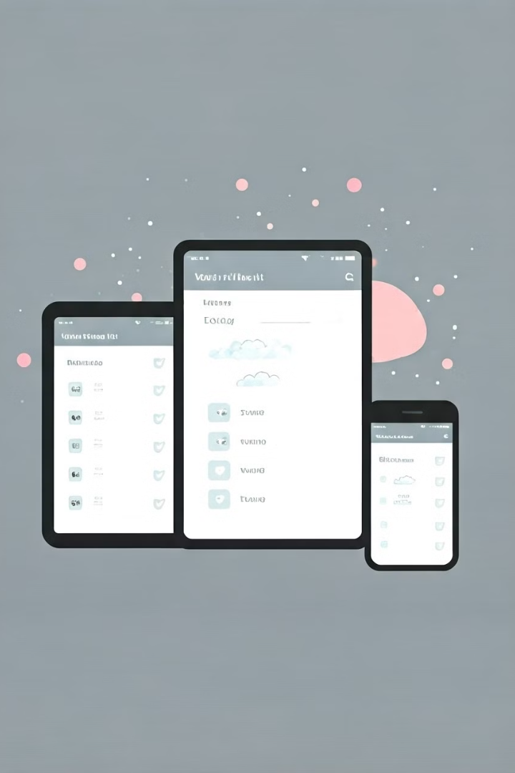


Conclusion:
Innovative Combination
Successfully integrated a weather app and a to-do list,
providing users with essential information and task
management in one place
Real-Time Functionality
The weather app component retrieves live weather data,
giving users updated forecasts for better planning.
Productivity Enhancement
The to-do list helps users stay organized and manage tasks effectively,
making it a valuable tool for day-to-day activities.

