Slide 1

GlucoTwin
A personalised Digital Twin for Type 2 Diabetes that predicts glucose spikes 2 hours before they happen
Team Mavericks · NIT Silchar · Digital Twin Challenge 2026, Happiest Health
Notes:
Introduce the team and the one-line idea: a virtual copy of each diabetic patient that warns the doctor two hours before a glucose spike and lets them test lifestyle changes on the twin first.

Slide 2



Diabetes care in India is reactive
A check-up every 3 months
101M
HbA1c shows the average, not the daily spikes after meals
Indian lifestyle drives spikes
people with diabetes in India (ICMR-INDIAB, Lancet Diabetes & Endocrinology, 2023)
Rice/roti-heavy meals, late dinners, short sleep, low activity
Most of them have Type 2 Diabetes
Data overload
A CGM produces 288 readings a day — no doctor can read them for 500 patients
Notes:
Explain why repeated post-meal spikes above 180 mg/dL matter: they damage eyes, kidneys, nerves and the heart over time, and they are invisible between clinic visits.

Slide 3




Our idea: a living virtual copy of each patient
Static stream
Dynamic stream
Digital Twin
Doctor gets
EHR: age, BMI, HbA1c, labs, meds, TCF7L2 gene
Every 5 min: CGM glucose, heart rate, HRV, steps, sleep, meal log
Fuses both streams + personal physiology model
2-h spike risk, forecast, reasons, alerts, what-if
Proactive, not reactive: act before glucose crosses 180 mg/dL
Notes:
Walk left to right: the two required data streams, the twin that fuses them, and what the doctor sees.

Slide 4
Data: synthetic, privacy-safe, India-specific
Synthetic EHR (FHIR-style)
Simulated wearable + CGM
80 virtual Indian adults with T2D
ICD-10 diagnoses: E11, I10, E78.5
Metformin, glimepiride, basal insulin, statins
HbA1c, FPG, PPBG, lipids, eGFR, urine ACR
Genetics: TCF7L2 rs7903146, family history
14 days × 288 readings/day = 322k rows
CGM with 10-min lag, noise, dropouts
Heart rate, HRV, steps, sleep stages
Meal log: ~70% of meals, ±22% carb error
Late dinners, rice-heavy lunches, festive sweets
Labs are consistent with each patient's simulated glucose (HbA1c from the ADAG formula). No real patient data is used (DPDP Act / HIPAA). The schema maps to Synthea / MIMIC-IV.
Notes:
Mention the sandbox rule: all data is synthetic. Show data/ehr_patients.json and the CSV in the repo during the video.

Slide 5
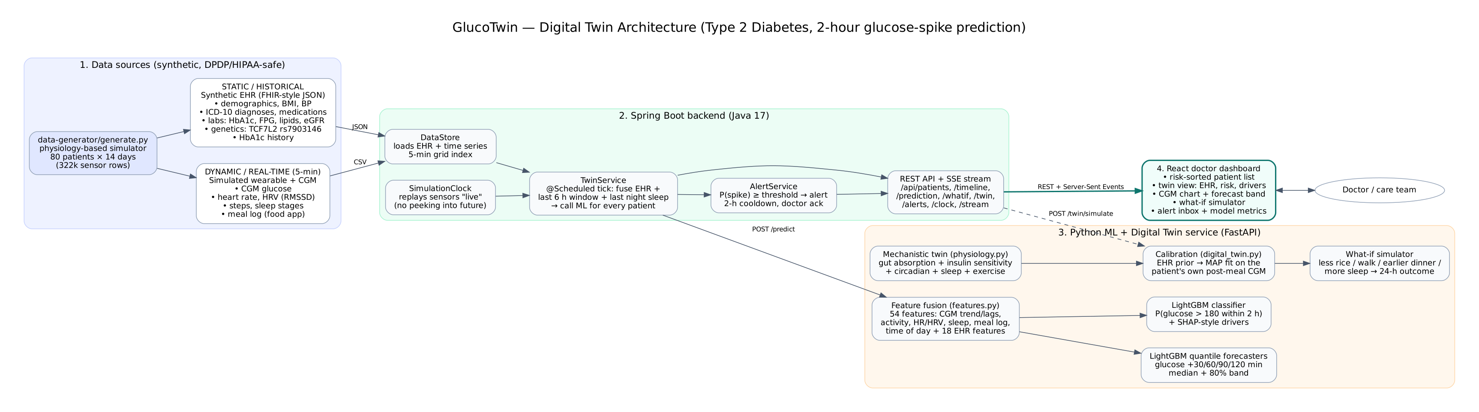
Architecture
Python data generator
FastAPI + LightGBM twin
Spring Boot 3 (Java 17)
React + Recharts
Notes:
The backend replays sensor data on a clock so the twin never sees the future. Every tick it sends each patient's last 6 hours plus EHR to the ML service, and it pushes updates to the dashboard over Server-Sent Events.

Slide 6



Fusion model: 54 features, 3 jobs
17
CGM
Spike classifier
level, lags, trend, variability
LightGBM: P(glucose > 180 within 2 h). Threshold set for ≥ 85% sensitivity on validation patients
16
Wearable + app
steps, HR, HRV, sleep, meals
Glucose forecaster
12 quantile models: +30/60/90/120 min, median + 80% band
18
EHR
HbA1c, BMI, meds, genes
Explanations
3
Time
TreeSHAP contributions grouped into plain words: "carbs logged", "short sleep"
time of day, weekend
Notes:
The same feature function is used in training and live serving, so there is no train/serve skew. The split is by patient: 48 train, 8 validation, 24 test.

Slide 7
The twin: small, explainable physiology
1
EHR prior
carbs → gut (2 stages) → blood
dG/dt = cf·Ra − k·S·(G − Gb) − exercise + stress
S changes with: evening dip · sleep debt · walking
Gb rises with the dawn phenomenon (4–8 am)
FPG → basal glucose; BMI, gene, HbA1c → insulin sensitivity
2
Calibrate
Fit to the patient's own post-meal CGM curves (5 days)
3
Simulate
Run the next 24 h under a doctor's what-if scenario
0.52 → 0.63
0.84 → 0.88
67%
insulin sensitivity: correlation with hidden truth
basal glucose: correlation with hidden truth
patients with a better fit on 2 held-out days
Notes:
This is what makes it a twin, not just a classifier: it has personal physiology parameters that a doctor can read. Be honest that the median post-meal error barely changed (16.4 to 16.8 mg/dL) because many meals are not logged.

Slide 8
Results on 24 patients the model never saw
0.95
AUROC
85.6%
spikes flagged ≥ 30 min early
100 min
median warning time
2.15
false alarms per patient-day
Notes:
Precision 84%, sensitivity 78% at the alert threshold. The forecast roughly halves the error of a 'glucose stays the same' baseline at every horizon. Note the false alarm rate and the 2-hour cooldown that limits alarm fatigue.

Slide 9
Does fusing the two streams help?
Full fusion is best
0.912 vs 0.901 for CGM alone
Works without a CGM
EHR + a basic smartwatch still reach 0.890, useful where CGMs are too costly
Honest note
Gains are small here: short-term glucose is driven mostly by recent CGM values and meal timing
Notes:
HbA1c, steps in the last hour and heart rate above resting are among the top features by gain, so the EHR and wearable streams carry real signal even when the AUPRC difference is small.

Slide 10
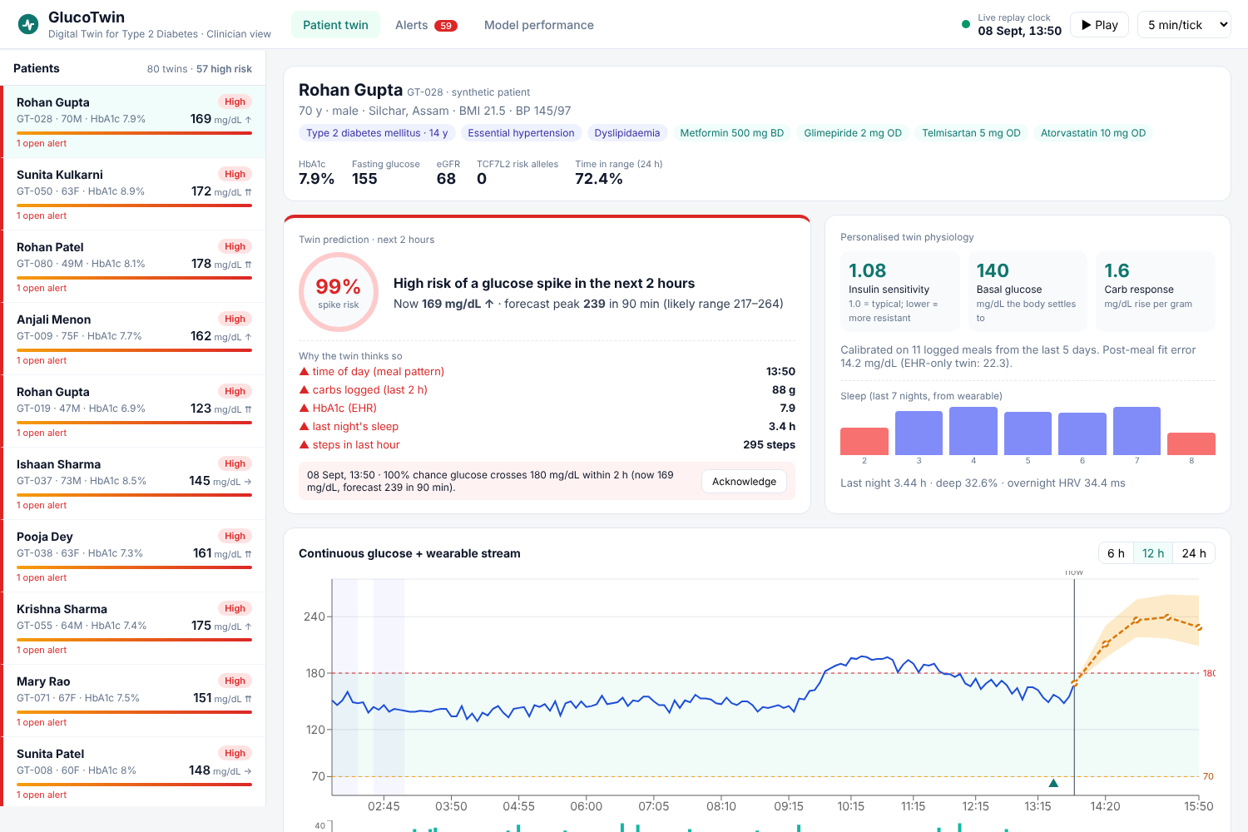
The doctor's view
Risk-sorted list
Highest-risk patients first, with live glucose and trend arrow
2-hour prediction
Probability, forecast peak, and why
Live stream chart
CGM, forecast band, meals, steps, sleep
Alert inbox
Acknowledge with an action note
Notes:
In the video, show the live replay clock moving and a patient turning from LOW to HIGH just after lunch, with the alert toast appearing.

Slide 11
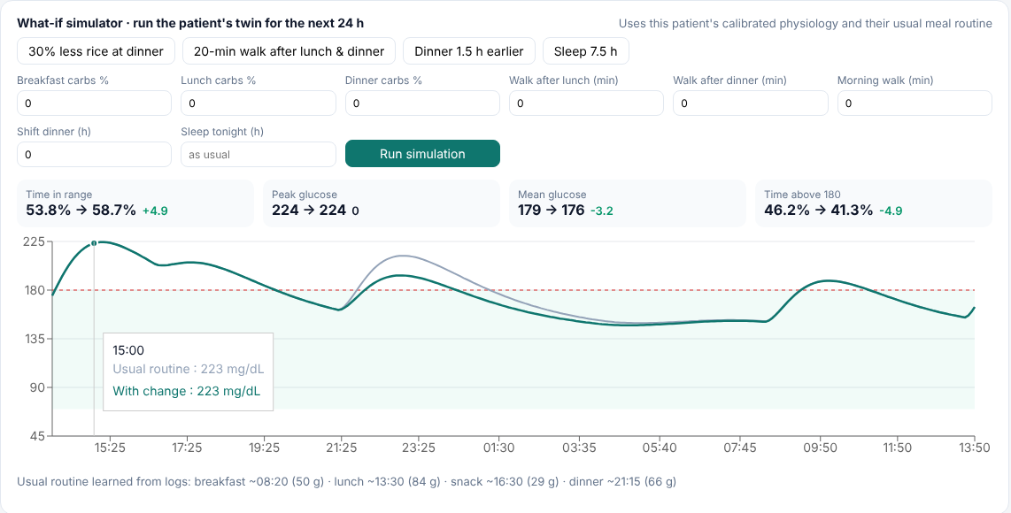
What-if: test advice on the twin first
Example: 30% less rice at dinner
+4.9
percentage points of time-in-range for this patient (53.8% → 58.7%) over the next 24 h
Other levers: post-meal walks, earlier dinner, more sleep, morning walk
Notes:
This turns generic advice into personalised advice: for one patient a walk after lunch helps most, for another an earlier dinner.

Slide 12




Real-world impact and fit for India
Remote monitoring at scale
Prevent, don't treat
One nurse can watch hundreds of twins and act only on alerts
A 15-minute walk advised 90 minutes early can blunt a spike
Low-cost path
Privacy by design
Works with a smartwatch + EHR when a CGM isn't available
Synthetic sandbox now; ABDM/FHIR + DPDP-consent integration next
Notes:
Tie back to Happiest Health's theme: proactive medicine. Mention how it fits telehealth programmes and hospital diabetes clinics.

Slide 13
Limitations and roadmap
1
Validate on real data
Limitations (honest)
CGMacros (PhysioNet): T2D CGM + Fitbit + meals
Synthetic data from the same model family, so the accuracy numbers are optimistic
Unlogged meals limit calibration
Not a medical device; needs clinical validation
2
Meal detection
Infer unlogged meals from CGM rises
3
Integrate
ABDM / FHIR EHR pull with consent
4
Close the loop
Patient nudges + measure spikes prevented
Notes:
Judges value honesty: state clearly what the prototype does not prove yet and how we would prove it.

Slide 14
Thank you
Team Mavericks · NIT Silchar
Raushan Kumar (team leader) · Chaitanya Prasad · EIE, final year
Code under the MIT License · synthetic data only
Notes:
Invite questions. Have the dashboard open and ready for a live demo.

