Slide 1


IOT Based Health Monitoring System
Bangalore Institute of Technology
K.R. Road, V.V. Puram, Bangalore-560004
Department of Electronics and Communication Engineering
MINI-PROJECT PRESENTATION
Under the guidance of:
Presented by
Guide Name - Keshava A
Designation – Assistant professor
Dept. of ECE
BIT.
Name- 1. Munendra Gaur(1BI20EC076)
2. Raushan Singh(1BI20EC110)
3. RAJ (1BI20EC106)

Slide 2
INSTITUTE VISION AND MISSION
Vision:
Providing quality education to achieve Academic Excellence in the core fundamentals of engineering in order to be a globally competent Engineer. To build and grow the institute as a center of higher learning, always on the cutting edge of knowledge in engineering and technology, with entrepreneurial thinking, leadership excellence for life-long success, and the ability to address societal issues.
Mission:
The mission of this reputed institutes constitutes providing exceptionally talented, proficient and prolific engineers that contribute towards the betterment of the society.
1. Offer top-notch instruction in engineering to students at all academic levels, from undergraduate to doctoral, through innovative academic and professional program.
2. Establish the Institute as a global leader in management, science, engineering, and technology.
3. Research and use knowledge for the good of society.
4. Create collaborations that are mutually advantageous with business, alumni, local, state, and federal governments through public service assistance and joint research.
Bangalore Institute of Technology
Dept. of ECE, BIT

Slide 3
DEPARTMENT VISION , MISSION, PEOs, PSOs
Vision :
Providing top-notch instruction to attain academic excellence in electronics and communication engineering for engineers with global competence.
Mission:
• Develop cutting-edge infrastructure for high-quality instruction.
• Encourage creative thinking and problem-solving abilities.
• Providing qualified engineers to suit societal needs.
PEOs:
• PE01: Prepare graduates to be professionals, Practicing engineers an Entrepreneurs in the field of Electronics and communication Engineering.
• PE02: To acquire sufficient knowledge base for innovative techniques in design and development of systems and tools.
• PE03: Capable of competing globally in multidisciplinary field.
PSOs:
• PSO1:The graduates will be able to apply the principles of Electronics and Communication in Core areas.
• PSO2:An ability to use latest hardware and software tool sin Electronics and Communication engineering.
• PSO3:Preparing Graduates to satisfy industrial needs and pursue higher studies with social awareness and universal moral values.
Bangalore Institute of Technology
Dept. of ECE, BIT

Slide 4
Course Outcomes of Mini-Project
1 | Ability to carry-out literature review and define the problem.
2 | Ability to co-ordinate to work as a team member or a single member.
3 | Inculcate methods to use advance tools .
4 | Design analytical modeling and develop a systems
5 | Ability to equip analysis skills and interpretation.
6 | Enhance presentation skills, drafting and documentation of project work.
CO-PO Mapping Table
PO CO | 1 | 2 | 3 | 4 | 5 | 6 | 7 | 8 | 9 | 10 | 11 | 12 | PSO 1 | PSO 2 | PSO 3
1 | 3 | 2 | 2 |  |  | 1 |  | 1 | 1 | 1 |  |  | 2 | 2
2 | 3 | 2 | 2 |  |  | 1 |  | 1 | 1 | 1 |  |  | 2 | 2
3 | 3 | 2 | 2 |  | 3 |  |  | 1 | 1 | 1 |  |  | 2 | 2
4 | 3 | 2 | 2 |  | 3 | 1 |  | 1 | 1 | 1 |  |  | 2 | 2
5 | 3 | 2 | 2 |  | 3 | 1 |  | 1 | 1 | 1 |  |  | 2 | 2
6 | 3 |  |  |  | 3 |  |  | 1 | 1 | 1 | 2 |  | 2 | 2
Bangalore Institute of Technology
Dept. of ECE, BIT

Slide 5
CONTENTS
1. Title of Mini Project
2. INSTITUTE VISION AND MISSION
3. DEPARTMENT VISION , MISSION, PEOs, PSOs
4. Course Outcomes of Mini-Project
5. Abstract
6. Content
7. Introduction
8. Literature Survey
9. Objective
10. Methodology
11. Implementation And Design
12. Results and Observation
13. Conclusion
14. Future Work
15. References
Bangalore Institute of Technology
Dept. of ECE, BIT

Slide 6
ABSTRACT
When we were presented with the opportunity to prepare a mini project, a plethora of ideas were coming in our mind. Finally, we decided to create a project dedicated towards the health sector. We employed the ESP 32 microcontroller and Arduino programming to prepare an excellent health monitoring system.
1. A project called an IoT-Based Health Monitoring System seeks to give people an easy way to keep track of their health condition via a web-connected gadget. Various health sensors, an IoT capable microcontroller such the ESP32, and a web server make up the system.
2. The initiative makes use of the Internet of Things' (IoT) capabilities to give customers direct access to their health data from any location at any time. The system gathers real-time health information from the user with the aid of sensors including temperature, heart rate, and blood pressure sensors.
3. The data is processed by the microcontroller before being sent to the web server, where it is saved and presented to the user via a web-based interface. Any internet-connected device can be used by the user to access the interface.
Bangalore Institute of Technology
Dept. of ECE, BIT

Slide 7
INTRODUCTION
An Internet of Things (IoT)-based health monitoring system is a project that uses IoT technology to build a system that can track and monitor a person's health state in real-time. This system includes a web server, a microcontroller with IoT capabilities, and a variety of sensors.
The main goal of the project is to offer people a quick and simple way to check on their health at any time, anyplace. To gather real-time health information from the user, the system makes use of sensors including temperature, heart rate, and blood pressure sensors. Following processing, the user can view the data on a web-based interface after it has been transferred to a web server for storage.
By gathering and analysing the data from the sensors, the IoT-enabled microcontroller contributes significantly to the system. The microcontroller is an essential part of the whole system since it interacts with the web server to deliver and receive data and commands. The web server acts as the central location for the collection, processing, and storage of all health data.
Bangalore Institute of Technology
Dept. of ECE, BIT

Slide 8
LITERATURE SURVEY
The use of IoT technology in the healthcare sector is gaining popularity due to its potential to revolutionize the way healthcare services are delivered. Several studies have been conducted on the development and implementation of IoT-Based Health Monitoring Systems, and here are some of the key findings:
1. In a study published in 2018, M. N. Nour et al. suggested a system that made use of IoT technology to track patients' health in real-time. The system was created to keep track of vital signs including blood pressure and heart rate and to notify medical professionals of any irregularities.
2. A system that employed IoT technology to track patients' health in real-time and convey the information to healthcare practitioners was suggested in a paper by M. A. Al-Bayati et al. (2019). The system was made to gather information from a variety of sensors, including those that measure blood pressure, temperature, and glucose levels, and transfer the information to a cloud server for analysis.
Overall, the research indicates that IoT-Based Health Monitoring Systems have the potential to enhance healthcare delivery by allowing healthcare practitioners to give timely interventions and providing real-time monitoring of patients' health state. However, more investigation is required to address concerns with data security and privacy as well as to improve the precision and dependability of these systems.
Bangalore Institute of Technology
Dept. of ECE, BIT

Slide 9
OBJECTIVES
The main objective of an IoT-Based Health Monitoring System project is to develop a system that can monitor a person's health status in real-time using IoT technology. Here are some specific objectives of the project:
1. To design a system that can collect and process health data from various sensors, such as temperature, heart rate, and blood pressure sensors.
2. To develop an IoT-enabled microcontroller that can communicate with the sensors, process the data, and send it to a web server.
3. To create a web server that can receive the data from the microcontroller, store it, and display it to the user on a web-based interface.
4. To provide a user-friendly interface that allows the user to monitor their health status and receive alerts in case of any anomalies.
Overall, the main goal of the project is to provide a reliable and efficient way for users to monitor their health status using IoT technology and enable healthcare providers to deliver timely interventions to improve the user's health.
Bangalore Institute of Technology
Dept. of ECE, BIT

Slide 10
METHODOLOGY
Here are the steps to run an IoT-Based Health Monitoring System on ESP32 Web Server:
Hardware setup: Connect the ESP32 microcontroller to the health sensors, power source, and any other required hardware components.
Software setup: Install the Arduino Integrated Development Environment (IDE) on your computer and connect the ESP32 microcontroller to your computer using a USB cable. In the Arduino IDE, select the appropriate board and port for the ESP32 microcontroller.
Programming: Write the code for the ESP32 microcontroller using the Arduino programming language. This code should include functions to read data from the health sensors, establish a WIFI connection, start a web server, and handle HTTP requests from the web server. You can use the Web Server library to build the web server and handle HTTP requests.
Uploading the code: Upload the code to the ESP32 microcontroller using the Arduino IDE. Once the code is uploaded, the microcontroller will start collecting data from the sensors and sending it to the web server.
Web interface: Create a web interface that displays the data collected by the ESP32 microcontroller. You can use HTML, CSS, and JavaScript to build the web interface. The web interface should be responsive and accessible from any device connected to the same network as the ESP32 microcontroller.
Data processing: Process the data collected by the ESP32 microcontroller to display it on the web interface. You can use PHP, Python, or any other programming language to process the data.
Bangalore Institute of Technology
Dept. of ECE, BIT

Slide 11
IMPLEMENTATION & DESIGN
A number of elements and procedures go into the installation and design of an IoT-Based Health Monitoring System. The system's implementation and design have the following important components:
Hardware: The system's hardware consists of a power source, a temperature, heart-rate, and blood-pressure sensor, as well as a microcontroller with IoT capabilities. The sensors are connected to the microcontroller, which then processes the data and sends it to a web server.
Software Components: The system's software consists of the Webserver library, which is used to create the web server, and the Arduino programming language, which is used to programme the microcontroller. The microcontroller can gather sensor data, process it, and send it to the web server thanks to the programming code. The data is received by the web server, stored there, and then made available to the user via a web-based interface.
Data gathering and processing: The microcontroller receives data from the sensors on several health indicators, including temperature, heart rate, and blood pressure. The user sees the data on a web-based interface once the microcontroller processes it and transmits it to the web server, where it is stored.
Bangalore Institute of Technology
Dept. of ECE, BIT

Slide 12
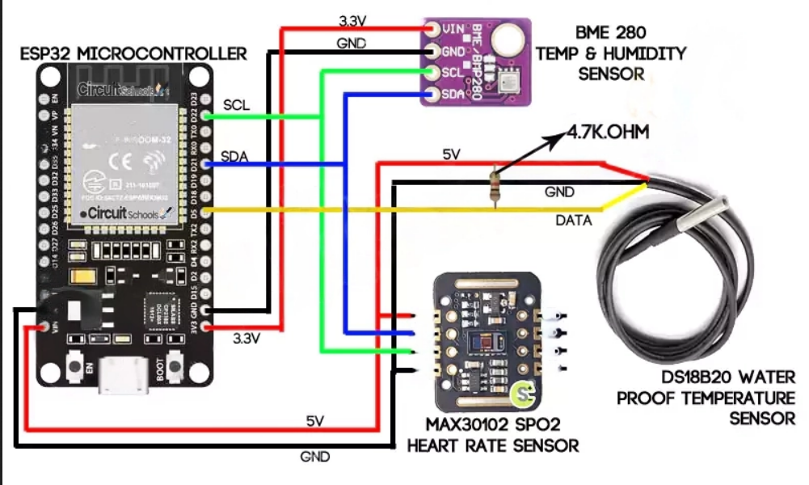
IMPLEMENTATION & DESIGN
Figure demonstrating circuit diagram of the health monitoring system:
Bangalore Institute of Technology
Dept. of ECE, BIT

Slide 13
IMPLEMENTATION & DESIGN
Data collection and processing: The microcontroller receives data from sensors on several health indicators such as temperature, heart rate, and blood pressure. After the microcontroller processes the data and transfers it to the web server, where it is stored, the user sees it on a web-based interface.
Web-based Interface: The web-based interface allows the user to check their health status and receive notifications if something goes wrong. The interface shows real-time statistics on a variety of health factors and allows the user to watch their progress over time. Any device connected to the same network as the microcontroller can access the interface.
Security and privacy: The system must ensure that the user's data is secure and private. This entails putting in place safeguards such as data encryption, user authentication, and secure communication protocols.
Evaluation and Testing: The system should be rigorously tested to confirm its correctness, dependability, and usefulness in real-time monitoring of a person's health state.
Overall, careful consideration must be given to different hardware and software components, data collection and processing, web-based interface design, security and privacy measures, assessment, and testing when developing and implementing an IoT-Based Health Monitoring System.
Bangalore Institute of Technology
Dept. of ECE, BIT

Slide 14
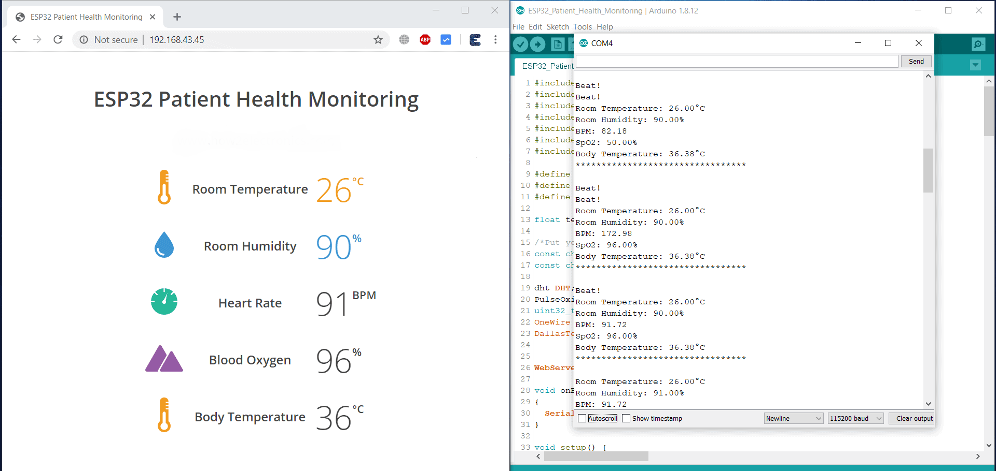
RESULTS & OBSERVATIONS
Figure demonstrating operation of health operating system through Arduino Programming:-
Bangalore Institute of Technology
Dept. of ECE, BIT

Slide 15
CONCLUSION
By providing remote monitoring, real-time data processing, and customised healthcare services, an IoT-based health monitoring system with an ESP32 web server has the potential to revolutionize healthcare. A reliable platform for gathering, examining, and exchanging health data from numerous sensors and devices is made possible by the ESP32 microcontroller's web server capabilities. By utilizing this technology, medical practitioners are able to follow patients' health status, remotely monitor their vital signs, and take immediate action as required. Contrarily, patients can gain from ongoing health monitoring, personalized healthcare recommendations, better illness treatment, and early discovery of abnormalities.
Some critical features can help to enhance the IoT-based health monitoring system on an ESP32 web server. These include ensuring data security and privacy, implementing real-time monitoring and alerts, implementing advanced analytics and machine learning algorithms, integrating with wearable devices for additional data inputs, improving user interfaces for a better user experience, optimizing power consumption for battery-powered devices, fostering interoperability and standardization, addressing ethical and privacy concerns, and developing long-term data strategies. By addressing these areas for improvement, IoT-based health monitoring systems will continue to expand and grow, becoming more dependable, secure, and efficient at providing customised healthcare. IoT, ESP32, and web server technologies have the capacity to transform healthcare delivery, improve patient outcomes, and give people more control over their own health.
We would like to express our sincere gratitude to our respected HOD Dr. Hemanth Kumar A R and reputed principal Dr. Aswath M.U. for giving us this fantastic chance to showcase our talent via this small project. We also acknowledge the valuable contributions of our project guide Asst. Professor Keshava A and co-evaluator Associate Professor Pushpajalli J. Without their help, this project would have remained only a notion. We really hope that we exceeded their expectations.
Bangalore Institute of Technology
Dept. of ECE, BIT

Slide 16
FUTURE WORK
More research and developments in the field of IoT-based health monitoring systems are conceivable on an ESP32 web server. Here are some suggestions:
Strengthen the system's security mechanisms to protect personal health information: Use MQTT or HTTPS for secure and authorized communication. You must also consider access controls, user authentication, and authorization processes to ensure that only those with permission may access the system.
Enhance the system with real-time monitoring and instant alerts, enabling healthcare professionals to receive timely notifications in critical or emergency situations. Implement advanced algorithms to analyze sensor data and generate alerts based on predefined thresholds or trends.
Ensure seamless integration with cloud services to enhance scalability, data storage, and leverage advanced analytics capabilities. Connecting the application to cloud platforms enables easy access to health information and enables data synchronization across devices from anywhere, anytime.
Address privacy and ethical concerns associated with IoT-based health monitoring devices by implementing robust measures. Develop proper permission processes, anonymization techniques, and privacy policies to safeguard patient information and comply with relevant regulations like GDPR or HIPAA.
The following are only a few of the potential options for IoT-based health monitoring systems on an ESP32 web server. The particular emphasis areas may be influenced by the targeted clients, intended use, and resource availability.
Bangalore Institute of Technology
Dept. of ECE, BIT

Slide 17
REFERENCES
We took references from various textbooks, links and YouTube links to study the various components used in the health monitoring system. First, we studied the concepts of the ESP 32 microcontroller from the internet and then we studied about the various fundamentals of Arduino Programming. The various links and youtube videos which we used have been given below:
- https://www.techtarget.com/iotagenda/definition/Internet-of-Things-IoT#:~:text=The%20internet%20of%20things%2C%20or,human%2Dto%2Dcomputer%20interaction.
- https://www.geeksforgeeks.org/introduction-to-internet-of-things-iot-set-1/
- https://www.simplilearn.com/iot-devices-article#how_do_iot_devices_work
- Designing the Internet of Things by Adrian McEwen and Hakim Cassimally is a good primer on how to plan, design and build a connected product. It also describes how to prototype various aspects of the product.
- Internet of Things: Converging Technologies for Smart Environments and Integrated Ecosystems (River Publishers' Series in Information Science and Technology) (1 Jun 2013) Editors Ovidiu Vermesan & Peter Friess
- https://www.youtube.com/watch?v=h0gWfVCSGQQ&t=4716s
Bangalore Institute of Technology
Dept. of ECE, BIT

Slide 18
REFERENCES
- https://www.youtube.com/watch?v=Hl6XAHeX9y0
- https://predictabledesigns.com/how-to-use-esp32-wireless-microcontroller-with-arduino-ide/
- https://all3dp.com/2/esp32-vs-arduino-differences/
- https://www.researchgate.net/figure/Arduino-format-ESP32-MCU-board_fig3_350110802
- https://www.youtube.com/watch?v=1R3fqSFCAjM
- https://www.tutorialspoint.com/arduino/arduino_temperature_sensor.html
- https://www.tutorialspoint.com/arduino/arduino_humidity_sensor.html
- https://electropeak.com/learn/interfacing-max30102-pulse-oximeter-heart-rate-module-with-arduino/
- https://circuitdigest.com/microcontroller-projects/how-max30102-pulse-oximeter-and-heart-rate-sensor-works-and-how-to-interface-with-arduino
- https://www.youtube.com/watch?v=V5UvNVQsUsY
- https://www.youtube.com/watch?v=0rsHJbog6dk
- https://www.electroduino.com/ds18b20-waterproof-temperature-sensor/
- https://randomnerdtutorials.com/guide-for-ds18b20-temperature-sensor-with-arduino/
- https://www.youtube.com/watch?v=hIkUQZuaTE4
- https://www.infineon.com/cms/en/product/sensor/co2-sensors/pasco2v01/?gclid=Cj0KCQjwu-KiBhCsARIsAPztUF3uEc52ed2oZlIiOiw3bLPrbJS6mPB1M79hyZuokBTniNPbU7uSVcIaAktGEALw_wcB&gclsrc=aw.
Bangalore Institute of Technology
Dept. of ECE, BIT

Slide 19
THANK YOU
Bangalore Institute of Technology
Dept. of ECE, BIT

