Slide 1


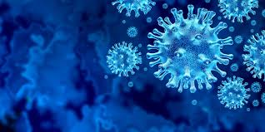
Understanding The Problem Statement Given : - A dataset containing the number of daily new confirmed COVID-19 cases county wise from 22/01/2020 till 30/01/2021. The dataset also contains several other parameters such as deaths, population data mobility reports ,etc. leading to a total of 83 parameters. Task : - To develop a time series model to forecast daily COVID-19 cases county wise based on the given features.
EXL EQ ROUND – 2
Team HACKELITE
(NIT JAMSHEDPUR)

Slide 2
SOLUTION DESIGN
DATA PRE-PROCESSING
MODEL DEVELOPMENT
1.
2.
Data analysis
3.
Data visualisation
Data cleaning /Handling missing values
1.
Model Training
2.
Model Evaluation/Testing
3.
Making predictions

Slide 3



Forecasting/Modelling Tool Development Process
Tools :-
Python
Numpy
Pandas
Matplotlib
Seaborn
Statsmodels
Additional Analysis tools :-
SEIR based models , Scipy , lmfit.
Model Development Process :-
Group data by county.
Perform granger causality test to check the effect of features on confirmed cases.
Select features where null hypothesis is rejected i.e. (p<=0.05).
Perform Adfuller test to check stationarity.
Fit a vectorized form of Auto Regressive Model (VAR).
Time lag parameter tuning.
Evaluate on validation and make forecasting on test set.

Slide 4
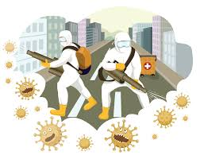
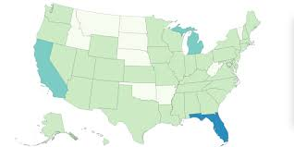
Top Drivers Of The Model
Deaths
Google mobility reports
test_count
test_rate
hospital_onset_covid_SD
Previous day admission records
Total hospitalized , suspected & confirmed covid cases
Beds utilization
Top 5 States Expected to be worst affected by COVID-19 pandemic by 30th April 2021 considering the population demographics
In terms of maximum confirmed cases :-
California , Texas , Florida , New York , Illinois
In terms of deaths :-
California , Texas , Florida , New York , Pennsylvania
In terms of maximum percentage of people affected :-
Wyoming , North Dakota , South Dakota , Alaska , West Virginia
In terms of maximum death percentage :-
Maine , Kentucky , Oklahoma , Oregon , Vermont.

Slide 5
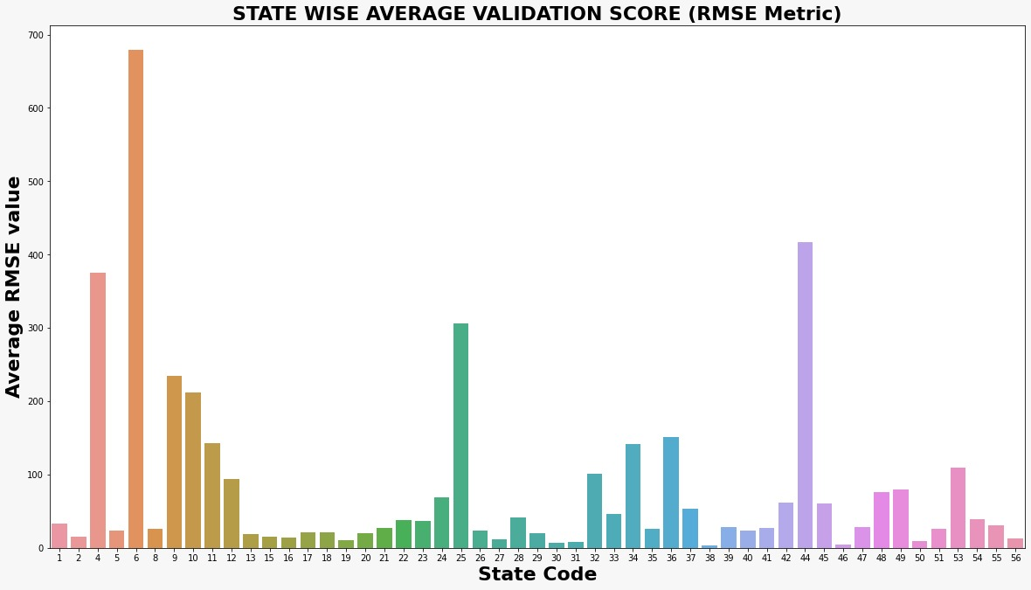
Validation Results
( from 11-01-2021 to 30-01-2021)
(Confirmed Cases)
Percentage of people with major ailment/illness history
County wise education/literacy rate
Vaccination rate
Health infrastructure rating county wise
Quarantine period and number of people quarantined.
Additional Variables that could have been used to improve prediction accuracy

Slide 6
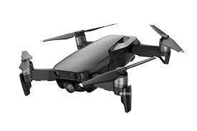
Vaccination Strategy
Vaccination Using Drones
The ultra-cold temperatures required for storing some Covid-19 vaccines like pfizer or mordana in US create logistical challenges for medical facilities. The use of drones could be a pioneering step for medical supplies, often in hard to reach, less developed regions.
Firstly we’ll be creating an application where all citizens have to register and give their details like their county, age, economic status ,any previous disease (mention if any),etc.
The vaccine will first reach every state through air and then the drones will move it forward to every vaccination centre
If possible drones will carry vaccines directly from it's industry.
OR
Based on the provided details, some people will be filtered daily for vaccination who are at high risk. This filtering can be done either by health care experts or a Machine Learning model which will be trained on past data. Those people will be notified through SMS or E-mails.
Every county will have its own vaccination centres under national vaccination campaign where people will come for vaccination. The vaccines will reach those centres by the drone system.

