Slide 1

WIPRO CAPSTONE PROJECT
Selenium PyTest and Behave BDD Automation Frameworks
Project Title:
Apollo 24/7 (Healthcare)
Team Members:
Raushan Kumar
Amman Farooque
Advitiya Raj
Kiran Sakthivel A
Gadi Teja Sai Manikanta
Mohan Nandamuri

Slide 2
Introduction
Project Objective: Develop a robust, automated testing framework for the Apollo 24/7 Healthcare platform to ensure reliable user journeys.
Modules in Scope: End-to-end testing for core functionalities including Health Monitors, Buy Medicines, Cart Management, and Checkout workflows.
Framework Architecture: Designed a Hybrid Framework combining Page Object Model (POM), Behavior Driven Development (BDD), and Data-Driven Testing.
Technology Stack: Built using Python, Selenium WebDriver, Pytest, and Behave BDD, ensuring scalable and maintainable test execution.
Collaborative Effort: A unified team approach to implement modular page objects, reusable utilities, and comprehensive reporting.

Slide 3
Apollo Automation
10
8
2
Health Monitors · Capstone Project
Test Scenarios
Positive Cases
Negative Cases
PyTest + BDD
Login, cart, categories
Fake category + invalid product
Raushan Kumar | 5531902 | Apollo Pharmacy
FRAMEWORK LAYERS
✓ POSITIVE TEST SCENARIOS
✕ NEGATIVE TEST CASES
TEST
✓
End-to-End: Login → Health Monitors → Cart → Proceed
✕
Fake Category — should not be visible on the page
test_e2e.py | test_positive_negative.py
PAGES
✓
Login with valid mobile number + manual OTP verification
✕
Invalid Product — should not be present in DOM/page text
LoginPage | Shop By Category Page | BasePage
✓
Open Health Monitors category and verify URL
UTILS
KEY METHODS — Shop By Category Page
LogGen | Screenshot Util | CSVReader | ConfigReader
✓
Apply Doctor S Choice brand filter successfully
add_exact_product_to_cart_with_retry()
CONFIG
✓
Add exact product and verify same item in cart
Retry logic + product-name verification in cart
conftest.py | config.properties | CSV data
click_proceed_button()
Visible text/title based click + next-step validation
BDD
environment.py | Feature Files + Steps
AUTOMATION WORKFLOW
1
2
3
4
5
6
Read CSV
Open Browser
Login OTP
Apply Filter
Add Cart
Allure Report
Selenium · Pytest · Behave BDD · Allure · POM · Chrome WebDriver
login/category data
Chrome driver
manual OTP
Doctor's Choice
verify product
logs + screenshots
Apollo 247 Automation · Selenium PyTest + Behave BDD · Allure Evidence
Capstone Project

Slide 4
Apollo Automation
10
8
2
Buy Medicines · Capstone Project
Test Scenarios
Positive Cases
Negative Cases
PyTest + BDD
Login, cart, categories
Invalid Login+ invalid product
Amman Farooque | 4289621 | Apollo Pharmacy
FRAMEWORK LAYERS
✓ POSITIVE TEST SCENARIOS
✕ NEGATIVE TEST CASES
TEST
✓
End-to-End: Login → Searches Medicines → Cart → Proceed to Pay
✕
Invalid Login Validation
test_e2e.py | test_all.py
PAGES
✓
Login with valid mobile number + manual OTP verification
✕
Invalid Medicine — should not be present in DOM/page text
BasePage | LoginPage | SearchMedicinePage | CartPage
✓
Open Pharmacy Page and verify URL
UTILS
KEY METHODS — BuyMedicinePage
LogGen | ScreenshotUtil | CSVReader | ConfigReader
✓
Valid Medicine Search Add to art
Login & OTP Validation
CONFIG
✓
Verify Product and Checkout to Pay
Mobile logic + OTP validation + Invalid logic handling
conftest.py | config.properties | CSV data
Checkout & Payment Validation
Product-name Verification in Cart
BDD
environment.py | Feature Files + Steps
AUTOMATION WORKFLOW
1
2
3
4
5
6
Read CSV
Open Browser
Login OTP
Valid Search
Add Cart
Allure Report
Login/Product data
Chrome driver
Manual OTP
Result Validation
Verify product
Logs + Screenshots
Selenium · Pytest · Behave BDD · Allure · POM · Chrome WebDriver
Apollo 247 Automation · Selenium PyTest + Behave BDD · Allure Evidence
Capstone Project

Slide 5
10
8
2
Apollo 24/7 Automation
Test Scenarios
Positive Cases
Negative Cases
Healthcare Appointment Booking
PyTest + BDD
LDoctor search, appointment booking, slot validation
Invalid doctor search + unavailable slot validation
Advitiya Raj| 5393203 | Apollo Pharmacy
FRAMEWORK LAYERS
✓ POSITIVE TEST SCENARIOS
✕ NEGATIVE TEST CASES
TEST
✓
End-to-End: Login → Find Doctor → Book Appointment
✕
Invalid doctor search — should not display results
test_e2e.py | test_positive_negative.py
PAGES
✓
Login with valid mobile number + OTP verification
✕
Unavailable slot — booking should not proceed
LoginPage | FindDoctorPage | AppointmentPage | BasePage
✓
Open Find Doctors page and verify navigation
UTILS
KEY METHODS —FindDoctorPage
LogGen | ScreenshotUtil | CSVReader | ConfigReader
✓
Search doctor by specialization/name successfully
search_doctor_with_retry()
CONFIG
✓
Select appointment slot and validate workflow
Retry logic + dynamic search handling
conftest.py | config.properties | CSV data
select_appointment_slot()
Slot selection + booking workflow validation
BDD
environment.py | Feature Files + Steps
AUTOMATION WORKFLOW
1
2
3
4
5
6
Read CSV
Open Browser
Login OTP
Search Doctor
Book Appointment
Allure Report
doctor/search data
Chrome driver
manual OTP
specialization/Location
select slot + validate
logs + screenshots
Selenium · Pytest · Behave BDD · Allure · POM · Chrome WebDriver
Apollo 247 Automation · Selenium PyTest + Behave BDD · Allure Evidence
Capstone Project

Slide 6
Apollo 24/7
Automation Framework
Kiran Sakthivel A · 5304127 Wipro Capstone Project
18 Total Test Cases PyTest + Behave BDD
8 Positive Cases Passed Page load, filter, sort
8 Negative Cases Validated Invalid login, url handling
2 End-to-End Scenarios Full checkout workflows covered
FRAMEWORK OVERVIEW
✓ POSITIVE TEST SCENARIOS
✗ NEGATIVE TEST SCENARIOS
✓ Valid Lab Booking (E2E): Given user launches Apollo 24/7 web application → When user navigates to Popular Health Checkup → And adds package and enters details → Then pay screen displays successfully.
✓ Popular Health Packages Load: Dynamic health packages listings load dynamically on main page with correct details.
✓ Apply Category Filters: Selects specific health categories (e.g. Men's Health) & filters search records.
✓ Sort Pricing High to Low: Sorts packages correctly by low-to-high / high-to-low pricing filters.
✓ View Package details (PDP): Clicks card title → opens PDP details screen → validates prices show ₹ symbol.
✗ Invalid Login Mobile Validation: Rejects phone number <10 digits, blocking OTP login popups.
✗ Invalid Category URL: Navigates to bogus category URL and handles page error gracefully.
✗ Duplicate Add to Cart Handling: Gracefully blocks duplicate items from lists from adding to cart again.
✗ Cart Checkout Without Patient: Blocks checkout from cart details page if no patient is selected.
TEST AUTOMATION:
End-to-End UI testing using Selenium WebDriver and Python.
BDD FRAMEWORK:
Behavior Driven Development using Behave and Gherkin Syntax.
TEST DATA ENGINE:
CSV parameterized data loader without variables hardcoding.
REPORTING:
Allure Reports with details and automated failure screenshots.
DESIGN PATTERN:
Page Object Model (POM) structure for clean script separation.
LOGGING:
Rotating daily logging execution logs for robust debugging.
KEY METHOD VALIDATIONS
• Login & OTP Validations • Cart & Quantity Validations
• Category & Filter Validations • Checkout & Payment Validations
BDD & PYTEST AUTOMATION WORKFLOW
1
2
3
4
5
6
Python · Selenium · Behave · Allure
User Login OTP verification via mobile number.
Lab Navigation Browse & search popular health checkups.
Package Select Filter packages & sort by price listings.
Cart Verify Add checkup package & validate cart details.
Patient & Slot Select patient address & collection schedule.
Checkout Pay & Allure Reports Validate proceed button & checkout pay screen. Generate reports and launch visual interactive dashboards.
Project: Apollo 24/7 - Lab Tests Booking | Framework: POM + BDD + Data Driven | Result: Reliable · Reusable · Maintainable

Slide 7
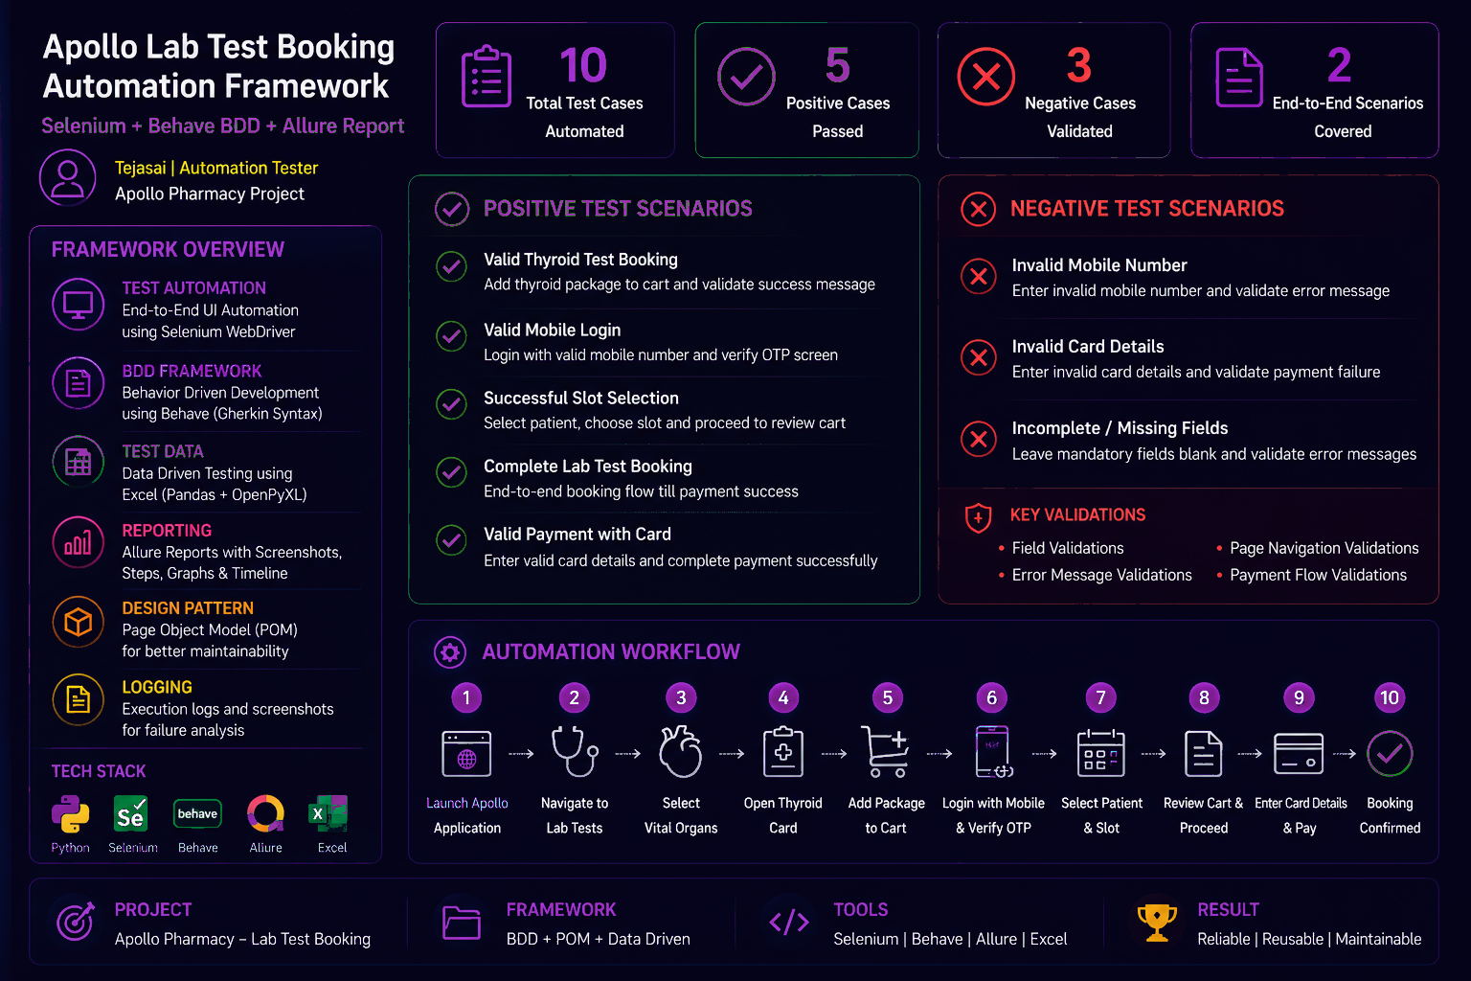

Slide 8
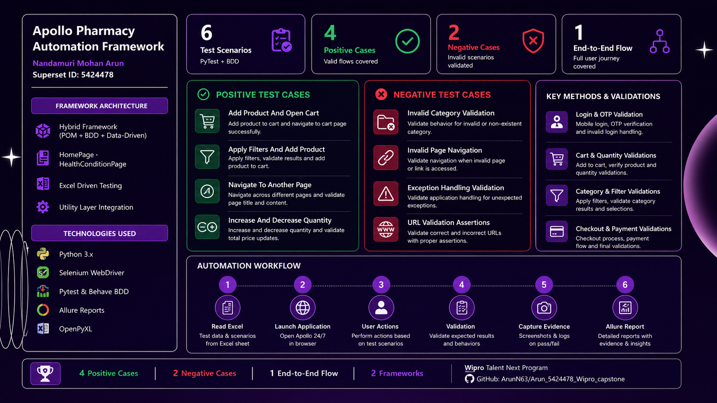

Slide 9
Conclusion
Successful Delivery: Automated end-to-end user journeys for the Apollo 24/7 platform across all core modules.
Robust Architecture: Built a scalable Hybrid Framework (POM + BDD + Data-Driven) using Python, Selenium, and Pytest.
Comprehensive Coverage: Successfully validated both positive and negative scenarios using Excel and CSV test data.
Clear Visibility: Integrated Allure Reports to provide detailed execution logs, screenshots, and easy failure analysis.
Final Outcome: Delivered a highly reliable, reusable, and maintainable test automation solution.

Slide 10
Thank You

