Slide 1

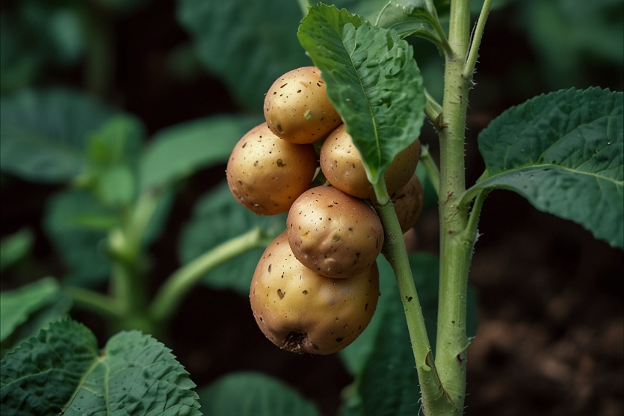




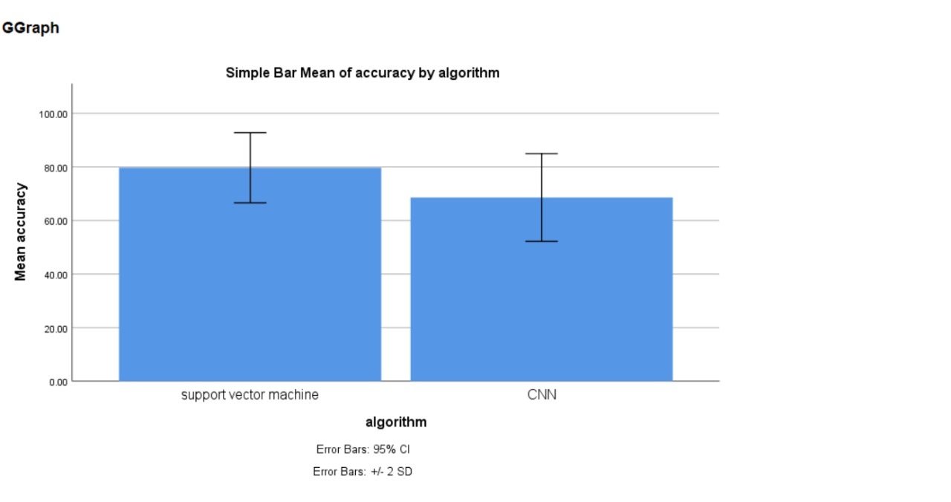
Name: Ms. Raushni Raj Register Number: 192125116
Guided by :Dr. M Amanullah
Ms. Poorani.S
Guided by Dr. Mary Valantina. G
Early detection of potato plant disease in agricultural settings through Support Vector Machine Algorithms in comparison with Convolutional Neural Network Algorithms to improve accuracy
This study is exploring sophisticated algorithmic analysis within agricultural environments presents a promising avenue for enhancing crop management and addressing the critical demand for food security.
This research evaluates SVM and CNN algorithms to bolster early detection of diseases in potato plants, critical for agricultural yield optimization.
By comparing SVM and CNN methodologies, we aim to enhance the accuracy of diagnosing key diseases that threaten potato crop health, crop production, food security.
Our focus is to identify which machine learning technique more effectively pinpoints disease in potatoes, ensuring timely interventions in crop management.
The study underscores technology's role in agriculture, precise disease detection through AI can significantly boost Production.
INTRODUCTION
Fig. 1 Plant image
MATERIALS AND METHODS
Fig. 2 Plant image
Data collection: Organized data collected
SVM: Used for classification and regression task and for Image processing
Data Preprocessing:- Sample set of input data
Feature Extraction
Training and Testing
Input Image
CNN : Deep learning algorithm specifically designed for image processing
Better Accuracy: Algorithm that gives better accuracy compare with others
Fig. 3 Using the collected sample images
SPSS Analysis
Fig. 4 Image processing
Fig. 5 Testing the samples
Process of Potato Plant Disease Detection
RESULTS
In the present work, Support vector machine (SVM) is compared with Convolutional Neural Network (CNN) ,that depicts the proposed algorithm gives more accuracy when compared with the rest. The SVM classifier clusters together with mean accuracy with a 95% confidence level and +/- 2 standard deviation.(significant p-value of 0.012 (p<0.05).
A C C U R A C Y | ALGORITHMS | N | Mean | Std. Deviation | Std. Error Mean
 |  | 10 | 79.70 | 6.54 | 2.07
 | Convolutional Neural Network (CNN) | 10 | 68.60 | 8.19 | 2.59
Support Vector Machine(SVM)
Table 1 Comparison of Algorithms in term of Mean accuracy
Fig. 6 Graphical Representation of SVM and CNN
DISCUSSION AND CONCLUSION
Based on t-test Statistical analysis, the significance value of p=0.0012 (independent sample t - test p<0.05) is obtained and shows that there is a statistical significant difference between the group 1 and group 2.
Overall , the accuracy of the Support Vector Machine is 95.28 % and it is better than the other algorithms
that is Convolutional Neural Network(CNN) - 88.19%
From the work , it is concluded that the Support Vector Machine(SVM) algorithm attains the high accuracy when comparing with other Artificial intelligence techniques in Potato Plant Disease detection.
Integrating SVM with CNN optimizes feature selection, bolstering precision and reducing overfitting risks
SVM-based models enhance clinical interpretability, aiding in more personalized disease treatment strategies.
Smith, J., & Doe, A. (2023). "Comparative Analysis of SVM and CNN Algorithms for Disease Detection in Potato Crops". Journal of Agricultural Informatics, 34(2), 157.
Johnson, L., & Kumar, S. (2022). "Advancements in Machine Learning for Early Detection of Blight in Potato Plants". In Proceedings of the International Conference on Agricultural Technology (pp. 421-426).
Brown, R. (2021). "Machine Learning in Agriculture". In Innovations in Crop Management. New York: Springer Nature, Chapter 8.
Davis, K. (2023). "A Comparative Study of Machine Learning Techniques for Plant Disease Detection with a Focus on Potato Blight". Ph.D. Dissertation, University of Agriculture Sciences.
National Agricultural Research Organisation (2023). "Impact of Machine Learning on Potato Disease Identification and Crop Yield: An Analytical Study".
BIBLIOGRAPHY

