Slide 1

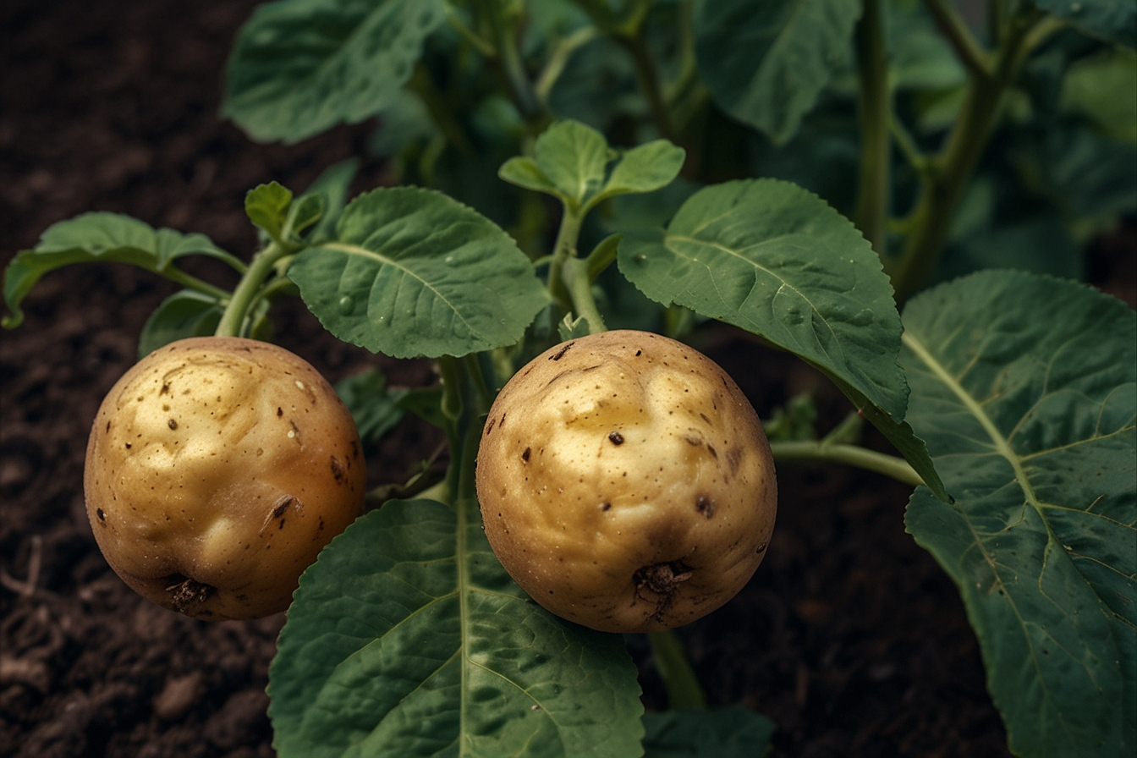
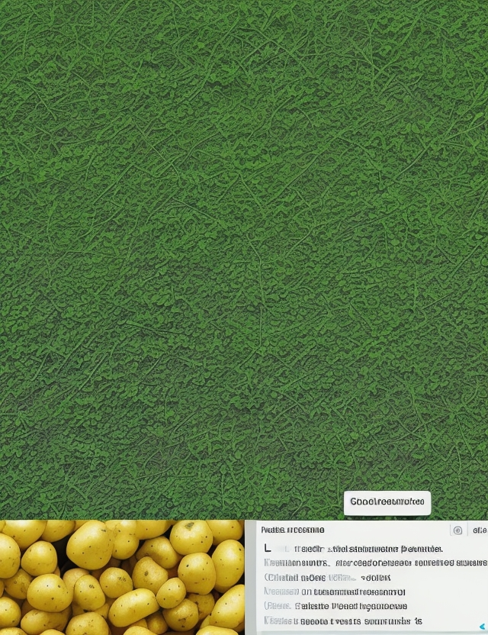
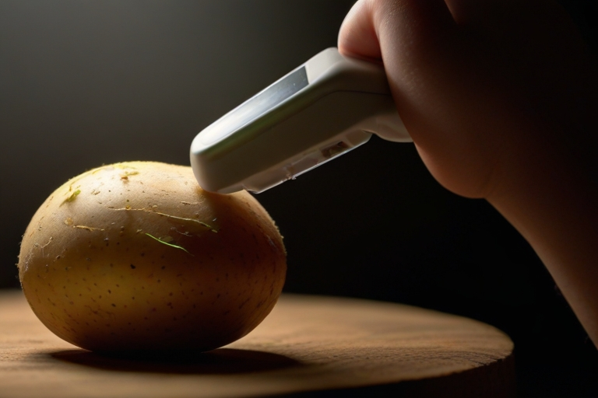



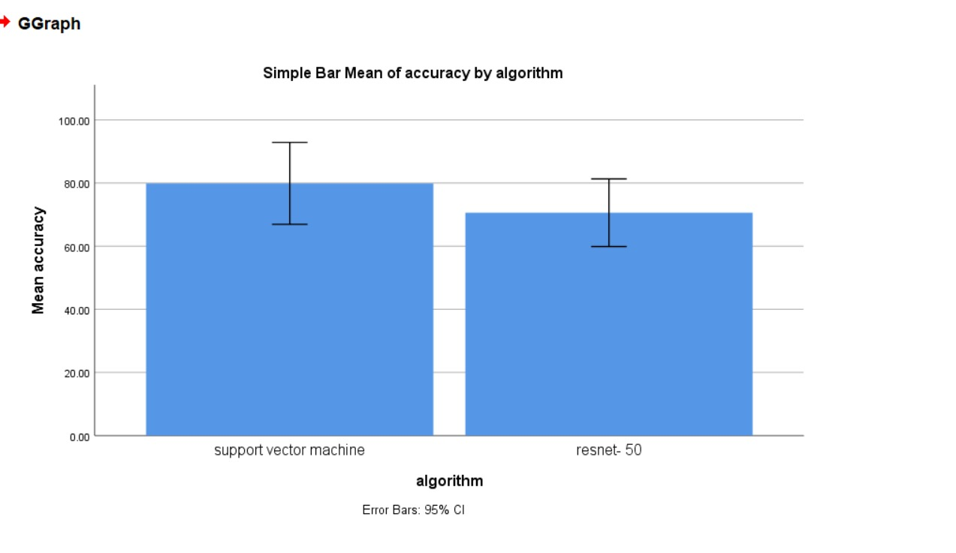
"The SVM classifier outperformed the ResNet-50, achieving a precision of 94.89% compared to 59.38%. Statistical tests in SPSS confirmed this significant difference, with a p-value of 0.012 from an independent sample T-test, underscoring the SVM model's superior accuracy."
Name: Ms. Raushni Raj Register Number: 192125116
Guided by :Dr. M Amanullah
Ms. Poorani.S
Guided by Dr. Mary Valantina. G
Early detection and management of potato plant disease by comparative analysis of Support Vector Machine Algorithm and ResNet-50 Algorithm to improve accuracy
INTRODUCTION
Tackling the significant challenge of potato plant diseases, this study delves into machine learning's potential for early detection and strategic disease management, crucial for sustaining crop health and food security.
The study focuses on comparing the traditional Support Vector Machine (SVM) algorithm with the advanced deep learning ResNet-50 model, aiming to significantly refine the accuracy of disease identification in potato crops.
SVM's prowess in classification tasks and ResNet-50's deep convolutional neural network approach represent two potentially transformative techniques in agricultural disease detection and analysis.
Through a comprehensive evaluation, this research is dedicated to determining which algorithm—SVM or ResNet-50—offers the most effective solution for the early detection of potato plant diseases.
Fig. 1 Potato image
Fig. 2 Crop production
MATERIALS AND METHODS
SVM:- Used for classification and regression task and for Image processing
Train Data: Sample set of inputs, often used to validate the functionality
Data Preprocessing: Raw data into a usable format for analysis, storage, or presentation.
Data Collection:- Structured or unstructured data organized for analysis
ResNet-50 :- Deep learning algorithm specifically designed for image processing
Fig.3 Potato image for detection
Test Data: Input-output pairs that the model learns from to make predictions or classifications.
Better Accuracy
SPSS Analysis
Process of Potato Plant Disease Detection
RESULTS
A C C U R A C Y | ALGORITHMS | N | Mean | Std. Deviation | Std. Error Mean
 | Support Vector Machine (SVM) | 10 | 79.70 | 6.48 | 2.05
 | ResNet-50 | 10 | 70.60 | 5.35 | 1.69
Table 1 Comparison of Algorithms in term of Mean accuracy
Fig. 4 Graphical Representation of SVM and ResNet-50
DISCUSSION AND CONCLUSION
This study addresses the pressing issue of potato plant diseases and explores the potential of machine learning algorithms, specifically comparing the traditional SVM with the advanced ResNet-50 model, to enhance early detection and strategic disease management, crucial for sustaining crop health and food security.
By conducting a thorough evaluation, the research aims to determine which algorithm—SVM or ResNet-50—offers the most effective solution for the early detection of potato plant diseases, which is vital for implementing timely interventions to safeguard and improve crop health and productivity.
This reveal a significant disparity in accuracy between the SVM and ResNet-50 classifiers, with the SVM classifier boasting a precision rate of 95.88% compared to the ResNet-50 classifier's 59.38%, as corroborated by statistical analysis using SPSS.
Overall, this study underscores the importance of adopting advanced machine learning algorithms in agricultural settings to address critical challenges like early disease detection, paving the way for more effective and efficient disease management strategies and ultimately contributing to global food security..
BIBLIOGRAPHY
Jones, R.A.C. (2019). Plant virus emergence and evolution: Origins, new encounter scenarios, factors driving emergence, effects of changing world conditions, and prospects for control. Virus Research, 273, 197–208.
Mohanty, S.P., Hughes, D.P., & Salathe , M. (2016). Using deep learning for image-based plant disease detection. Frontiers in Plant Science, 7, 1419.
Singh, A.K., Ganapathy Subramanian , B., Sarkar, S., & Singh, A. (2018). Deep learning for plant stress phenotyping: Trends and future perspectives. Trends in Plant Science, 23(10), 883–898.
Mwebaz e, E., Owomugisha , G., Ayoo , G., & Ssemwogerere , B. (2016). A review of deep learning methods and applications for unmanned aerial vehicles. Journal of Sensors, 2016, 1-17.

