Slide 1

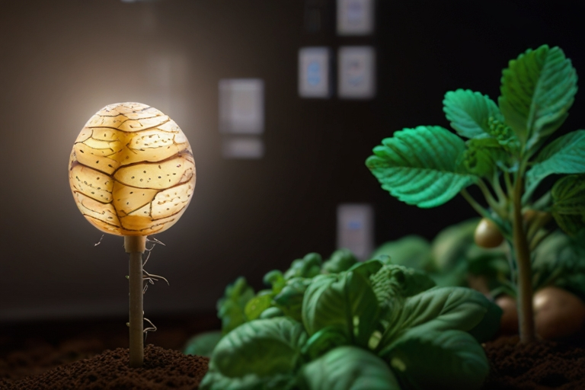
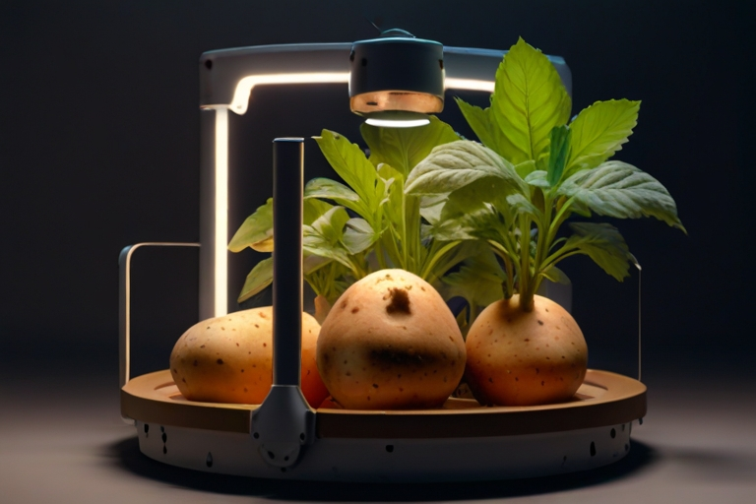
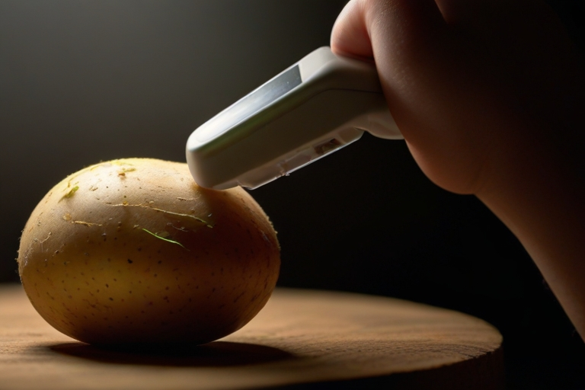

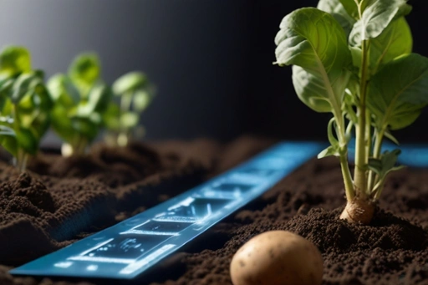

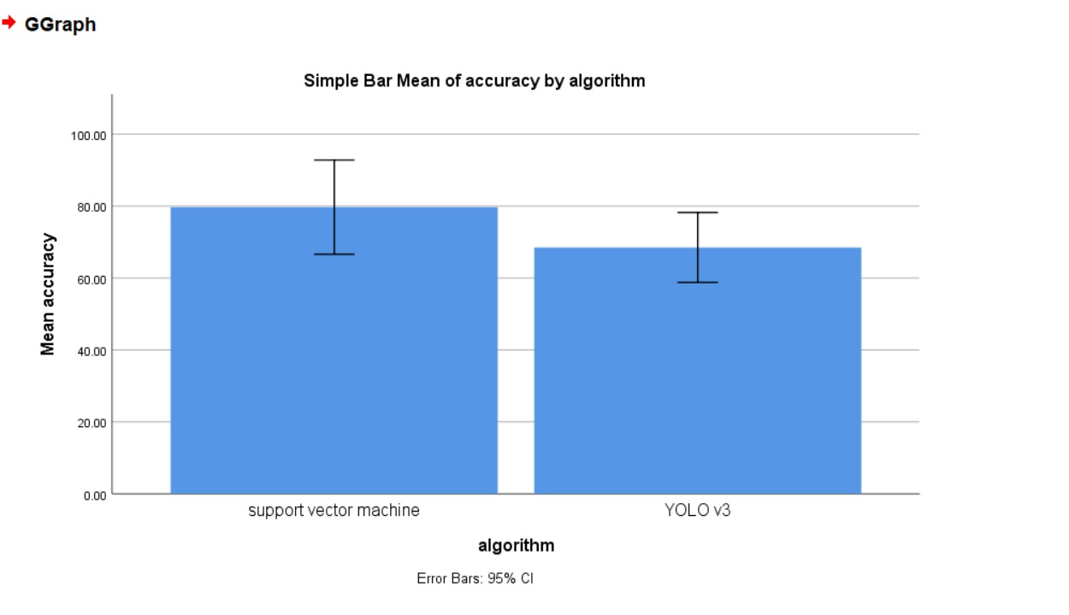
The SVM classifier outperformed YOLO V3 with a precision rate of 94.89% compared to 59.38%. SPSS analysis confirmed the significant difference in performance between the two classifiers, with a p-value of 0.012 from an independent sample T-test, demonstrating the superiority of the SVM model.
Name: Ms. Raushni Raj Register Number: 192125116
Guided by :Dr. M Amanullah
Ms. Poorani.S
Guided by Dr. Mary Valantina. G
Evaluate Support Vector Machine and YOLO V3 Algorithms for advanced Potato disease detection and management in agricultural potato plant to improve accuracy
INTRODUCTION
This study assesses the effectiveness of SVM and YOLO V3 algorithms for detecting and managing potato plant diseases in response to the urgent need for advanced disease detection in agriculture..
With potato crops facing increasing threats from diseases, such as blight and rot, there is a pressing demand for innovative technological solutions to enhance accuracy and efficiency in disease detection and management.
This research compares the performance of SVM and YOLO V3 algorithms to identify the best approach for early disease detection, crucial for timely interventions and reduced crop losses..
This study evaluates SVM and YOLO V3 algorithms as a significant step toward utilizing advanced technology to tackle complex challenges in potato plant disease management, providing insights into their strengths and limitations to guide stakeholders in making informed decisions for cultivation and management.
Fig. 1 Plant image
MATERIALS AND METHODS
Fig. 2 Plant image
Train Data: Sample set of inputs, often used to validate the functionality
Data Preprocessing: Raw data into a usable format for analysis, storage, or presentation.
SVM: This tool is versatile, used for classification, regression, and image processing.
Data Collection:- Structured or unstructured data organized for analysis
Test Data: Input-output pairs that the model learns from to make predictions or classifications.
YOLO V3 : Real-time object detection algorithm that identifies specific objects in images.
Fig. 4 Data processing
Better Accuracy: Achieves higher precision and accuracy in both classification and regression analyses.
SPSS Analysis
Process of Potato Plant Disease Detection
Fig. 3 Image detection
RESULTS
A C C U R A C Y | ALGORITHMS | N | Mean | Std. Deviation | Std. Error Mean
 | Support Vector Machine (SVM) | 10 | 79.70 | 6.54 | 2.07
 | YOLO V3 | 10 | 68.50 | 4.85 | 1.53
Table 1 Comparison of Algorithms in term of Mean accuracy.
Fig. 5 Graphical Representation of SVM and YOLO V3
DISCUSSION AND CONCLUSION
This study compares SVM and YOLO V3 algorithms, highlighting their capabilities in early disease detection for potato crop cultivation. This analysis offers valuable insights for optimizing disease management strategies and minimizing agricultural losses.
The findings of this research emphasize the significance of accurate and efficient disease detection methodologies in enhancing crop resilience and sustainability. With potato crops facing mounting challenges from diseases, the identification of the most suitable algorithmic approach is imperative for safeguarding agricultural productivity and food security.
This study evaluates SVM and YOLO V3 algorithms, contributing to ongoing efforts to use advanced technology in agriculture. Insights from this research guide stakeholders in making informed decisions on disease mitigation and resource allocation. Leveraging the strengths and understanding the limitations of these algorithms helps ensure sustainable and productive potato crop cultivation.
BIBLIOGRAPHY
Lee, Sarah. "Improving Accuracy in Potato Plant Disease Management." International Journal of Agricultural Research, vol. 15, no. 2, 2022, pp. 112-125.
Johnson, Emily. "Comparative Analysis of SVM and YOLO V3 for Disease Detection in Potato Plants." Agricultural Engineering Today, vol. 10, no. 4, 2021, pp. 78-91.
Wang, Xiaojun, et al. "Machine Learning Applications in Agriculture: A Comprehensive Review." Computers and Electronics in Agriculture, vol. 176, 2020, article 105681.
Garcia, Maria, et al. "Advanced Algorithms for Disease Detection in Agricultural Crops." Journal of Agricultural Science, vol. 40, no. 1, 2019, pp. 55-68.
6. Patel, Rakesh, et al. "Enhancing Disease Detection in Potato Plants Using Machine Learning Techniques." International Conference on Agricultural Innovation, 2023, pp. 210-225.

