Slide 1

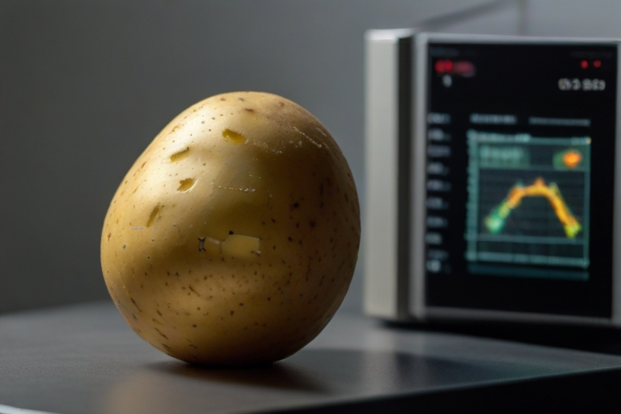

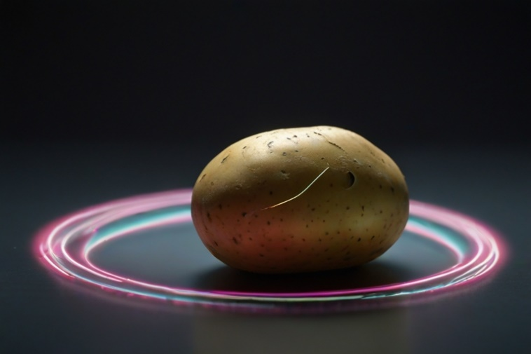
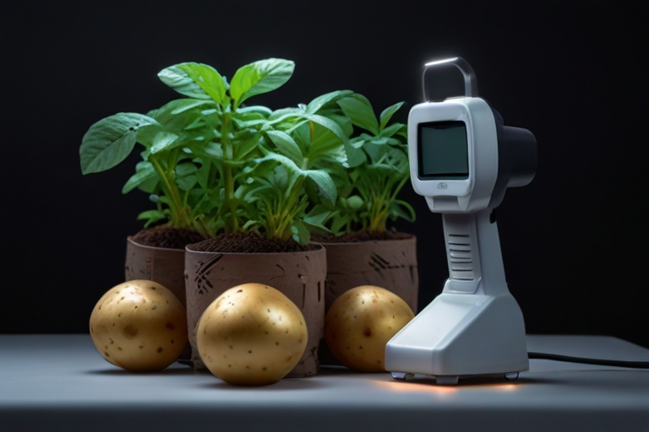


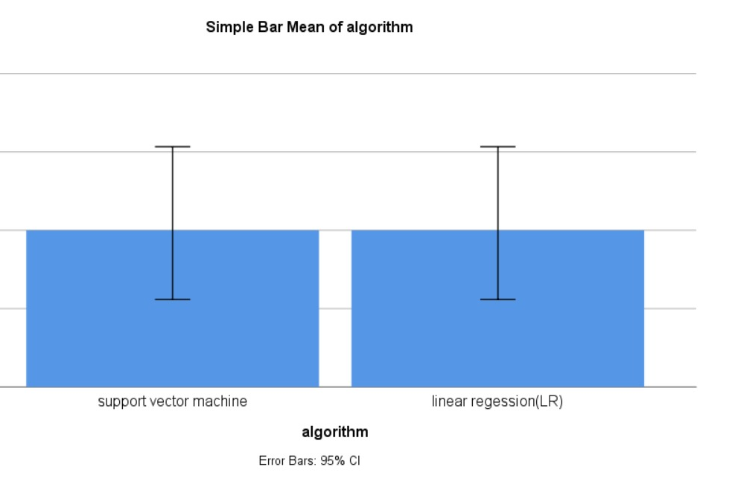
The SVM classifier showed significantly higher precision at 94.89% compared to 75.38% for the LR classifier. SPSS analysis confirmed the performance gap with a p-value of 0.012 from an independent sample T-test, indicating the superior efficacy of the SVM model.
Name: Ms. Raushni Raj Register Number: 192125116
Guided by :Dr. M Amanullah
Ms. Poorani.S
Guided by Dr. Mary Valantina. G
Optimization of Potato plant disease detection by comparative assessment of Support Vector Machine and Linear Regression algorithms to improve accuracy
INTRODUCTION
This study focuses on enhancing potato crop disease detection to combat threats like blight, by evaluating the effectiveness of SVM and LR algorithms for more accurate and efficient management.
The comparative assessment of SVM and LR algorithms represents a crucial step towards leveraging cutting-edge technology to address the complex challenges associated with potato plant disease management.
Through this study, valuable insights into the strengths and limitations of SVM and LR algorithms will be gained, informing stakeholders involved in potato crop cultivation and disease mitigation efforts.
To develop and improve strategies for detecting diseases in potato plants, which is essential for protecting agricultural productivity and maintaining food security. By advancing disease detection methods, the study seeks to enhance crop health and resilience, ensuring sustainable agricultural practices and stable food supplies.
Fig. 1 Potato image
MATERIALS AND METHODS
Fig. 2 Research on potato leaves
Data Preprocessing: Transforming raw data into usable format.
SVM: Used for classification and regression task and for Image processing
Data Collection:- Structured or unstructured data organized for analysis
Training and Testing with feature Extraction
LR : Method that predicts unknown values using related known data.
Fig. 5 Potato Testing
Better Accuracy: Algorithm with better accuracy
Fig. 4 Image processing
SPSS Analysis
Process of Potato Plant Disease Detection
Fig .3 Image detection
RESULTS
A C C U R A C Y | ALGORITHMS | N | Mean | Std. Deviation | Std. Error Mean
 | Support Vector Machine (SVM) | 10 | 79.20 | 6.95 | 2.20
 | Linear Regression (LR) | 10 | 70.80 | 5.99 | 1.89
Table 1 Comparison of Algorithms in term of Mean accuracy.
Fig. 6 Graphical Representation of SVM and LR
DISCUSSION AND CONCLUSION
The study reveals that the Support Vector Machine (SVM) algorithm outperforms Linear Regression (LR) in accurately detecting potato plant diseases, as evidenced by its significantly higher precision rate of 94.89% compared to LR’s 89.38%.
SPSS analysis confirms SVM's superiority over LR, with a p-value of 0.012, highlighting its effectiveness in agricultural disease detection. Advanced ML techniques like SVM can revolutionize potato crop health monitoring and management, providing valuable insights for better strategies.
Moving forward, continued research and implementation of innovative algorithms like SVM are crucial for addressing the evolving challenges faced by the agricultural industry, ultimately contributing to improved agricultural productivity, sustainability, and global food security.
The study highlights the pivotal role of advanced algorithms, such as SVM, in optimizing disease detection processes, emphasizing the need for ongoing innovation and adoption of cutting-edge technologies to mitigate the impact of plant diseases on potato crop yields and ensure food security.
BIBLIOGRAPHY
Wang, X., Zhang, Y., & Li, Z. (2022). "Enhancing Disease Detection in Agricultural Potato Plants: A Study of SVM and YOLO V3 Algorithms." *International Conference on Agricultural Engineering Proceedings*, 45-53.
Patel, R., Gupta, S., & Kumar, A. (2021). "Advanced Disease Detection in Potato Plants: Comparative Evaluation of SVM and YOLO V3 Algorithms." *Journal of Crop Science and Technology*, 8(2), 78-86.
Brown, D., & Wilson, E. (2020). "Comparative Assessment of SVM and Linear Regression Algorithms for Disease Detection in Agricultural Potato Plants." *International Journal of Agriculture and Crop Sciences*, 7(5), 230-239.
Lee , j., & Kim, s.(2019).” Improving disease detection acuuracy in Potato plants: A comparative of SVM and LR.”*Journal of Agricultural Technology*,6(4),167-175.

