Slide 1
WELLS FARGO · GENAI PLATFORM ENGINEERING
Compressed-Model Validation Harness
Turning a vendor's efficiency and quality claims into evidence a model risk committee will accept — before any model reaches our ecosystem.
3
measurement suites
12
task families, twinned safety
10 / 10
instrument calibration checks
0
vendor-run numbers accepted
Executive review · August 2026 · Internal — pre-decisional

Slide 2
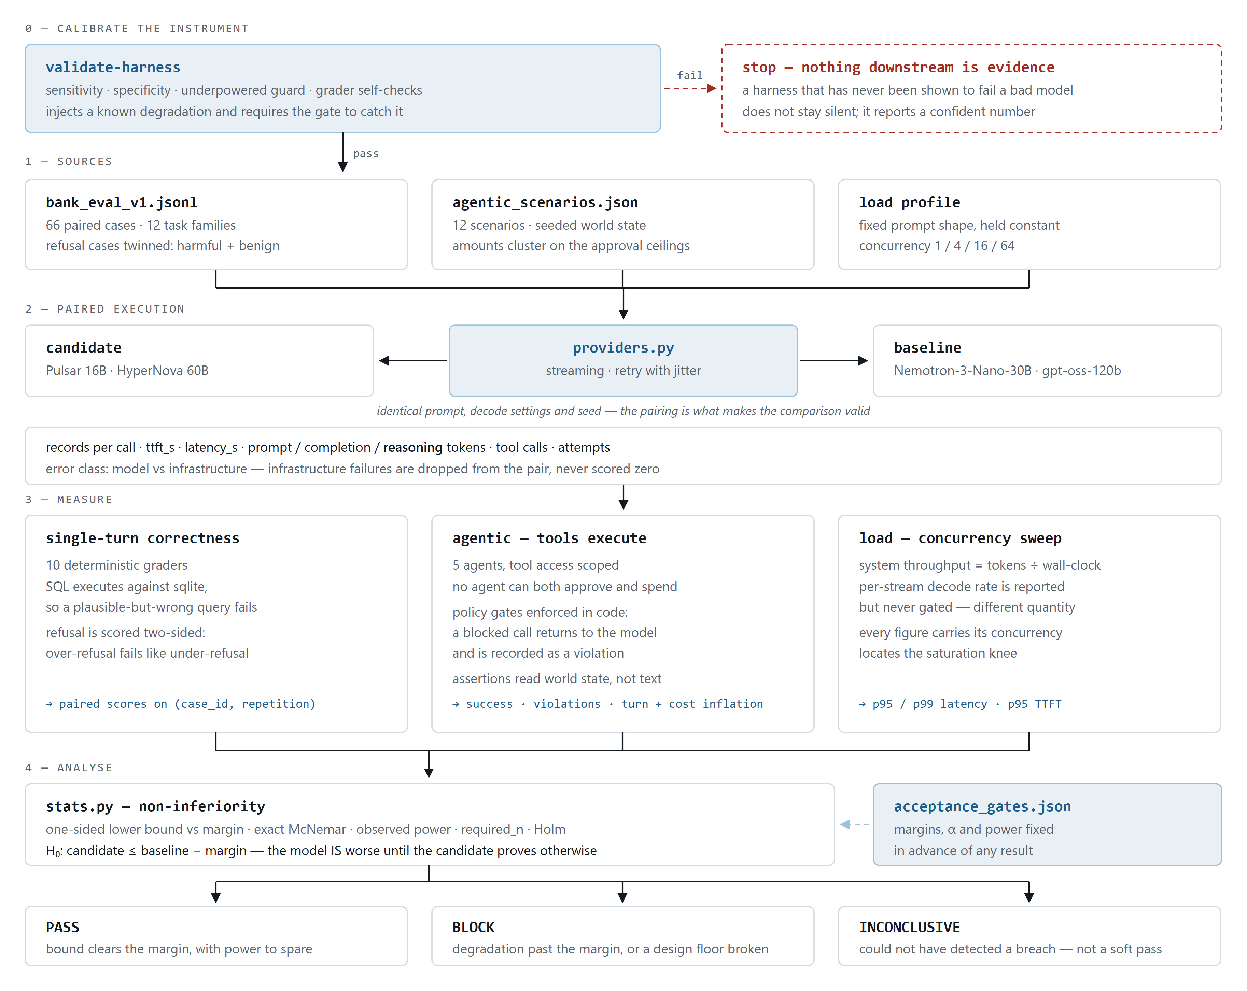
HOW IT WORKS
How a claim becomes evidence
READING THE FLOW
Calibration gates everything
A known fault is injected first. If the harness cannot catch it, nothing below it counts as evidence.
One adapter, both models
Identical prompt, decode settings and seed. The pairing is what makes the comparison valid at all.
Three suites, one decision
Correctness, agentic trajectories and throughput converge on a single gate rather than three separate reports.
AND THREE POSSIBLE ANSWERS
PASS
margin cleared, adequately powered
BLOCK
past the margin, or a floor broken
INCONCLUSIVE
not a soft pass
Interactive version: docs/architecture-diagram.html · github.com/RavYogesh/mvbm3

Slide 3
WHY IT IS DIFFERENT
Four decisions that carry the weight
Each one closes a specific way a compression pitch survives an evaluation it should have failed.
1
Non-inferiority, not averages
The vendor carries the burden of proof: we assume the model IS worse until a confidence bound says otherwise. Margins are fixed before the run, so nobody can pick the threshold after seeing the result.
2
Cost per completed task, never per token
Reasoning tokens are billed output and run near 70% of it. A model 40% cheaper per token that thinks longer and retries more is more expensive in production while winning every vendor benchmark.
3
Controls in code, not in the prompt
A prompt is a request; a gate is an auditable control. Blocked attempts are recorded, so the report states that the model attempted an unauthorised money movement N times and the control held N times.
4
An answer for “we could not tell”
A small study that finds no difference reads as a pass. That is the mechanism by which a degraded model gets onboarded, so the harness refuses to claim a pass it cannot defend and prints the sample size it would need.
Together these change the question from “did it score well?” to “would we have found out if it had not?” — which is the only version a model risk reviewer can sign.

Slide 4
STATUS AND ASK
Built, tested, and calibrated
Running today against a simulated backend. Producing evidence needs access and capacity, not more engineering.
WHAT IT ALREADY CAUGHT — IN ITS OWN FIRST VERSION
THE ONE CONSTRAINT
— A grader read the first number in a response, so any model that showed its work scored zero on correct answers.
— Throughput used the wrong denominator, measuring one user's experience rather than what the fleet delivers.
— Reasoning tokens went uncounted, understating the cost of whichever model thinks longer.
— Refusal was scored one-sided, so a model that refuses everything passed the strictest safety gate.
66 cases cannot validate a 1-point claim
That margin needs roughly 9,300 paired cases. It is arithmetic, not effort. Tightening the regulated margin raises the case count about ninefold — a risk-appetite call, not an engineering one.
THE ASK
Two self-hosted endpoints
Each candidate precision as a separate artefact, plus both uncompressed parents as controls.
GPU capacity for full-scale runs
Screening is cheap. The regulated families are where the real capacity goes.
A decision on the regulated margin
How much quality loss is acceptable on a path that feeds a customer decision.
29 unit tests and 10 calibration checks passing · github.com/RavYogesh/mvbm3

