Slide 1



AQI ANALYSIS ,ALERT AND PREDICT SYSTEM
Atmiya University
Team : Suraj Dube(Team Leader) , Pratik Raval , Meet Lalkiya , Souvick Mete
Team ID : S4F_CP_Team_50743
Mentor : Rohit Bhadauriya
Github link : https://github.com/RavalPratik1204/Work-Shop-Project.git
Date : 8 jan 2026

Slide 2
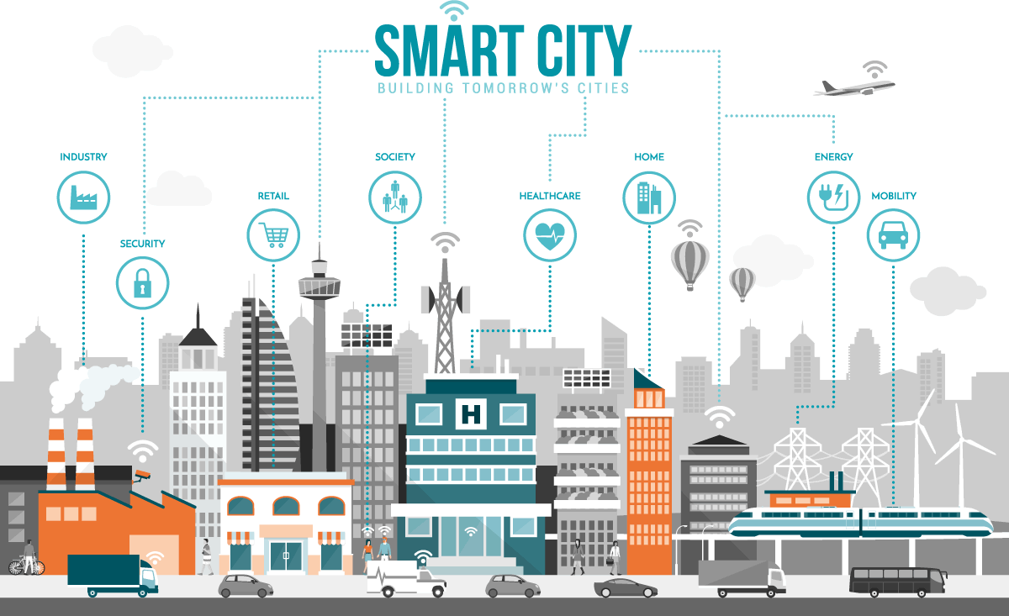

Slide 3
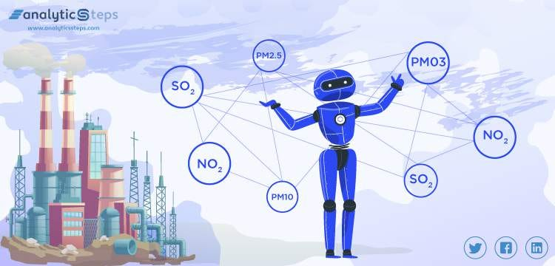
Dataset Overview
Dataset Description :
A smart-city air quality dataset with timestamped sensor readings (PM2.5, PM10, CO, NO₂, SO₂, O₃), temperature, humidity, traffic density, and location data, used to analyze pollution trends and predict air quality levels or hazardous conditions.
Data Preprocessing:

Slide 4
Data Preprocessing:
Data preprocessing improves data quality and model performance. Missing values are handled using mean or median imputation, and outliers are identified and removed using statistical methods. Categorical features (e.g., location, air quality category) are encoded numerically, while numerical features are normalized or standardized. Finally, the dataset is split into training and testing sets.

Slide 5
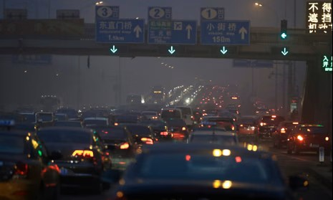
Problem Statement
Rapid urbanization and industrial growth in smart cities have increased air pollution, impacting public health, traffic management, and quality of life. To address this, smart cities need an intelligent, data-driven environmental monitoring system that continuously analyzes air quality and provides early warnings and control recommendations.

Slide 6
Key Objectives:
Monitor air pollution levels across different zones of a smart city
Analyze pollution trends using historical and real-time data
Predict Air Quality Index (AQI) categories in advance
Provide AI-based alerts and pollution control recommendations
Support smart governance and citizen awareness

Slide 7
Methodology
Approach:
A data-driven machine learning approach is used to analyze pollution patterns and predict air quality levels, enabling continuous monitoring and early warnings when pollution exceeds safe limits.
Algorithms Used:
Random Forest – for accurate air quality classification
Support Vector Machine (SVM) – for pollution level prediction
Linear Regression – for predicting pollutant concentration trends
K-Means Clustering – to identify pollution zones in the city
Evaluation Metrics:
Accuracy measures the overall correctness of the model’s predictions. Precision and recall evaluate how effectively the system identifies and alerts high pollution conditions. The F1-score represents a balance between precision and recall. RMSE (Root Mean Square Error) is used in regression models to measure the average prediction error.

Slide 8
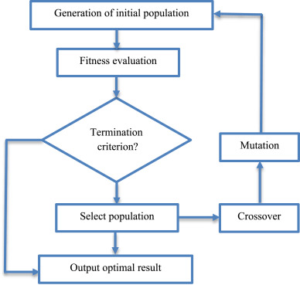
Result
The Random Forest model achieved the highest accuracy in classifying air quality levels. Regression models accurately predicted pollution trends with low error rates. Clustering analysis identified high-risk pollution zones, particularly near industrial and traffic-dense areas.
Graphs/Visualizations:

Slide 9
Discussion
The results demonstrate that machine learning models can effectively analyze complex environmental data and detect pollution spikes early, enabling preventive action by city authorities. However, model accuracy depends on sensor quality and data availability.
Source :
www.freepik.com/

Slide 10

Conclusion
    This study highlights the importance of a data-driven air quality monitoring system for smart cities. Machine learning models effectively analyze pollution data, predict air quality levels, and provide early warnings. The proposed system supports timely decision-making, improves public health awareness, and promotes sustainable urban development, with real-time data further enhancing air quality management and quality of life.

Slide 11
References
World Health Organization (WHO) – Air Quality Guidelines
UCI Machine Learning Repository – Air Quality Dataset
Scikit-learn Documentation
Research papers on Smart City Environmental Monitoring

Slide 12
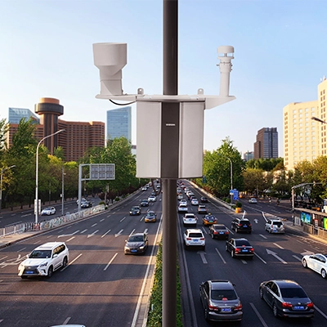
Thank You
Notes:
Thank You !!

