Slide 1

Meet-Up Assistant
Mohit Patel (msp552)
Saqib Patel (sip257)
Shivam Raval (sgr341)
Tirupal Rao Ravilla (trr321)
An AWS based virtual assistant to recognize people, organize meetups, collect data, & analyze

Slide 2
CONTENTS
Idea and Inspiration
Flow
Architecture
Services
Challenges
Demo
Future
Meet-up Assistant

Slide 3
IDEA and Inspiration
Meet-ups attract a variety of people
Not easy to gather all their details
Maintaining the attendees list is hard
Insights into the details of the crowd would be valuable
Introducing… an assistant that can:
Recognize people
Gather their data
Help organize the meetup
provide analysis
Meet-up Assistant

Slide 4
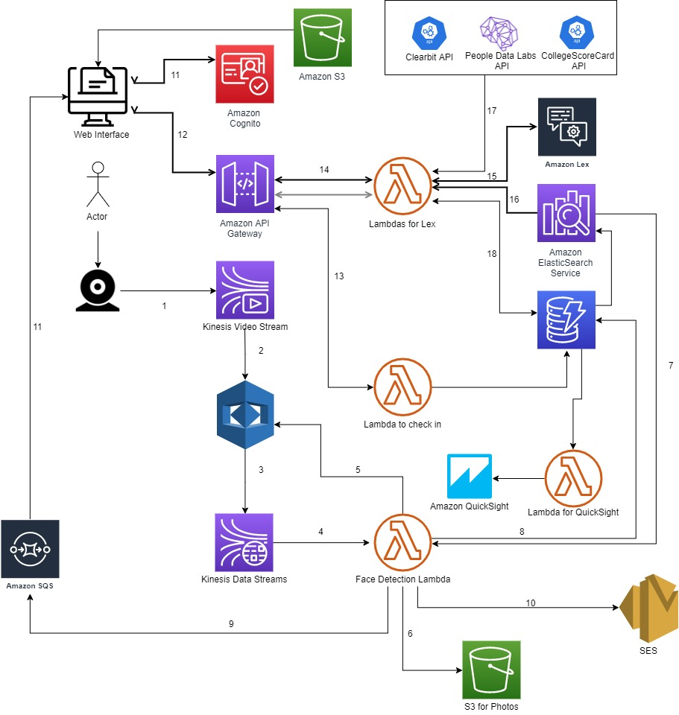
FLOW
Webcam to KVS
KVS to Rekognition
Rekognition to KDS
KDS to Face Detection Lambda
Read Frame and Index Image
Store photo unknown person
Elastic search for face id
Store details in DynamoDB (unk)
Send message to SQS
Send email with new person photo
Webapp polls SQS using ID Pool
Check in known guest
Register an entry for known user in DB
Ask email for unknown guest
Lex chat for Unknown user
Index unknown user in ElasticSearch
Access APIs to gather User Info
Store user details in BydamoDB
Meet-up Assistant

Slide 5
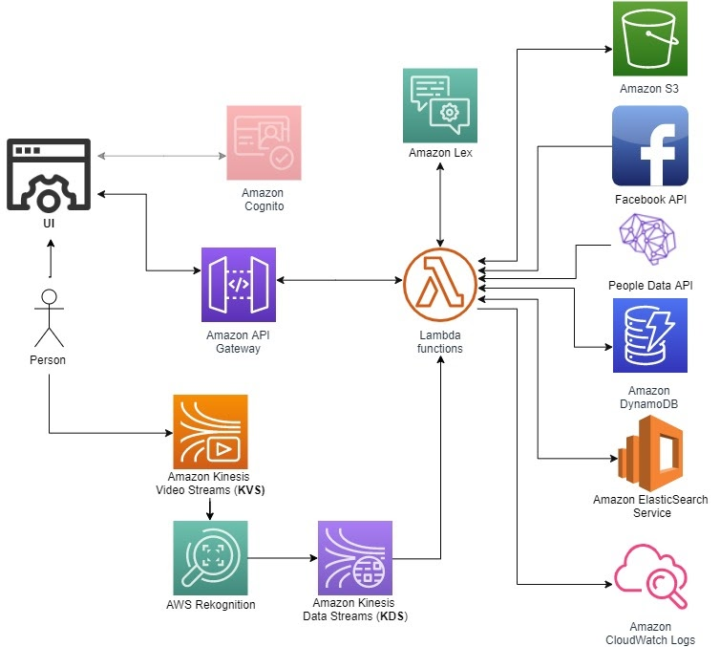

ARCHITECTURE
APIS:
https://clearbit.com/
https://collegescorecard.ed.gov/data/documentation/
https://www.peopledatalabs.com/
Lambdas:
UI to Lex
Lex Fulfilment and Store details
Face Detection and store
Check in Known People
QuickSight Analysis
APIs
ClearBit / CollegeScoreCard
Amazon QuickSight
Meet-up Assistant

Slide 6
Services
AWS
AWS Kinesis Video Streams
Amazon Rekognition
AWS Kinesis Data Streams
Amazon Lex
Amazon APIGateway
AWS Lambda
Amazon S3
Amazon DynamoDB
Amazon ElasticSearch
Amazon SQS
Amazon SES/ Amazon SNS
Amazon QuickSight
Amazon Cognito
Amazon CloudWatch
Others:
HTML
Javascript
Python
PeopleData API
Clearbit API
CollegeScoreCard API
Meet-up Assistant

Slide 7
Challenges
Facebook Graph API is out of service
People Data API is inconsistent with many user accounts
Kinesis Video Streaming with Rekognition is very challenging and unstable
Rekognition processing abruptly stops at times
Rekognition identifies faces continuously
Rekognition is poor at times
Amazon QuickSight Standard edition does not support many crucial features (sending analyses to UI, Data Pipeline support etc.)
CloudWatch Logs can be very inconsistent many a time, leading to wrong conclusions about the invocations of Lambdas and other services
Limitations on data pipeline to push data to QuickSight
Challenges in preprocessing the api data to make a uniform and consistent model for all people
Meet-up Assistant

Slide 8

Future scope
Meet-Up is only one application for this idea
Any ad-hoc meeting can use this application
Parties, unofficial gatherings can use a quick check-in using facial recognition
An extension of this idea is to verify students who misplaced their id cards
Discussion Topic Ranking (choosing the best topic from among the favorite topics gathered from used upon check-in)
Meet-up Assistant

Slide 9
DEMO
Meet-up Assistant

Slide 10
THANK YOU
Mohit Patel
Saqib Patel
Shivam Raval
Tirupal Ravilla
Master of Science in Computer Science
Department of Computer Science and Engineering
NYU Tandon School of Engineering
Brooklyn NY

