Slide 1
IRONHACK — DEVOPS & CLOUD
PROJECT 1
Secure, Scalable 3-Tier App on Azure
Migrating a legacy monolith to a production-grade Azure architecture with WAF, private networking, and monitoring.
GROUP 2 • WEEK 6 • 2026
3
1
TIERS
PUBLIC IP
0
3
PUBLIC VMS
ALERTS

Slide 2
IRONHACK — DEVOPS & CLOUD
IMPLEMENTATION
Team members
Yunis Q.
Mahammad S.
Miralakpar J.
Ravan G.

Slide 3
PROJECT OVERVIEW
What we built
A fully private, scalable 3-tier ecommerce application on Microsoft Azure — migrated from a single on-prem VM to a cloud-native architecture with zero direct public exposure of application or database services.
KEY LEARNING OBJECTIVES
01
02
Design a production-like 3-tier Azure reference architecture with private networking
Provision Azure SQL Database secured with Private Endpoint (public access disabled)
03
04
Deploy React frontend and Express/Node.js backend as separate App Services
Secure all tiers using VNet, subnets, NSGs, and Private DNS Zones
05
06
Expose only the gateway via Application Gateway WAF v2 with path-based routing
Validate & monitor health, logs, metrics and alerts across the full stack

Slide 4

3-Tier Architecture Overview
TIER 1 — GATEWAY
TIER 2 — APPLICATION
TIER 3 — DATA
Application Gateway WAF v2
React + Express App Services
Azure SQL + Private Endpoint
Only public entry point. OWASP 3.2 Prevention mode. Routes / → Frontend, /api/* → Backend.
Two separate App Services. Public access disabled. VNet integrated. Autoscaling enabled.
Zero public access. Private IP only via Private Endpoint. Private DNS Zone resolves internally.
NETWORKING & SECURITY
OBSERVABILITY
VNet 10.0.0.0/16 • 3 Subnets • 3 NSGs
Log Analytics Workspace • App Insights x2
Private DNS Zone • Defense in depth
3 Alert Rules • Email Action Group

Slide 5
Traffic Flow & Network Design
INTERNET
WAF
User hits http://20.42.155.71 — the only public IP in the entire infrastructure
App Gateway inspects every request — OWASP 3.2 Prevention blocks SQLi, XSS, path traversal
ROUTING
APP TIER
Path rule: / → pool-frontend (React) /api/* → pool-backend (Express)
App Services in snet-appservice — public access disabled, VNet integrated, autoscale on
DATABASE
DNS
Azure SQL via Private Endpoint — private IP 10.0.2.x, public access permanently disabled
Private DNS Zone: sql-server.database.windows.net → 10.0.2.x — no public DNS leakage

Slide 6
IMPLEMENTATION
Key Techniques & Best Practices
Private Endpoint + Private DNS
Subnet Delegation
SQL has no public endpoint. A NIC in snet-data holds the private IP. Private DNS resolves the hostname internally — backend connects using the same connection string as any SQL client, unaware of the private routing.
snet-appservice is delegated to Microsoft.Web/serverFarms — Azure's mechanism to reserve a subnet exclusively for App Service VNet Integration. This enables outbound private traffic from App Services into the VNet.
Custom Health Probes
WAF in Prevention Mode
App Gateway health probes point to /health on the backend. Default probes hit / which returns 404 — marking the pool unhealthy. Custom probes ensure App Gateway only routes to genuinely healthy instances.
WAF policy set to Prevention, not Detection. Detection only logs attacks — Prevention actively blocks them. OWASP 3.2 ruleset applied globally before any request reaches application code.

Slide 7

CHALLENGES & SOLUTIONS
Obstacles We Overcame
SQL Query Editor blocked
React env vars baked at build time
Azure Portal Query Editor couldn't reach SQL — public access was disabled by design. Needed to run the full schema (5 tables, indexes, triggers, sample data) before the backend could start.
Setting REACT_APP_API_URL in Azure portal had zero effect. React compiles env vars into the static bundle at build time — Azure injects them at runtime, after compilation is done.
→ Temporarily whitelisted our IP, ran schema in 6 separate batches, immediately re-disabled public access
→ Injected the variable during the GitHub Actions build step so it gets compiled into the bundle correctly
App Gateway 502 Bad Gateway
Shared subscription restrictions
The default health probe sent requests to / on the backend which returns 404. App Gateway marked the entire backend pool as unhealthy and returned 502 to every user request.
As students on a shared subscription, SCM access restrictions and certain Azure Policy enforcements blocked GitHub Actions cloud runners from deploying to App Services.
→ Configured a custom health probe pointing to /health (returns 200) — pool immediately became healthy
→ Set up a self-hosted GitHub Actions runner on a VM inside the VNet — deployments run from within the private network

Slide 8
TOOLS & TECHNOLOGIES
Technology Stack
FRONTEND
BACKEND
React + TypeScript
Express / Node.js
Azure App Service (Linux, Node 20 LTS)
REST API — JWT auth, rate limiting, input validation
DATABASE
GATEWAY
Azure SQL Database
App Gateway WAF v2
Basic tier, single DB, private endpoint only
OWASP 3.2 Prevention, path-based routing, health probes
NETWORK
MONITORING
VNet + NSGs + DNS
Azure Monitor Stack
10.0.0.0/16, 3 subnets, 3 NSGs, Private DNS Zone
Log Analytics + App Insights x2 + 3 alerts + email
CI/CD
GitHub Actions
Self-hosted runner on Ubuntu VM inside VNet

Slide 9
TEAMWORK & PROJECT MANAGEMENT
How We Managed the Project
WHAT WORKED WELL
WHAT COULD BE IMPROVED
Divided phases clearly: networking → database → app → gateway → monitoring
Tackled infrastructure first before touching application code
Documented every Azure resource name and IP as we went — avoided confusion later
Used Azure Log Stream to debug backend startup failures in real time
Verified each phase worked before moving to the next (test-as-you-go)
Plan for shared subscription permission limits earlier — cost us significant time
Set up the self-hosted runner at the start, not mid-project when deploys failed
Test App Gateway health probes immediately after creation, not after routing rules
Use Infrastructure as Code (Terraform/Bicep) to avoid manual portal clicks
Allocate more time for monitoring setup — left to the end, slightly rushed

Slide 10
MAJOR OBSTACLE
The Deployment Deadlock
THE PROBLEM
THE SOLUTION
WHAT WE LEARNED
With public access disabled on App Services (correct architecture), GitHub Actions cloud runners received 403 Forbidden on every deploy attempt. The SCM endpoint was blocked. We couldn't deploy code to the backend — stuck for over an hour trying different workarounds.
Deployed a self-hosted GitHub Actions runner on an Ubuntu VM inside the VNet. Jobs now run from within the private network — the App Service sees the request as internal traffic and allows it. CI/CD works without compromising the security model.
Security and automation are not opposites — they require intentional design. In hindsight, we would plan the deployment pipeline alongside the network design from day one, treating it as a first-class concern rather than an afterthought. Private networks require private runners.

Slide 11
MAIN LEARNINGS
Insights & Surprising Findings
Security makes everything harder — by design
PaaS hides complexity — but not forever
Disabling public access is correct. But it creates friction in places you don't expect: the portal Query Editor stops working, GitHub Actions gets blocked, Kudu becomes inaccessible. Every security decision has operational consequences that must be planned for.
App Service makes deployment trivial until it doesn't. VNet Integration, subnet delegation, SCM endpoints, Oryx build system — the abstractions leak when you need fine-grained control. Understanding what's happening underneath makes debugging possible.
Private networking requires end-to-end thinking
Monitoring should be designed upfront, not bolted on
A Private Endpoint alone isn't enough. You also need the Private DNS Zone, VNet link, and the app's connection string to use the right hostname. Each piece is simple — but missing any one breaks the entire chain silently.
We set up monitoring last. In production, you'd want alerts from the first deployment. Application Insights auto-attached was a nice surprise — Azure was already collecting data before we configured anything.

Slide 12
IRONHACK — DEVOPS & CLOUD
CONCLUSION
Production-grade. Secure by design.
Defense in depth, private networking, WAF protection, and full observability — the same patterns used by production cloud engineering teams worldwide.
0
1
PUBLIC VMS
PUBLIC ENTRY POINT
3
3
SECURITY LAYERS
LIVE ALERT RULES

Slide 13
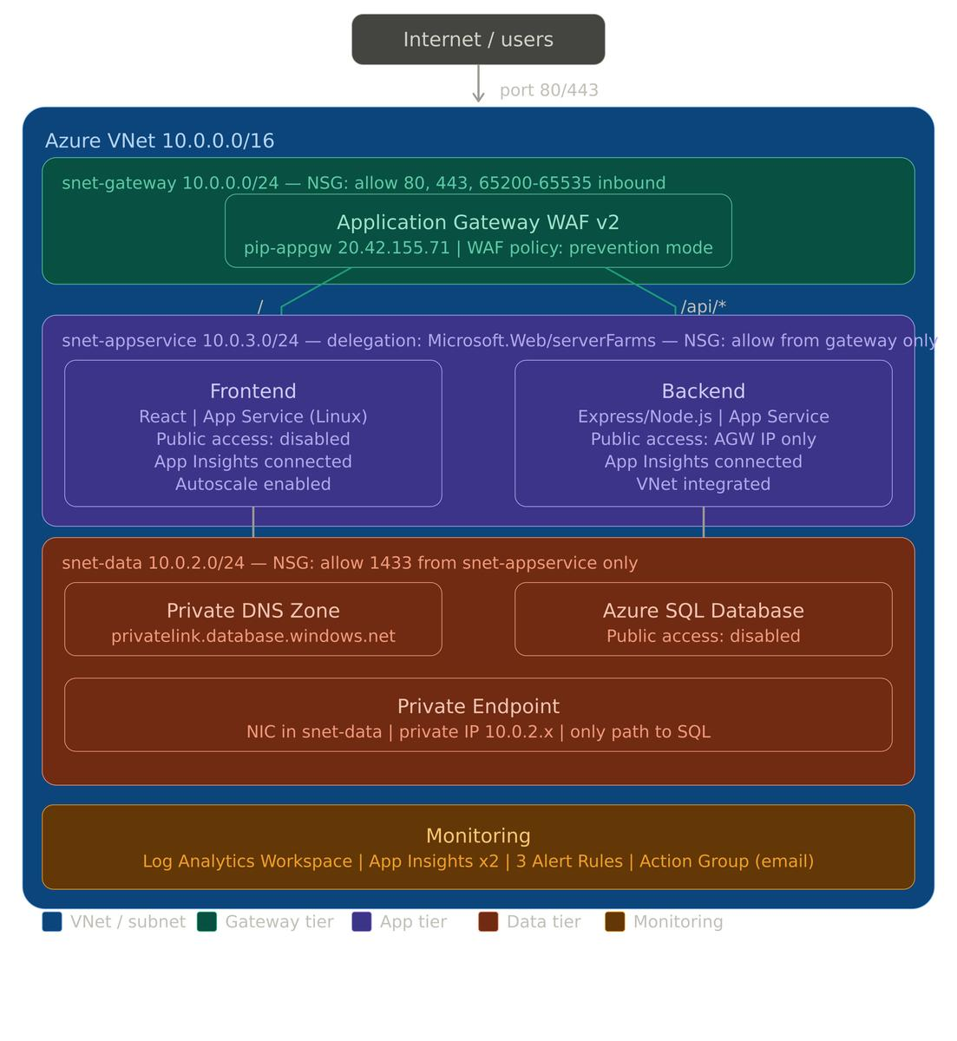
Platform Overview & Visual Proof
This section presents an overview of the platform along with visual evidence demonstrating its functionality and development progress. The following screenshots highlight key features. These visuals serve as confirmation of the project.

Slide 14
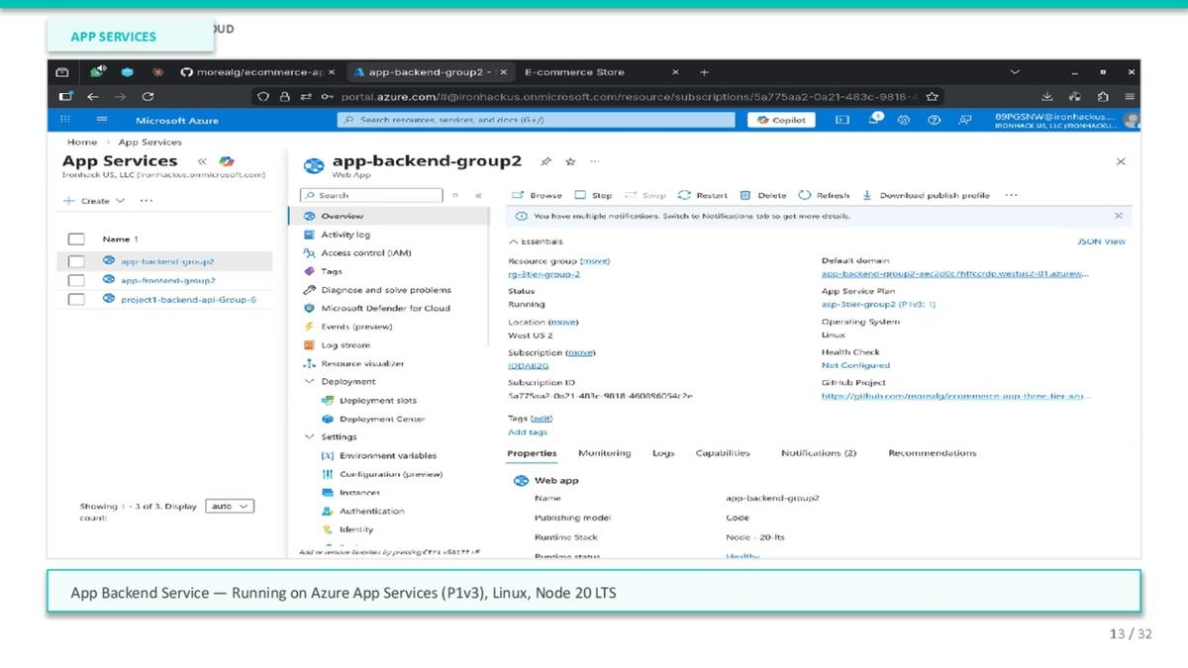

Slide 15
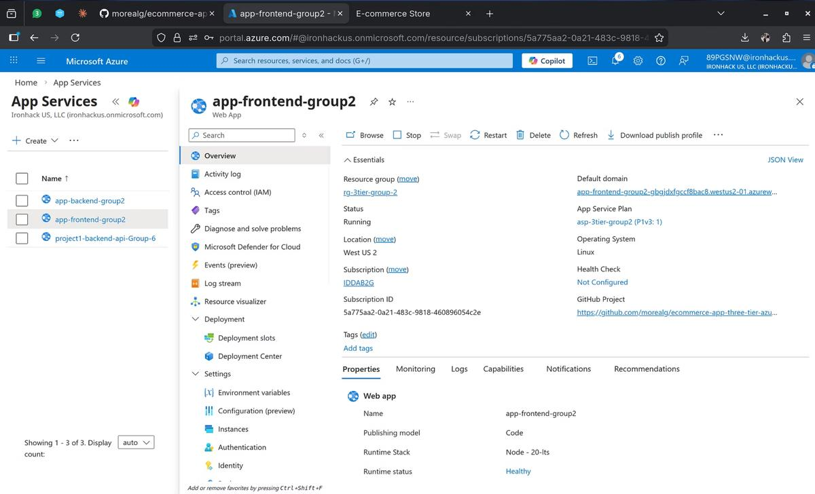
APP SERVICES
App Frontend Service — Running on Azure App Services (P1v3), Linux, Node 20 LTS

Slide 16
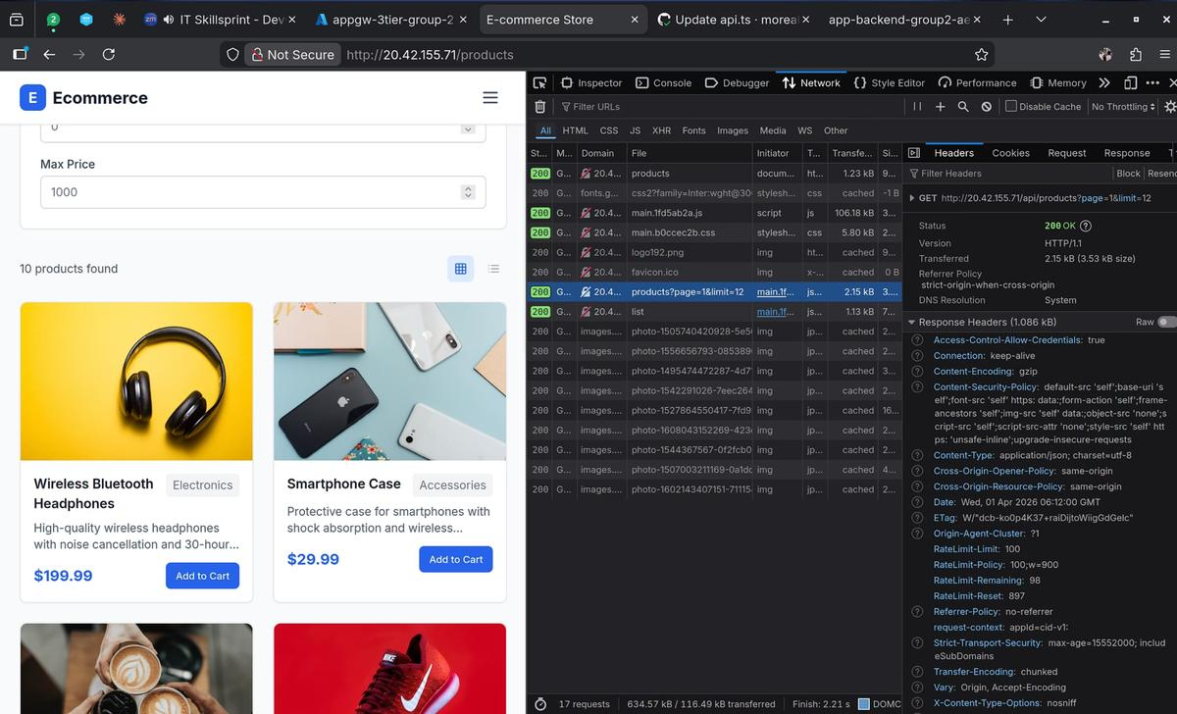
LIVE APPLICATION
Live App via WAF — E-commerce frontend loading via Application Gateway (HTTP 200)

Slide 17
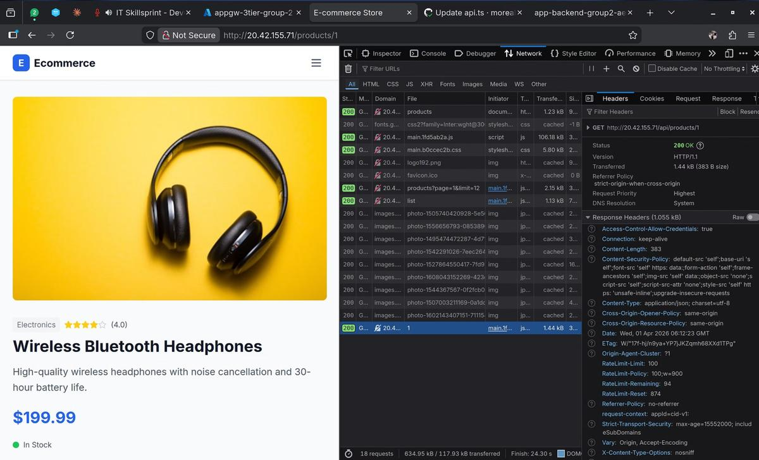
LIVE APPLICATION
Product Detail Page — Individual product API endpoint returning 200 OK via WAF

Slide 18
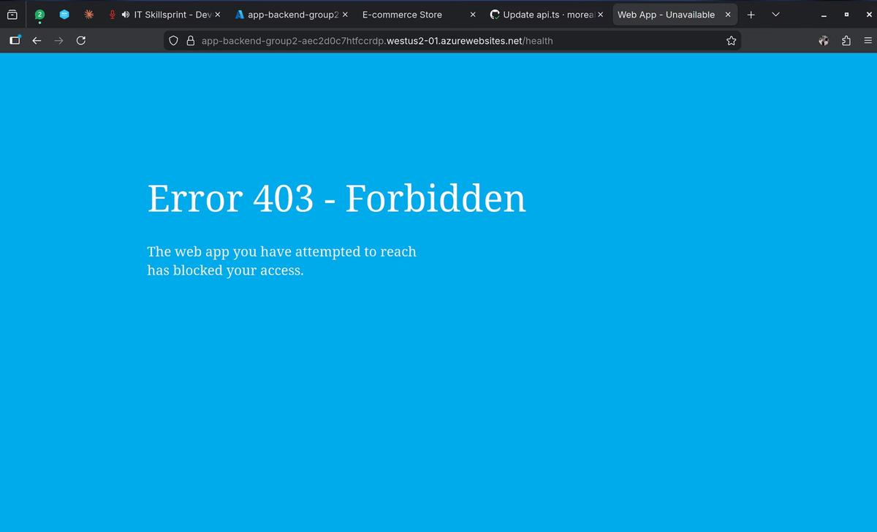
IRONHACK — DEVOPS & CLOUD
PRIVATE NETWORKING
Private Access Enforced — Direct backend URL blocked with 403 Forbidden (no public access)

Slide 19
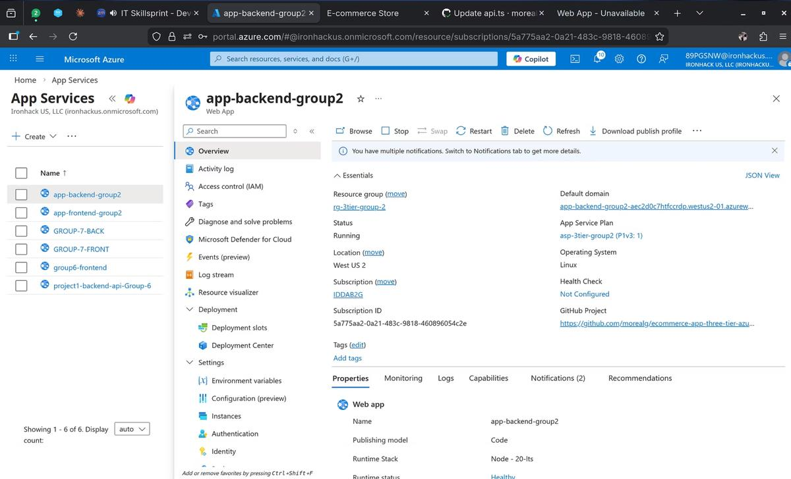
APP SERVICES
Backend App Service — Running status confirmed, linked to GitHub repository

Slide 20
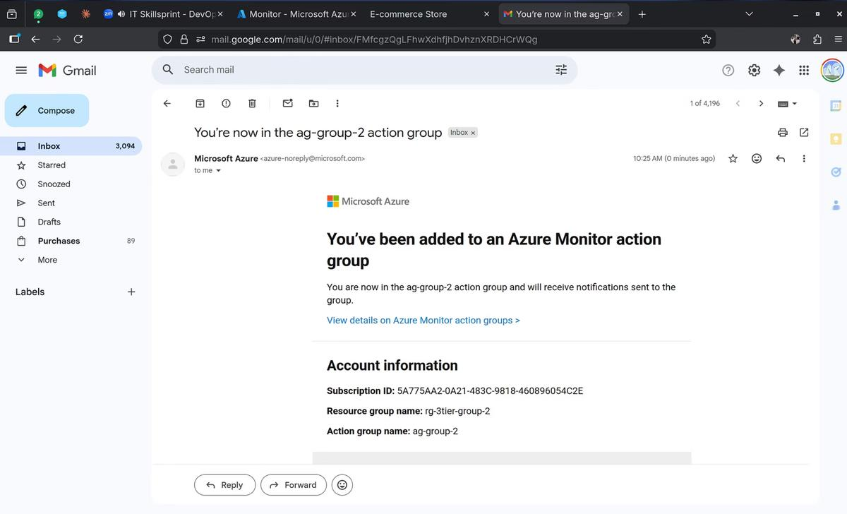
IRONHACK — DEVOPS & CLOUD
MONITORING
Azure Monitor Action Group — Email action group ag-group-2 configured and confirmed

Slide 21
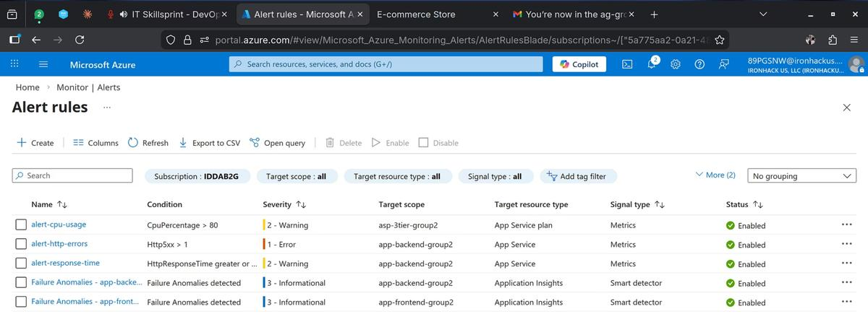
MONITORING
Alert Rules — 3 custom + 2 smart detector rules enabled (CPU, HTTP errors, response time)

Slide 22
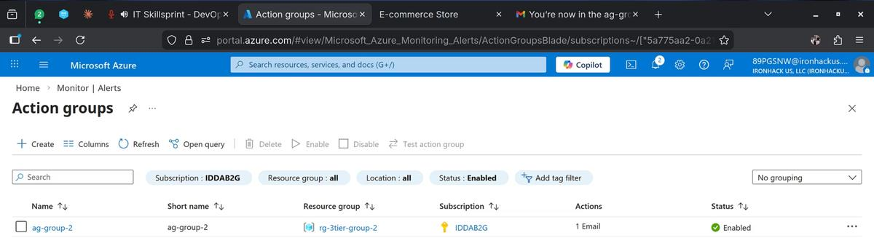
MONITORING
Action Groups — ag-group-2 enabled with 1 email action in rg-3tier-group-2

Slide 23
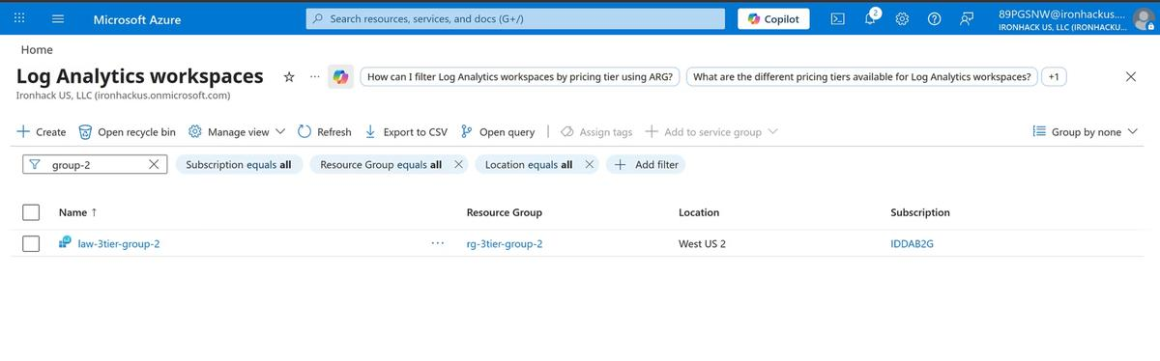
MONITORING
IRONHACK — DEVOPS & CLOUD
Log Analytics Workspace — law-3tier-group-2 deployed in West US 2

Slide 24
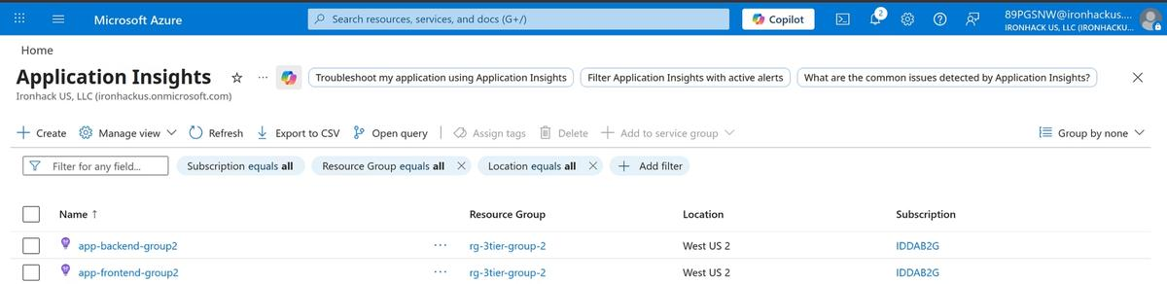
IRONHACK — DEVOPS & CLOUD
MONITORING
Application Insights — Two instances (backend + frontend) in rg-3tier-group-2
23 / 32

Slide 25
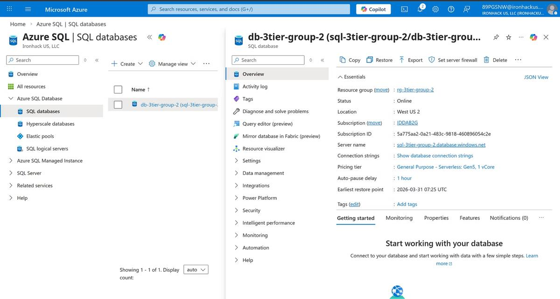
IRONHACK — DEVOPS & CLOUD DATABASE
Azure SQL Database — db-3tier-group-2 Online, Serverless Gen5, Private Endpoint only

Slide 26
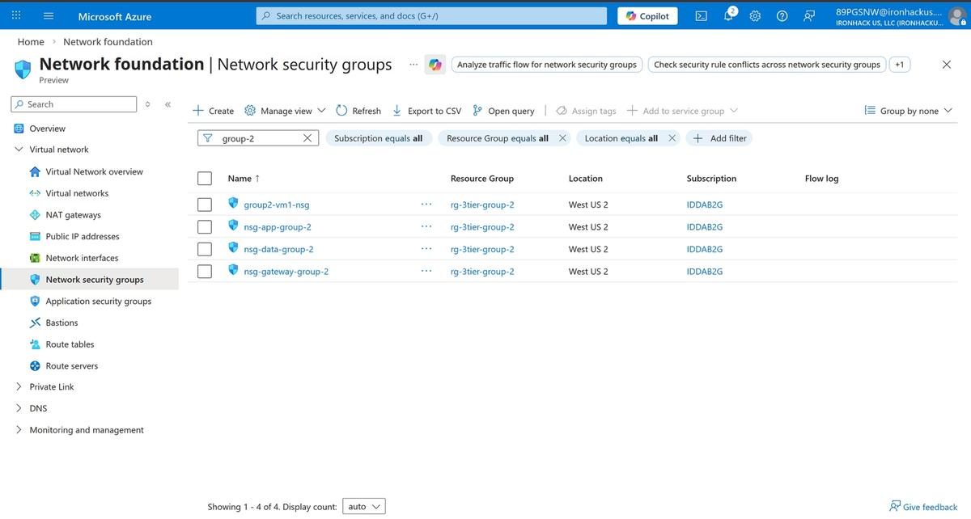
NETWORKING
Network Security Groups — 4 NSGs covering gateway, app, data, and VM subnets

Slide 27
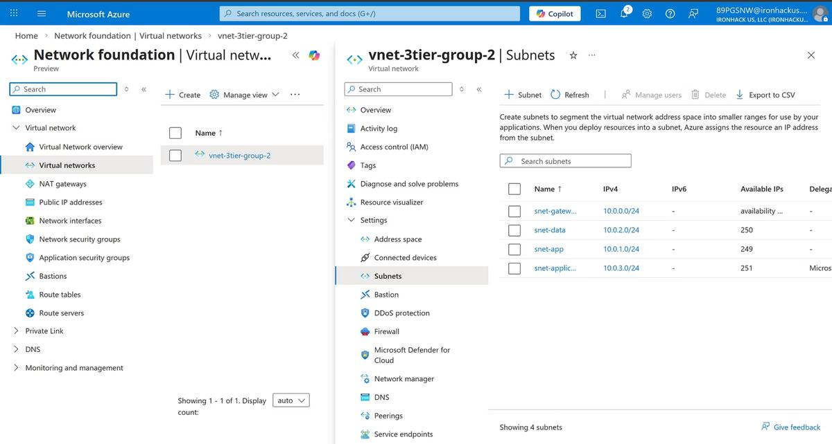
NETWORKING
Virtual Network & Subnets — vnet-3tier-group-2 with 4 subnets (gateway, data, app, applic)

Slide 28
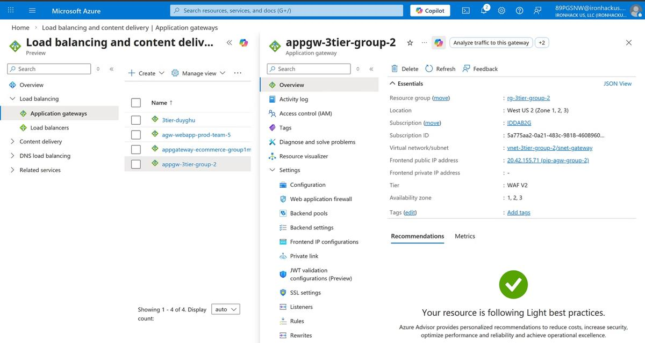
IRONHACK — DEVOPS & CLOUD
APPLICATION GATEWAY
Application Gateway WAF v2 — appgw-3tier-group-2, Public IP 20.42.155.71, Zones 1-2-3
27 / 32

Slide 29
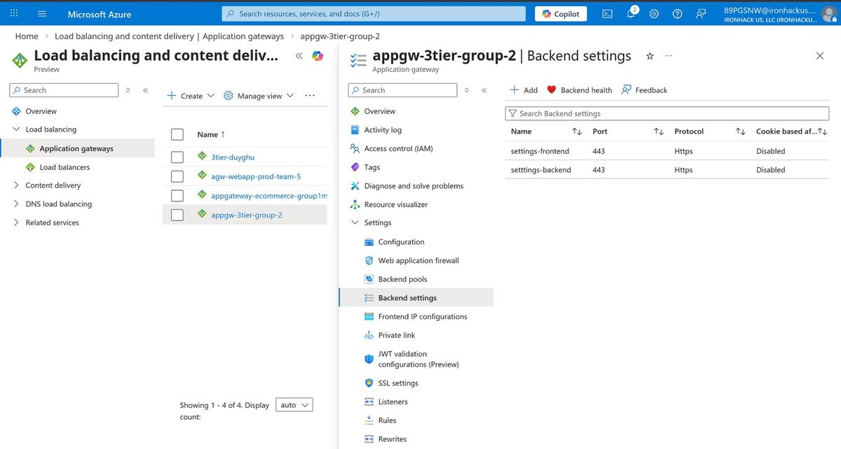
IRONHACK — DEVOPS & CLOUD
APPLICATION GATEWAY
AGW Backend Settings — Frontend (443 HTTPS) and Backend (443 HTTPS) configured

Slide 30
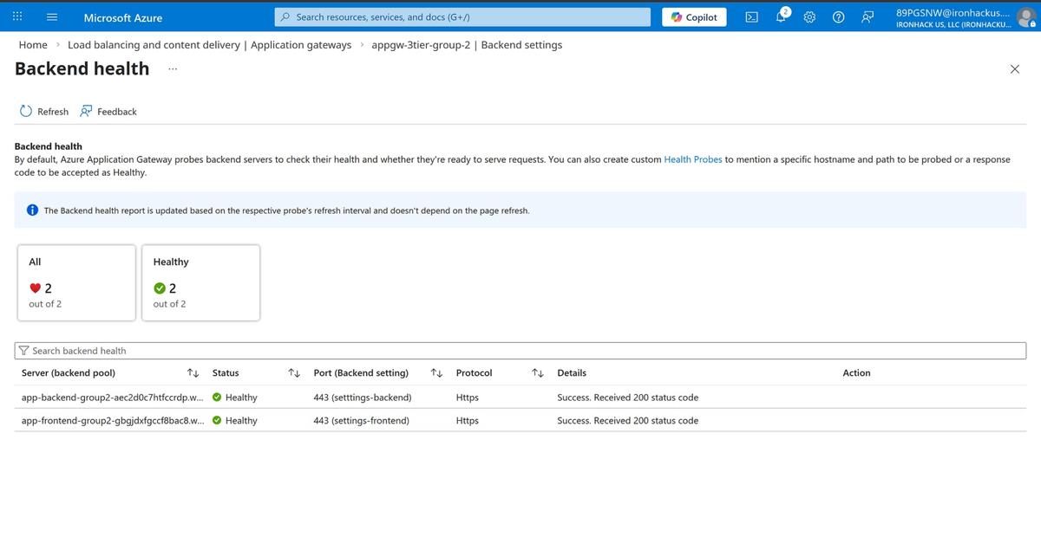
IRONHACK — DEVOPS & CLOUD
APPLICATION GATEWAY
AGW Backend Health — Both frontend and backend pools healthy (200 OK)

Slide 31
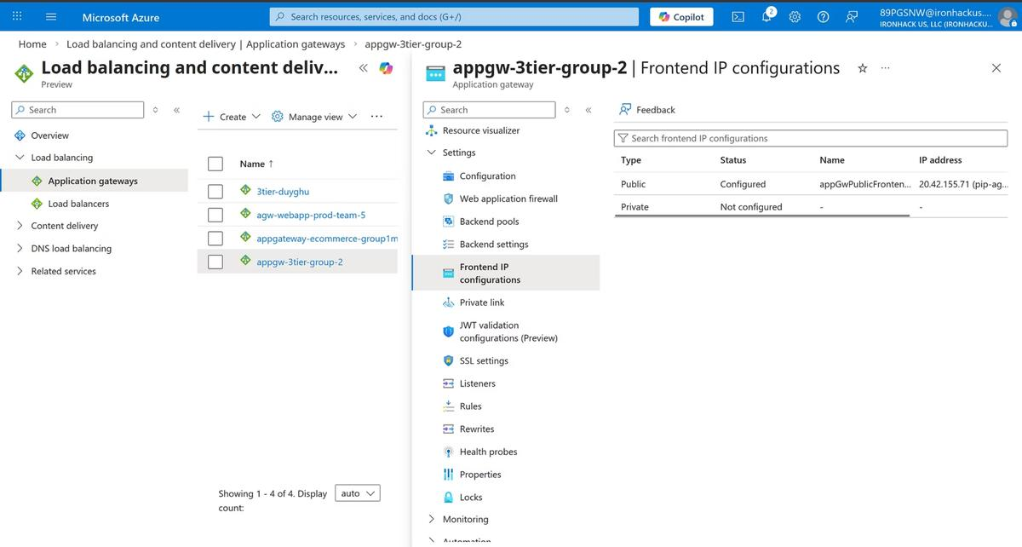
IRONHACK — DEVOPS & CLOUD
APPLICATION GATEWAY
AGW Frontend IP — Public IP 20.42.155.71 configured, private IP not configured

Slide 32
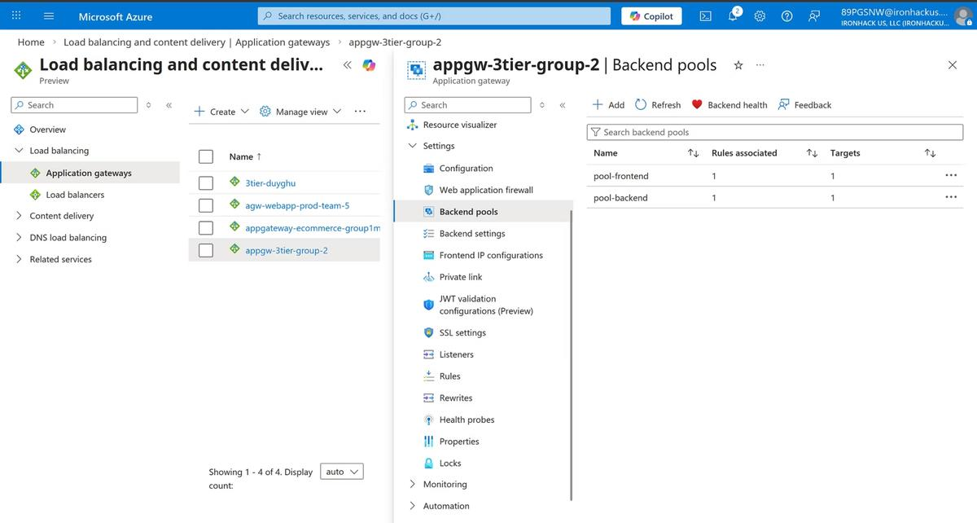
APPLICATION GATEWAY
AGW Backend Pools — pool-frontend and pool-backend, each with 1 rule and 1 target

Slide 33
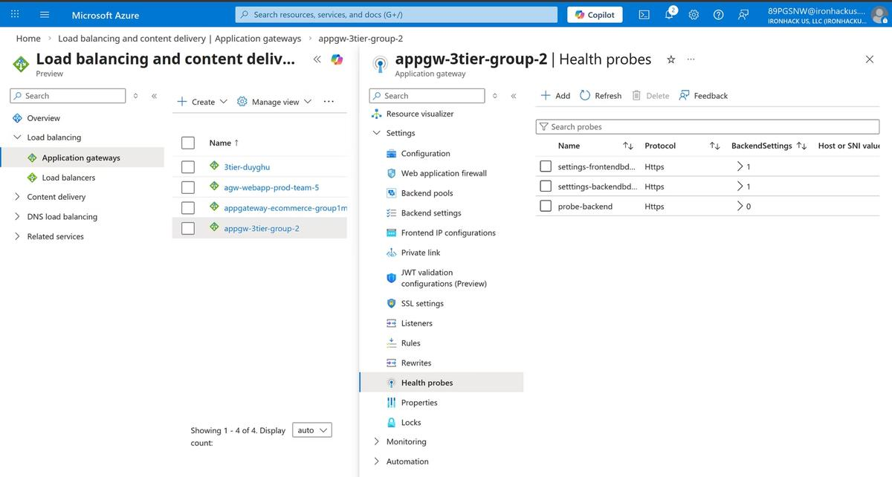
IRONHACK — DEVOPS & CLOUD
APPLICATION GATEWAY
AGW Health Probes — 3 probes (frontend, backend, probe-backend) using HTTPS

Slide 34

CONCLUSION & INSIGHTS
Did We Meet the Objectives?
✓ COMPLETED
✓ COMPLETED
3-tier Azure reference architecture with private networking
Azure SQL with Private Endpoint, public access disabled
✓ COMPLETED
✓ COMPLETED
React frontend and Express backend as separate deployable services
VNet, subnets, NSGs, Private Endpoints, Private DNS Zones
✓ COMPLETED
✓ COMPLETED
Monitoring: health probes, App Insights, alert rules, action groups
App Gateway WAF v2 — / to frontend, /api/* to backend

