Slide 1
Sort Algorithm
Prepared by TeamName

Slide 2
Topics
What is Sort Algorithm?
Selection Sort
Bubble Sort
Insertion Sort
Merge Sort
Quick Sort
Heap Sort

Slide 3
Sort Algorithm
A Sorting Algorithm is used to rearrange a given array or list of elements according to a comparison operator on the elements. The comparison operator is used to decide the new order of elements in the respective data structure. Different algorithms are optimized for different types of data and scenarios, offering trade-offs between speed, memory usage, and complexity.

Slide 4
Selection Sort
Selection Sort is a comparison-based sorting algorithm. It sorts an array by repeatedly selecting the smallest (or largest) element from the unsorted portion and swapping it with the first unsorted element. This process continues until the entire array is sorted.

Slide 5
Selection Sort Algorithm:
Steps of the Selection Sort Algorithm:
Start with the first element as the initial position.
Find the smallest element in the unsorted portion of the array.
Swap this smallest element with the first unsorted element.
Move the boundary of the sorted portion one element forward.
Repeat steps 2-4 for the remaining unsorted elements until the entire array is sorted.

Slide 6
Animation

Slide 7
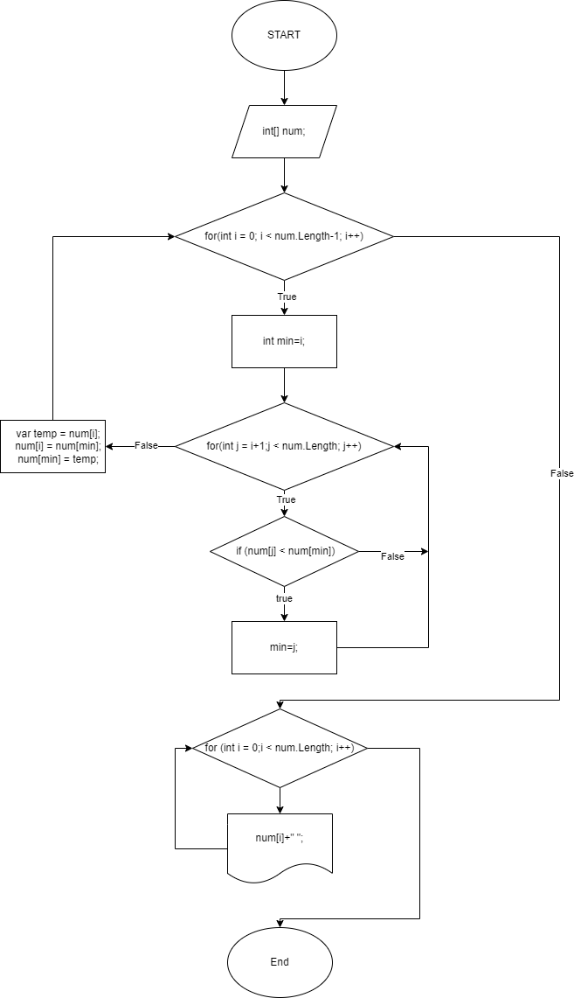
Selection Sort Flowchart

Slide 8
Selection Sort Code in C#
int[] num = { 12, 3, 56, 8, 24, 6, 89 };
int min;
int temp;
for (int i = 0; i < num.Length-1; i++)
{
min = i;
for (int j = i+1;j < num.Length; j++)
{
if (num[j] < num[min])
{
min = j;
}
}
temp = num[i];
num[i] = num[min];
num[min] = temp;
}
for (int i = 0;i < num.Length; i++)
{
Console.Write(num[i]+" ");
}

Slide 9
