Slide 1
Employee Data Analysis using Excel
STUDENT NAME: Y.V.RAVANA
REGISTER NO: 312216118/asunm1621312216118
DEPARTMENT: III B.COM (Accounting & Finance)
COLLEGE: Shri Shankarlal Sundarbai Shasun Jain College For Women.

Slide 2
PROJECT TITLE
Employee Performance Analysis using Excel

Slide 3


AGENDA
Problem Statement
Project Overview
End Users
Our Solution and Proposition
Dataset Description
Modelling Approach
Results and Discussion
Conclusion
3/21/2024 Annual Review

Slide 4

PROBLEM STATEMENT It allows us to identify the specific area of performance that is problematic,such as low productivity,high absenteeism,or poor quality of work. And it also provides a system-wide analysis of workflow, talent, product quality, and other key indicators of organizational success.

Slide 5

PROJECT OVERVIEW
Summary of Employee data analysis:
The process of collecting, analyzing, and interpreting employee data to improve business decisions, productivity, and the workplace environment.It allow us to Identify trends in employee behavior, job satisfaction, and productivity, Manage costs related to recruitment, hiring, and training by reducing turnover.

Slide 6

WHO ARE THE END USERS?
The end users of Excel data analysis are anyone who uses Excel to organize, interpret, and evaluate data
Finance
Accounting
Healthcare
Industries
Retails etc

Slide 7

OUR SOLUTION AND ITS VALUE PROPOSITION
Analyze data: natural language queries to understand data, and get visual summaries, trends, and patterns.
Pivot tables: View hierarchical data in a compact layout.
Charts: Create charts regularly, and use new charting formats.It represents the data in various forms such as pie chart, bar graphs etc.
Conditional formatting: Use icons, data bars, and color scales to emphasize data. In this project we used this to highlight the missing values
Formula: Formula used to calculate the Performance level of the employees using given information.

Slide 8
Dataset Description
Employee data set downloaded from Kaggle
It consist of 26 features, in which features that used in the project are 9 features
The features are given below:
Employee id – numerical
First name - Text
Name – Text
Employee Type - Text
Performance level- numerical
Gender- Male/Female
Employee rating – Numrical
Employee classification – Text
Performance score – Text

Slide 9

THE "WOW" IN OUR SOLUTION
=IFS(Z7>=5,"VERY HIGH",Z7>=4,"HIGH",Z7>=3,"MED",TRUE,"LOW")
Formula used to calculate the Performance level of the employees using given information.
3/21/2024 Annual Review
9

Slide 10
MODELLING
Data collection:
1). Login to the keggle website
2). Downloaded the data set information from the keggle website
3). Sorted out the required data’
Features collection:
1).Conditional formatting
2).filter
Data cleaning:
1). Highlight/identify the missing values
2).Filter option used to remove the missing values/or to filter the values.
10

Slide 11
Performance level:
=IFS(Z2>=5,"VERY HIGH",Z2>=4,"HIGH",Z2>=3,"MED",TRUE,"LOW")
Using this formula the performance level will be calculated which shows the performance level of the employees according to their performance.
It will be categorized in three different level , if employee performance score is 5 then he will be ranked as “very high” if it is 4 they the level will be “high”if it is 3 then the rank will be med (medium).
Summary:
1). Review the employee’s job description get a current copy of each person’s job description and review the requirements.
2). Compare strengths and weaknesses next, use past evaluations and job descriptions to create a list of each team member’s strengths and weaknesses.

Slide 12
Visualization:
1). Enter the data into the sheet using the "Insert" option in the program toolbar.
2). After the data is in the sheet, find the "Select data" option to choose the information you want to display. This gives you a basic chart display, but you can change the chart design to a different style.
3). Select the style of graph you want for your report from the "Chart design" tool in the menu.
Pivot table:
1). Under the "Insert" option, select "PivotTable" in the menu.
2).Select the range and location of the data you want to include in the table.
3).Enter the labels for the reference and values fields of the new table and arrange it in your sheet.
4).Choose the calculation you want the table to measure from the data, such as the average or maximum and minimum, and update the pivot table.

Slide 13
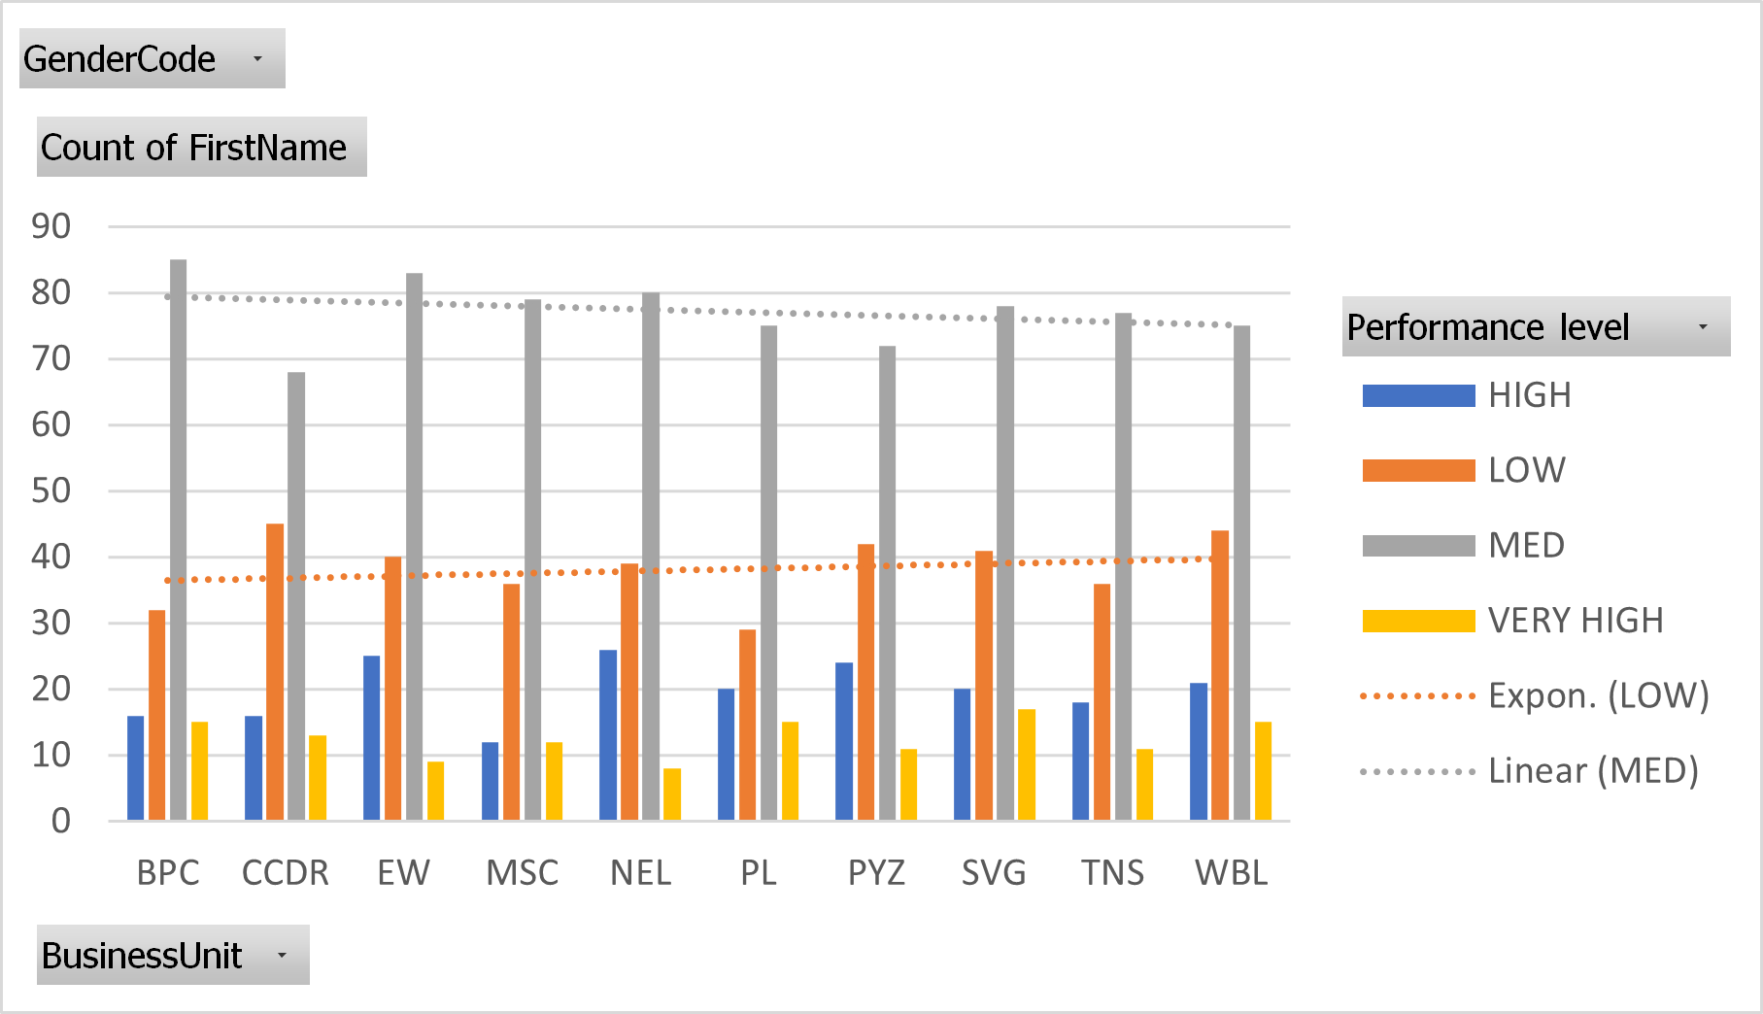
RESULTS
13

Slide 14
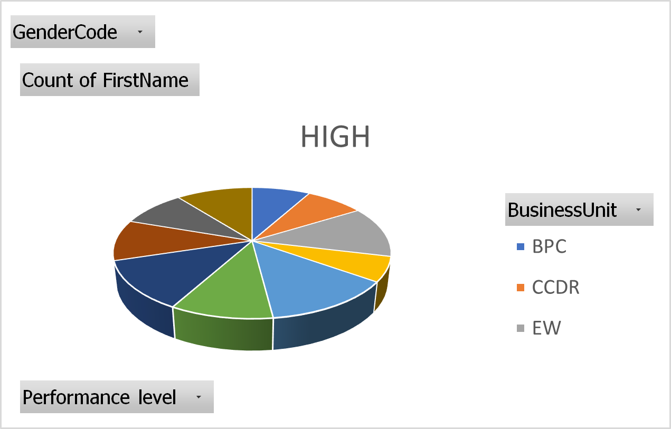

Slide 15
conclusion
Employee data is a valuable asset that must be protected from unauthorized access, misuse, and data breaches. Excel, a widely used spreadsheet tool, can be a secure platform for managing employee data.
Learnt about different types of employee data and find out how to make your employee data collection process transparent and effective!

