Slide 1
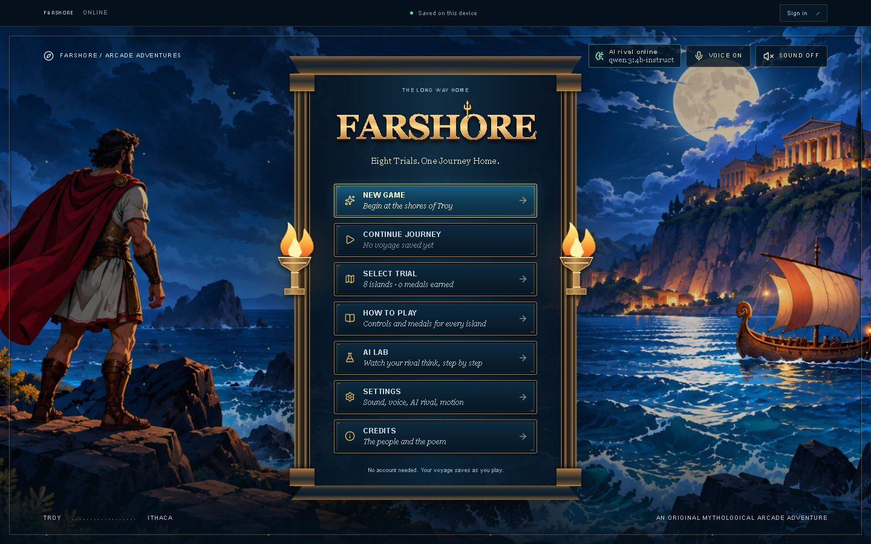
Farshore
Phase 3: design, frontend and Cyclops usability testing
Bibek Pathak · CMPS 4200 HCI: AI-Enhanced UI/UX · November 2026
Farshore prototype title menu
Eight trials. One journey home. A mythic rival that a language model plans every round.
Notes:
About 30 seconds. Farshore is eight Odyssey trials, each with an AI rival that a language model plans before every round. This study tested Cyclops' Cave.

Slide 2
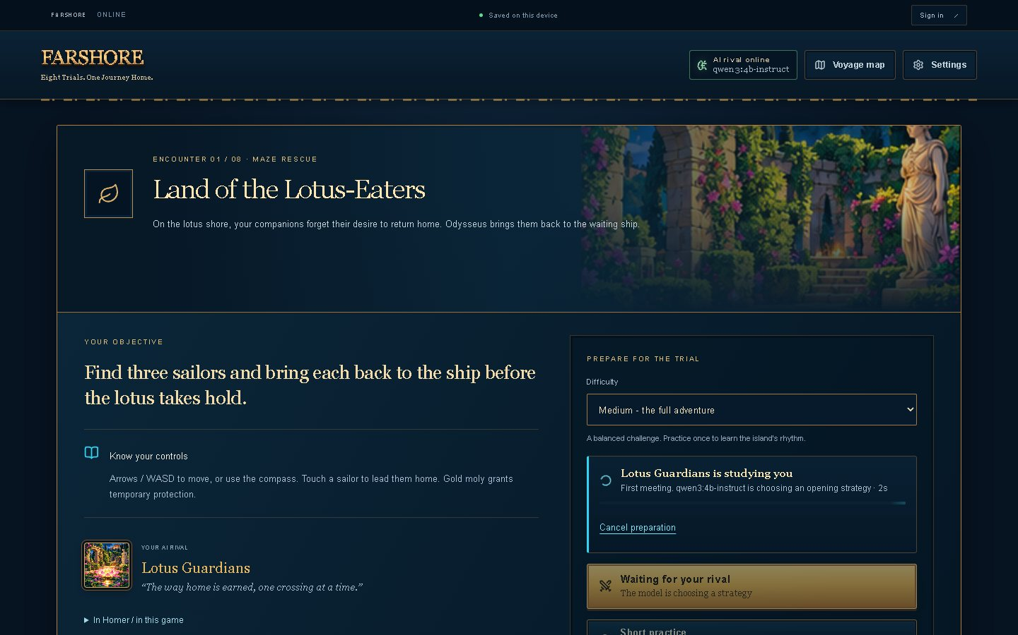
An arcade Odyssey with an AI rival
1
Eight trials, one per episode
Lotus-Eaters maze, Cyclops' Cave runner, Aeolus' winds, Circe's duel, the Sirens, Scylla, Calypso and Ithaca's bow.
2
A model plans every rival
Before each round, Qwen3-4B reads the player's recent attempts and picks the rival's strategy and taunt.
3
Code owns game rules
Code owns scoring and collisions; the model picks the strategy.
Trial selection, with each trial's AI technique
Notes:
About 35 seconds. One trial per episode. Before each round the model reads recent attempts and picks the rival's strategy; the game code keeps the rules.

Slide 3
Style basics, defined once in code
Colour
Five text sizes
Spacing scale
Background
#071523
Surface
#0B2033
Aa XS · 12 px
4 px
Aa S · 14 px
8 px
Text
#F6F0E3
Muted text
#93AFC0
Aa M · 16 px
12 px
16 px
Aa L · 24 px
24 px
Accent (gold)
#E9B85C
AI (cyan)
#32D4F5
Aa XL · 40-72 px
32 px
48 px
Error
#F4604F
Success
#9FE6B4
Defined once in src/styles/tokens.css and reused on every screen.
Notes:
About 40 seconds. One palette, four font families, five sizes and one spacing scale, defined once in tokens.css. Cyan is only for the AI, so it never reads as danger.

Slide 4
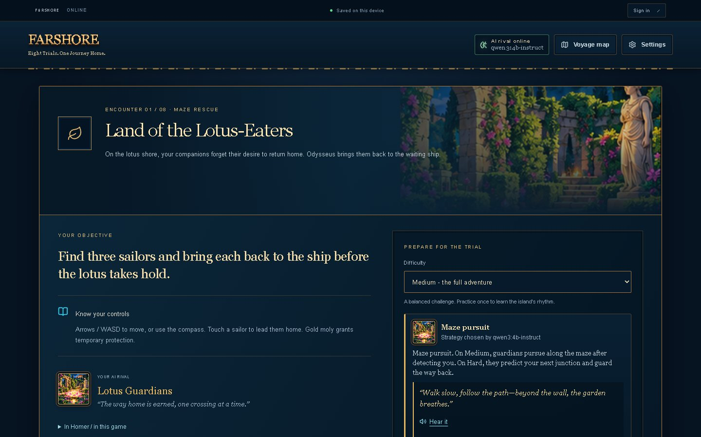
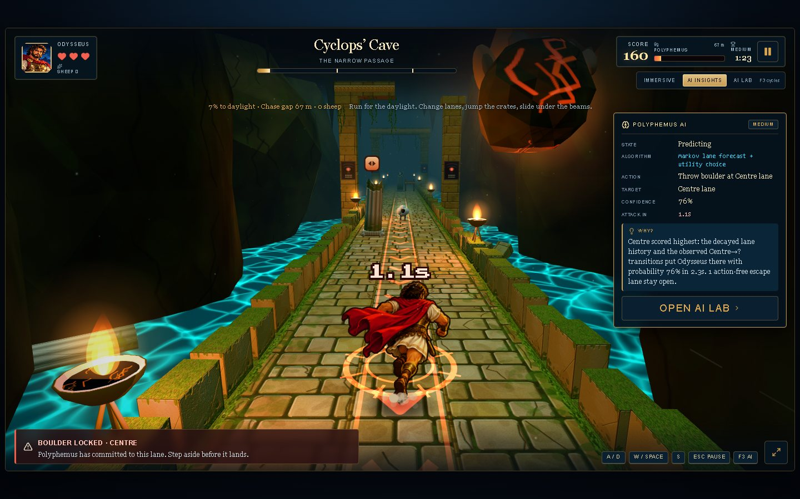
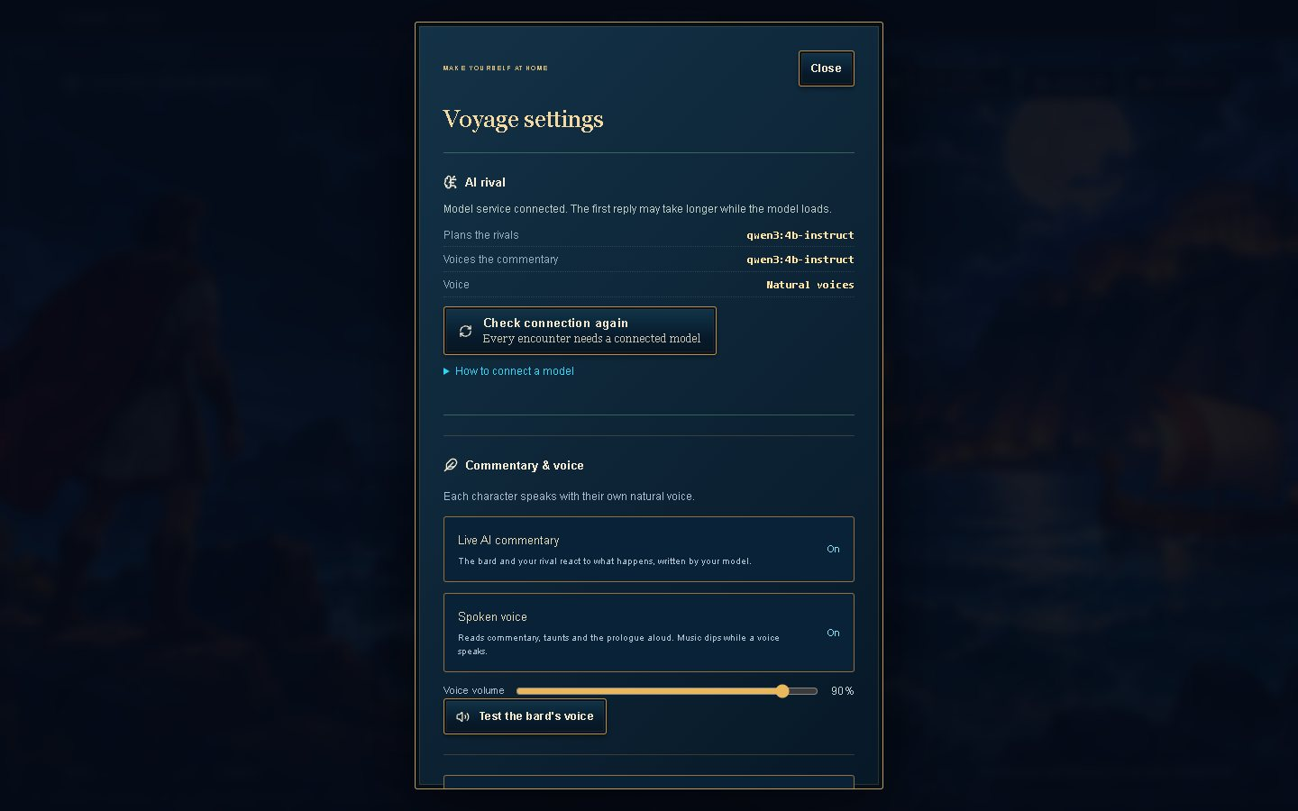
Core screens built from the Phase 2 site map
29
annotated design frames: 25 desktop, 4 phone
F1 Start
F2 Choose a trial
F3 Prepare the rival
F4 Play
F5 Understand the rival
F6 Settings
F7 Account
Title menu
Briefing: strategy ready
Cyclops' Cave with AI Insights
Settings: AI status and controls
Notes:
About 35 seconds. Four of the core screens. All 29 annotated frames are submitted as images and cover flows F1 to F7.

Slide 5
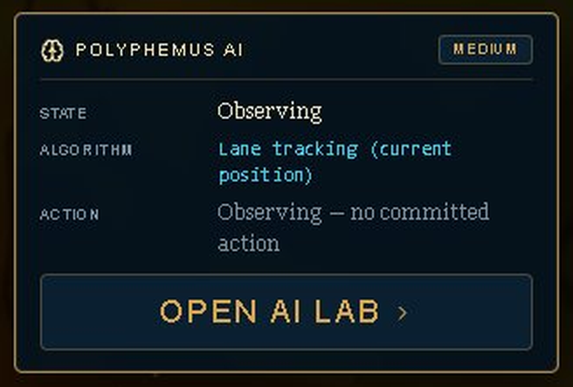
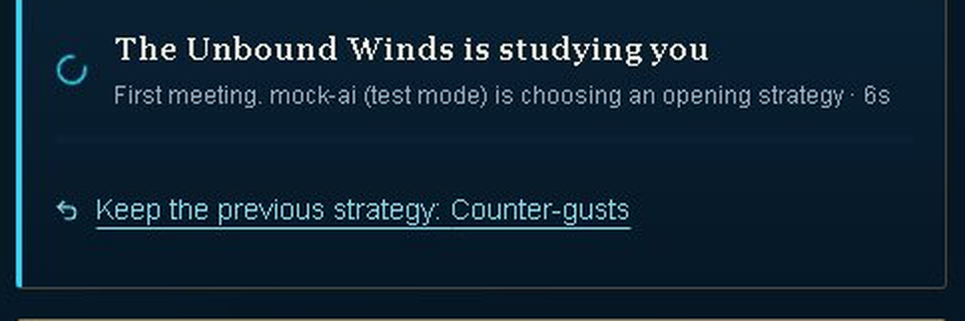
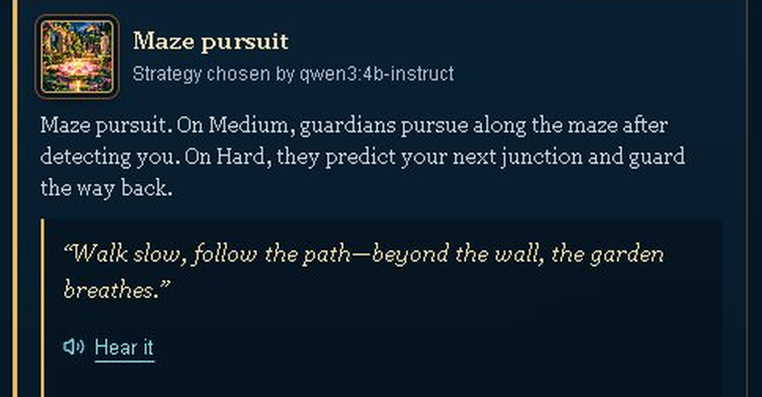
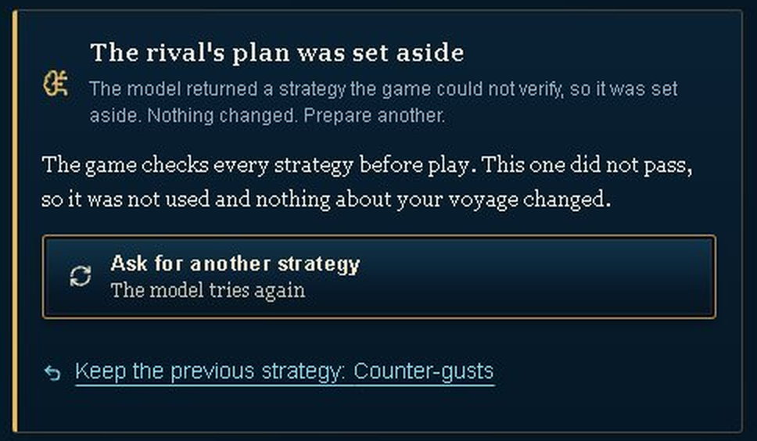
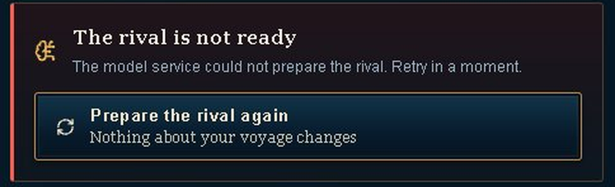
The rival's strategy in all five states
1
Empty
2
Loading
3
Success
Before the rival commits: "no committed action".
Elapsed seconds, no fake progress bar.
The strategy, the model that chose it, and the rival's taunt.
4
Low confidence
5
Error
HOW THESE WERE MADE
From the running game
States 4 and 5 use the mock AI service.
Failed the game's checks, so it was set aside.
A plain message and a way to recover.
Notes:
About 45 seconds. The rival's strategy in all five states. States 4 and 5 were captured with the mock AI service.

Slide 6
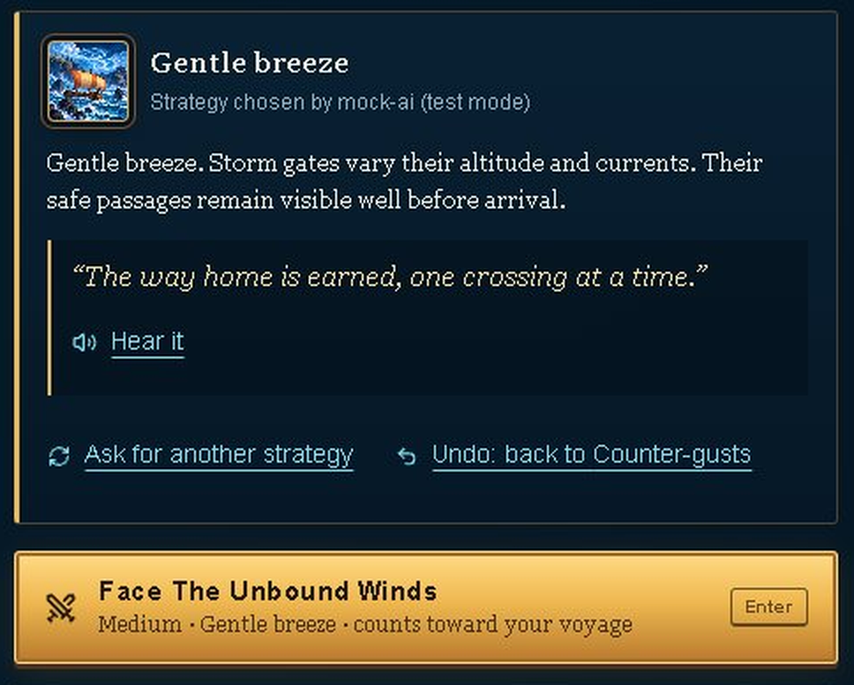
Players stay in control of the AI's choice
1
Regenerate
"Ask for another strategy": the model chooses again.
2
Undo
Go back to the previous strategy.
3
Reject
Plans that fail the game's checks are never used.
4
Cancel
Stops the request and waits.
5
Edit: not offered
The strategy is the opponent's move.
Notes:
About 35 seconds. Players can regenerate, undo and cancel, and plans that fail the checks are never used. Editing is not offered: the strategy is the opponent's move.

Slide 7
A mock AI service tests every state on demand
mock-ai.ts (test mode)
success · slow · uncertain · error · offline
Game interface
model-api.ts
Briefing, rival panel, live commentary
One module for every AI call
Live model
Qwen3-4B through Ollama, or a hosted provider
Switch from a second tab: localhost:3000/api/ai-mock?mode=error-once
Task 4 uses a mock error on the Cyclops' Cave briefing.
Notes:
About 40 seconds. Every AI call goes through one module, which asks the mock first. The moderator switches modes from a second tab; Task 4 uses it to trigger an error.

Slide 8
What changed since the Phase 2 wireframes
A1
A5
A7
Five trials became eight
Explainable AI Insights
Full-screen play stage
One game per episode, in the Odyssey's order.
Shows why the rival acted.
More room for play.
A2
A15-A16
A14, A17
The AI rival is required
Low confidence and undo
Mock service and tokens
A clear offline state replaces the toggle.
A doubtful plan never looks like an outage.
Test every AI state; style defined once.
Notes:
About 35 seconds. The main changes since the Phase 2 wireframes. The full list is in the report, Section 4 Part A.

Slide 9
Usability test: four tasks, one script for everyone
T1
from F1
T2
from F2
T3
from F3
T4
from F4
Start your journey
Know your opponent
Read the rival's mind
AI failure
Reach the Cyclops' Cave briefing
Recover from an AI error without help
Say what the rival plans and who decided
Explain one decision from the AI panel
Mock error, no warning
Measures
Success: Yes / Partly / No / Gave up
Time on task
Ease 1-5
SUS, 10 items
AI trust 1-5, with why
5 participants · Cyclops' Cave · the same script for everyone
Notes:
About 45 seconds. Four tasks from the primary flows and the same script for every participant, then SUS and an AI trust question.

Slide 10
Baseline results: five participants
Task | Reported Yes | Median time (s) | Mean ease (1-5)
T1 Start your journey | 5/5 | 4 (n=5) | 4.2 (n=5)
T2 Know your opponent | 4/4 | 30 (n=4) | 3.2 (n=4)
T3 Read the rival's mind | 4/4 | 21 (n=4) | 2.8 (n=5)
T4 AI failure | 5/5 | 8 (n=5) | 3.8 (n=4)
59.5
SUS mean
out of 100; the average is 68
3.0
AI trust
mean rating, 1-5
All 5 recovered from the AI error without help.
Notes:
About 60 seconds. Mean SUS 59.5, below the average of 68; trust 3.0 of 5. Starting and recovering were easy; reading the AI panel was hardest (ease 2.8). The report covers the data limits.

Slide 11
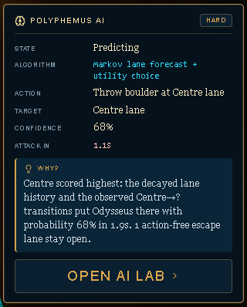
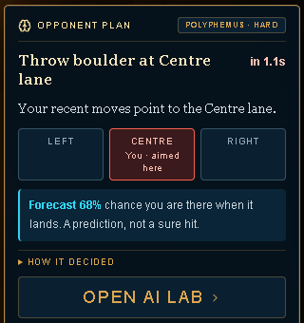
Findings and interface improvements
Issue | Severity (0-4) | Participants | Change in the game
Dense AI text | 3 | 4/5 | Compact explanation
Prediction doubts | 2 | 3/5 | Forecast + result
Hard-to-find plan | 2 | 3/5 | One opponent panel
Before and after
Before (as tested)
After
Fixed in the game; retest in Phase 5
Action and short reason first
Details only on demand
Forecast vs. observed result
Matching recovery labels
Notes:
About 55 seconds. The worst issue was dense AI text, then doubt about predictions and a hard-to-find plan. All are fixed in the game; ?ui=baseline shows the before view. Retesting is Phase 5.

Slide 12
Next: Phase 4, then a short demo
Phase 4 plan
Live demo, about 2 minutes
Phone: opponent plan inside the play area
Lotus-Eaters: use the model's plan
Short reasons for every rival
Phase 5: retest with the same tasks
1
New game, then the first briefing
2
The rival panel: strategy and who chose it
3
Ask for another strategy, then Undo
4
Mock error, then Keep previous strategy
5
Cyclops' Cave: the Opponent plan panel
Questions?
Notes:
About 105 seconds. The Phase 4 issues, then the live demo: new game, the rival panel, ask again and undo, a mock error with Keep previous strategy, and the Opponent plan panel in Cyclops' Cave.

