Slide 1
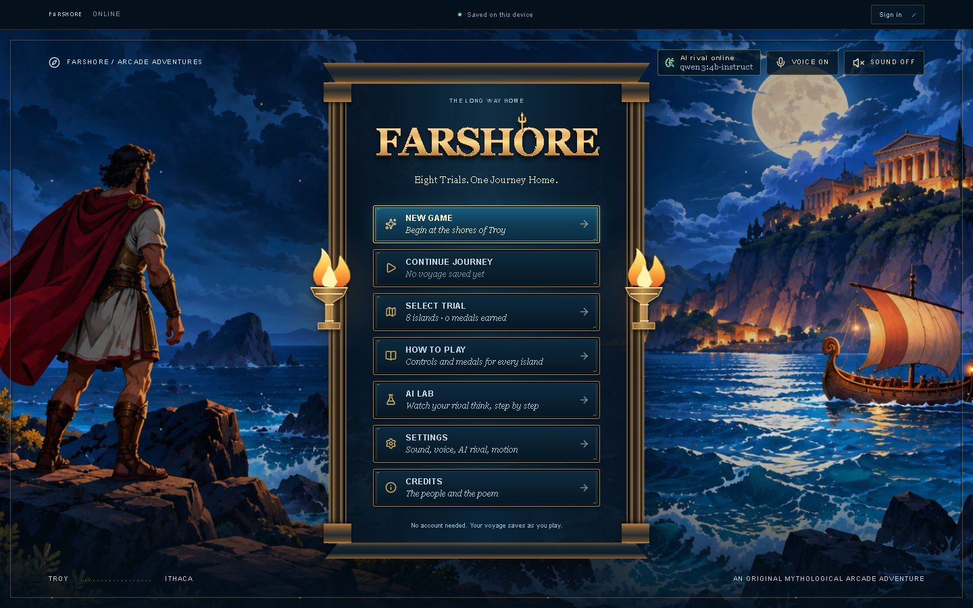
Farshore
Phase 3: design, frontend and Cyclops usability testing
Bibek Pathak · CMPS 4200 HCI: AI-Enhanced UI/UX · November 2026
Farshore prototype title menu
Eight trials. One journey home. A mythic rival that a language model plans every round.
Notes:
Suggested time: 30 seconds.
Introduce Farshore and the scope: five user-supplied participant JSON records focused on Cyclops Cave. Dates and exact build version were not supplied. This is the participant-data package, replacing the earlier illustrative analysis.
Sources: participant_p1_cyclops_cave.json through participant_p5_cyclops_cave.json; supplied Farshore design report and Phase 3 requirements. Total suggested talk 9 minutes 20 seconds, leaving 40 seconds within the 10-minute slot.

Slide 2
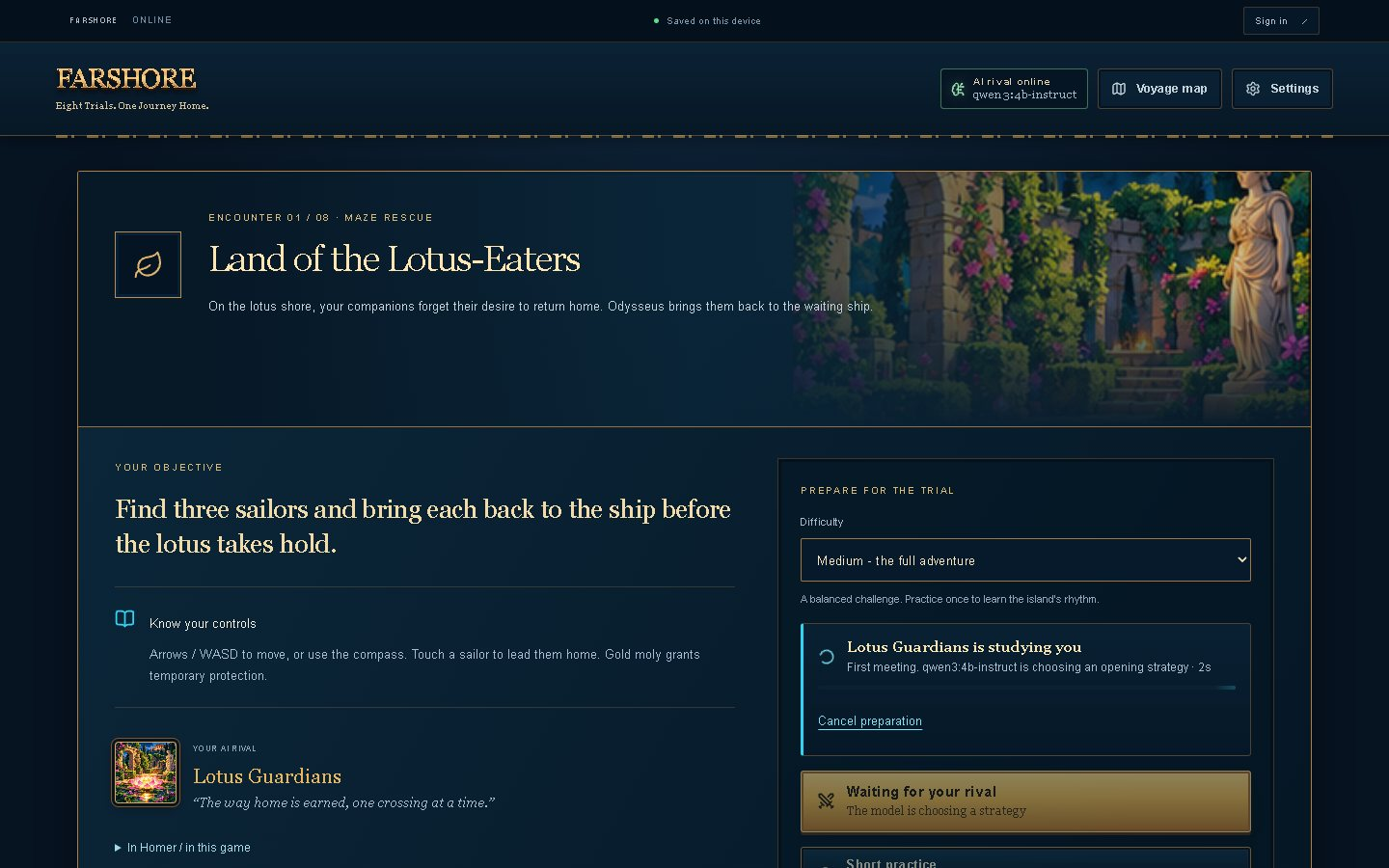
An arcade Odyssey with an AI rival
1
Eight trials, one per episode
Lotus-Eaters maze, Cyclops' Cave runner, Aeolus' winds, Circe's duel, the Sirens, Scylla, Calypso and Ithaca's bow.
2
A model plans every rival
Before each round, Qwen3-4B reads the player's recent attempts and picks the rival's strategy and taunt.
3
Code owns game rules
Code owns scoring and collisions. The supplied pilot notes identify a Lotus strategy integration issue for follow-up.
Trial selection, with each trial's AI technique
Notes:
Suggested time: 35 seconds.
Explain the eight-trial concept. Separate before-round model strategy selection from the live game decision algorithm. Source materials document a Lotus integration concern; do not claim that all displayed plans are verified in gameplay.
Sources: participant_p1_cyclops_cave.json through participant_p5_cyclops_cave.json; supplied Farshore design report and Phase 3 requirements. Total suggested talk 9 minutes 20 seconds, leaving 40 seconds within the 10-minute slot.

Slide 3
Style basics, defined once in code
Colour
Five text sizes
Spacing scale
Background
#071523
Surface
#0B2033
Aa XS · 12 px
4 px
Aa S · 14 px
8 px
Text
#F6F0E3
Muted text
#93AFC0
Aa M · 16 px
12 px
16 px
Aa L · 24 px
24 px
Accent (gold)
#E9B85C
AI (cyan)
#32D4F5
Aa XL · 40-72 px
32 px
48 px
Error
#F4604F
Success
#9FE6B4
src/styles/tokens.css is the only place these values are defined; every stylesheet reads them. Cyan is kept for the AI, so "the rival is thinking" never looks like danger.
Notes:
Suggested time: 40 seconds.
Present the palette, typography and spacing from the supplied source design. Refer to tokens.css as source documentation; current repository verification was unavailable.
Sources: participant_p1_cyclops_cave.json through participant_p5_cyclops_cave.json; supplied Farshore design report and Phase 3 requirements. Total suggested talk 9 minutes 20 seconds, leaving 40 seconds within the 10-minute slot.

Slide 4
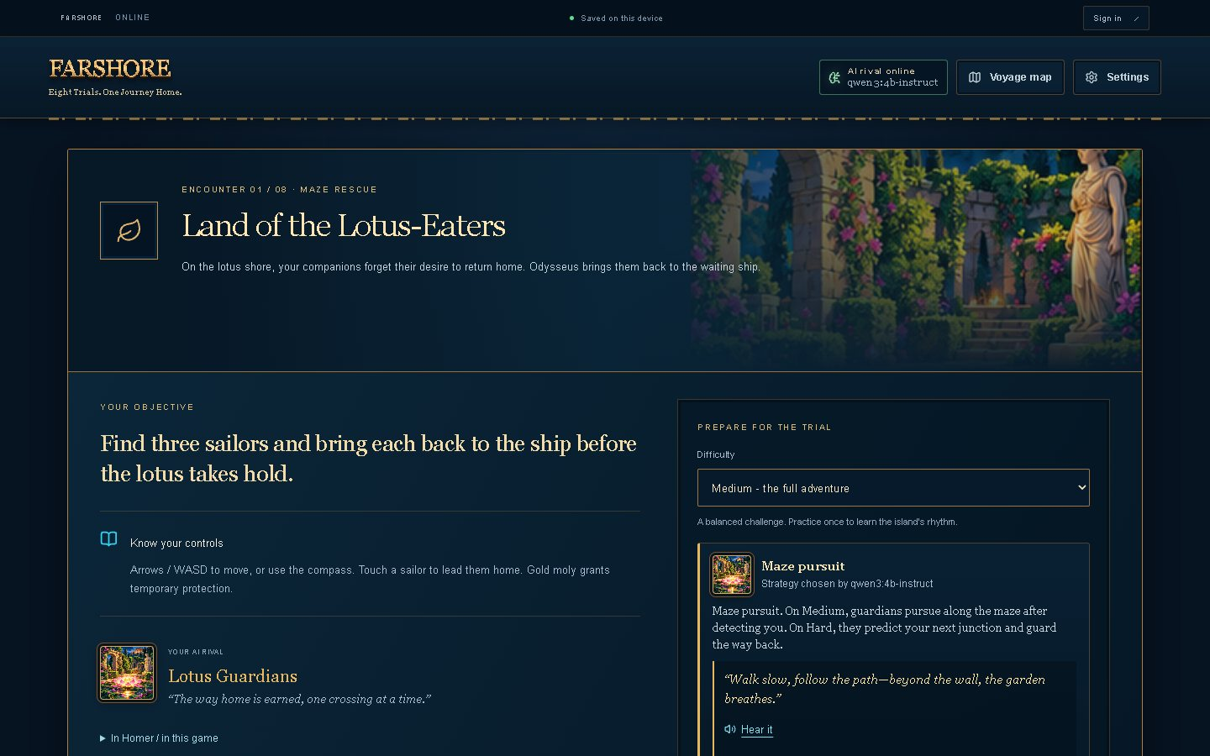
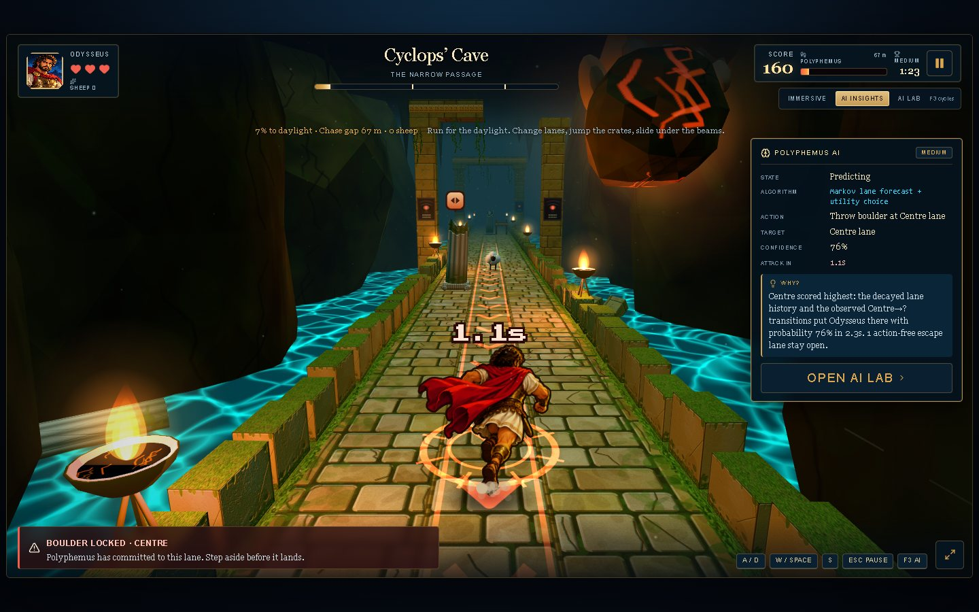
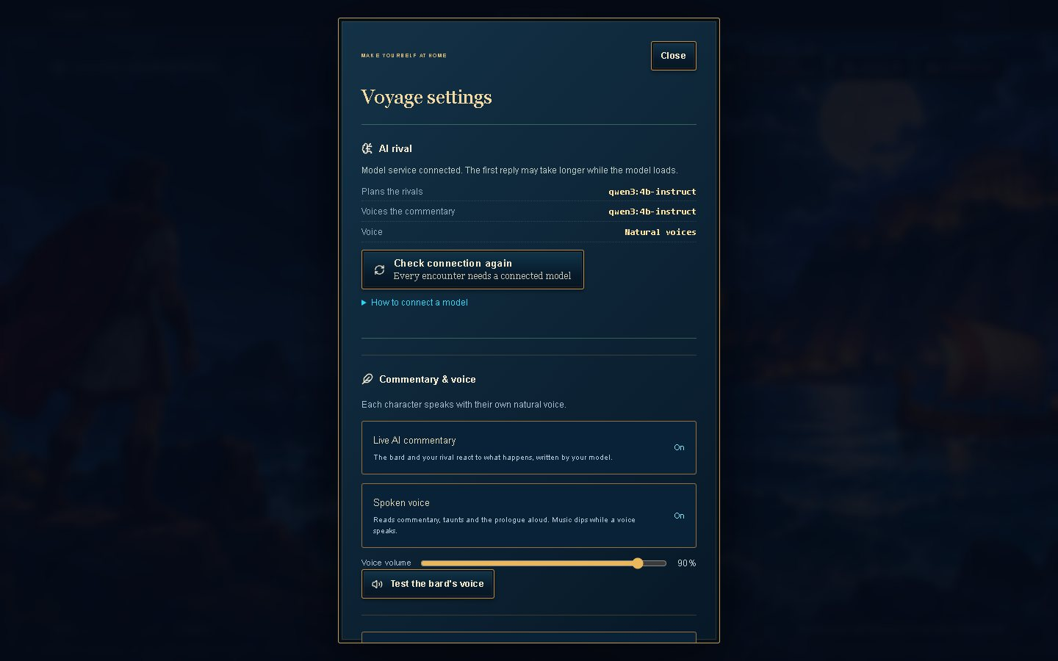
Core screens built from the Phase 2 site map
29
annotated design frames: 25 desktop, 4 phone. Figma view link pending.
F1 Start
F2 Choose a trial
F3 Prepare the rival
F4 Play
F5 Understand the rival
F6 Settings
F7 Account
Title menu
Briefing: strategy ready
Cyclops' Cave with AI Insights
Settings: AI status and controls
Notes:
Suggested time: 35 seconds.
Show the supplied core screens. There are 29 annotated design frames, while the live study is limited to Cyclops Cave. The final Figma view URL must be added before submission.
Sources: participant_p1_cyclops_cave.json through participant_p5_cyclops_cave.json; supplied Farshore design report and Phase 3 requirements. Total suggested talk 9 minutes 20 seconds, leaving 40 seconds within the 10-minute slot.

Slide 5
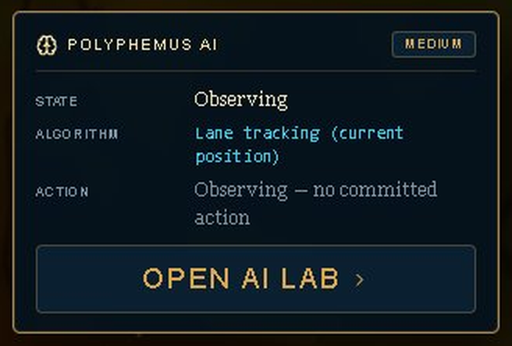
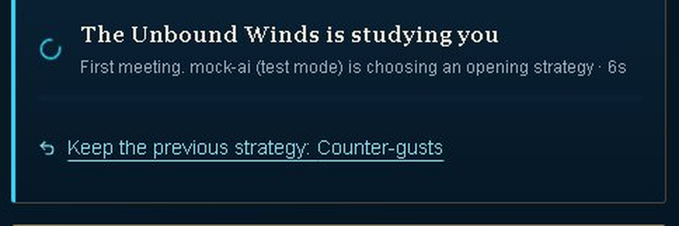
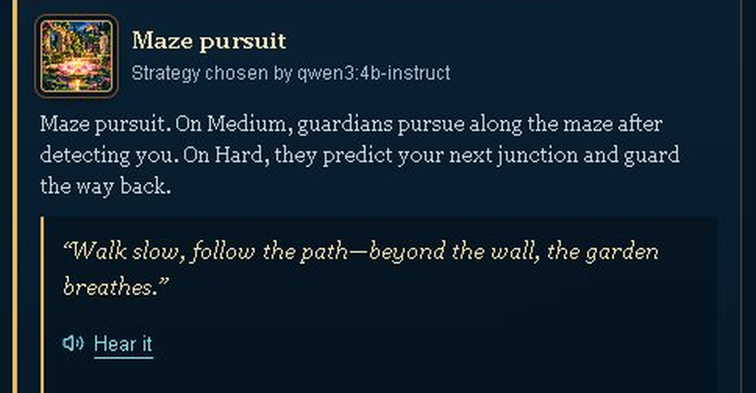
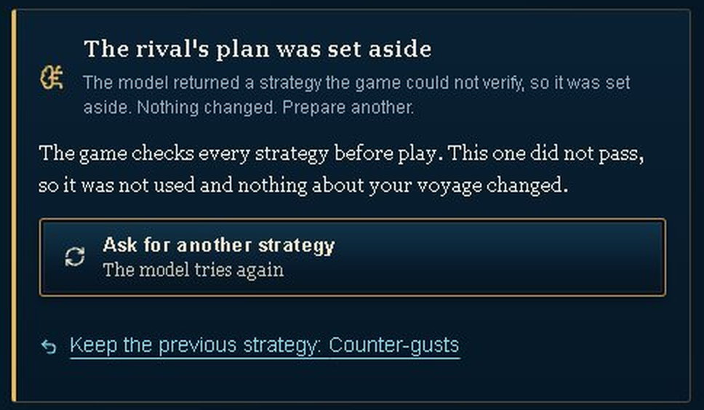
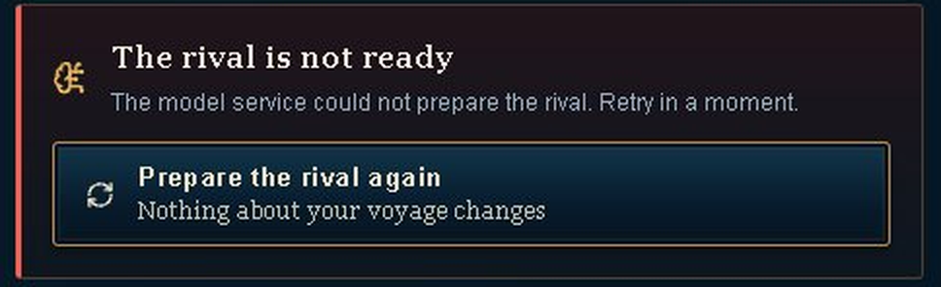
The rival's strategy in all five states
1
Empty
2
Loading
3
Success
AI Insights before the rival commits: "no committed action".
Elapsed seconds, no fake progress bar. Earlier source notes: 7-12 s.
The strategy, the model that chose it, and the rival's taunt.
4
Low confidence
5
Error
HOW THESE WERE MADE
From the running game
States 4 and 5 were triggered with the mock AI service. Success shows the live model, qwen3:4b-instruct.
Failed the game's checks, so it was set aside. Amber, not red.
A plain message and one recovery action. Nothing is lost.
Notes:
Suggested time: 45 seconds.
Describe all five AI states. Earlier latency values are from the supplied materials. This study did not remeasure model latency separately.
Sources: participant_p1_cyclops_cave.json through participant_p5_cyclops_cave.json; supplied Farshore design report and Phase 3 requirements. Total suggested talk 9 minutes 20 seconds, leaving 40 seconds within the 10-minute slot.

Slide 6
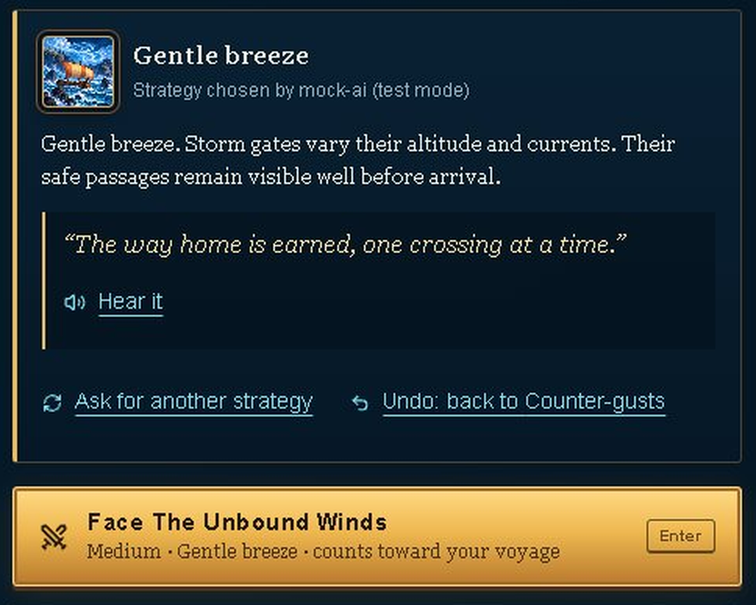
Players stay in control of the AI's choice
1
Regenerate
"Ask for another strategy": the model chooses again.
2
Undo
Go back to the previous strategy, even while a new one loads or if it fails.
3
Reject
The game rejects plans that fail its checks. Commentary and voice can be switched off.
4
Cancel
Cancel is exposed; supplied pilot notes report an automatic restart.
5
Edit: not offered
The strategy is the opponent's move. Changing difficulty asks for a new one.
Notes:
Suggested time: 35 seconds.
Describe regenerate, undo, reject and cancellation controls. The separate prototype keeps cancellation stopped; integration into Farshore must still be verified.
Sources: participant_p1_cyclops_cave.json through participant_p5_cyclops_cave.json; supplied Farshore design report and Phase 3 requirements. Total suggested talk 9 minutes 20 seconds, leaving 40 seconds within the 10-minute slot.

Slide 7
A mock AI service tests every state on demand
mock-ai.ts (test mode)
success 1.5 s · slow 12 s · uncertain · error · offline. "-once" modes fail once, then recover.
Game interface
model-api.ts
Briefing, rival panel, live commentary
One module for every AI call
Live model
Qwen3-4B through Ollama, or a hosted provider for signed-in players
Switch from a second tab: localhost:3000/api/ai-mock?mode=error-once
Task 4 uses a mock preparation failure on the Cyclops' Cave briefing. P1 first needed another strategy request to display the error.
Notes:
Suggested time: 40 seconds.
Explain the mock-service boundary. Task 4 occurs before gameplay. In P1 the first setup showed no error; another strategy request displayed the preparation failure. Recovery times are reported from the uploaded records.
Sources: participant_p1_cyclops_cave.json through participant_p5_cyclops_cave.json; supplied Farshore design report and Phase 3 requirements. Total suggested talk 9 minutes 20 seconds, leaving 40 seconds within the 10-minute slot.

Slide 8
What changed since the Phase 2 wireframes
A1
A5
A7
Five trials became eight
Explainable AI Insights
Full-screen play stage
Follows the Odyssey's route, with one game per episode.
Players see why the rival acted, and that it cannot attack unfairly.
The small embedded canvas competed with the page around it.
A2
A15-A16
A14, A17
The AI rival is required
Low confidence and undo
Mock service and tokens
The opponent is the core experience; a clear offline state replaces the toggle.
A doubtful plan no longer looks like an outage, and asking again can be undone.
Every AI state can be tested on demand; style values are defined once.
Notes:
Suggested time: 35 seconds.
Explain the changes documented between Phase 2 and the original prototype. These historical claims are retained from the supplied source, while new study-led UI changes are documented separately.
Sources: participant_p1_cyclops_cave.json through participant_p5_cyclops_cave.json; supplied Farshore design report and Phase 3 requirements. Total suggested talk 9 minutes 20 seconds, leaving 40 seconds within the 10-minute slot.

Slide 9
Usability test: four tasks, one script for everyone
T1
from F1
T2
from F2
T3
from F3
T4
from F4
Start your journey
Know your opponent
Read the rival's mind
AI failure
Reach the Cyclops' Cave briefing
Recover from an AI error without help
Explain the strategy, and that the AI chose it
Cite a reason from AI Insights while playing
Mock error, no warning
Measures
Success: Yes / Partly / No / Gave up
Time on task
Ease 1-5
SUS, 10 items
AI trust 1-5, with why
Five supplied participant records; Cyclops only. P1 procedure evolved, and P3 received a prompt on T3. Build and dates unconfirmed.
Notes:
Suggested time: 45 seconds.
Describe the four tasks and available measurements. P1 T2 and T3 outcome and time are absent. P3 received a prompt in T3, despite a recorded Yes. T4 ease was collected for P2-P5 only. These limitations prevent a claim of uniformly independent 100 percent success.
Sources: participant_p1_cyclops_cave.json through participant_p5_cyclops_cave.json; supplied Farshore design report and Phase 3 requirements. Total suggested talk 9 minutes 20 seconds, leaving 40 seconds within the 10-minute slot.

Slide 10
Cyclops baseline from five participant records
Task | Reported Yes | Median time (s) | Mean ease (1-5)
T1 Start your journey | 5/5 | 4 (n=5) | 4.2 (n=5)
T2 Know your opponent | 4/4* | 30 (n=4) | 3.3 (n=4)
T3 Read the rival's mind | 4/4* | 21 (n=4) | 2.8 (n=5)
T4 AI failure | 5/5 | 8 (n=5) | 3.8 (n=4)
59.5
SUS mean
out of 100; the average is 68
3.0
AI trust
mean rating, 1-5
5 participants; 18 of 20 task outcomes recorded.
Reported completion is not proof of independent success. Gameplay victory is separate: 1 of 5.
* P1 T2/T3 missing; P3 T3 prompted. T4 ease is supplementary.
Notes:
Suggested time: 60 seconds.
Mean SUS is 59.5/100, SD 21.9, median 57.5; mean trust 3.0/5. Reported Yes is 5/5, 4/4, 4/4 and 5/5 for T1-T4, with two missing outcomes. Median times are 4, 30, 21 and 8 seconds with n=5,4,4,5. T3 panel ease is 2.8/5 across five records. All five records report unassisted error recovery; P1 timing boundaries were not confirmed. Gameplay outcomes are one win and four losses, separate from usability-task completion.
Sources: participant_p1_cyclops_cave.json through participant_p5_cyclops_cave.json; supplied Farshore design report and Phase 3 requirements. Total suggested talk 9 minutes 20 seconds, leaving 40 seconds within the 10-minute slot.

Slide 11
Findings and interface improvements
Issue | Severity (0-4) | Participants | UI prototype change
Dense AI text | 3 | 4/5 | Compact explanation
Prediction doubts | 2 | 3/5 | Forecast + result
Hard-to-find plan | 2 | 3/5 | One opponent panel
UI prototype
Implemented as a separate HTML interface module; it does not modify the game.
Short action, target and reason
Optional advanced explanation
Forecast and observed result
Clear error and retry labels
Standalone prototype implemented; game integration and retest pending
Severity is an analyst rating from 0 to 4. The report distinguishes participant findings, screenshot observations and remaining game fixes.
Notes:
Suggested time: 55 seconds.
Prioritize dense AI explanations, reported by P1, P2, P3 and P5. P1, P2 and P3 express prediction doubt; P2, P3 and P5 report discoverability friction. Severity ratings are analyst judgments. The supplied HTML implements a compact panel, optional advanced details, forecast language, lane cues and five AI states. It is a standalone prototype, not an integrated game fix. Browser execution was unavailable in this environment, so do not claim gameplay or browser behavior was verified.
Sources: participant_p1_cyclops_cave.json through participant_p5_cyclops_cave.json; supplied Farshore design report and Phase 3 requirements. Total suggested talk 9 minutes 20 seconds, leaving 40 seconds within the 10-minute slot.

Slide 12
Next: Phase 4, then a short demo
Phase 4 plan
Live demo, about 2 minutes
Integrate the compact panel and retest the highest-severity issues
Verify prediction wording and opponent-plan visibility
Phone: show AI Insights beside the play area
Keep the mock as the test fixture for every AI state
Phase 5: repeat the same tasks and measures
1
New game, then the first briefing
2
The rival panel: strategy and who chose it
3
Ask for another strategy, then Undo
4
Mock error, then Prepare the rival again
5
Cyclops' Cave with AI Insights
Questions?
Record a backup demo before the presentation
Notes:
Suggested time: 105 seconds.
Demonstrate the current game if available, and optionally open Cyclops-UI-Improvements.html as an explicitly separate prototype. Finish by explaining the integration and retest plan. Confirm links, contribution agreement and a backup video before presenting. Phase 5 should use the documented Cyclops protocol and retain or report any changes.
Sources: participant_p1_cyclops_cave.json through participant_p5_cyclops_cave.json; supplied Farshore design report and Phase 3 requirements. Total suggested talk 9 minutes 20 seconds, leaving 40 seconds within the 10-minute slot.

