Slide 1

Neural data-analysis Workshop
Ben-Gurion University of the Negev
Dept. of Brain and Cognitive Sciences
fMRI - BOLD

Slide 2
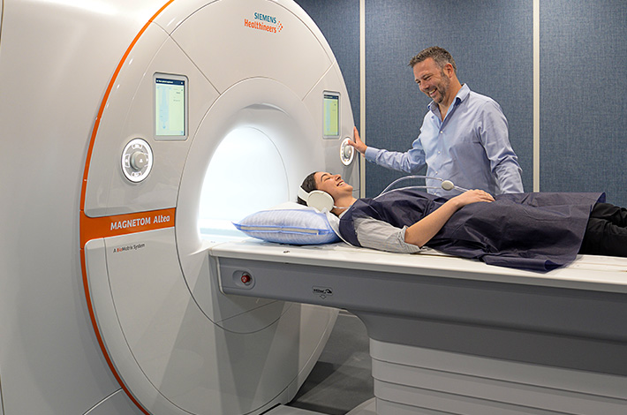
Magnetic Resonance Imaging
MRI physics: https://www.youtube.com/watch?v=Ok9ILIYzmaY&ab_channel=LightboxRadiologyEducation

Slide 3
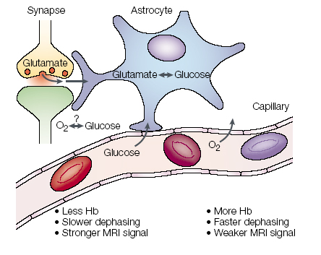
Neurovascular coupling
Increase in neuronal activity increases demand for oxygen rendering in local increase of blood flow near the area of activity
Hemoglobin carries oxygen. Following Hb magnetic differences with MRI can be used to detect brain activity
Heeger et. al. 2002

Slide 4
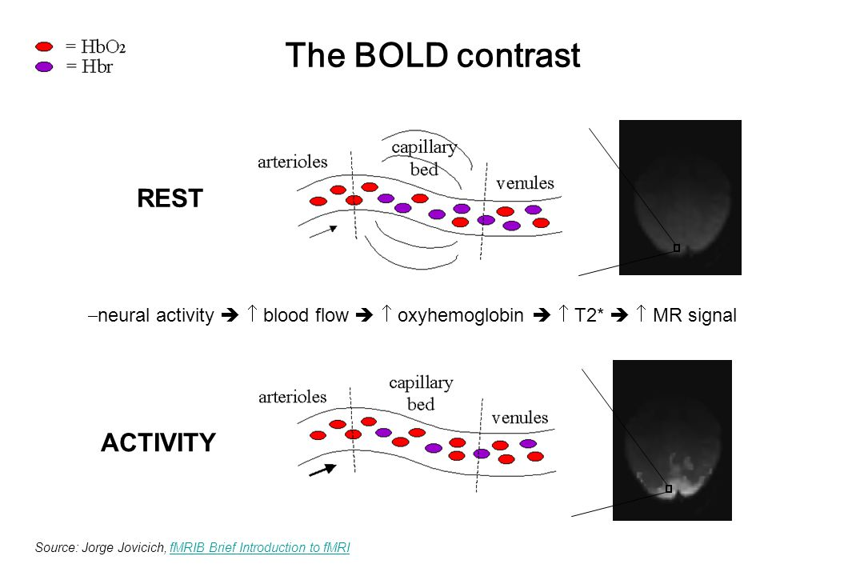
Blood Oxygen Level Dependent contrast
T2* (inhomogeneous T2) is sensitive to deoxygenated Hb (paramagnetic) and oxygenated Hb (diamagnetic)
Oxygenated Hb molecule diphase slower, so T2* signal retained longer in a region when it has more oxygenated blood, and we get more intense image
Notes:
The paramagnetism refers a type of magnetism that produces a magnetic field in the direction of the external magnetic field and vanishes when the external field is removed.
The diamagnetism denotes a type of magnetism that opposes the external magnetic field and vanishes when the external field is switched off.

Slide 5
BOLD Correlations

Slide 6
BOLD time-course

Slide 7
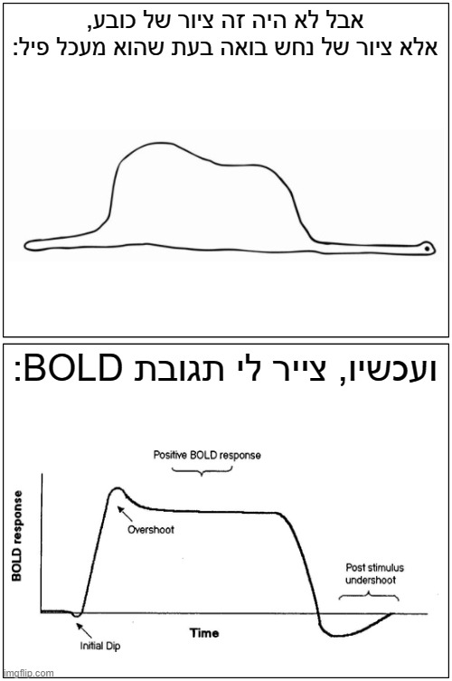
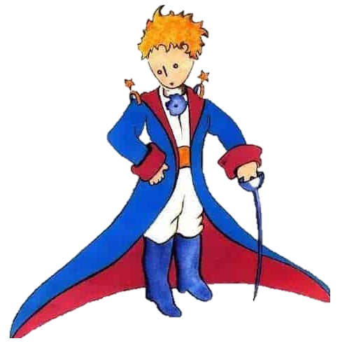
Good LUCK

Slide 8
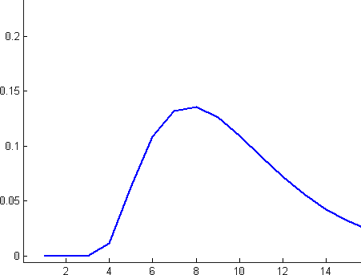
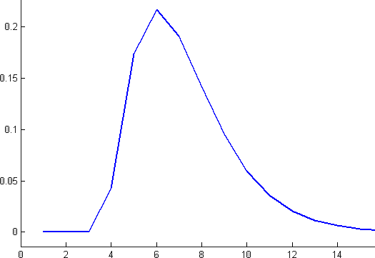
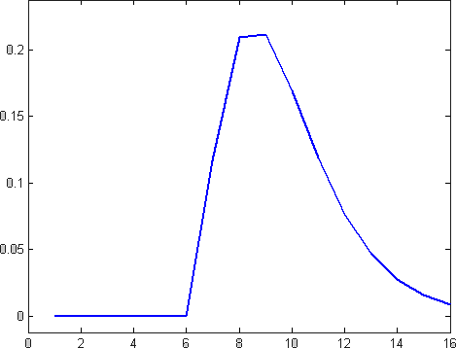
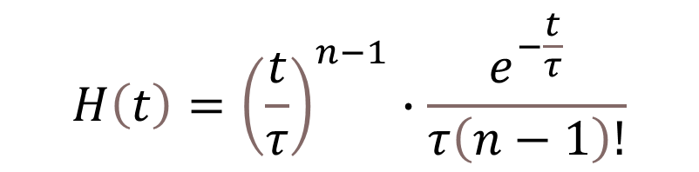
Hemodynamic Response Function
HRF can be modeled with a Gamma function:
$$H\left(t\right)={\left(\frac{t}{τ}\right)}^{n−1}∙\frac{e^{−\frac{t}{τ}}}{τ\left(n−1\right)!}$$
τ - time to peak
n - time shift (amount of delay)

Slide 9
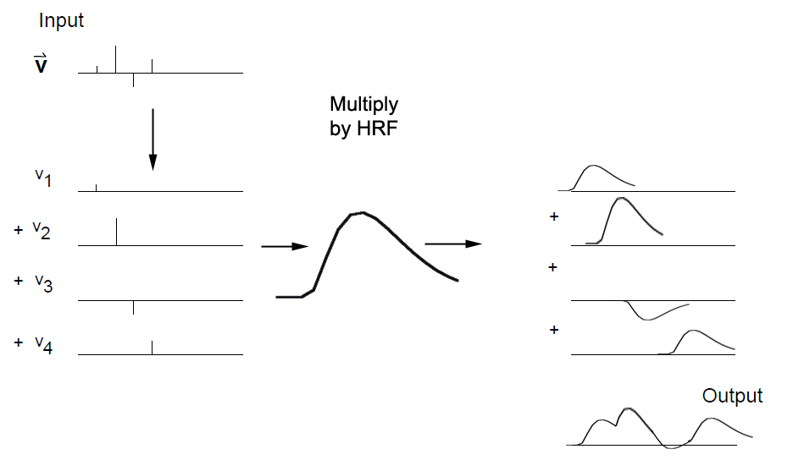
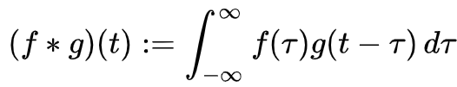
convolution
Multiply each timepoint of the neural response by a copy of the HRF
Notes:
Convolution visualized:
https://www.youtube.com/watch?v=HW4IamyQnzw&ab_channel=NTS
https://www.youtube.com/watch?v=Ma0YONjMZLI&ab_channel=RezaArfa
https://www.youtube.com/watch?v=C1N55M1VD2o&t=19s&ab_channel=YangCao

Slide 10

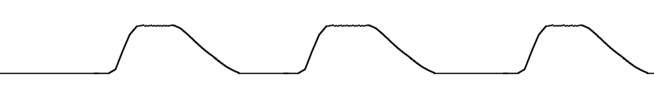
Typical Experiment
Stimulus or experiment structure
Convolution with HRF
Model of hemodynamics

Slide 11
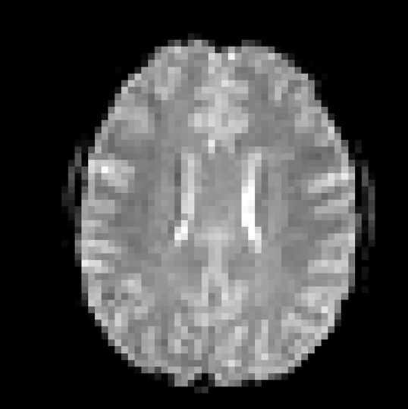
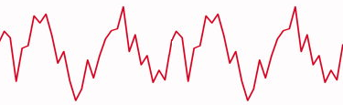
correlations
Where in the brain was there similar activity?

Slide 12
Correlation maps
Paint the voxels according to the correlation level
How big are the correlation values?
Is there a chance we would get strong correlations from random hemodynamic fluctuations?
Activity localization
Notes:
Correlation significance (p-values)

Slide 13
functional-MRI visualization
Significant clusters of activation from and audiovisual experiment.
Red clusters show visual activation, Blue clusters show auditory activation

Slide 14
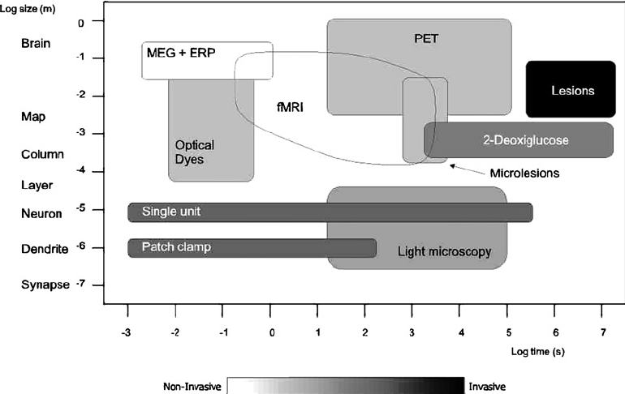
Resolution Scales

Slide 15
Biological Motion

