Slide 1

Cornell
A project by Nyle, Dylan, Gerald, Chantell, Kosta, and raveena

Slide 2
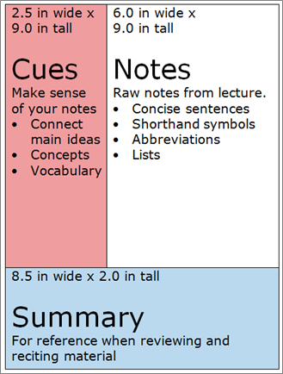
What is it?
The Cornell note-taking method was first developed by Walter Pauk, director of Cornell University’s Reading and Study Skills Center.
It consists of separating your paper into three unequal sections: a cue/questions column, a note column, and a summary area.
This style of note taking is close to the split-page note taking method, however it is more specific in the guidance and the format of the columns.

Slide 3
Advantages
Organized and systematic, which makes absorbing content easier
Beneficial for auditory AND visual learners
Enhanced comprehension, which promotes efficient review of the content
Active learning

Slide 4
Disadvantages
Requires more thought in class for accurate organization because if not done neat can be cluttered
It doesn't lend to diversity of a review attach for maximum learning and question application.
This system cannot be used if the lecture is too fast as it's time consuming
Inflexibility [may not suit everyone's note taking style]

Slide 5
Summary
In Conclusion, the Cornell note taking method consists of organized structure that has you split your paper into three uneven columns. This can be time consuming, but overall works for auditorial and visual learners.

