Slide 1
IT1050- Object Oriented Concepts
Lecture – 02 - C++

Slide 2
Learning Outcomes
At the end of the Lecture students should be able to
Write a C++ program including :
- namespaces
-Variables
- Sequence
- Selection
- Repetition
- Using Input Commands and Formatting Output

Slide 3
The std namespace
Let’s have a look at the iostream.h header file (a simplistic view of the actual file)
// iostream.h header file
// this is inserted to your program when you use the command #include <iostream>
namespace std {
// various commands related to input and output are defined here
ofstream cout;
//
ifstream cin;
char endl = ‘\n’;
}
To access cout, cin, endl outside the namespace we have to explicitly use
std::cout
std::cin
std::endl
Everything defined in the iostream header file is defined under a namespace called std

Slide 4
namespaces are used to avoid naming collisions
// I could write my code for example
// using the namespace FOCSLIIT
// Imagine a namespace to be a folder
// in your computer.
namespace FOCSLIIT {
int data;
void graphics(int x, int y);
}
namespace Graphics {
void graphics(int x, int y);
int mygraphics;
int data;
}
// Since FOCSLIIT and Graphics are
// two separate namespaces (folders)
// variables, functions with the same
// name can exist without issues
FOCSLIIT::data
FOC::graphics(10,20);
Graphics::data
Graphics::graphics(10,20);
namespace1.cpp
namespace2.cpp

Slide 5
The std namespace
The std :: before cout is required when we use names that we’ve brought into the program by the preprocessing directives #include <iostream>
Means cout belongs to namespace std
// C++ Program
#include <iostream>
using namespace std;
int main ( )
{
cout<< “Hello “;
cout<<“World !“;
cout << endl;
return 0;
}
// C++ Program
#include <iostream>
int main ( )
{
std::cout<< “Hello “;
std::cout<<“World !“;
std::cout << std::endl;
return 0;
}

Slide 6
namespace std
using namespace std;
The keyword namespace defines a scope
std is a namespace defined by C++
cout is included in std
Using the above statement will omit having to use std:: ( :: - scope resolution operator ) with every member ( directive/keyword) of the std namespace

Slide 7
Chaining multiple << operators together
Instead of using only one << for each cout. We can chain multiple insertion operators in the same line. Each of the data can be of different types.
// C++ Program
#include <iostream>
using namespace std;
int main ( )
{
cout << “ My Score is “;
cout << 70;
cout << endl;
return 0;
}
// C++ Program
#include <iostream>
using namespace std;
int main ( )
{
cout << “My Score is “ << 70 << endl;
return 0;
}

Slide 8
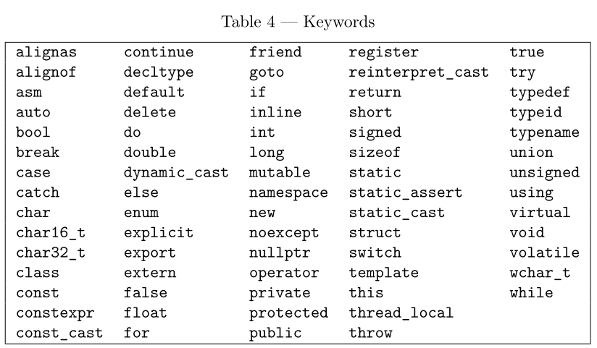
C++ Keywords

Slide 9
Use of Variables
Same as in C
// prg_02.cpp
//Program that adds two numbers
#include <iostream>
int main ( )
{
int number1 = 25;
int number2 = 32;
int sum;
sum = number1 + number2;
cout<< “Sum is : “ << sum << endl; // Display value of sum
return 0;
}

Slide 10

Recall…….
C++ Rules for making identifies
Consists with letters, digits, and underscore character
Starts with a letter
Cannot contain spaces, special characters, operators and reserve words / keywords
Cannot contain more than 31 characters
C

Slide 11
Input from Keyboard
// C Program
#include <stdio.h>
void main ( void)
{
int num;
printf (“Input Number : ”);
scanf(“%d”, &num);
printf(“Number : %d\n”, num);
}
// C++ Program
#include <iostream>
using namespace std;
int main ( )
{
int num;
cout<< “Input Number :”;
cin >> num;
cout<<“Number is : “<< num <<endl;
return 0;
}

Slide 12
cin command
cin is the stream input in the C++ standard library.
The Extraction operator >> will skip leading whitespace
( blank, tab, newline) characters and start the value with the first non-whitespace characters.
A value is terminated by whitespace.
e.g:
Output
cout<< “Input length and width :”;
cin >> length >> width;
Input length and width : 7.5 8.5

Slide 13
Exercise
Write a C++ program to input the length and the width of a rectangle and calculate and print the perimeter.

Slide 14
Formatting Output
Use header file <iomanip>
These allow you to send control signals to cout to control how the output is displayed.
setw(n) - specifies number of spaces used to display a number
setprecision (n) – determines the number of digits to be printed in a floating point number
setiosflags (ios::fixed) – determines the number of decimal places to be printed in a floating point number

Slide 15
Formatting Output cont….
cout<< setw(12) <<25.695789<< endl;
 |  |  | 2 | 5 | . | 6 | 9 | 5 | 7 | 8 | 9
cout<< setw(12) <<setprecision (3) << 25.695789<< endl;
 |  |  |  |  |  | 2 | 5 | . | 6 | 9 | 6
cout<< setw(12) <<setiosflags(ios::fixed) << setprecision (5) << 25.695789<< endl;
 |  |  |  | 2 | 5 | . | 6 | 9 | 5 | 7 | 9
iomanip.cpp

Slide 16
Exercise 01
Modify the program that was written to calculate the perimeter and area of a circle to display the results using two decimal places.

Slide 17
Selection Control Structure
if( a >b )
{
cout <<a <<“is the largest”<<endl;
}
if ( a > b )
cout<< a << “is greater than”<< b<<endl;
else
cout<<b <<“is greater than”<<a<< endl;
if
if- else
switch

Slide 18
Selection Control Structure
if( score == 4 )
cout <<“Excellent”<<endl;
else
if ( score == 3 )
cout<<“Good”<<endl;
else
if ( score == 2)
cout<<“Average”<<endl;
else
{
cout<<“Below Average”<<endl;
cout<<“Needs Improvement”;
}
switch( score )
{
case 4 :cout <<“Excellent”<<endl;
break;
case 3 :cout<<“Good”<<endl;
break;
case 2 :cout<<“Average”<<endl;
break;
default :
cout<<“Below Average”<<endl;
cout<<“Needs Improvement”;
}

Slide 19
Exercise 02
Write a C++ program to input the total price to be paid by a customer and calculate the discount according to the chart below.
Total Price | Discount rate
> 10000 | 25%
10000 - 5000 | 15%
5000 - 3000 | 10%

Slide 20
Iteration Control Structure
int count=1;
while ( count <=10 )
{
cout<<count<<endl;
count ++;
}
while
do – while
for
int count=1;
do
{
cout<<count<<endl;
count ++;
} while ( count <=10 );
for(int count=1; count <=10 ; count ++)
cout<<count<<endl;

Slide 21
Exercise 03
Display number 1000,900,800,700,… 100
Using a while loop, do while loop and a for loop within the same program.
i.e. Display these number series three times. One for each repetition structure.

Slide 22
Exercise 04
Consider Exercise 03
Modify the program to input details of 3 customers and calculate the total discount amount given.
What would you do if you want to continue entering prices until -1 is entered ?
What would you do if you want to enter data until user enters ‘y’ to continue and ‘n’ to stop?

Slide 23
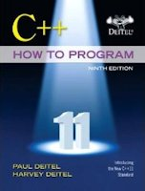
Reference
Chapter 01 & 02
Deitel & Deitel’s (2016), C++ How to Program,
9th Edition

