Slide 1
Gas Leak Sensor ML Rebuild
Production-oriented roadmap for sensor-array gas detection
ESP32-S3 + 8 MQ Sensor Array + TensorFlow Lite Micro + LoRa

Slide 2
Source Documents
This deck summarizes the latest project documentation, not the older three-class prototype presentation.
design.md: system architecture, firmware contract, payload, risks, chamber design, and ML roadmap.
documentation.md: client-facing explanation, model method, chamber plan, safety notes, and acceptance criteria.
session_notes.md: current continuation notes and decisions from the rebuild session.
todo.md: execution checklist for data, chamber, ML, firmware, gateway, and documentation work.
Gas Test Chamber Design.jpeg: mechanical chamber drawing reviewed for revision recommendations.
Gas Leak Sensor ML Rebuild | 2

Slide 3
Project Goal
Detect gas leaks using the combined response fingerprint of 8 MQ sensors.
Train one model per board because MQ boards behave differently.
Run inference locally on ESP32-S3 using TensorFlow Lite Micro.
Send versioned binary results through LoRa to the cluster head and gateway.
Use chamber data and calibrated references before claiming production ppm.
Gas Leak Sensor ML Rebuild | 3

Slide 4
System Architecture
Sensor Node
Network And Reporting
8 MQ voltages through ADS1256
Board-specific scaler
TFLite Micro inference
Local alarm decision
LoRa payload transmit
Cluster head forwards LoRa packets
Gateway publishes upstream data
Future gateway decodes named MQTT fields
Payload stays under 64-byte transport limit
Model/scaler/payload versions are tracked
Gas Leak Sensor ML Rebuild | 4

Slide 5
Gas Class Contract
Stable IDs prevent firmware and dashboard churn as new chamber data is added.
0
normal
1
methane
2
H2S
3
butane / LPG-related gas
4
propane
5
CO
Gas Leak Sensor ML Rebuild | 5

Slide 6
Current Dataset Status
Usable Excel datasets exist for Board1, Board3-Board7, Board9, Board10, and Board11.
Board2-2 has firmware but no matching Excel dataset; Board8 dataset is empty.
Current data mostly covers normal, methane, and butane/LPG-related rows.
No calibrated ppm labels exist yet, so ppm output is only a response proxy.
The dataset is useful for prototype validation, not production safety claims.
Gas Leak Sensor ML Rebuild | 6

Slide 7
Production Dataset Requirements
Collect time-series chamber data, not isolated rows.
Log session_id, board_id, gas_type, param, reference_ppm, BME280 readings, and chamber state.
Capture baseline, injection, mixing/rise, stable target ppm, recovery, and post-recovery phases.
Include false-positive vapors such as alcohol, perfume, smoke, cleaning chemicals, humid air, and exhaust-like cases.
Validate on held-out sessions or days instead of random row splits.
Gas Leak Sensor ML Rebuild | 7

Slide 8
Model Design
Current Improvement Program
Next Production Model
Input: 8 MQ voltages
Shared dense body
gas_type softmax
leak_present sigmoid
severity softmax
ppm_estimate regression proxy
Add BME280 features
Add baseline delta and ratio features
Add 10-60 second window features
Add slope, moving average, max response
Add uncertain / out-of-distribution behavior
Gas Leak Sensor ML Rebuild | 8

Slide 9
Suggested ESP32-S3 Model Shape
Inputs: 8 scaled MQ voltages + 8 baseline deltas + 8 slope/window features + temperature + humidity + pressure.
Network: Dense 64 ReLU -> Dense 32 ReLU -> Shared Dense 16 ReLU.
Outputs: six-class gas_type, leak_present, four-class severity, ppm_estimate.
Keep float TFLite export until firmware explicitly supports int8 quantized tensors.
Measure tensor arena size and inference time on device before expanding the model.
Gas Leak Sensor ML Rebuild | 9

Slide 10
Validation Metrics
Report precision, recall, F1, and confusion matrix per gas, not only total accuracy.
Track false alarm rate and missed leak rate; missed leak rate is the key safety metric.
Report leak-present precision/recall and severity confusion matrix.
Report ppm MAE per gas only after calibrated reference_ppm labels exist.
Break metrics down by board, session/day, humidity range, and temperature range.
Gas Leak Sensor ML Rebuild | 10

Slide 11
Firmware Contract
Verify ADC channel order exactly matches MQ135V, MQ2V, MQ3V, MQ4V, MQ7V, MQ5V, MQ6V, MQ8V.
Validate input tensor type, input shape, output count, and output dimensions before trusting inference.
Fail safe on invalid voltages, disconnected sensors, stale readings, ADC saturation, low confidence, or OOD inputs.
Include model version, scaler version, payload version, and board ID in artifacts and reports.
Keep alarm threshold conservative until session/day validation proves reliability.
Gas Leak Sensor ML Rebuild | 11

Slide 12
Versioned LoRa Payload
Size
32 bytes, fits current 64-byte message limit
Header
version, gas_type, leak_present, severity
Confidence
gas, leak, and severity confidence scaled x1000
Estimate
uint16 ppm proxy now; real ppm later after calibration
Timing
uint32 inference time in microseconds
Sensors
8 signed int16 MQ millivolt readings
Gas Leak Sensor ML Rebuild | 12

Slide 13
Chamber Hardware Recommendation
Use a controlled-flow chamber, not a sealed box with manual gas injection.
Recommended early chamber size: 10-30 L clear acrylic or polycarbonate with gasketed lid.
Add clean-air inlet, gas inlet, exhaust outlet, cable glands, mixing fan, and safe ventilation.
Keep solenoids, relays, and switching contacts outside the gas space.
Use regulator plus needle valve, flow meter, or mass flow controller for repeatable tests.
Gas Leak Sensor ML Rebuild | 13

Slide 14
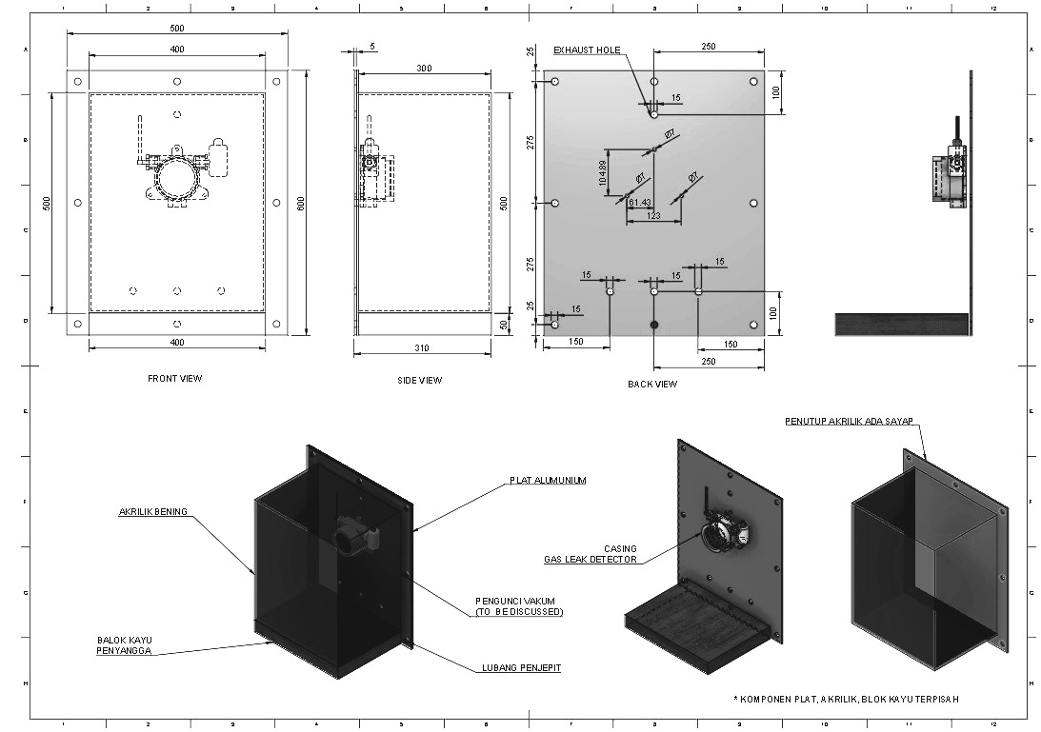
Gas Test Chamber Drawing Review
Current mechanical concept and required revisions
Revision Priorities
Add gas inlet, clean-air inlet, exhaust outlet, cable gland, and reference sampling port.
Add gasket/seal detail around the removable plate.
Add internal low-voltage mixing fan and log fan state.
Replace internal wood with acrylic, aluminum, stainless, or PTFE.
Consider reducing chamber volume from about 60 L to 10-30 L for early tests.
Keep solenoids, relays, and switching electronics outside the gas space.
Gas Leak Sensor ML Rebuild | 14

Slide 15
Reference Instruments
CO and H2S require certified instruments, ventilation, gas-rated safety equipment, and supervision.
Butane / LPG
Calibrated LPG or LEL detector; TGS2610 as reference/cross-check
Propane
Calibrated LPG or LEL detector; TGS2610 as reference/cross-check
Methane
Calibrated methane or LEL detector
CO
Calibrated CO detector/logger or CO analyzer
H2S
Calibrated H2S detector/logger or H2S analyzer
Gas Leak Sensor ML Rebuild | 15

Slide 16
Critical Risks
Random row split can overestimate accuracy because adjacent chamber samples are correlated.
Current ppm_estimate is not real calibrated concentration.
Missing H2S, propane, and CO data blocks production claims for those gases.
Swapped ADC feature order can silently break on-device inference.
False-positive vapors and long-term drift must be tested before deployment claims.
Gas Leak Sensor ML Rebuild | 16

Slide 17
Next Work
Finalize chamber dataset schema and operating procedure.
Revise chamber drawing with controlled-flow ports, gasket, fan, cable glands, and safer internal materials.
Build chamber controller/logger for MQ, reference sensor, BME280, valve states, fan state, and chamber state.
Collect LPG-family time-series data first, then expand to methane with calibrated reference hardware.
Integrate the improved four-output model wrapper into firmware after tensor contract validation.
Gas Leak Sensor ML Rebuild | 17

