Slide 1
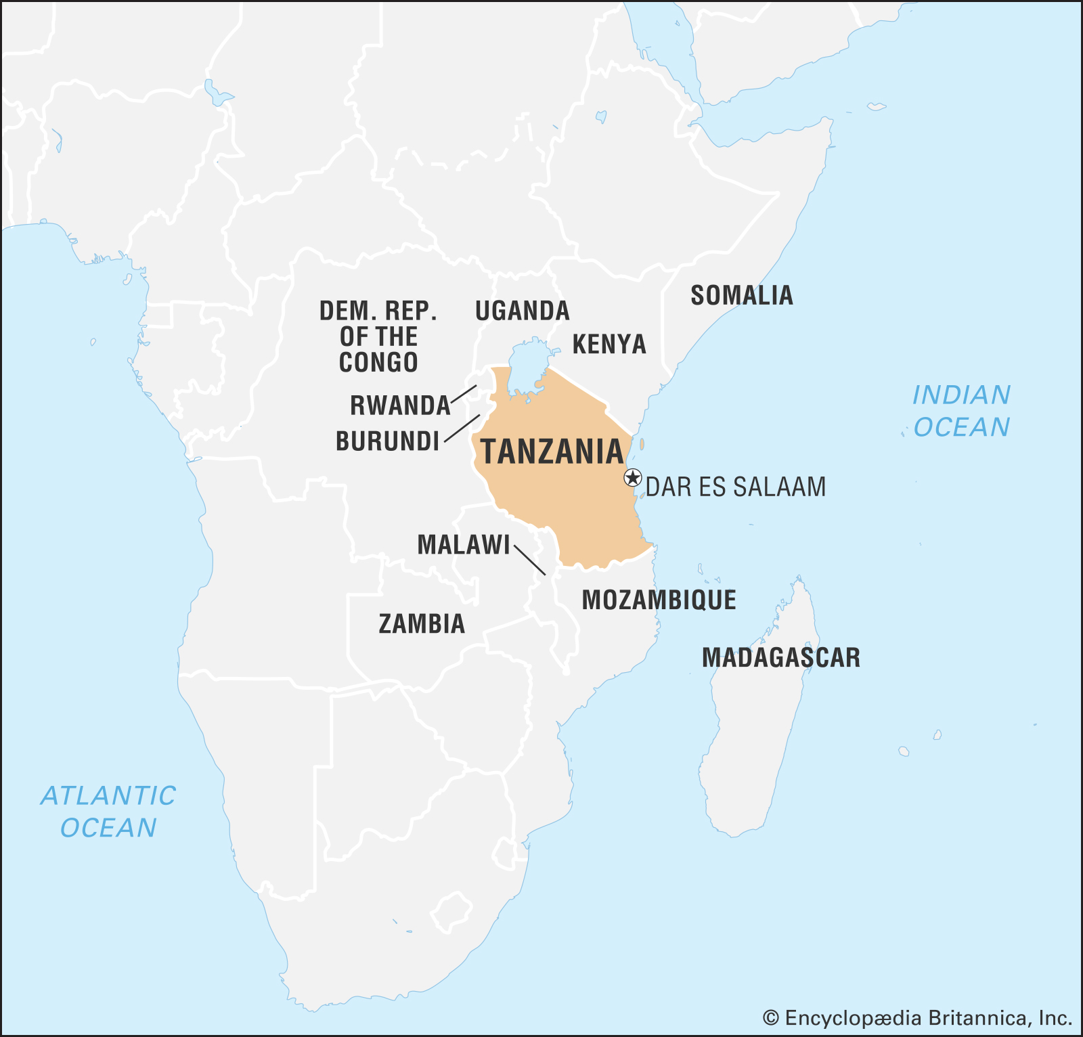

Pump it Up:
Data Mining the Water Table
Driven Data Competition
for the Tanzanian Ministry of Water
Raven Welch &
Clair Marie Wholean

Slide 2
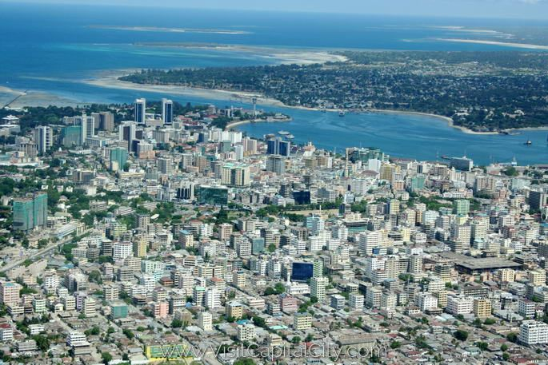
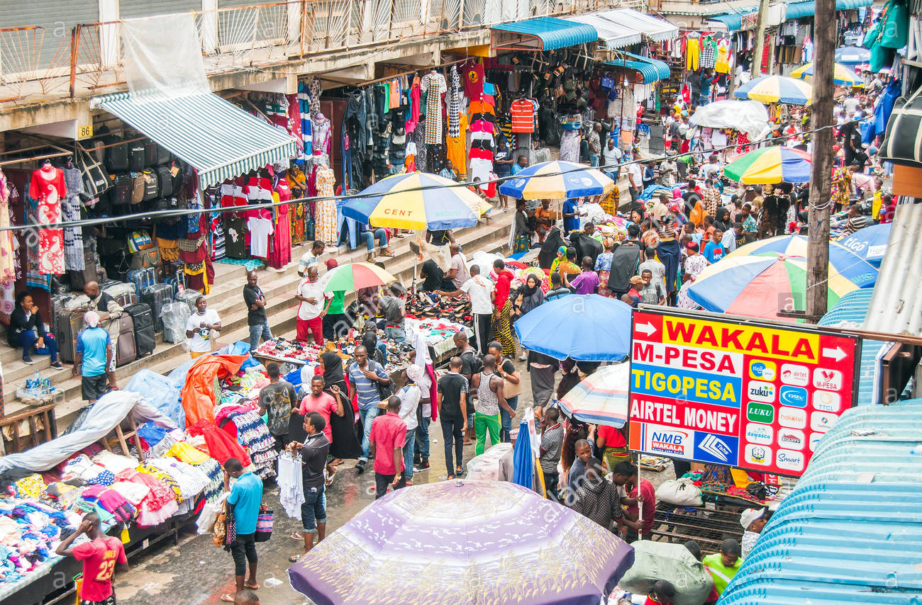
Dar es Salaam
Largest city in Tanzania
6.7 million people
9th fastest growing city in the world

Slide 3
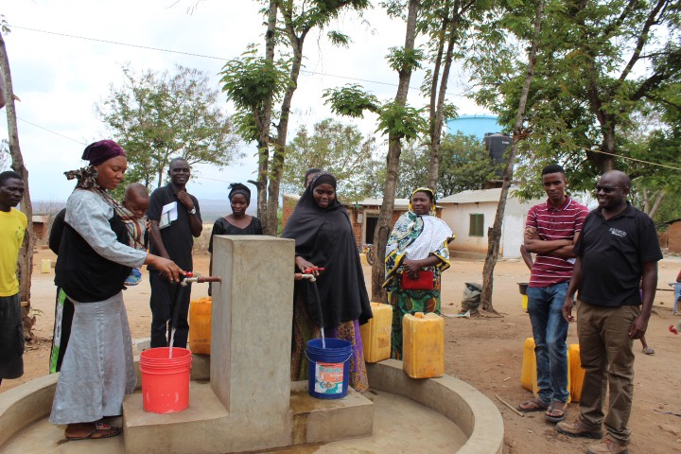
68% of Tanzania's citizens live below $1.25 a day.

Slide 4
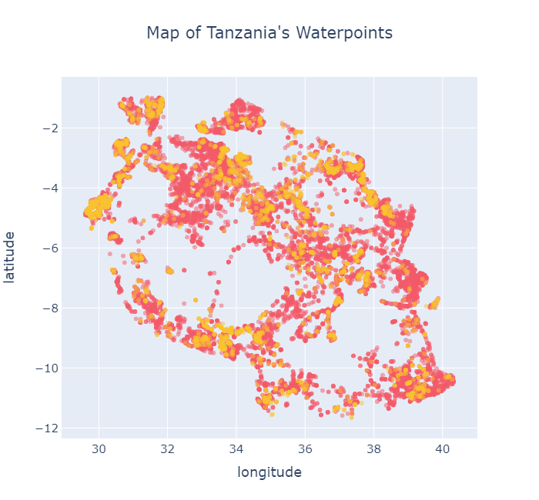
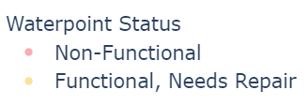
Large areas of Tanzania
are without safe,
drinkable water

Slide 5

Our Goal:
Predict the condition of a waterpoint for Water Management companies
The why: prevent pumps from becoming non-functional.

Slide 6
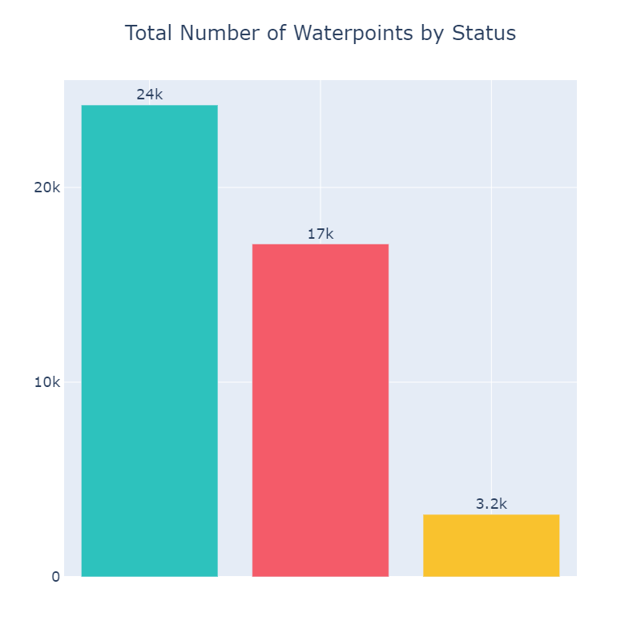
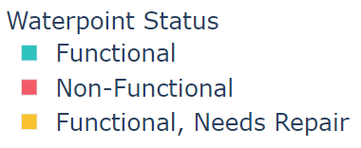
Data
Tanzanian Ministry of Water
Waterpoint Mapping System
44,550 water pumps
9 geographic drainage basins (watershed)

Slide 7

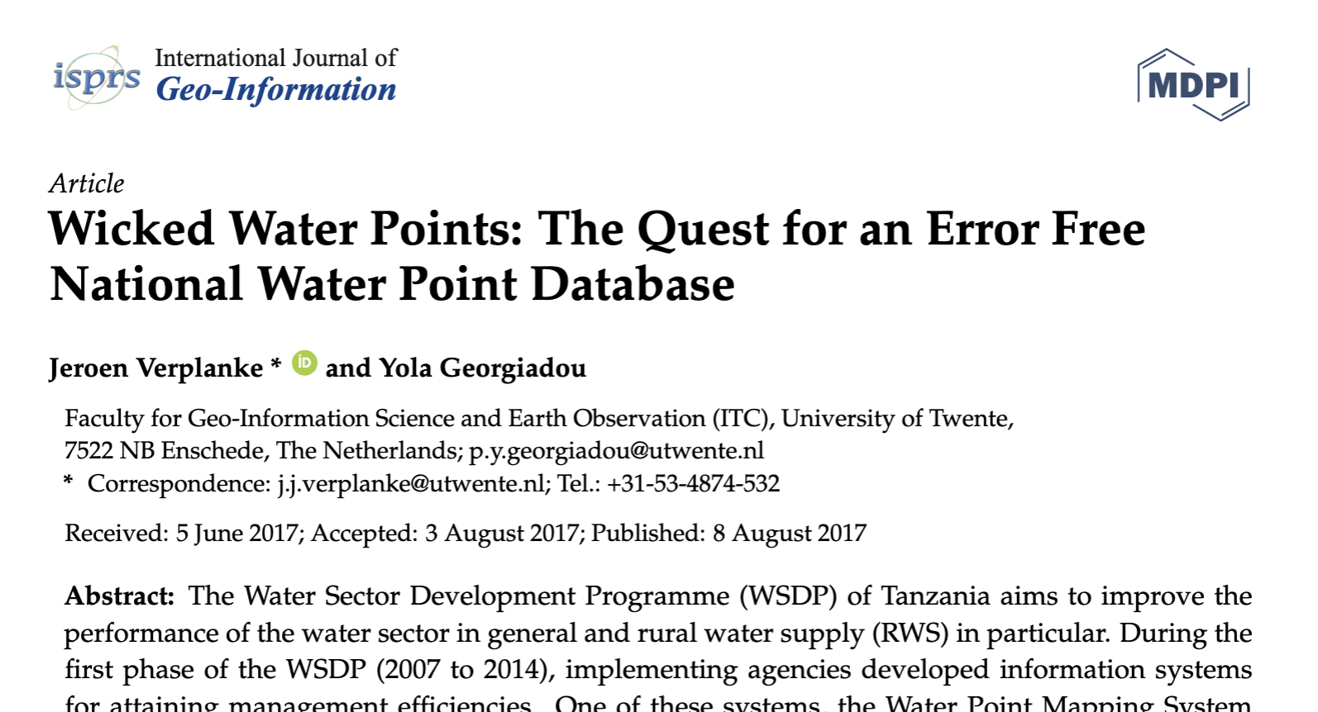
Research
Quality, Access, and Upkeep, and Management Vary
Maintenance Cost & Affordability Varies
Efficiency, Age, and Maintenance History Unknown
33% of Waterpoints are
non-functional in 2 years

Slide 8
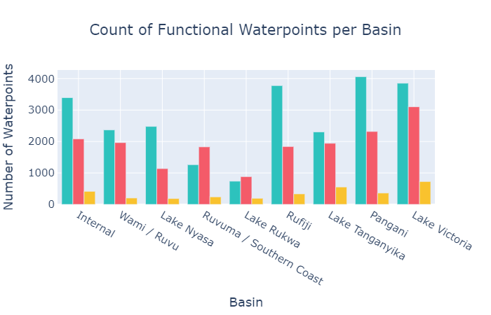
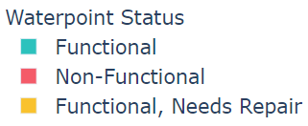
Pump Condition Varies Widely

Slide 9
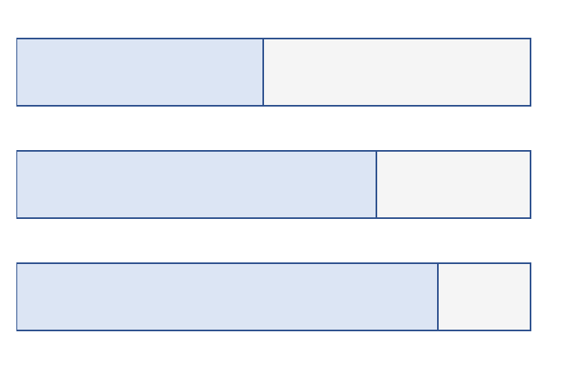
Model Summary
The model correctly predicted the status of a waterpoint 73.2% of the time
Functional, Needs Repairs
48% Correct
Functional
70% Correct
Non-Functional
82% Correct

Slide 10
Recommendations
Concentrate on improving features related to pump and water quality
Streamline future data collection
Collect more data on functional waterpoints needing repair

Slide 11
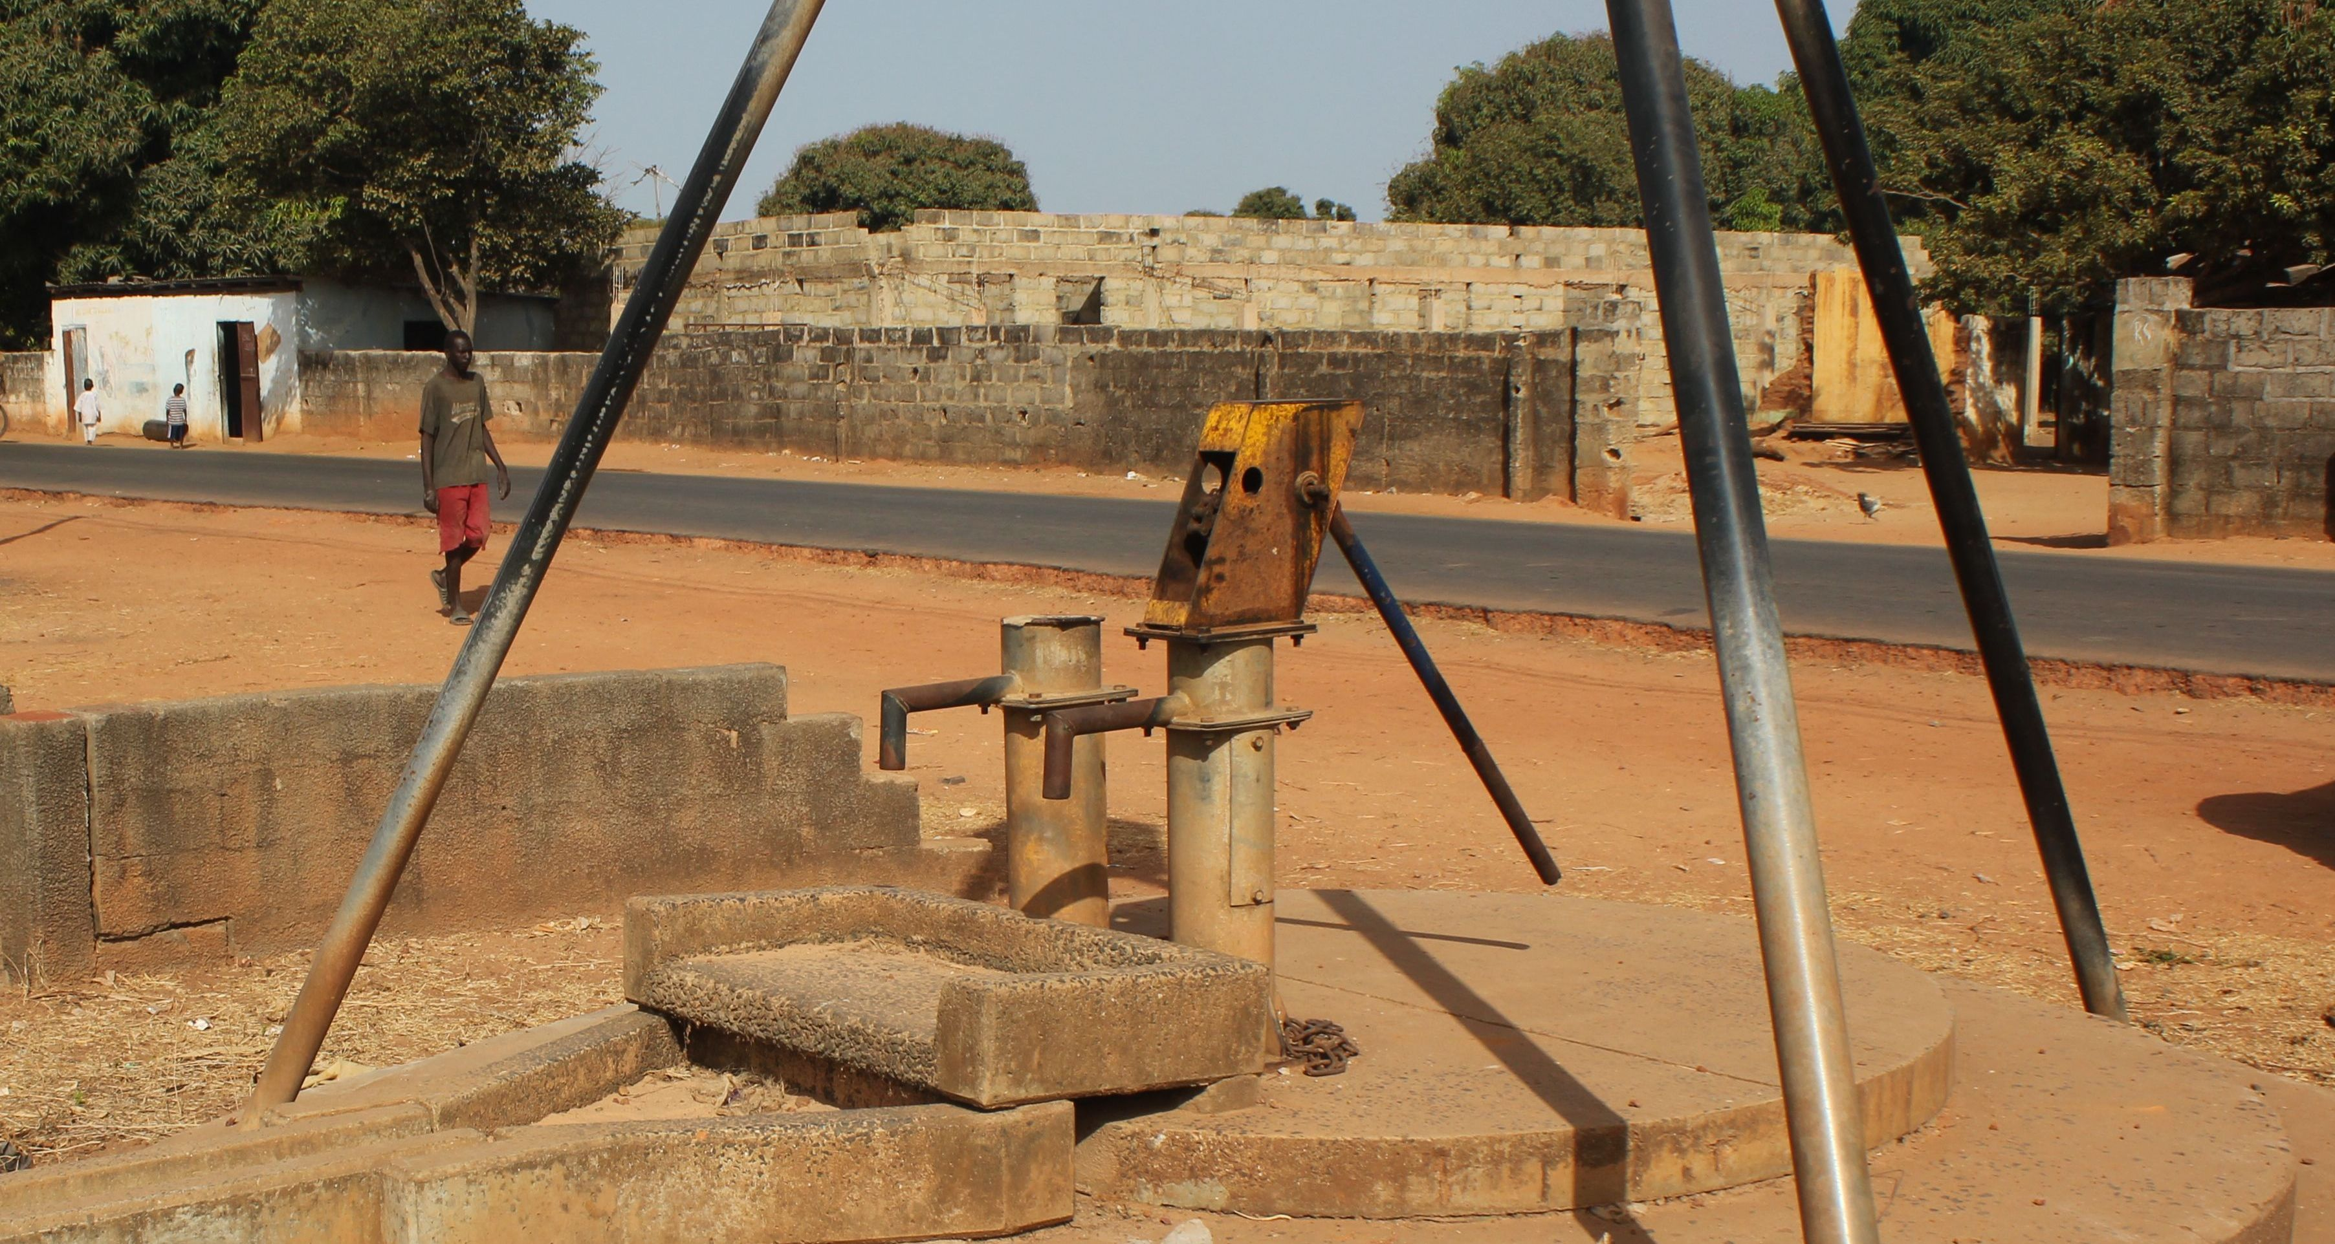
Next Steps
Determine Steps to Prevent Waterpoint Breakage
Determine Features that Affect Function Status
Reduce Number of Features Used

Slide 12


Thank you for listening
Questions and comments are welcome
RavenNHW
clairmarie8
Raven Welch
Clair Marie Wholean
Data provided by https://www.drivendata.org/competitions/7/pump-it-up-data-mining-the-water-table/page/23/, sourced from Taarifa and the Tanzanian Ministry of Water

