Slide 1
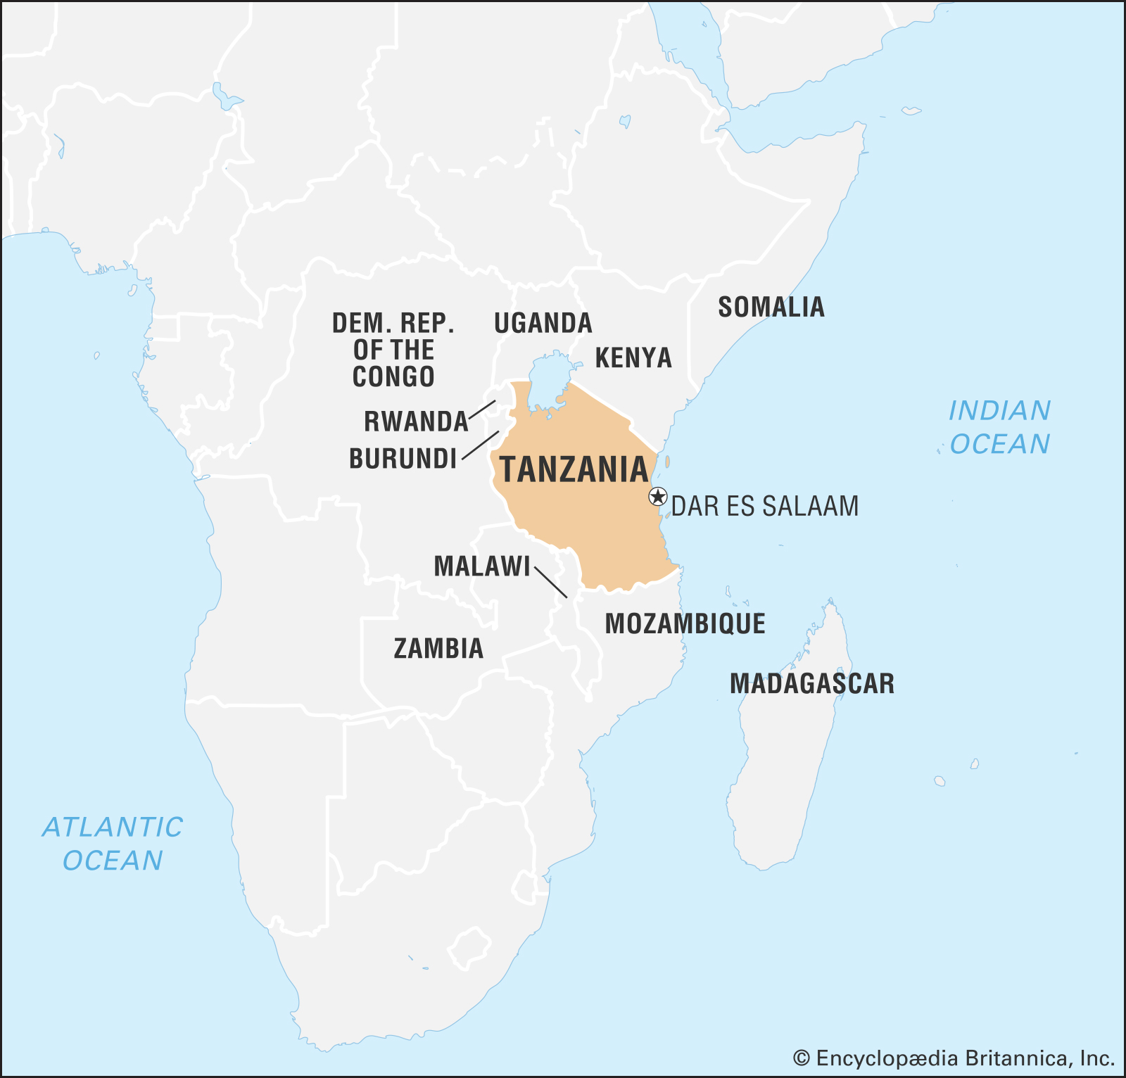

Pump it Up:
Data Mining the Water Table
Driven Data Competition to predict water pump functionality for the Tanzanian Ministry of Water
Raven Welch & Clair Marie Wholean

Slide 2
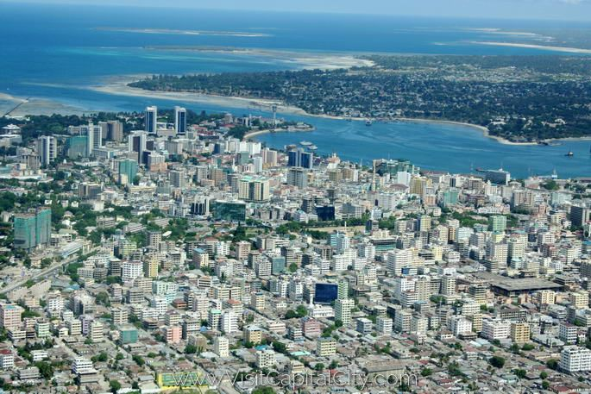
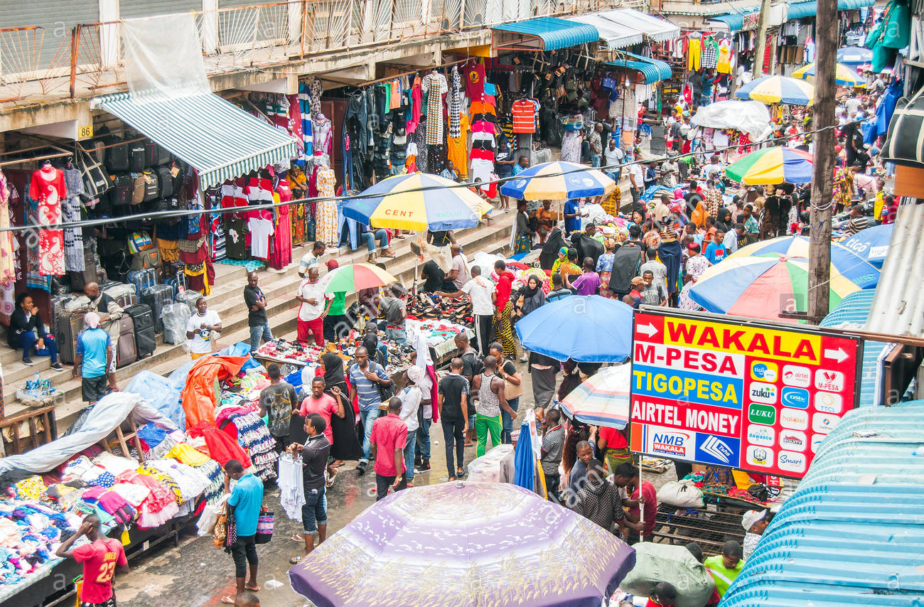
Dar es Salaam
6.7 million people
9th fastest growing city in the world
(Wikipedia)

Slide 3
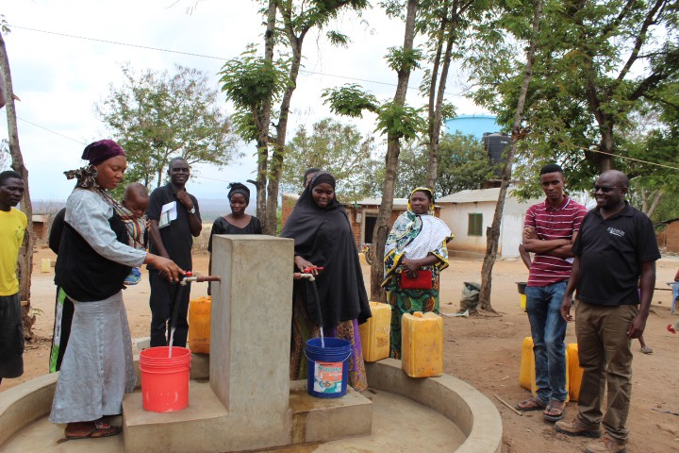
68 per cent of Tanzania's citizens live below $1.25 a day.
(Wikipedia)

Slide 4
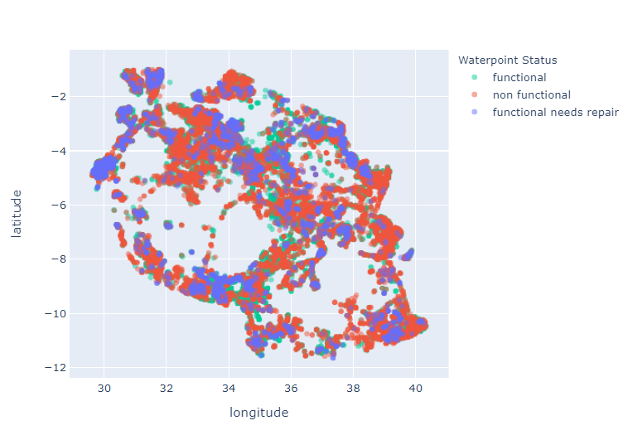
Large areas of Tanzania
are without safe,
drinkable water

Slide 5
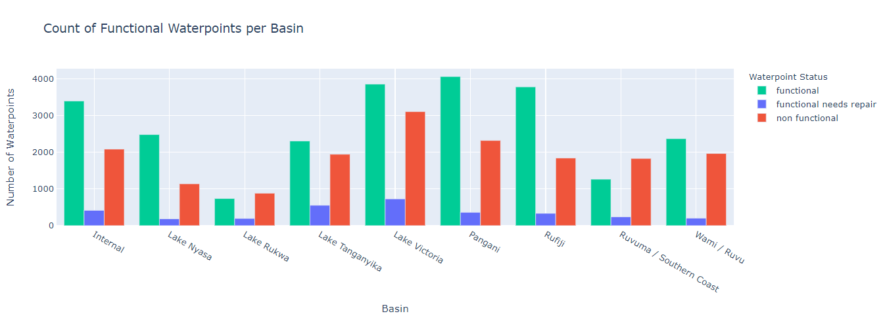
Business Problem:
Predict the condition of a well
Functional
Non-functional
Functional needs repair

Slide 6
Data & Assumptions

Slide 7
Model Summary

Slide 8
Model Results & Next Steps

