Slide 1
Structured AI Theorem Proving with Human-Learnable Knowledge Extraction
Zihan Zheng

Slide 2
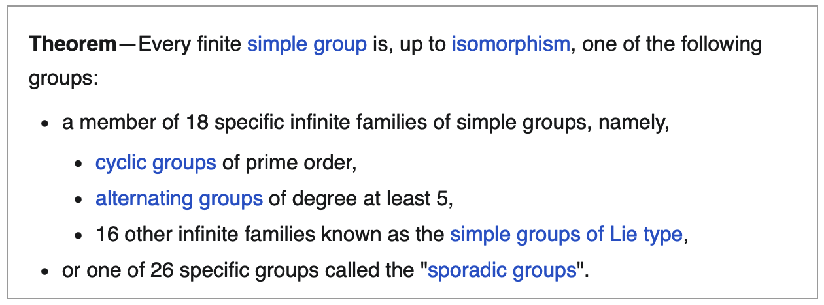
The Age of Human
The Age of AI
The enormous theorem:
We use AI to:
Fix bugs
Implement features
Design systems
Prove theorems
~ 50 years of work (1955-2004)
15,000 pages or proof across ~500 papers
GLS "Simplified Proof" Project(1981 -)
planned: 12 volumes
published so far: 9 volumes
ends up longer than the original
How hard is it to study:
GPU kernels with ~10k Loc?
Proof of theorem in 1M+ Loc?
The proof is verified. The understanding lags decades behind!

Slide 3
Recap: Problem Statement & Solution
For formalized math theorem proving:
Mechanization ≠ reasoning
Peripheral errors and intrinsic difficulty are conflated
Solution 1/3 : Decouple thinking(subgoal decomposition) and labor(calc, formalization)
Verified ≠ understanding
Current systems optimize for "does it compile?" and discard everything else
Solution 2/3 : Digest key info(relational structure, strategy templates) from proof traces
Solution 3/3: A ground truth relational dataset for grad-level math problems
We want AI assisted proofs that enhance human understanding, not just accumulate truths.

Slide 4
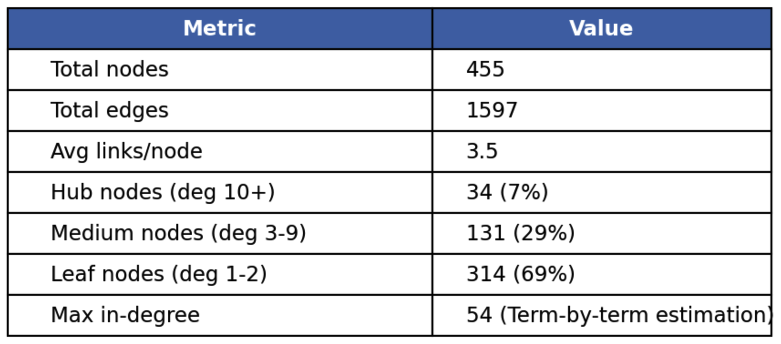
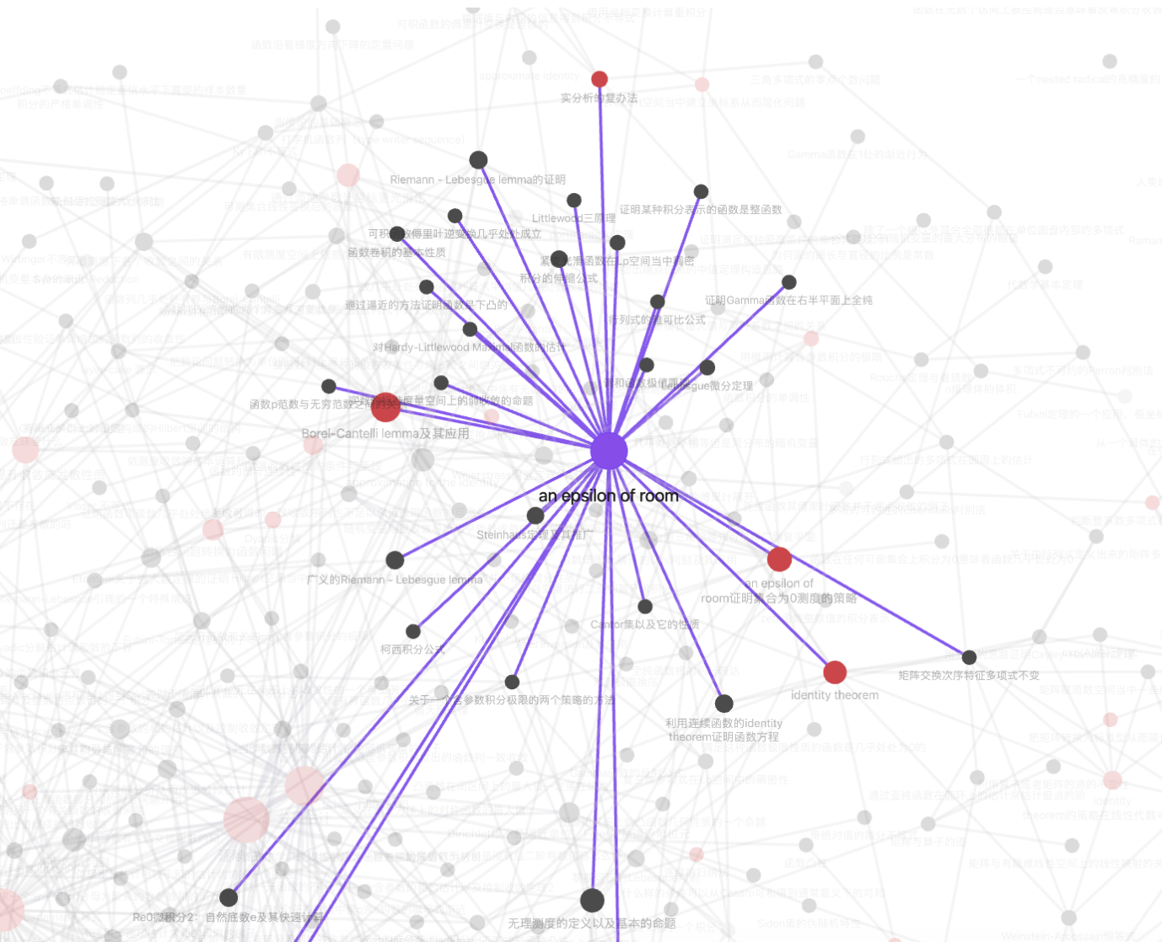
Recap: Evaluation Methodology & Midterm Results
Core raw data: math-notes obsidian vault
455 notes, 1596 note-level edges; few general strategies, many specific problems
Data Curation & Relation Extraction
Prover Effectiveness
Knowledge Digest Quality
Baseline: free agents
- Claude Code, opencode
Our solution: structured agents
- Plan -> Impl -> Replan in SKILL.md
Objective: generate formalized proof that passes the LEAN compiler check
Metrics:
Pass@k
Metrics: precision & recall
Of the connections the digest claims, how many match ground truth edges?
Of the ground truth edges, how many does the digest recover?

Slide 5
Results (1/4): Dataset Asymmetric Utility
Our relational graph: problems linked by shared strategy / technique. Two directions of use, one solved, one open.
Forward direction — works
Reverse direction — open
Graph edge = ground truth: "these two problems share a strategy / technique / intuition"
Hub nodes = recurring techniques (degree > 30)
Enables hub-recall benchmarks, transfer experiments, and model training
Limitation: Problem formalization is token heavy(each is a coding task in itself), hitting usage limit easily
Summary:
105 / 455 notes curated
461 nodes (439 problems + 22 hubs) with 7415 edges
357 / 439 problems formalized: 81% success rate
Given two digest outputs (NL abstractions), are they "the same intuition"?
Different wording, same idea — vs — same wording, too problem-specific?
Semantic equivalence in NL math reasoning is unsolved
Blocks direct evaluation of digest agent quality
Contribution: dataset is ready for forward use. Limitation: reverse-direction evaluation is the open problem.

Slide 6
Result (2/4): Opening a can of worms
We gave gpt-5.4 the full reasoning trace and asked, three ways, to extract the abstract strategy. The trace explicitly contains the words "by pigeonhole".
Naive Digest
Directed Digest
Atomic-format prompt
DIGEST_PROMPT:
Summarize the high-level strategy used in this proof in 3-5 sentences, in an abstract way that could transfer to other problems.
Response:
"think of the objects as vectors, and look for a subset whose directions align enough to prevent too much cancellation… projecting vectors onto carefully chosen directions…"
DIGEST_PROMPT:
Below is a reasoning trace. Extract the abstract methodology — state the general principle, without referring to...
Response:
"directional or component-wise alignment, while cancellation is the main obstruction… discrete partitioning, decomposition into components, and continuous averaging…"
Trigger: lower bound on the size of a sum formed by selecting some vectors/items that can cancel… Action: Choose a direction, keep only the items with nonnegative projection… average over all directions. Boundary: weakens in higher dimensions or when no projection-based lower bound controls the target.
Three prompts, zero "pigeonhole." The digest agent paraphrases the application; it doesn't name the principle.
Recovering edges to related problems is a categorical gap, let alone the hub .

Slide 7
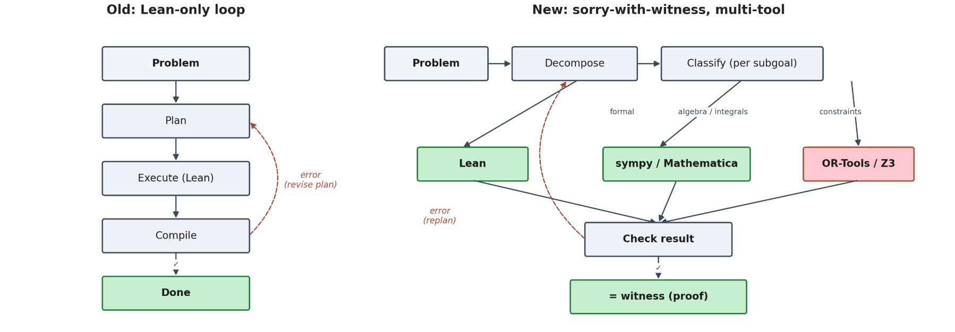
Result (3/4): Sorry-with-witness
Averaging proof had 3 sorry's. One is a definite integral. Lean can't close it; sympy can in one call.
Without sympy — pure Lean
With sympy-witness
lemma integral_max_cos : ∫ u in (0 : ℝ)..(2 * Real.pi), max (Real.cos u) 0 = 2 := by sorry
import sympy as sp u = sp.Symbol('u', real=True) result = sp.integrate( sp.Max(sp.cos(u), 0), (u, 0, 2*sp.pi)) # result = 2
Mathlib has no closed form. To close in pure Lean: FTC + integral splitting at the zero of cos + periodicity. Substantial bespoke proof.
Trusted external witness. Lean keeps the sorry; we accept it because sympy independently verified the underlying claim.
Decompose work by tool. Each tool is a dense information sink. → Next: decompose work by model capability:
planning, reasoning, coding, formalization.
Notes:
Enough of bad news.

Slide 8
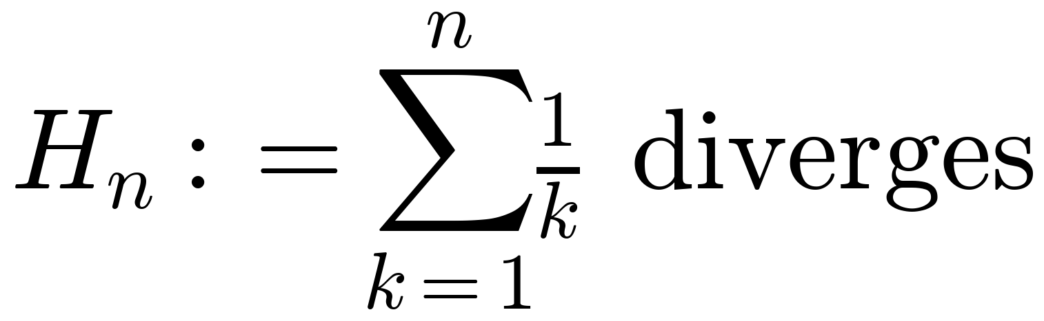
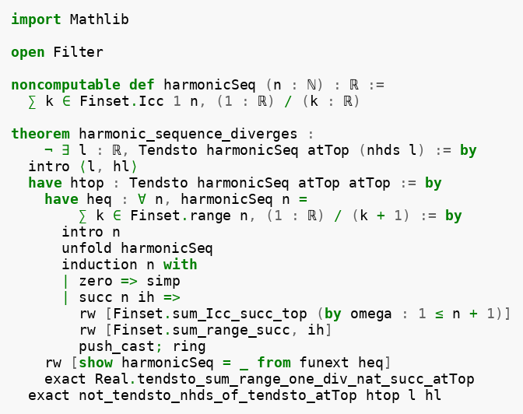

Results (4/4): Ablation
def harmonicSeq (n : ℕ) : ℝ := ∑ k ∈ Finset.Icc 1 n, (1:ℝ) / k theorem harmonic_sequence_diverges : ¬ ∃ l : ℝ, Tendsto harmonicSeq atTop (nhds l)
Opus 4.7, three runs ✅
GPT 5.4 mini, ten runs ❌
Findings
# | errors | Category
1 | 13 | Hallucinated API
2 | 2 | Type mismatch
3 | 3 | Type mismatch
4–10 | 1 | Mechanistic loop
Capability decomposition: planning · reasoning · coding · formalization
Weak ≈ strong on planning + reasoning (right strategy at attempt 4)
Weak fails at formalization (Lean tactic ordering, can't close the bridge)
Implication: cheap model (~6×) for planning + reasoning; strong reserved for formalization
1. Mechanical — `∑ k in S` → `∑ k ∈ S` 2. Strategy — `simp_rw` failed; `funext` lifts pointwise eq to function eq 3. Success — clean compile, 0 errors
same `funext` insight
same Mathlib lemma
same contradiction step
→ correct strategy + proof flow
but fail at coding!

Slide 9
Future work from midterm:
Mathematica/sympy integration [done, improvement observed]
Formalized dataset curation [in-progress, 105/455, limited by AI usage limit]
Improve digest agent [attempted, categorical gap observed]
Full-scale evaluation: prover + digest agent [blocked by digest agent]
Future work from now:
Scaling already-built infrastructure
New directions
Sympy-witness coverage across more sorry'd proofs
Ablation matrix expanded (more problems × more weak models)
Digest probe across more proof traces: quantify the categorical gap
Atomic analysis: (per-step intuition, boundary, counterexample) as stricter standard for digest
Reasoning Arbitration: proactive delegation to tools
Broader tool integration: OR-Tools, Z3
Notes:
For the rest of the semester. First, full-scale evaluation — run the prover and digest agent on many problems from the curated dataset, not just one. Second,
Mathematica and sympy integration — this reduces the gap between "mathematically correct" and "Lean-verified." Some sorry'd lemmas are trivial computations that a
computer algebra system solves instantly. Third, complete the formalized dataset curation — extract problems from the vault, formalize in Lean, rebuild edges. And
fourth, improve the digest agent based on what we learn from the evaluation. The machinery is built. What remains is running it at scale and measuring.

Slide 10
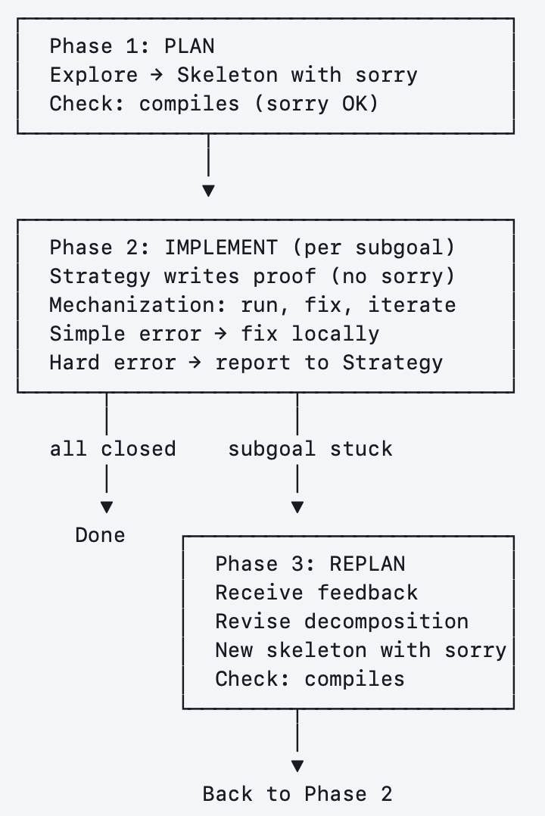
Our Solution: Architecture Recap
Traces
Prover Agent
Plan - Impl - Replan Loop
Skeleton with "sorry"
Formal checker at every step
Separate bug fix vs. math step
Digest Agent
1. Reinterpretation
2. Scope Expansion
3. Progressive Construction
4. Strategy Templates
Lessons

Slide 11
Our Solution 2/2: Digest agent
How would human digest a problem?
Given n complex numbers with ∑|zₖ| = 1, prove ∃ subset S with |∑_s zₖ| ≥ 1/6.
Our digest agent will do the following:
1. Reinterpretation: "complex numbers → 2D vectors"
2. Scope expansion : "can we beat 1/6?"
3. Progressive construction: "What if we start with 2 vectors instead of n?"
4. Strategy templates: "Pigeonhole!"
5. Failure lessons: "We tried X. It won't work and here's why."
Notes:
How would a human digest a problem? Let's take a concrete example. Given n complex numbers whose absolute values sum to one, prove there exists a subset whose sum has
norm at least one-sixth.
A human doesn't just prove it — they learn from it. Our digest agent mirrors this process. First, reinterpretation: complex numbers are really just 2D vectors. That
changes what tools are relevant. Second, scope expansion: can we beat one-sixth? Third, progressive construction: what if we start with just 2 vectors instead of n?
That reveals the problem is about selection, not summation. Fourth, strategy templates: this is a pigeonhole argument — project onto a direction. And fifth, failure
lessons: we tried X, it didn't work, and here's why.

Slide 12
Evaluation 1/3: Dataset Curation
Core raw data: math-notes obsidian vault
Features:
455 notes, 1596 note-level edges
Inside a note:
Human-authored reasoning, not just solutions
Difficulty progression
Between notes:
explicit relational structure
few general strategies, many specific problems
Vault author: Pikachu345@Bilibili, proprietary
Notes:
Now let's talk about evaluation. We obtained a proprietary Obsidian vault — 455 math notes with 1600 bidirectional links between them. This is the graph view. Each
node is a note, each edge is a connection that the author made.
What makes this dataset special? Inside each note, it's not just a solution — it contains the author's reasoning, and difficulty progression from the original problem
to stronger versions and generalizations. Between notes, the links form an explicit relational structure. a few
general strategies connect to dozens of problems, while most nodes are individual problems.
(Those hub nodes — the high-level strategies — are exactly what our digest
agent should be recovering. )

Slide 13
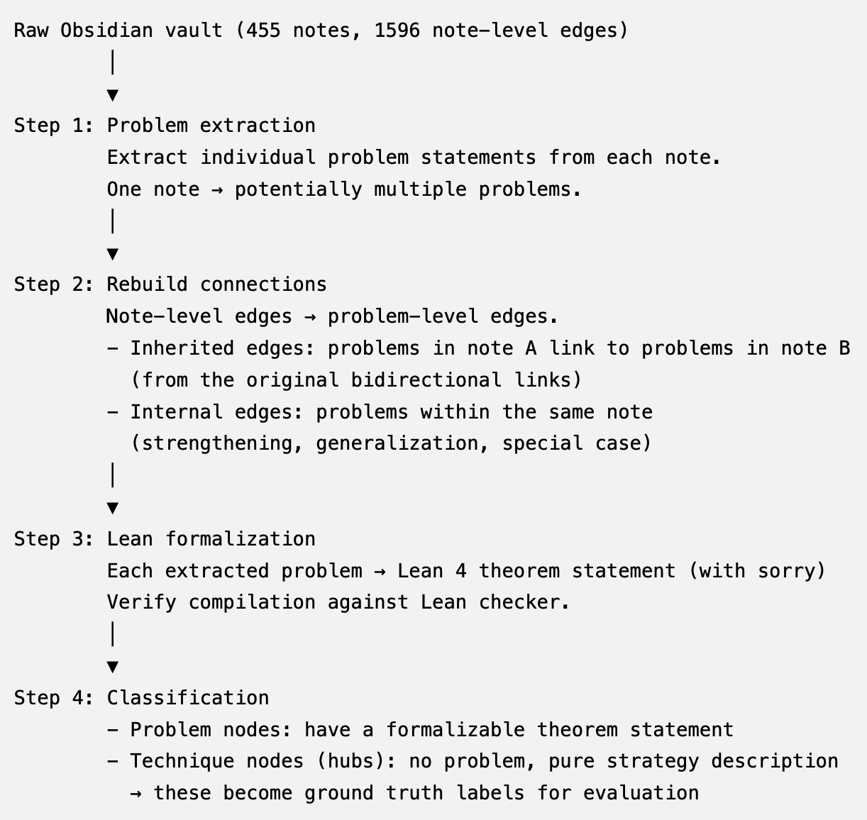
Evaluation 1/3: Dataset Curation Pipeline
Why do we need curation?
One note ≠ one problem
Strategy node vs. problem node
node-level edges -> problem-level
Raw notes are in natural language
Notes:
We can't use the raw data directly — we need a curation pipeline. several reasons. One note doesn't equal one problem. A single note might contain the original question, a
strengthened version, and a generalization. Also, hub nodes are strategy descriptions with no theorem to formalize. And the
edges are at the note level instead of problem level.
Our pipeline has four steps:
extract individual problems from each note,
rebuild connections at the problem level,
formalize each problem as Lean 4 code,
then classify nodes into problem nodes and technique nodes.
The technique hubs — 34 of them, representing just 7% of all nodes —
become our ground truth labels for evaluation.

Slide 14
Evaluation 2/3: Prover effectiveness
Evaluation setup
Env:
Same model (Opus 4.6, GPT 5.4, ...)
Same problem set
Same LEAN checker MCP tools
Baseline: free agents
Claude Code, opencode
ReProver, Lean Copilot, InternLM
Our solution: structured agents
Plan -> Impl -> Replan in SKILL.md
Metrics:
Pass@k
Iteration count
Error type
preliminary result(1 example problem):
agent type | # iterations | error type | revisions
Structured(Ours) opus 4.6 | 36 calls | 100% mechanization | 0
Free(claude code) opus 4.6 | can't solve in 25min | - | -
Notes:
For the prover, we compare our structured workflow against free agents — same model, same problem set, same Lean checker.
Baselines include Claude Code, OpenCode, and
dedicated provers like ReProver and Lean Copilot.
We measure three things: pass rate, iteration count, and error type.
We have a preliminary result on one problem. Using Opus 4.6 with our structured workflow on the complex subset sum problem: 36 checker calls, 100% mechanization
errors, zero strategy revisions.
For the free agent on the same model: the attempt failed after 25 minutes consuming 1M tokens. Which showcases the importance of our framework.

Slide 15
Evaluation 3/3: Knowledge extraction quality
Baseline: Prompt-based summarization
Our solution: Digest Agent
Reinterpretation
Scope expansion
Progressive construction
Strategy templates
Eval setup:
Input: (problem + proof/trace) x N
→ digest agent → extracted lessons
Ground truth: Relational Graph
Semantic match:
digest msg vs. ground truth edges
Metrics: precision & recall
Of the connections the digest claims, how many match ground truth edges?
Of the ground truth edges, how many does the digest recover?
preliminary result(Hub-recovery only):
agent type | precision | recall
prompt-based | 1/1 | 1/2
digest agent | 2/2 | 2/2
Notes:
For the digest agent, we evaluate knowledge extraction quality. The baseline is simple prompt-based summarization — just ask an LLM to summarize the proof. Our
solution uses the digest agent with its four core functions.
(The setup: give the agent a problem and its proof trace, let it extract lessons, then compare against our ground truth,which is the relational graph from the Obsidian vault.)
(We use semantic matching between the digest output and the ground truth edges, since the digest won't use the exact same wording as the notes.)
We measure precision and recall against ground truth hub connections. On our preliminary test — the complex subset sum problem — there are two ground truth hubs: the
probabilistic method and the pigeonhole principle. The baseline found one — 50% recall.
The digest agent found both — 100% recall. which gives us confidence that the digest agent can identify the deeper underlying strategy.

Slide 16
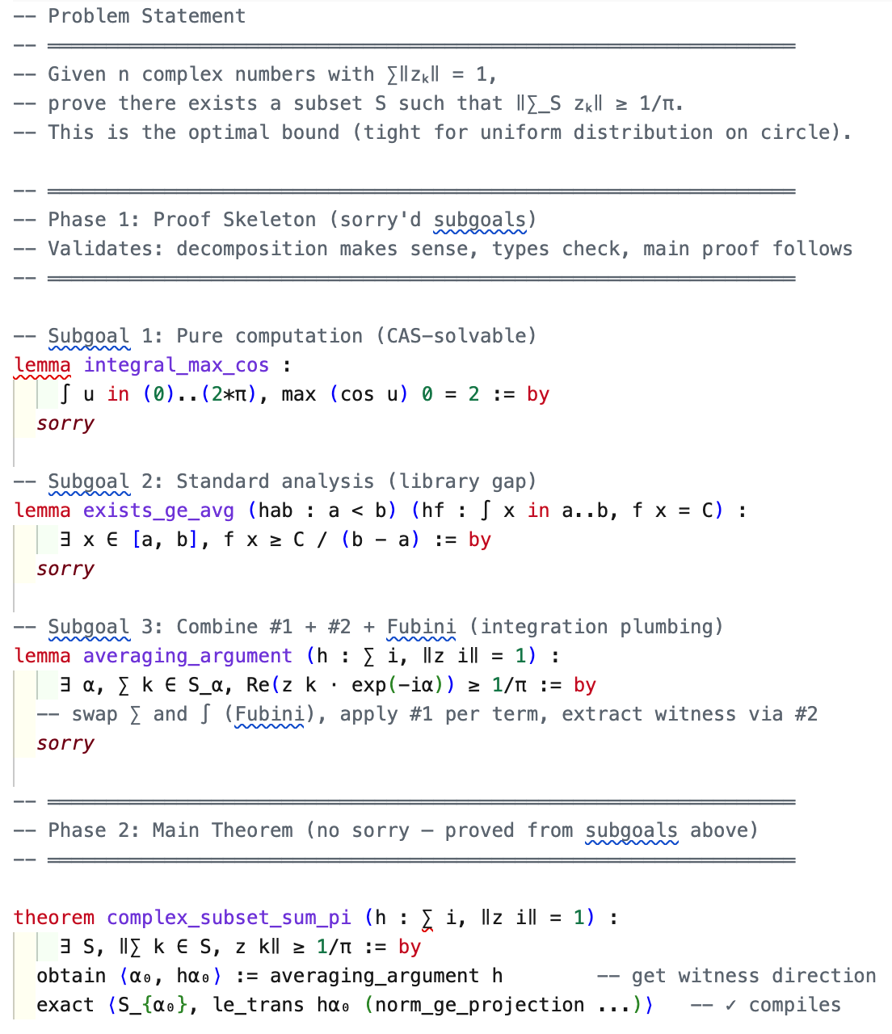
Case Study 1:
Subgoal strategy is the key
Better readability(full proof ~300 loc)
Could be checked using other tools
Mechanization dominated
35 iterations of formalization labor
Data leakage masks true difficulty
Opus 4.6 already knows the solution upfront!
Co-curation of training vs. eval data
agent type | # iterations | error type | revisions
Structured opus 4.6 | 36 calls | 100% mechanization | 0
Notes:
And we provide one case study on the complex subset sum problem. On the right you can see the actual proof skeleton generated by our agent. The problem statement is at the top. Below it, Phase 1 —
the skeleton with three sorry'd subgoals. One is a pure computation. One is a standard analysis result. One is
integration plumbing. At the bottom, the main theorem — fully proved from these subgoals, no sorry.
Three takeaways. First, the subgoal strategy gives better readability than the full 300-line proof, and the sorry'd lemmas could be checked using tools like
Mathematica.
Second, mechanization dominated — 36 iterations of formalization labor, all API names and syntax, zero mathematical errors.
Third,(we identified a data leakage issue that we need to address)
data leakage masks
true difficulty.
Opus 4.6 already knew the answer upfront. Co-curation of training versus evaluation data is an important concern.

Slide 17
Future work
Scaling already-built infrastructure
New directions
Sympy-witness coverage across more sorry'd proofs
Ablation matrix expanded (more problems × more weak models)
Digest probe across more proof traces: quantify the categorical gap
Atomic analysis: (per-step intuition, boundary, counterexample) as stricter standard for digest
Reasoning Arbitration: proactive delegation to tools
Broader tool integration: OR-Tools, Z3
Infrastructure is in place; ran into the weekly usage-limit on the coding plan during benchmarking. At-scale evaluation will run after the limit resets.

Slide 18
Towards interpretable AI theorem proving
Dataset Curation
Reasoning Loop
Digest Lessons

