Slide 1
Structured AI Theorem Proving with Human-Learnable Knowledge Extraction
Ashley, Shaurya, Yuqi, Zihan

Slide 2
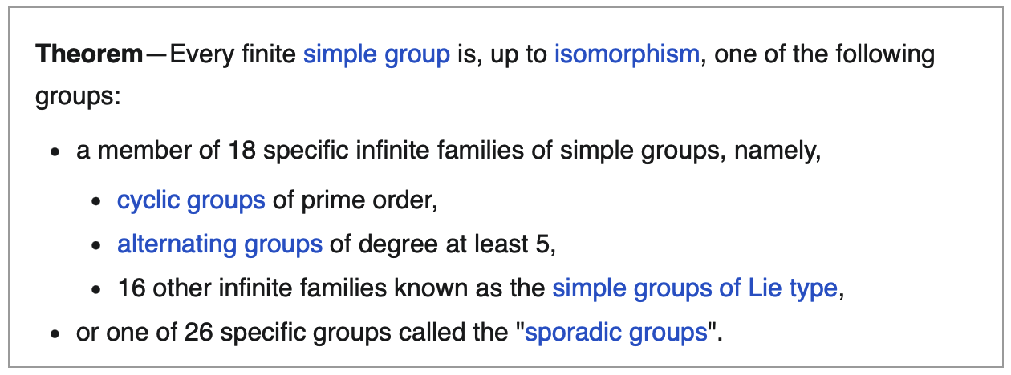
The Age of Human
The Age of AI
The enormous theorem:
We use AI to:
Fix bugs
Implement features
Design systems
Prove theorems
~ 50 years of work (1955-2004)
15,000 pages or proof across ~500 papers
GLS "Simplified Proof" Project(1981 -)
planned: 12 volumes
published so far: 9 volumes
ends up longer than the original
How hard is it to study:
GPU kernels with ~10k Loc?
Proof of theorem in 1M+ Loc?
The proof is verified. The understanding lags decades behind!
Notes:
In 1955, mathematicians began classifying all finite simple groups. It took 50 years, 500 papers, 15,000 pages, and over 100 mathematicians. The proof was finally
completed in 2004. Then someone asked — can we make this understandable? A project called GLS started in 1981 to write a simplified version. Twelve volumes planned. Forty-five
years later, nine are published and it's still ongoing.
Now we're in the age of AI. We use AI to fix bugs, implement features, and now — prove theorems. But when an AI generates a 10,000-line GPU kernel or a massive formal
proof, how does a human learn from that? Even if the proof is verified. The understanding lags decades behind.
This is the problem we're working on.

Slide 3
Problem Statement
For formalized math theorem proving:
Verified ≠ understanding
Current systems optimize for "does it compile?" and discard everything else
Mechanization ≠ reasoning
Peripheral errors and intrinsic difficulty are conflated
We want AI assisted proofs that enhance human understanding, not just accumulate truths.
Our objective:
Design a system that produces traces that are not only human-readable but human-learnable.
Notes:
For formalized math theorem proving, we identify two core problems. First, verified does not equal understanding. Current systems optimize for one thing — does the
proof compile? Everything else is discarded. The exploration, the failed attempts, the connections to other problems — all thrown away.
Second, mechanization does not equal reasoning. When a proof fails, it might be because you used the wrong API name, or it might be because your entire strategy is
wrong. These are completely different problems, but current systems treat them the same.
We want AI-assisted proofs that enhance human understanding, not just accumulate truths. Our objective is to design a system that produces traces that are not only
human-readable, but human-learnable.

Slide 4
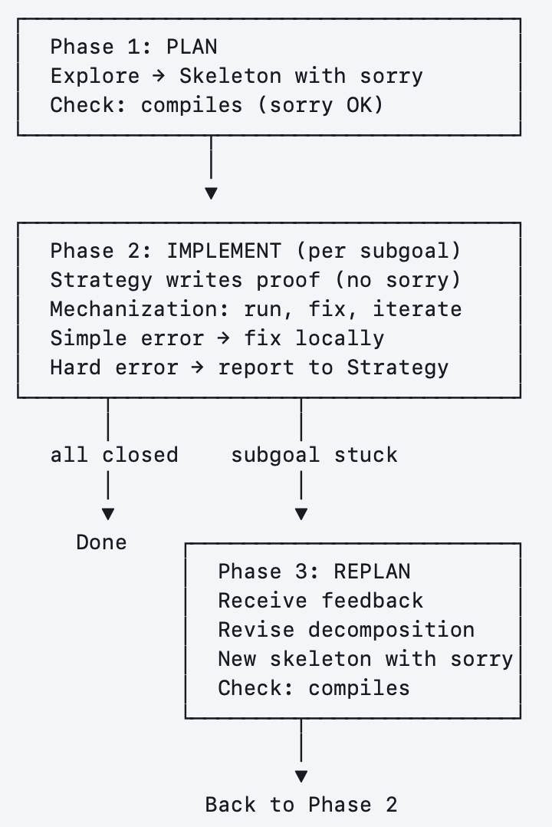
Our Solution 1/2: Prover Agent
Traces
Prover Agent
Plan - Impl - Replan Loop
Skeleton with "sorry"
Formal checker at every step
Separate bug fix vs. math step
Digest Agent
1. Reinterpretation
2. Scope Expansion
3. Progressive Construction
4. Strategy Templates
Lessons
Notes:
Our solution is a two-system architecture. On the proving side, we have a prover agent that follows a plan-implement-replan loop. In the planning phase, it explores
the problem and produces a skeleton with "sorry" — claimed subgoals that compile but aren't proved yet. This validates the proof structure before we invest in the
details. In the implementation phase, it fills in each subgoal. A mechanization agent handles simple errors like wrong API names, and only escalates hard errors back
to the strategy agent. If a subgoal gets stuck, we replan — revise the decomposition and try again.
The prover generates traces. These traces flow into the digest agent, which performs four functions: reinterpretation, scope expansion, progressive construction, and
strategy templates. The extracted lessons then feed back to improve future proving sessions.

Slide 5
Our Solution 2/2: Digest agent
How would human digest a problem?
Given n complex numbers with ∑|zₖ| = 1, prove ∃ subset S with |∑_s zₖ| ≥ 1/6.
Our digest agent will do the following:
1. Reinterpretation: "complex numbers → 2D vectors"
2. Scope expansion : "can we beat 1/6?"
3. Progressive construction: "What if we start with 2 vectors instead of n?"
4. Strategy templates: "Pigeonhole!"
5. Failure lessons: "We tried X. It won't work and here's why."
Notes:
How would a human digest a problem? Let's take a concrete example. Given n complex numbers whose absolute values sum to one, prove there exists a subset whose sum has
norm at least one-sixth.
A human doesn't just prove it — they learn from it. Our digest agent mirrors this process. First, reinterpretation: complex numbers are really just 2D vectors. That
changes what tools are relevant. Second, scope expansion: can we beat one-sixth? Third, progressive construction: what if we start with just 2 vectors instead of n?
That reveals the problem is about selection, not summation. Fourth, strategy templates: this is a pigeonhole argument — project onto a direction. And fifth, failure
lessons: we tried X, it didn't work, and here's why.

Slide 6
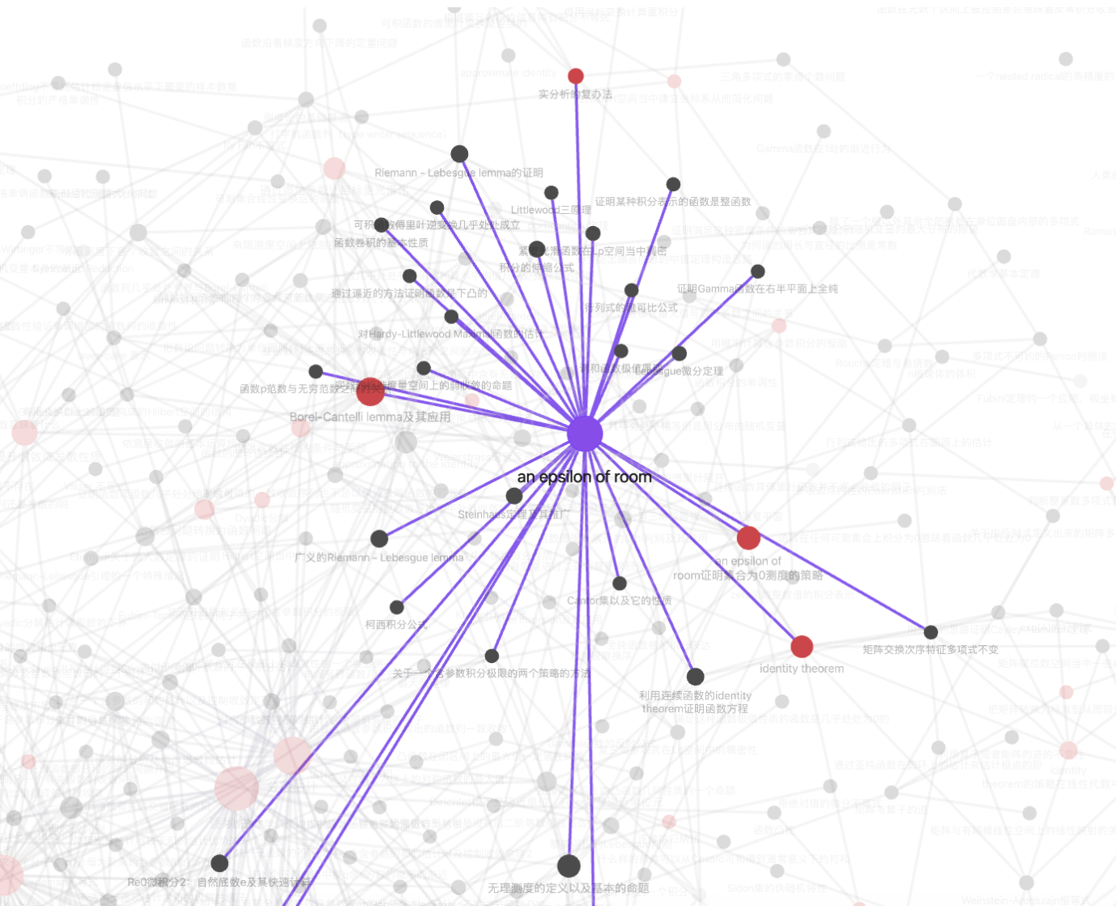
Evaluation 1/3: Dataset Curation
Core raw data: math-notes obsidian vault
Features:
455 notes, 1596 note-level edges
Inside a note:
Human-authored reasoning, not just solutions
Difficulty progression
Between notes:
explicit relational structure
few general strategies, many specific problems
Vault author: Pikachu345@Bilibili, proprietary
Notes:
Now let's talk about evaluation. We obtained a proprietary Obsidian vault — 455 math notes with 1600 bidirectional links between them. This is the graph view. Each
node is a note, each edge is a connection that the author made.
What makes this dataset special? Inside each note, it's not just a solution — it contains the author's reasoning, and difficulty progression from the original problem
to stronger versions and generalizations. Between notes, the links form an explicit relational structure. a few
general strategies connect to dozens of problems, while most nodes are individual problems.
(Those hub nodes — the high-level strategies — are exactly what our digest
agent should be recovering. )

Slide 7
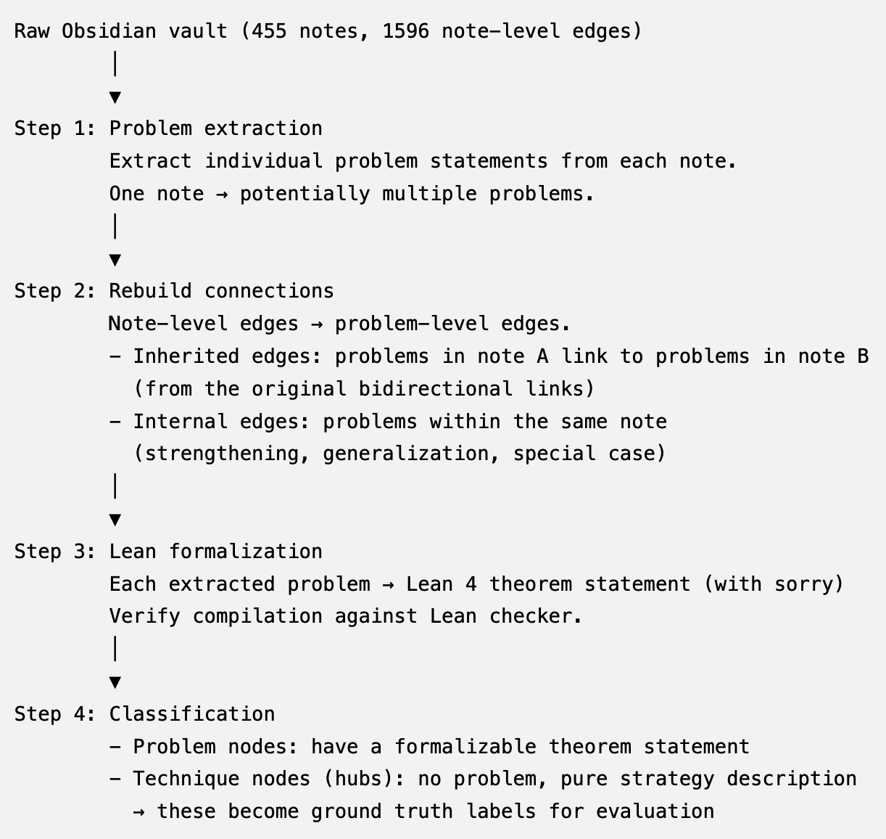
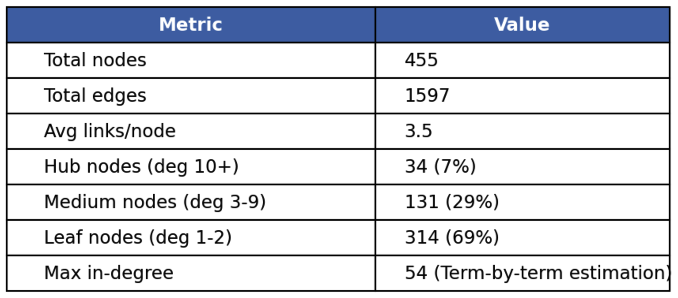
Evaluation 1/3: Dataset Curation Pipeline
Why do we need curation?
One note ≠ one problem
Strategy node vs. problem node
node-level edges -> problem-level
Raw notes are in natural language
Notes:
We can't use the raw data directly — we need a curation pipeline. several reasons. One note doesn't equal one problem. A single note might contain the original question, a
strengthened version, and a generalization. Also, hub nodes are strategy descriptions with no theorem to formalize. And the
edges are at the note level instead of problem level.
Our pipeline has four steps:
extract individual problems from each note,
rebuild connections at the problem level,
formalize each problem as Lean 4 code,
then classify nodes into problem nodes and technique nodes.
The technique hubs — 34 of them, representing just 7% of all nodes —
become our ground truth labels for evaluation.

Slide 8
Evaluation 2/3: Prover effectiveness
Evaluation setup
Env:
Same model (Opus 4.6, GPT 5.4, ...)
Same problem set
Same LEAN checker MCP tools
Baseline: free agents
Claude Code, opencode
ReProver, Lean Copilot, InternLM
Our solution: structured agents
Plan -> Impl -> Replan in SKILL.md
Metrics:
Pass@k
Iteration count
Error type
preliminary result(1 example problem):
agent type | # iterations | error type | revisions
Structured(Ours) opus 4.6 | 36 calls | 100% mechanization | 0
Free(claude code) opus 4.6 | can't solve in 25min | - | -
Notes:
For the prover, we compare our structured workflow against free agents — same model, same problem set, same Lean checker.
Baselines include Claude Code, OpenCode, and
dedicated provers like ReProver and Lean Copilot.
We measure three things: pass rate, iteration count, and error type.
We have a preliminary result on one problem. Using Opus 4.6 with our structured workflow on the complex subset sum problem: 36 checker calls, 100% mechanization
errors, zero strategy revisions.
For the free agent on the same model: the attempt failed after 25 minutes consuming 1M tokens. Which showcases the importance of our framework.

Slide 9
Evaluation 3/3: Knowledge extraction quality
Baseline: Prompt-based summarization
Our solution: Digest Agent
Reinterpretation
Scope expansion
Progressive construction
Strategy templates
Eval setup:
Input: (problem + proof/trace) x N
→ digest agent → extracted lessons
Ground truth: Relational Graph
Semantic match:
digest msg vs. ground truth edges
Metrics: precision & recall
Of the connections the digest claims, how many match ground truth edges?
Of the ground truth edges, how many does the digest recover?
preliminary result(Hub-recovery only):
agent type | precision | recall
prompt-based | 1/1 | 1/2
digest agent | 2/2 | 2/2
Notes:
For the digest agent, we evaluate knowledge extraction quality. The baseline is simple prompt-based summarization — just ask an LLM to summarize the proof. Our
solution uses the digest agent with its four core functions.
(The setup: give the agent a problem and its proof trace, let it extract lessons, then compare against our ground truth,which is the relational graph from the Obsidian vault.)
(We use semantic matching between the digest output and the ground truth edges, since the digest won't use the exact same wording as the notes.)
We measure precision and recall against ground truth hub connections. On our preliminary test — the complex subset sum problem — there are two ground truth hubs: the
probabilistic method and the pigeonhole principle. The baseline found one — 50% recall.
The digest agent found both — 100% recall. which gives us confidence that the digest agent can identify the deeper underlying strategy.

Slide 10
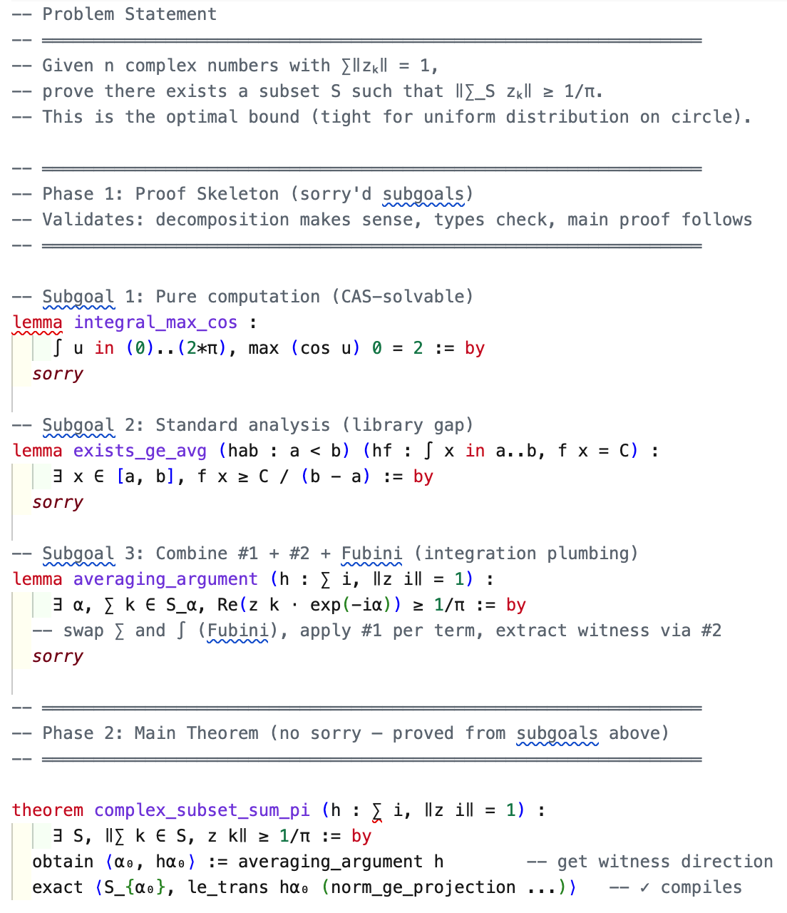
Case Study 1:
Subgoal strategy is the key
Better readability(full proof ~300 loc)
Could be checked using other tools
Mechanization dominated
35 iterations of formalization labor
Data leakage masks true difficulty
Opus 4.6 already knows the solution upfront!
Co-curation of training vs. eval data
agent type | # iterations | error type | revisions
Structured opus 4.6 | 36 calls | 100% mechanization | 0
Notes:
And we provide one case study on the complex subset sum problem. On the right you can see the actual proof skeleton generated by our agent. The problem statement is at the top. Below it, Phase 1 —
the skeleton with three sorry'd subgoals. One is a pure computation. One is a standard analysis result. One is
integration plumbing. At the bottom, the main theorem — fully proved from these subgoals, no sorry.
Three takeaways. First, the subgoal strategy gives better readability than the full 300-line proof, and the sorry'd lemmas could be checked using tools like
Mathematica.
Second, mechanization dominated — 36 iterations of formalization labor, all API names and syntax, zero mathematical errors.
Third,(we identified a data leakage issue that we need to address)
data leakage masks
true difficulty.
Opus 4.6 already knew the answer upfront. Co-curation of training versus evaluation data is an important concern.

Slide 11
Future work
Full-scale evaluation
Run prover + digest agent on many problems from the curated dataset
Mathematica/sympy integration
Reduces the gap between "mathematically correct" and "Lean-verified."
Formalized dataset curation
Improve digest agent
Notes:
For the rest of the semester. First, full-scale evaluation — run the prover and digest agent on many problems from the curated dataset, not just one. Second,
Mathematica and sympy integration — this reduces the gap between "mathematically correct" and "Lean-verified." Some sorry'd lemmas are trivial computations that a
computer algebra system solves instantly. Third, complete the formalized dataset curation — extract problems from the vault, formalize in Lean, rebuild edges. And
fourth, improve the digest agent based on what we learn from the evaluation. The machinery is built. What remains is running it at scale and measuring.

Slide 12
Towards interpretable AI theorem proving
Dataset Curation
Reasoning Loop
Digest Lessons

