Slide 1
Structured AI Theorem Proving
with Human-Learnable Knowledge Extraction
Zheng

Slide 2
Dataset: asymmetric utility
Our relational graph: problems linked by shared strategy / technique. Two directions of use, one solved, one open.
Forward direction — works
Reverse direction — open
Graph edge = ground truth: "these two problems share a strategy / technique"
Hub nodes = recurring techniques (deterministic top-3 + degree ≥ 10)
Enables hub-recall benchmarks, transfer experiments, conditioned generation
Already used in our midterm preliminary results (digest hub recovery)
Given two digest outputs (NL abstractions), are they "the same intuition"?
Different wording, same idea — vs — same wording, too problem-specific?
Semantic equivalence in NL math reasoning is unsolved
Blocks direct evaluation of digest agent quality
Contribution: dataset is ready for forward use. Limitation: reverse-direction evaluation is the open problem.

Slide 3
Opening a can of worms
We gave gpt-5.4 the full reasoning trace and asked, three ways, to extract the abstract strategy. The trace explicitly contains the words "by pigeonhole".
Naive prompt
Directed prompt
Atomic-format prompt
"think of the objects as vectors, and look for a subset whose directions align enough to prevent too much cancellation… projecting vectors onto carefully chosen directions…"
"directional or component-wise alignment, while cancellation is the main obstruction… discrete partitioning, decomposition into components, and continuous averaging…"
Trigger: lower bound on the size of a sum formed by selecting some vectors/items that can cancel… Action: Choose a direction, keep only the items with nonnegative projection… average over all directions. Boundary: weakens in higher dimensions or when no projection-based lower bound controls the target.
Three prompts, zero "pigeonhole." The model paraphrases the application; it doesn't name the principle. Recovering edges to related problems — let alone the hub — is a categorical gap.

Slide 4
Sorry-with-witness: sympy closes the analytic gap
Averaging proof had 3 sorry's. One is a definite integral. Lean can't close it; sympy can in one call.
Without sympy — pure Lean
With sympy-witness
lemma integral_max_cos : ∫ u in (0 : ℝ)..(2 * Real.pi), max (Real.cos u) 0 = 2 := by sorry
import sympy as sp u = sp.Symbol('u', real=True) result = sp.integrate( sp.Max(sp.cos(u), 0), (u, 0, 2*sp.pi)) # result = 2
Mathlib has no closed form. To close in pure Lean: FTC + integral splitting at the zero of cos + periodicity. Substantial bespoke proof.
One call. Trusted external witness. Lean keeps the sorry; we accept it because sympy independently verified the underlying claim.
Decompose work by tool. Each tool is a dense information sink. → Next: decompose work by model capability — planning, reasoning, coding, formalization.

Slide 5
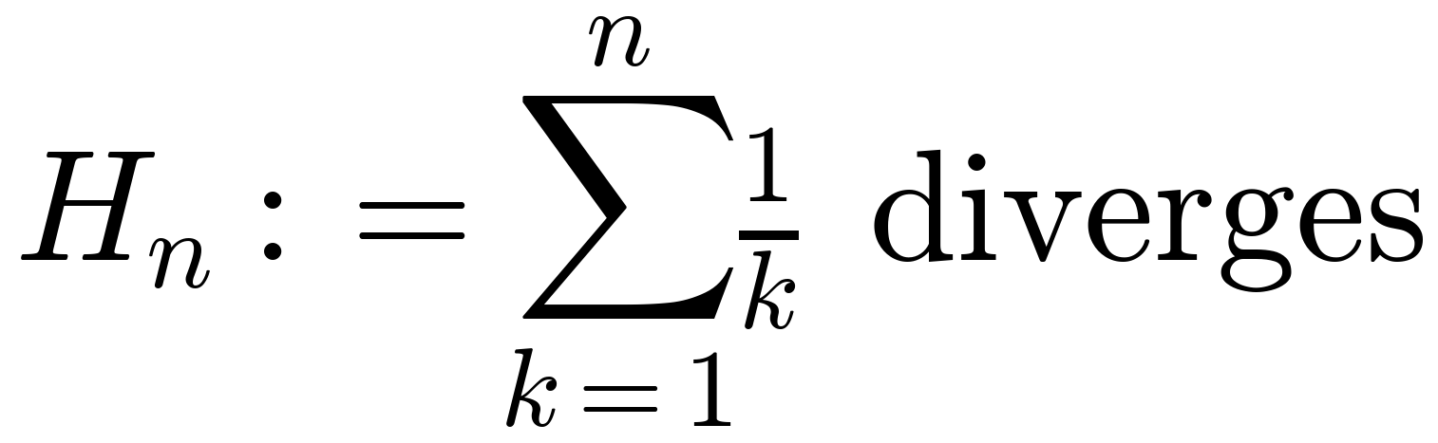
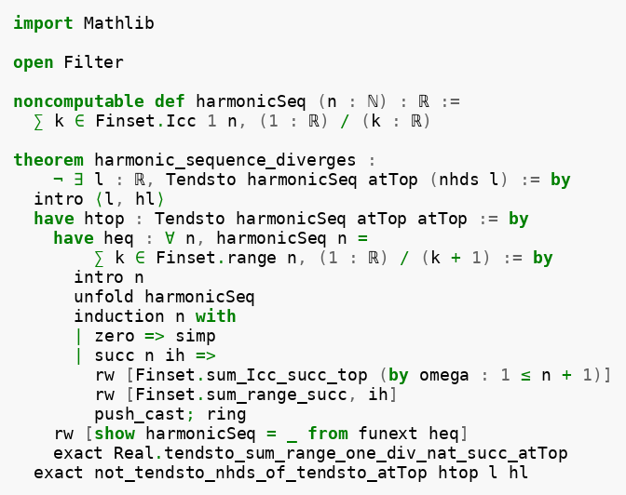

Evaluation (x/4): Ablation
def harmonicSeq (n : ℕ) : ℝ := ∑ k ∈ Finset.Icc 1 n, (1:ℝ) / k theorem harmonic_sequence_diverges : ¬ ∃ l : ℝ, Tendsto harmonicSeq atTop (nhds l)
Opus 4.7, three runs ✅
GPT 5.4 mini, ten rounds ❌
Findings
# | errors | Category
1 | 13 | Hallucinated API
2 | 2 | Type mismatch
3 | 3 | Type mismatch
4–10 | 1 | Mechanistic loop
Capability decomposition: planning · reasoning · coding · formalization
Weak ≈ strong on planning + reasoning (right strategy at attempt 4)
Weak fails at formalization (Lean tactic ordering, can't close the bridge)
Coding not tested here — covered by sympy-witness above
Implication: cheap model (~6×) for planning + reasoning; strong reserved for formalization
1. Mechanical — `∑ k in S` → `∑ k ∈ S` 2. Strategy — `simp_rw` failed; `funext` lifts pointwise eq to function eq 3. Success — clean compile, 0 errors
same `funext` insight
same Mathlib lemma
same contradiction step
→ correct strategy + proof flow

Slide 6
Future work
Scaling already-built infrastructure
New directions
Sympy-witness coverage across more sorry'd proofs
Ablation matrix expanded (more problems × more weak models)
Digest probe across more proof traces — quantify the categorical gap
Atomic analysis (Pikachu345's 3 criteria): per-step intuition, boundary, counterexample — stricter standard for digest
Reasoning Arbitration: proactive delegation to tools — extension of sorry-with-witness
Broader tool integration: Mathematica, OR-Tools, Z3 — multi-tool dense information sinks
Closing the digest-equivalence problem: methodology for measuring when two NL digests describe the same intuition
Infrastructure is in place; ran into the weekly usage-limit on the coding plan during benchmarking. At-scale evaluation will run after the limit resets.

