Slide 1

ACADEMIC CORE JAVA Object Orientation And Multi-Threading
HANDS-ON Training

Slide 2
01 Object Orientation
BEGIN

Slide 3
Objects… Objects … Objects …

Slide 4

What is this?
?
?
Notes:
The answer to the question “Can we develop this” depends on what we mean by developing.
Let us assume, that we mean by “development” that it that it eventually can be used by an end user.
Can we develop this? No, if we ask an artist, he will say, yes. Because in this case the end user might be a connesseur of art, who puts a drawing of this on the wall in her living room.
There are a variety of famous artists who made their fortune with these types of drawing (Escher, Dali).
So, defining it to be “useful for an end user” is not enough.

Slide 5
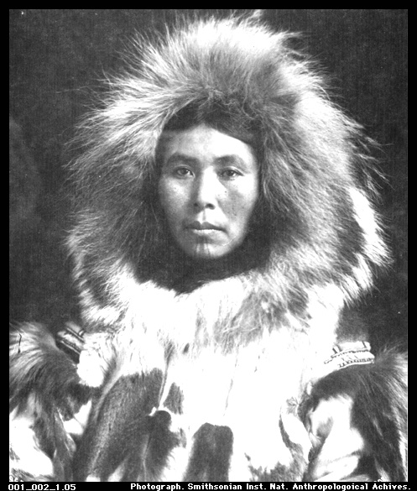
What is This?
?
?
Notes:
Object Technology does not make a team perform better or worse, it merely given a team a new excuse not to do so (Racco).
What is the problem? OO Technology has been around with us now for 25 years, and has accelerated enormously in the last 10 years.
By some people it has been hailed as the final solution to all our software engineering problems. By others it has been hailed as the final nail in the coffin that prevents us from thinking.
There are instances in industry, where teams very disciplined in object technology failed to deliver systems that met requirements or management goals. In other cases, teams excelled. What was the difference?

Slide 6
What’s an Object?
An abstraction, concept, or thing with crisp boundaries
Has meaning for the problem at hand
Characteristics:
Identity
Classification
State
Behavior

Slide 7
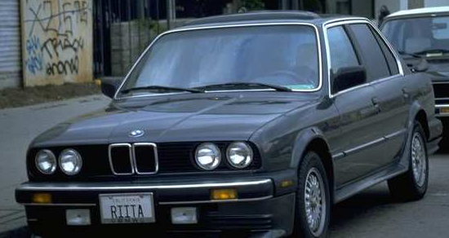
Identity
Objects have unique identity
Objects are inherently distinguishable
Twins

Slide 8
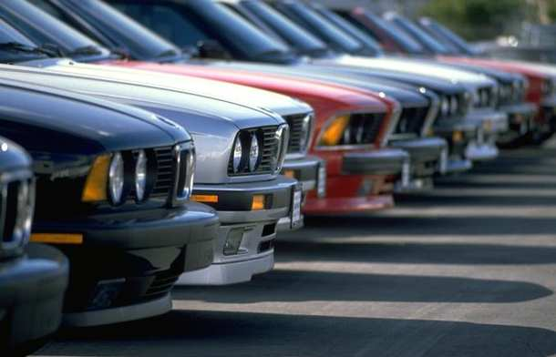
Classes
A set of similar objects
Object is a instance of a class
Share behavior and possibly some state
An abstraction that is meaningful for the problem at hand

Slide 9
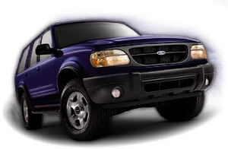
Object State
State = data properties
What do we (want) to know about an object?
At a given moment?
Constant or variable
Chassis No:
Speed, owner, date of next service
Attributes

Slide 10
Object Behavior
Actions that the object can be asked to perform
Objects can request other objects to act by messaging
Operations
Often involve changing state and/or values
Start
Accelerate
Turn
Slow Down

Slide 11
So, what is a object?
Something that has State - Attributes
Something that has behavior - Operations

Slide 12
Objects have many forms
Tangible Things
System
Airplane
Computer
Interactions
Car
Incidents
Roles
Interview
Doctor
Agreement
Withdrawal
Meeting
Teacher

Slide 13

END

