Slide 1

ACADEMIC CORE JAVA Object Orientation And Multi-Threading
HANDS-ON Training

Slide 2
02 Object Hierarchy
BEGIN

Slide 3
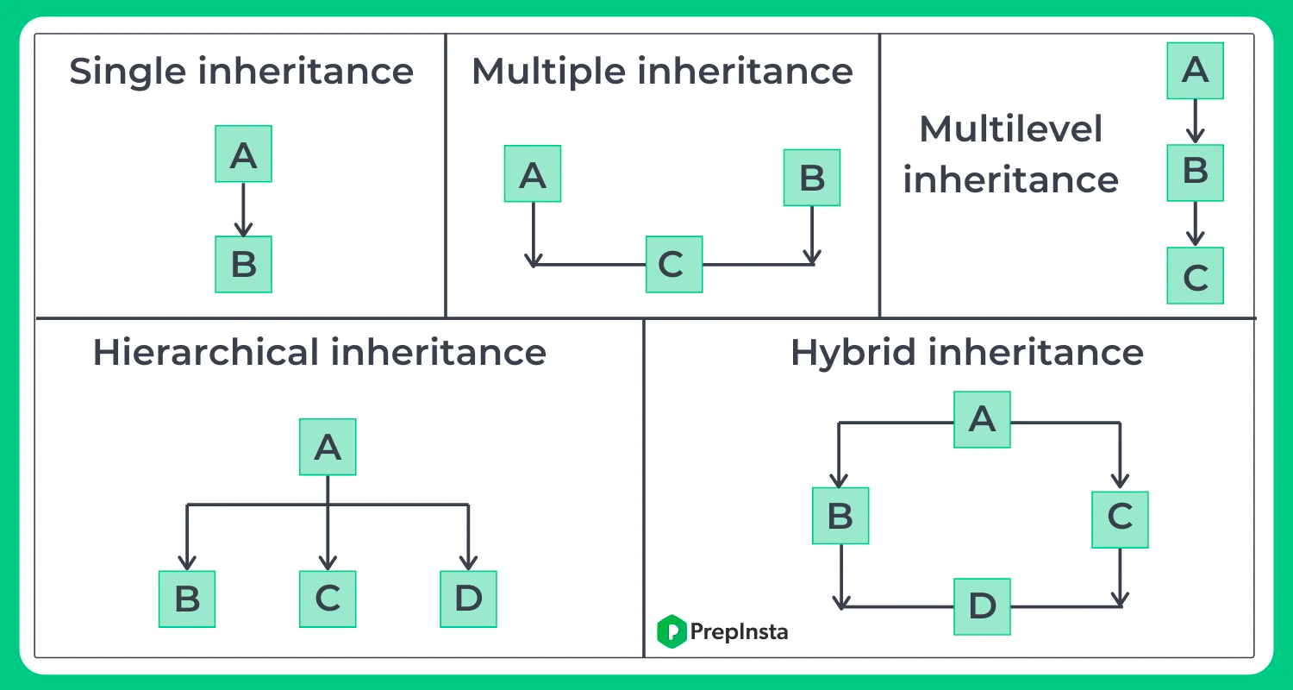

Slide 4
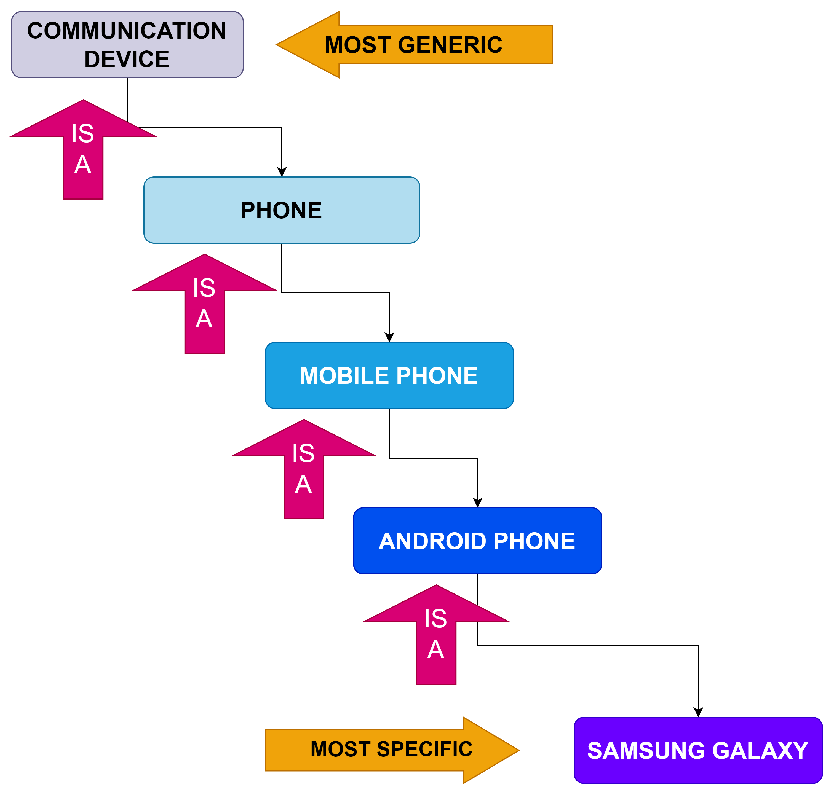

Slide 5
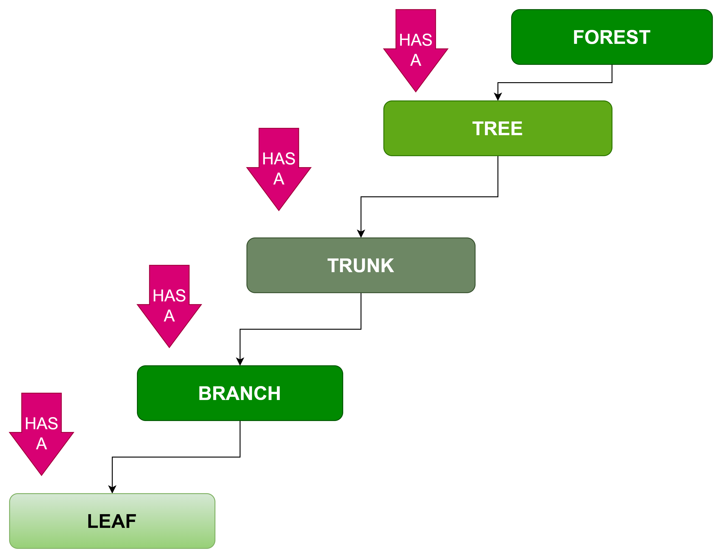

Slide 6
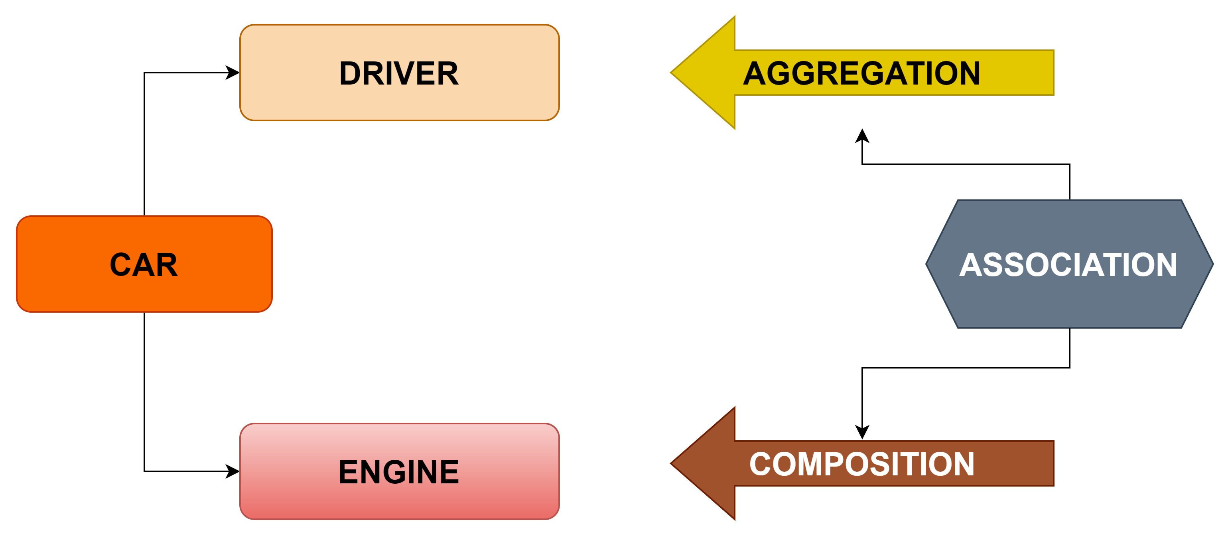

Slide 7

END

