Slide 1
PROJECT HOUSING
RAVI PRAKASH BAJPAI

Slide 2
INTRODUCTION
This project is related to prediction of price of the house nearly 80 features are given and price has to be predicted.
For understanding this project some knowledge of real state should be there and in real state basically knowledge for housing is required.
From this project I have learn many things that are applicable in real world scenerio for prediction of price of any house.what are the factor that are necessary for prediction of price.

Slide 3
DATA CLEANING
TREATING NULL VALUES
Features are mainly categorical data
Finding unique value for each features
Converted object data type features into numeric data type features

Slide 4
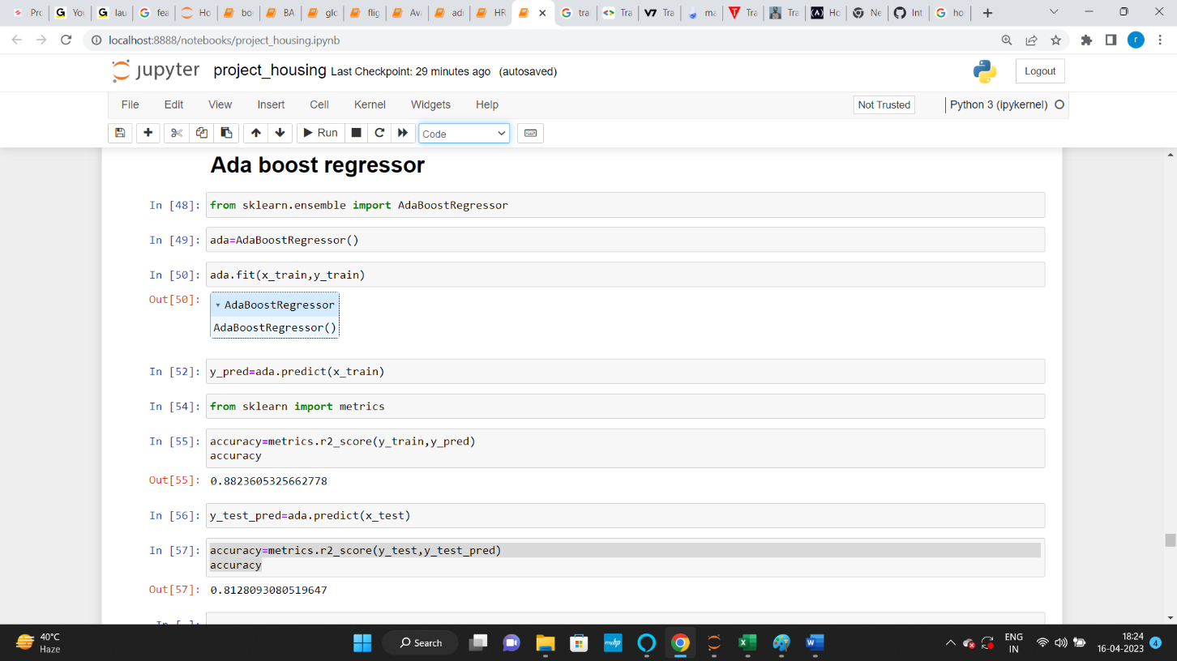
Snap shot performance

Slide 5
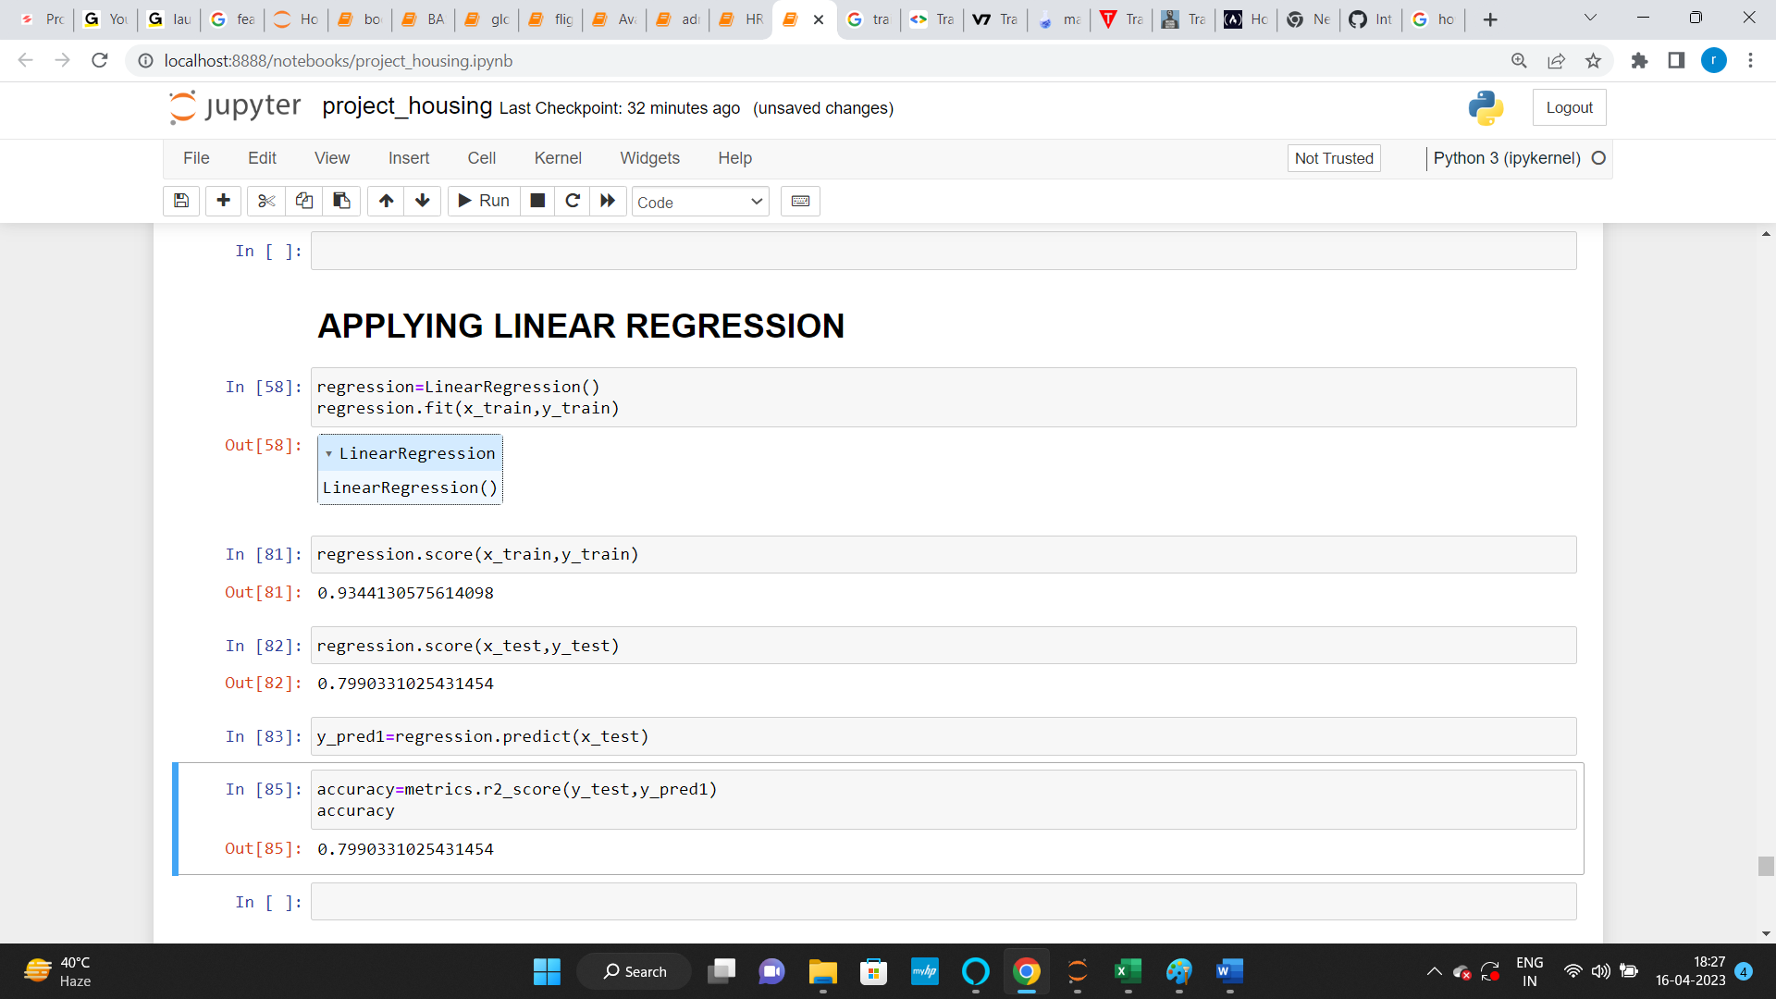
Snap shot performance

Slide 6
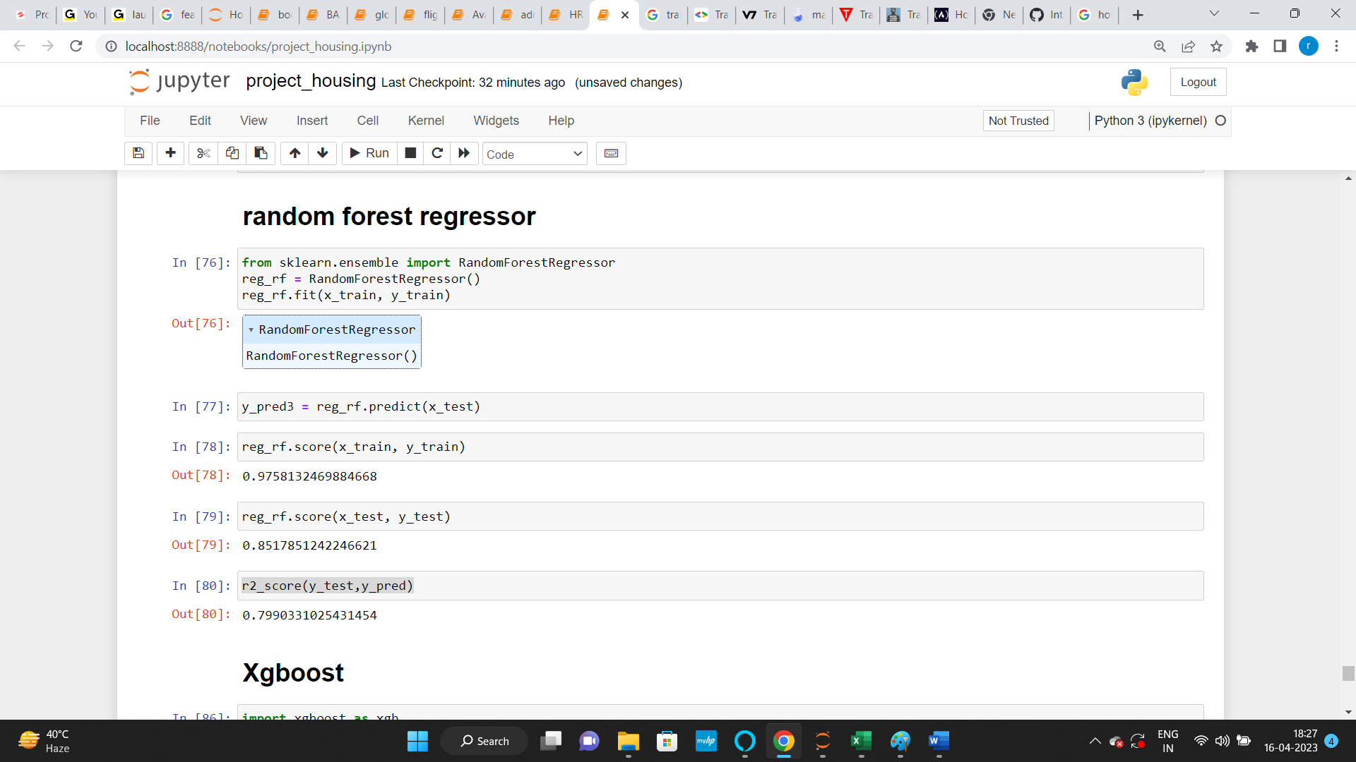
Snap shot performance

Slide 7
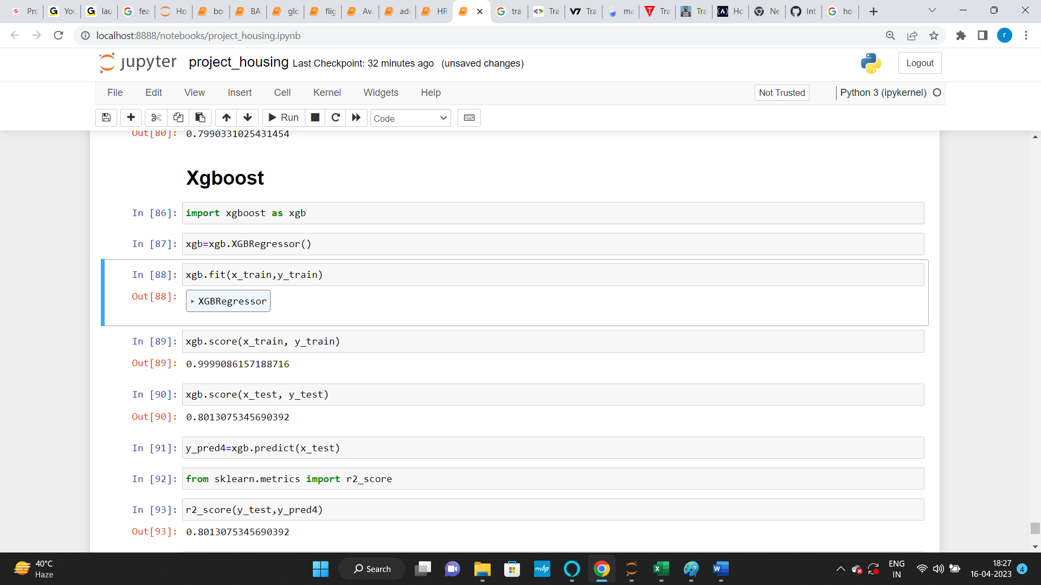
Snap shot performance

Slide 8
CONCLUSION
CONCLUSION
Learning Outcomes of the Study in respect of Data Science
From the given model I have learn the data cleaning part in deeper and also I have made research for feature selection technique as there are many features in this project.
Mainly I have face challenges in dealing with too many features and secondly I have face challenge how to represent visulalization of the project because after applying get dummies feature were nearly 313.
Overall my experience for building this model was good because I have learn a lot,may be I have not applied all the things I have learned but I have over come with many thing.

