Slide 1
Traffic Sign Detection
Team 11 - PY

Slide 2
Introduction
The creation and comparison of a deep learning-based architecture for identifying 43 types of traffic signals will be part of this research. The classification accuracy and prediction speed of common CNN-based designs were assessed. A simple, effective CNN (Convolutional Neural Network) was designed based on the findings. It combines high prediction speed with great accuracy. We used a German dataset containing about 50,000 images and 43 classes.

Slide 3
The recognition and classification of traffic signs is an intriguing problem in computer vision. Robust real-time traffic sign recognition algorithms are required for self-driving cars to become prevalent on roadways in the future. Current state-of-the-art technology is only trained on images taken without noise under natural light conditions. To address these issues, we will introduce a new machine learning method based on a completely deep convolutional neural network (CNN).

Slide 4
Machine learning and deep learning have been the subject of many studies and research. CNN is a well-known architecture that is commonly utilized in image classification. This section highlights some of the publications and projects that have most inspired us and helped us comprehend the issue.

Slide 5

Dataset
The dataset used in this project is the German benchmark for traffic sign recognition. This data contains a total of 51,830 images, each of which is (32 x 32 x 3) in size. Where 3 represents the RGB channel of the color image. The dataset was further divided into 34799 training, 4410 validation, and 12630 test images. [www.kaggle.com/datasets/meowmeowmeowmeowmeow/gtsr b-german-traffic-sign]

Slide 6
Implementation
This section details data preprocessing techniques and implemented CNN-based architectures, along with training details and metrics.
The approach adopted to create this computer vision model is to import and load datasets, perform exploratory data analysis (EDA) on datasets, visualize dataset variables and their properties, and fine-tune the model. Includes preprocessing the data to be done, designing the model. Use CNN to train and test your designed model using training and testing examples as shown in below figure.

Slide 7
Languages & Libraries
Python programming is used for machine learning models, artificial intelligence, and data analysis. A Python module for data processing that is frequently utilized by NumPy, and Pandas was also used. Jupiter Notebook is a web-based open-source tool that supports Python and other programming languages. Kera's is one of the most extensively used deep learning frameworks.

Slide 8
Data Preprocessing
The dataset has the images of different sizes by using the below code, all the images resized to 30x30 from the tarin folder. After converting the images to desirable shape, images converted into data list of NumPy array using np.array( ) function. We can see the image data shape i.e., 39209 and labels shape i.e., 39209. The data and labels are stored as .npy format for to skip the conversion if we are using the dataset again.

Slide 9
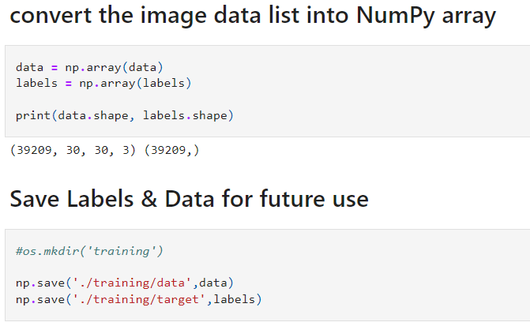
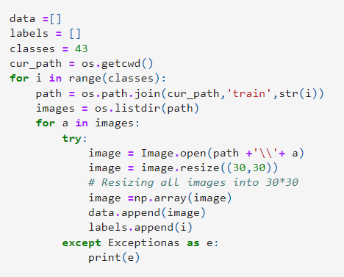

Slide 10
Parameters Used
CNN learns filter values during the model training process. Before the training process, you need to specify some parameters here. Increasing the number of filters will make it more efficient to detect invisible patterns in the image. The dataset is too huge to enter the system only once, so many submissions are required to get the best results. The batch size is a partition of the dataset that can be processed easily and accurately because the complete dataset cannot be provided to the neural network model at once.

Slide 11
Neural network training failures can be thought of as an ensemble collection of 2^n sparse networks, also known as the ensemble technique. This is useful for learning more robust functions from varied random subsets of neurons. The dropout layer selects some nodes in the neural network at random and moves them along the incoming and outgoing links. Loss regularization is a critical aspect in avoiding overfitting and ensuring precision.

Slide 12
CNN Network
Finally, we built a convolutional neural network architecture that consisted of two stacks of three convolutional layers, an average pooling layer, and two fully connected layers. We built a convolutional network that consisted of two stacks of three convolution layers, an average pooling layer, and two fully connected layers. To minimize gradient eruptions and disappearances propagating through several layers, we employed stack normalization after each convolution layer. To avoid overmatches, dropout layers were applied after each stack.

Slide 13
Grid Search for convolution layers was performed on several kernel dimensions: 3, 5, 7, 9, 11, 19, and 31. After each convolution layer, the ReLU activation function was utilized as a non-linearity that set negative input to zero. For the most part, Random Search was used to build this architecture.
To calculate the probability corresponding to 43 classes in the GTSDB dataset, the final output layer includes 43 neurons with SoftMax as the activation function.

Slide 14
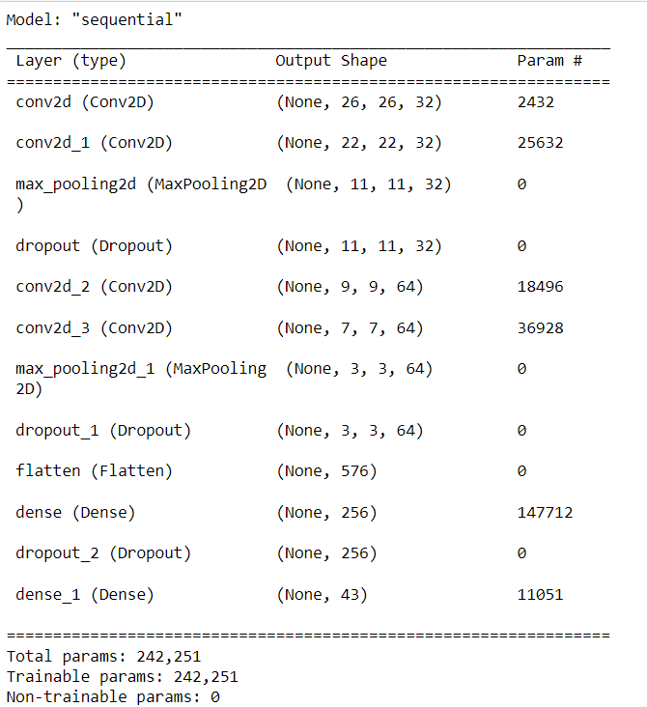
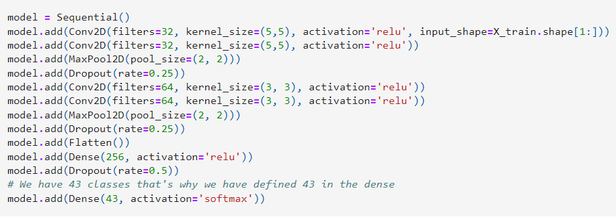

Slide 15
Training & Testing details
For model training and testing, the dataset is separated into two parts: 80 percent and 20%. The third comprehensive step is to train and validate the constructed ML model, which is done using the model.fit() method in the validation set.

Slide 16
Results
The accuracy of the training set is approximately 95.8%. The validation set gives correct results with a 99.06 percent accuracy rate. The testing set produces results with 90.3% accuracy. Precision was found to be 97.8% and recall was 98.06%.

Slide 17
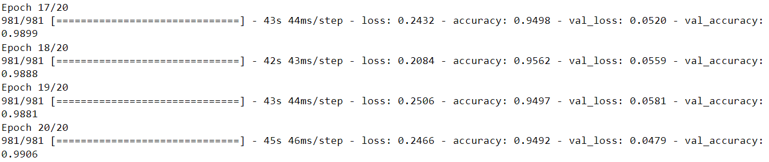
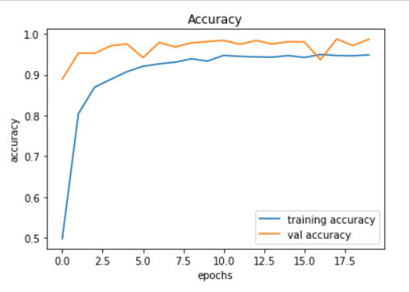
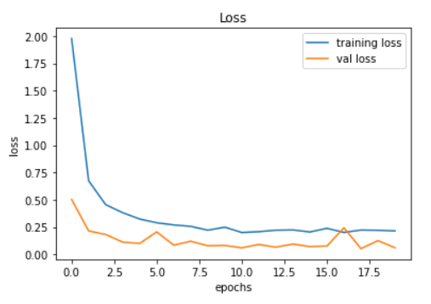

Slide 18
Conclusion
Using Python machine learning programming and Jupiter Notebook's deep learning package, the full task is completed. The developed neural network model's parameters have been fine-tuned to achieve good accuracy. The training set was 95 percent accurate, whereas the test set was 90.3 percent accurate. Integrating many CNNs might boost the model's learning rate, and while training photos are usually scaled, real-time image capture isn't as quick. Center Net can be used to adapt the model like any other CNN model.

Slide 19
References
1. S. Maldonado-Bascon, S. Lafuente-Arroyo, P. Gil- Jimenez, H. Gomez-Moreno, and F. Lopez-Ferreras. Road-sign detection and recognition based on sup- port vector machines. Trans. Intell. Transport. Sys., 8(2):264–278, June 2007.
2. Valentyn Sichkar and Sergey Kolyubin. Effect of various dimension convolutional layer filters on traffic sign clas- sification accuracy. Scientific and Technical Journal of In- formation Technologies, Mechanics and Optics, 19:546– 552, 06 2019.
3. X. Mao, S. Hijazi, R. Casas, P. Kaul, R. Kumar, & C. Rowen, Hierarchical CNN for traffic sign recognition. In 2016 IEEE Intelligent Vehicles Symposium (IV) (pp. 130-135). IEEE, 2016, June.
4. X. Changzhen, W. Cong, M. Weixin, and S. Yanmei, “A traffic sign detection algorithm based on deep convolutional neural network”, 2016 IEEE International Conference on Signal and Image Processing (ICSIP), 2016.
5. S. Raschka, & V. Mirjalili, “Python Machine Learning: Machine Learning and Deep Learning with Python. Scikit-Learn, and TensorFlow”.

