Slide 1

Falcon 9 SpaceX Data Science Capstone Project
Analysis and Insights
KATA RAVI
10.08.2024

Slide 2

OUTLINE
Executive Summary
Introduction
Methodology
Results
Discussion
Conclusion

Slide 3

EXECUTIVE SUMMARY
In this capstone project, we will predict if the SpaceX Falcon 9 first stage will land successfully using several machine learning classification algorithms.
The main steps in this project include:
Data collection, wrangling, and formatting
Exploratory data analysis
Interactive data visualization
Machine learning prediction
Our graphs show that some features of the rocket launches have a correlation with the outcome of the launches, i.e., success or failure.
It is also concluded that decision tree algorithm may be the best machine learning algorithm to predict if the Falcon 9 first stage will land successfully

Slide 4
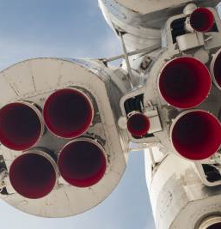
Introduction
The Falcon 9 is a partially reusable two-stage rocket designed and manufactured by SpaceX for the reliable and safe transport of satellites and the Dragon spacecraft into orbit. Since its debut in 2010, it has become known for its innovative reusable first stage, which can land back on Earth after launch to be refurbished and flown again. This capability has significantly reduced the cost of access to space. Falcon 9 has supported numerous missions, including commercial satellite deployments, cargo resupply missions to the International Space Station, and crewed spaceflights under NASA's Commercial Crew Program

Slide 5
METHODOLOGY
The overall methodology includes:
1. Data collection, wrangling, and formatting, using:
• SpaceX API
• Web scraping
2. Exploratory data analysis (EDA), using:
• Pandas and NumPy
• SQL
3. Data visualization, using:
• Matplotlib and Seaborn
• Folium
• Dash
4. Machine learning prediction, using
• Logistic regression
• Support vector machine (SVM)
• Decision tree
• K-nearest neighbours (KNN)

Slide 6
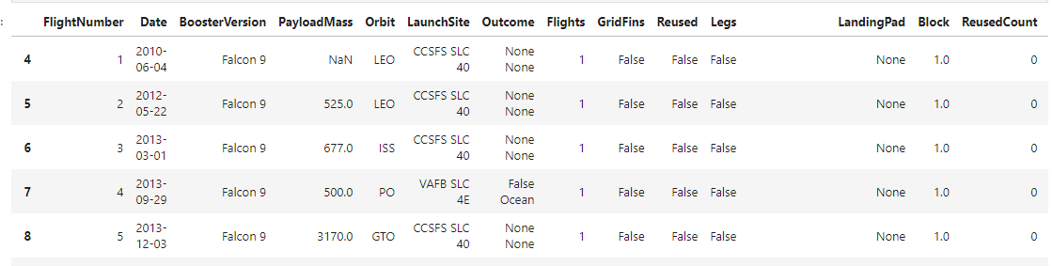
METHODOLOGY Data collection, wrangling, and formatting
• SpaceX API
• The API used is https://api.spacexdata.com/v4/rockets/.
• The API provides data about many types of rocket launches done by SpaceX, the data is
therefore filtered to include only Falcon 9 launches.
• Every missing value in the data is replaced the mean the column that the missing value
belongs to.
• We end up with 90 rows or instances and 17 columns or features. The picture below shows
the first few rows of the data:

Slide 7
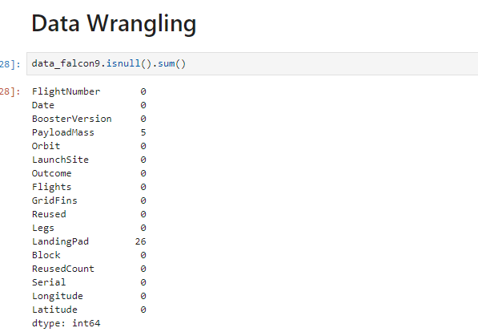
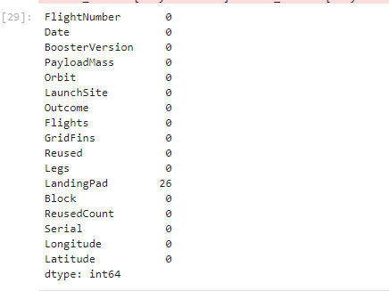
METHODOLOGY Data collection, wrangling, and formatting

Slide 8
METHODOLOGY Web Scraping from Wikipedia:
BeautifulSoup was used to scrape Falcon 9 launch records from Wikipedia.
The HTML table containing the launch records was parsed and converted into a pandas DataFrame.

Slide 9
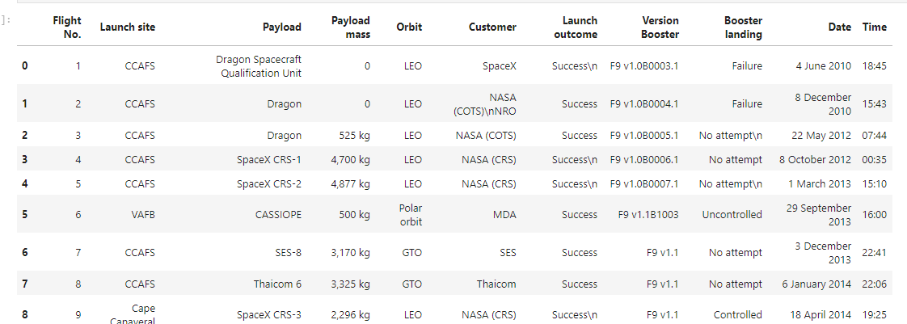
METHODOLOGY Web Scraping from Wikipedia:

Slide 10
METHODOLOGY Data collection, wrangling, and formatting
• The data is later processed so that there are no missing entries and categorical
features are encoded using one-hot encoding.
• An extra column called ‘Class’ is also added to the data frame. The column ‘Class’
contains 0 if a given launch is failed and 1 if it is successful.
• In the end, we end up with 90 rows or instances and 83 columns or features.

Slide 11
METHODOLOGY Exploratory data analysis (EDA)
Visualization:
Used various plots to visualize the relationship between different features like flight number, launch site, payload mass, and success rate.
Plotted success rate trends over the years and success rates of different orbit types

Slide 12
METHODOLOGY Machine Learning Prediction
• Functions from the Scikit-learn library are used to create our machine learning
models.
• The machine learning prediction phase include the following steps:
• Standardizing the data
• Splitting the data into training and test data
• Creating machine learning models, which include:
• Logistic regression
• Support vector machine (SVM)
• Decision tree
• K nearest neighbors (KNN)
• Fit the models on the training set
• Find the best combination of hyperparameters for each model
• Evaluate the models based on their accuracy scores and confusion matrix

Slide 13
RESULTS
• The results are split into 5 sections:
• SQL (EDA with SQL)
• Matplotlib and Seaborn (EDA with Visualization)
• Folium
• Dash
• Predictive Analysis
• In all of the graphs that follow, class 0 represents a failed launch outcome while class 1 represents a successful launch outcome.

Slide 14
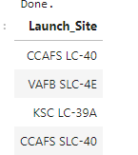
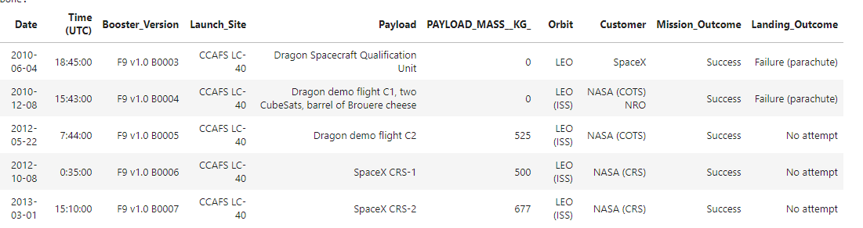
RESULTS EDA with SQL
The names of the unique launch sites in the space mission
5 records where launch sites begin with ‘CCA’

Slide 15
RESULTS EDA with SQL
The total payload mass carried by boosters launched by NASA (CRS)
total_payload_mass
45596
The average payload mass carried by booster version F9 v1.1
average payload mass carried by booster version F9 v1.1
2534
The date when the first successful landing outcome in ground pad was achieved
2010-06-04

Slide 16
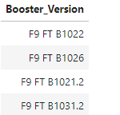
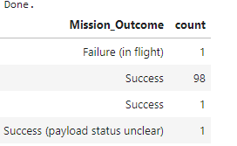
RESULTS EDA with SQL
The names of the boosters which have success in drone ship and have payload mass greater than 4000 but less than 6000
The total number of successful and failure mission outcomes

Slide 17
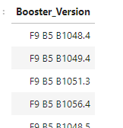
RESULTS EDA with SQL
The names of the booster versions which have carried the maximum payload mass

Slide 18
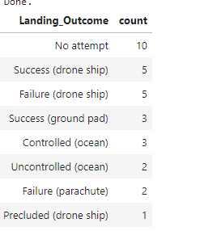
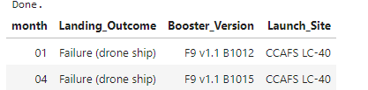
RESULTS EDA with SQL
The failed landing outcomes in drone ship, their booster versions, and launch site names for in year 2015
The count of landing outcomes between the date 2010-06-04 and 2017-03-20, in descending order

Slide 19
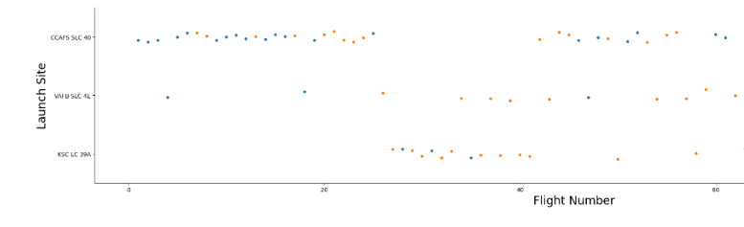
RESULTS Matplotlib and Seaborn (EDA with Visualization)
The relationship between flight number and launch site

Slide 20
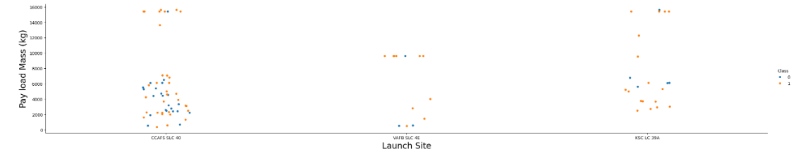
RESULTS Matplotlib and Seaborn (EDA with Visualization)
The relationship between payload mass and launch site

Slide 21
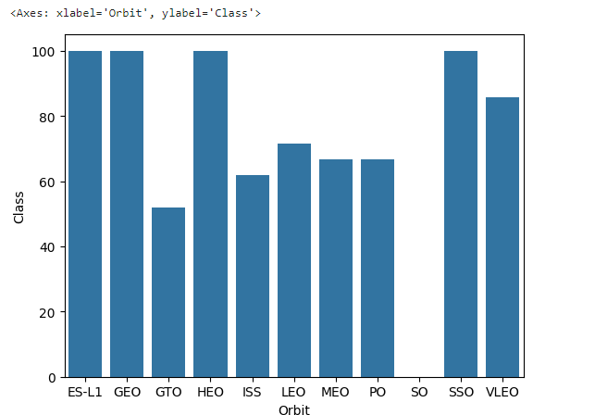
RESULTS Matplotlib and Seaborn (EDA with Visualization)
The relationship between success rate and orbit type

Slide 22
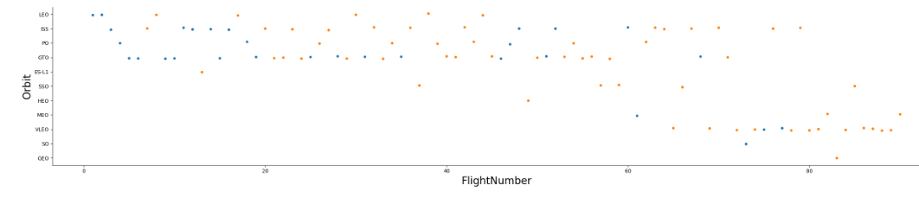
RESULTS Matplotlib and Seaborn (EDA with Visualization)
The relationship between flight number and orbit type

Slide 23
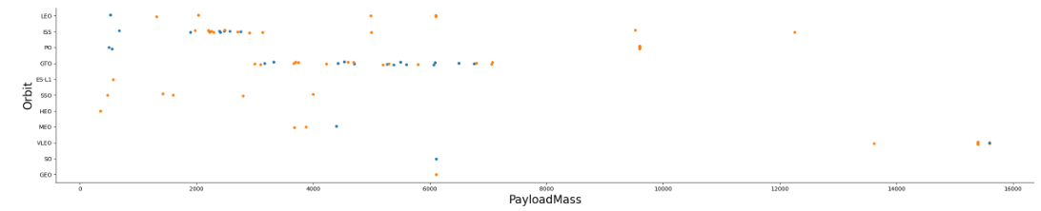
RESULTS Matplotlib and Seaborn (EDA with Visualization)
The relationship between payload mass and orbit type

Slide 24
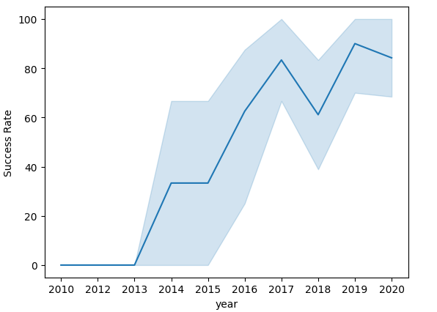
RESULTS Matplotlib and Seaborn (EDA with Visualization)
The launch success yearly trend

Slide 25
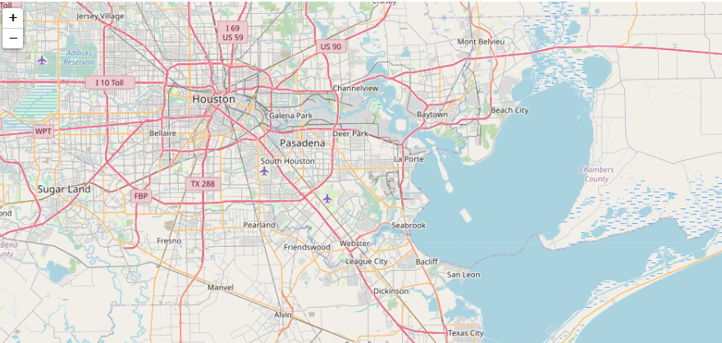
RESULTS Folium
All launch sites on map

Slide 26
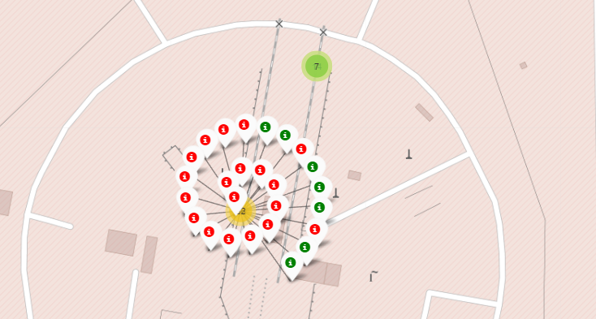
RESULTS Folium
If we zoom in on one of the launch site, we can see green and red tags. Each green tag
represents a successful launch while each red tag represents a failed launch

Slide 27
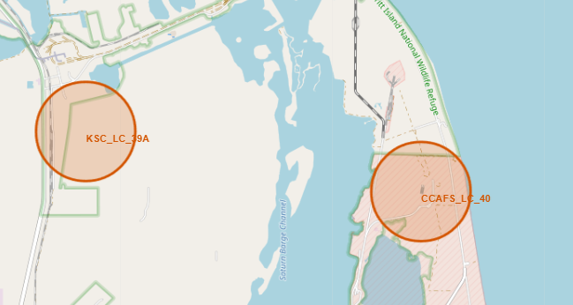
RESULTS Folium
The picture below shows the distance between the CCAFS SLC-40 launch site and the nearest Coastline

Slide 28
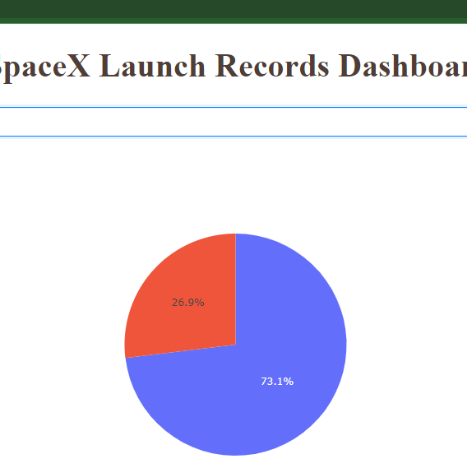
RESULTS Dash
• The picture below shows a pie chart when launch site CCAFS LC-40 is chosen.
• 0 represents failed launches while 1 represents successful launches. We can see that 73.1% of launches done at CCAFS LC-40 are failed launches.

Slide 29
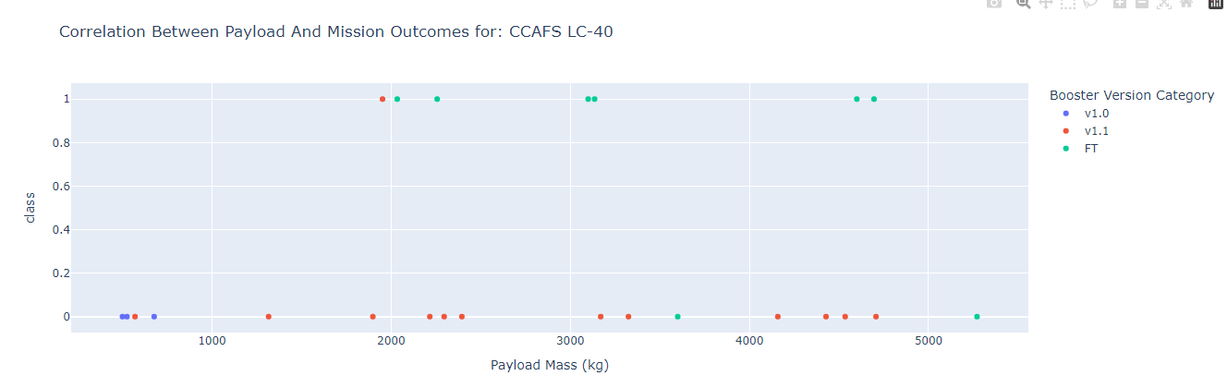
RESULTS Dash
• The picture below shows a scatterplot when the payload mass range is set to be from 2000kg to 8000kg.
• Class 0 represents failed launches while class 1 represents successful launches.

Slide 30
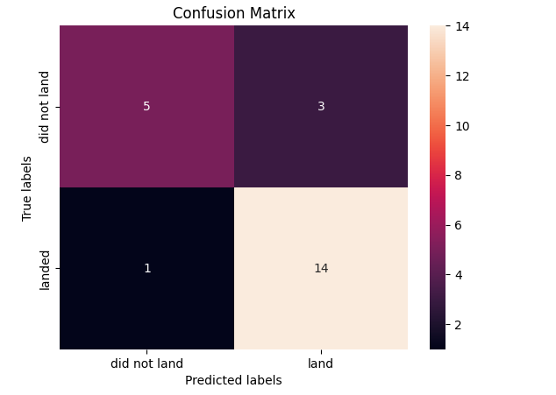
RESULTS Predictive Analysis
Logistic regression
• GridSearchCV best score: 0.8238095238095238
• Accuracy score on test set: 0.8260869565217391
• Confusion matrix

Slide 31
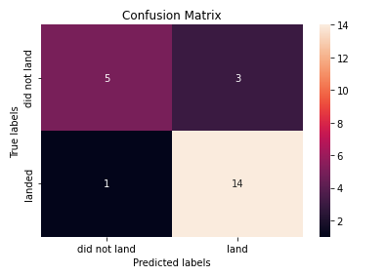
RESULTS Predictive Analysis
Support vector machine (SVM)
• GridSearchCV best score:
0.838095238095238
• Accuracy score on test set:
test set accuracy : 0.8260869565217391
• Confusion matrix:

Slide 32
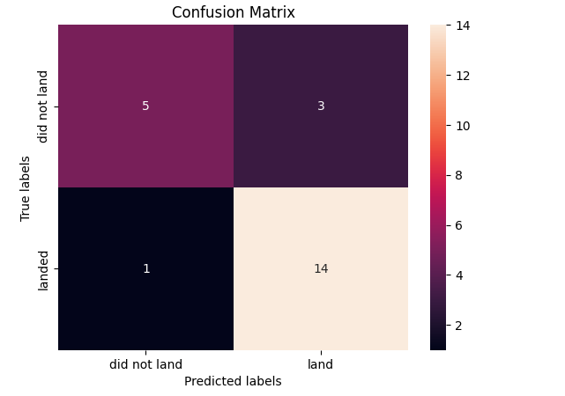
RESULTS Predictive Analysis
Decision tree
• GridSearchCV best score: 0.8833333333333332
• Accuracy score on test set: 0.8260869565217391
• Confusion matrix

Slide 33
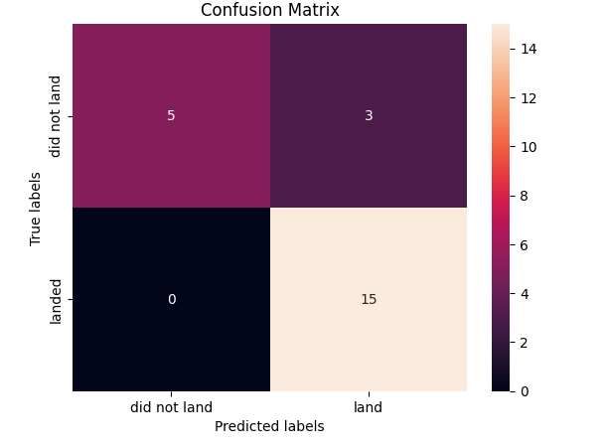
RESULTS Predictive Analysis
• K nearest neighbors (KNN)
• GridSearchCV best score:
0.85
• Accuracy score on test set: 0.8695652173913043
• Confusion matrix:

Slide 34
RESULTS Predictive Analysis
• Putting the results of all 4 models: Best Model Decision Tree
1. Decision tree (GridSearchCV best score: 0.8833333333333332)
2. K nearest neighbors, KNN (GridSearchCV best score:0.85 )
3. SVM (GridSearchCV best score: 0.838095238095238)
4. Logistic regression (GridSearchCV best score: 0.8238095238095238)

Slide 35
Machine Learning
We must also look at a high volume of connected data (from both internal and external sources) to gain a more complete picture of future outcomes. Every area of a business can derive value from predictive modeling. Using robust algorithms

Slide 36
CONCLUSION
The project demonstrated that various factors like flight number, payload mass, and orbit type significantly influence the success of Falcon 9's first stage landing. The success rate of launches has been improving over the years, and certain orbits have higher success rates. The Decision Tree Classifier was the most effective model for predicting landing success. These insights can help other companies to strategize and compete with SpaceX

Slide 37
innovative insights
Exploratory Data Analysis:
Found that higher flight numbers at a launch site correlate with higher success rates.
Certain orbits like ES-L1, GEO, HEO, SSO, and VLEO have higher success rates.
Success rate has been increasing since 2013.
Interactive Analytics:
Mapped all launch sites and their proximity to landmarks such as railways and highways.
Visualized success rates of different launch sites with color-coded markers on a map.
Predictive Analysis:
Decision Tree Classifier emerged as the best model for predicting landing outcomes.
Confusion matrix analysis showed high accuracy, though there were some false positives.

