Slide 1
AI-Powered Smart Document
Processing Platform
Presented By:
NAME | USN
Nishan Udaya Shetty | 1RV23AI068
Ravi Kishan Kumar | 1RV23AI080

Slide 2
Introduction
In today’s digital era, vast amounts of unstructured text—often in scanned, handwritten, or multilingual formats—pose challenges in accessibility and understanding. Our project, Modern Text Processing Platform, tackles this by integrating AI tools like OCR, language translation, entity recognition, and text-to-speech into a single user-friendly web application. Built using technologies such as pytesseract, deep_translator, and pyttsx3, the platform enables seamless extraction, translation, and audio output of text from documents or live feeds—making information processing faster, smarter, and more accessible.

Slide 3
Objectives
To develop a unified AI-based document processing platform that enables users to extract, analyze, and interact with text from scanned or digital documents through a simple and intuitive interface.
To implement Optical Character Recognition (OCR) using Tesseract to accurately extract text from various input formats such as PDF, DOCX, TXT, and image files including printed and handwritten content.
To integrate multilingual translation capabilities using the Google Translator API via deep_translator, allowing users to convert extracted text into multiple widely-used languages.
To design and apply Named Entity Recognition (NER) using regex and basic NLP techniques to automatically detect and highlight critical entities like names, dates, locations and email addresses from the extracted text.
To enable Text-to-Speech (TTS) conversion of extracted or translated text using the offline pyttsx3 library, enhancing accessibility for visually impaired users or those preferring auditory output.
To provide live camera feed support using OpenCV, allowing real-time OCR processing directly from webcam inputs, simulating real-world scanning scenarios.
To offer downloadable output options and performance insights, including word count, character count, and sentence segmentation for user reference and documentation.

Slide 4
Tools and techniques used
Streamlit – Used to build a clean and interactive web user interface.
Tesseract OCR (via pytesseract) – For extracting text from scanned documents, images, and live webcam input.
deep_translator – Enables language translation of extracted text using neural machine translation models.
Regex and NLP patterns – Used for Named Entity Recognition (NER) to identify names, dates, locations, etc.
pyttsx3 – Converts text to speech, adding accessibility for visually impaired users.
OpenCV and PIL – Handles image pre-processing tasks like grayscale conversion, resizing, and noise removal.
Base64 encoding and Streamlit features – Used to enable text download functionality.
Python – Primary programming language used for implementing all modules.

Slide 5
Methodology
Input Acquisition
Users can upload files (PDF, DOCX, TXT, Images) or scan using a live camera feed. This flexibility allows the system to accept various real-world document types.
Pre-processing
Uploaded files or images are first processed to improve readability. This includes:
  Converting images to grayscale
  Resizing and normalizing image dimensions
  Noise reduction for OCR clarity
Text Extraction (OCR)
The pre-processed image or document is passed to Tesseract OCR (via pytesseract) to extract text from printed or handwritten content. This step uses computer vision techniques to convert unstructured visual data into readable digital text.

Slide 6
Translation Module
The extracted text is translated using deep-translator, which connects to pre-trained neural machine translation models. Users can select source and target languages, or rely on auto-detection.
Named Entity Recognition (NER)
The system scans the text to identify and highlight important entities such as:
  Names (PERSON)
  Dates (DATE)
  Organizations (ORG)
  Locations(GPE)
  This is implemented using pattern-based Natural Language Processing (NLP).
Text-to-Speech(TTS)
Using the pyttsx3 library, any extracted or translated text can be converted into audible speech. This feature adds accessibility for visually impaired users or auditory learners.
Output and Export
Users can view all results within the app and choose to download them as .txt files. They can also replay spoken text or copy results directly.

Slide 7
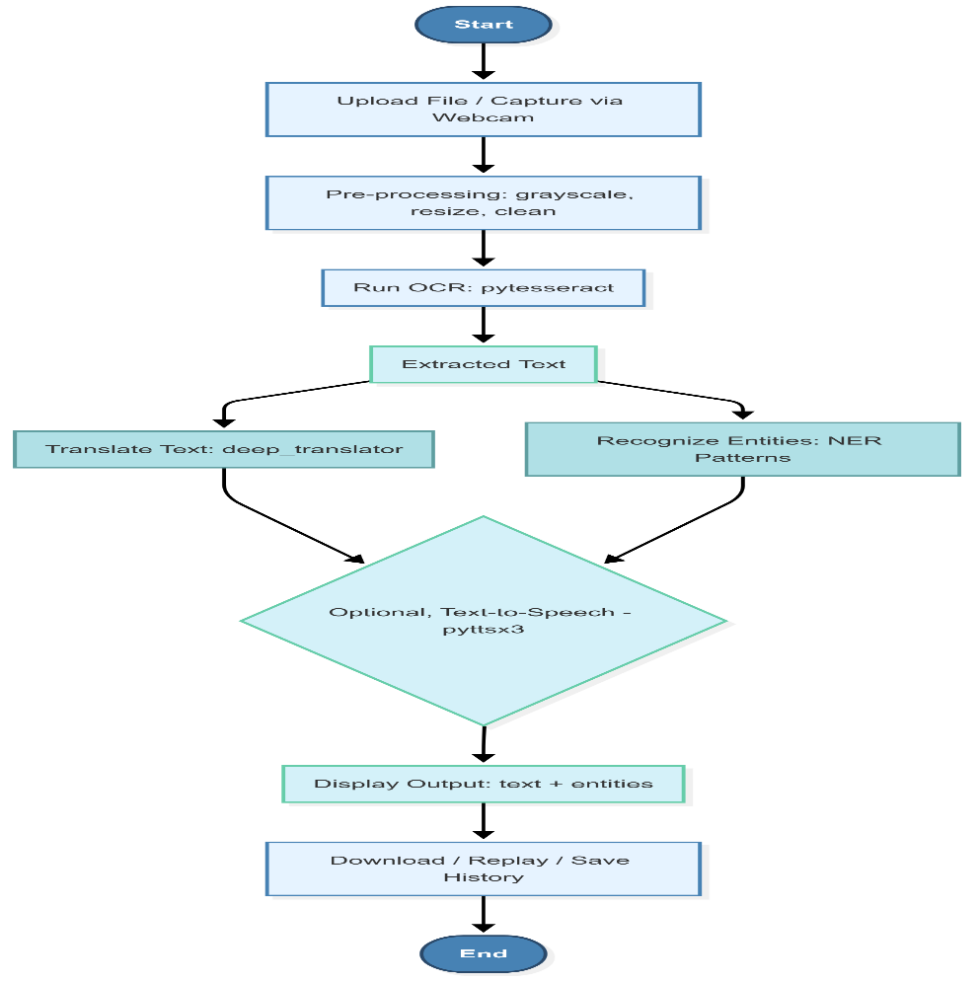
Flowchart

Slide 8
Applications
Education
Helps students and teachers extract, translate, and understand notes, assignments, and multilingual study materials.
Journalism & Media
Quickly processes image-based news content and press releases in different languages for faster reporting.
Government & Legal
Extracts information from scanned forms, official documents, and legal papers—making them easier to understand and process.
Research & Academia
Enables researchers to analyze multilingual papers and historical scanned data efficiently.
Accessibility & Assistive Tech
Supports visually impaired users through text-to-speech for documents, images, and translated content.
Cross-Language Communication
Bridges language gaps in multicultural and multilingual environments with real-time translation and NER.

Slide 9
Literature Review
Title | Authors | Method / Tools | Relevance
Object Detection in Digital Documents | Castillo et al. (2023) | Detectron2 (CNN + X101-FPN) | Layout-aware OCR with bounding box optimization
AI for Unstructured Document Analysis | Mahadevkar et al. (2024) | LayoutLM, DocFormer | Future integration of transformer-based models
Real-Time OCR System | Olumide (2025) | CNN-LSTM, TensorRT | Real-time webcam OCR & latency reduction
Multilingual OCR Recognition | Liu et al. (2022) | CRNN + Attention | Script-specific multilingual OCR enhancement
NER in Noisy OCR Text | Wang et al. (2023) | BERT, BiLSTM, CRF | Robust semantic entity recognition in distorted input

Slide 10
Title | Authors | Method / Tools | Relevance
TTS for Accessibility | Karthik et al. (2022) | pyttsx3, gTTS | Supports offline TTS with user feedback validation
Document Layout Analysis | Rao et al. (2023) | U-Net, PubLayNet | Enables segmentation of tables, fields, and text blocks
OCR for Indian Languages | Sharma et al. (2021) | Tesseract, Indic-OCR | Validates use of Tesseract for regional scripts
Mobile AI Translation System | Das et al. (2023) | ONNX + OCR + TTS | Inspiration for mobile pipeline integration
Metadata Extraction in Documents | Gupta et al. (2022) | YOLOv5, BERT | Future enterprise-level metadata tagging

Slide 11
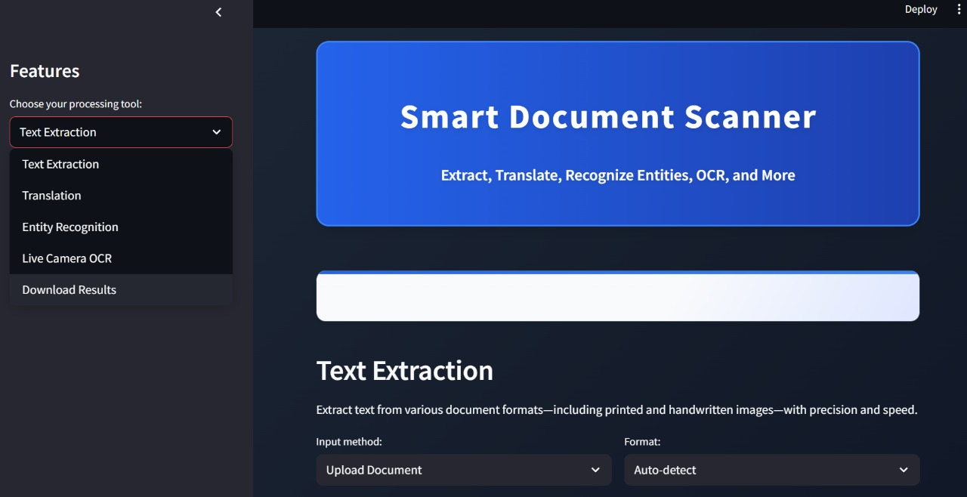
Results

Slide 12
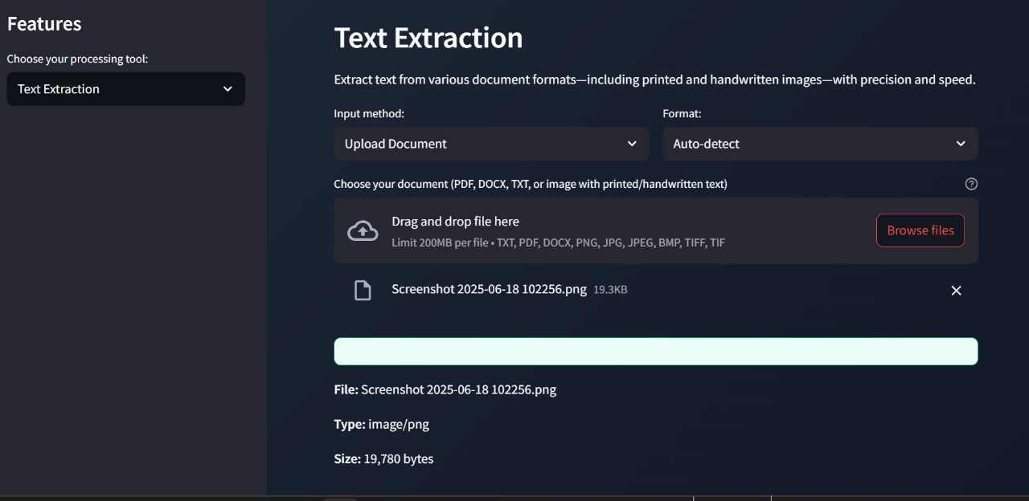

Slide 13
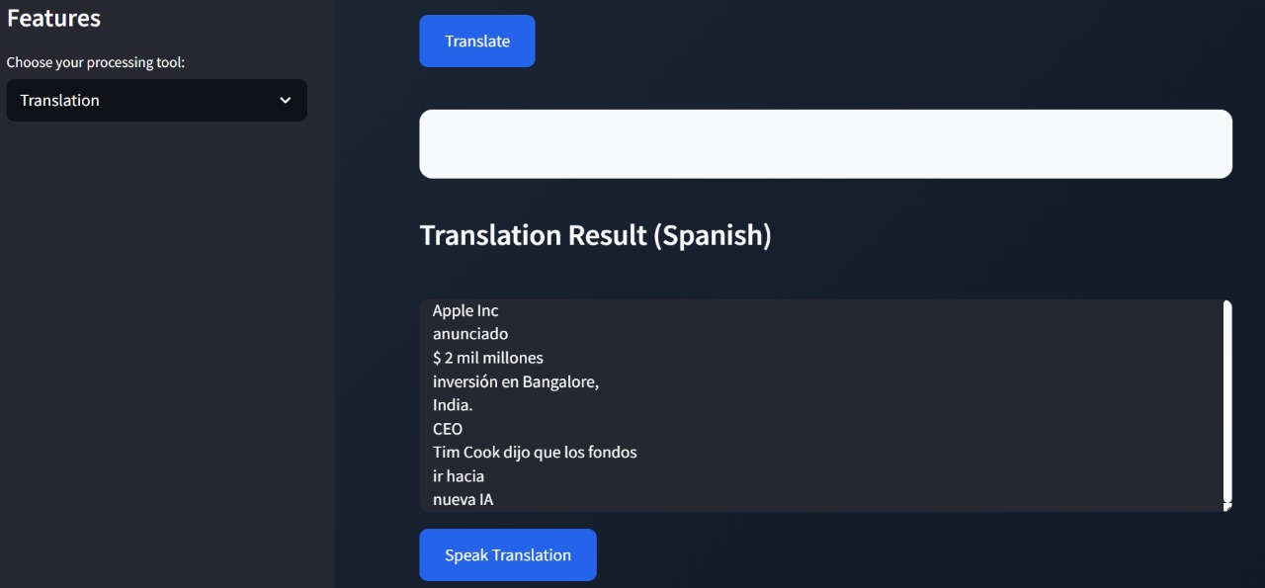

Slide 14
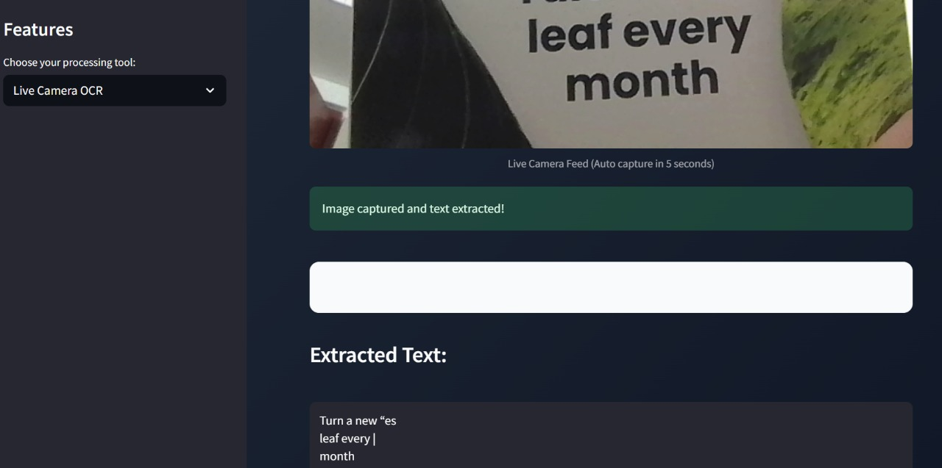

Slide 15
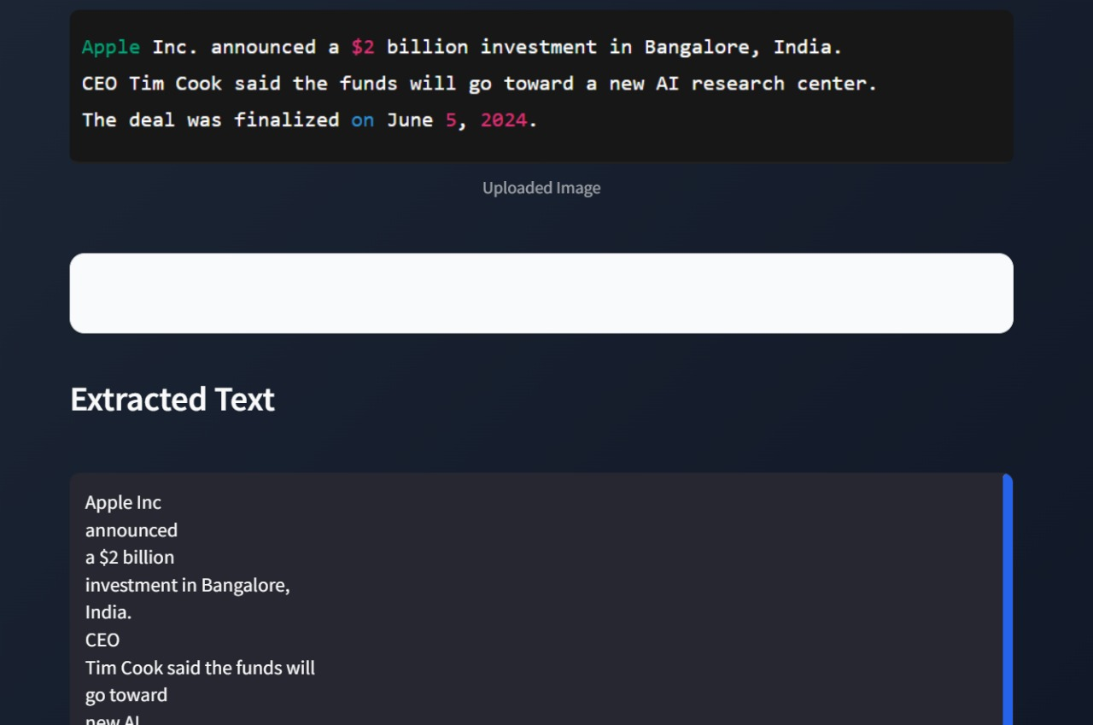

Slide 16
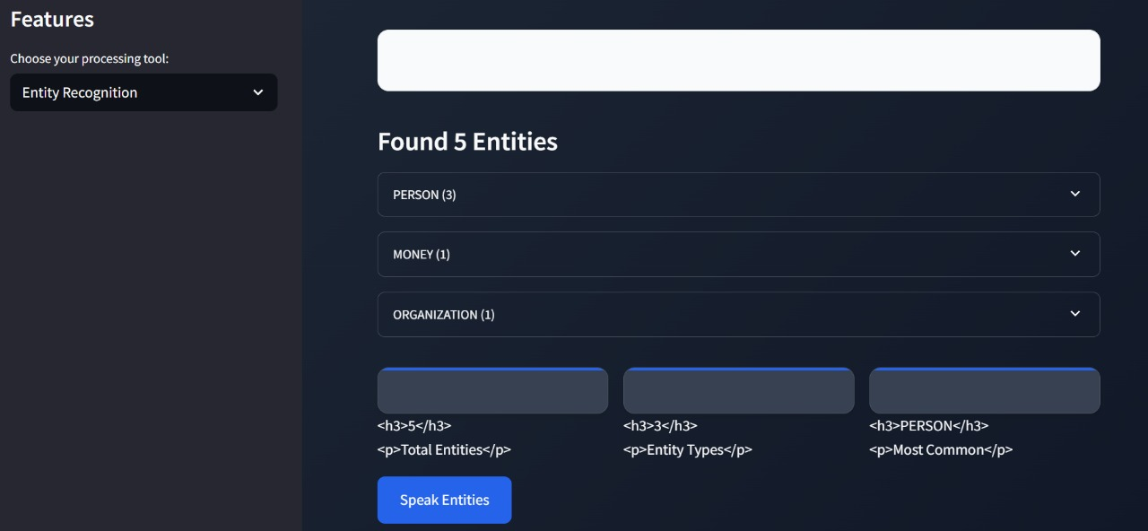

Slide 17
Conclusion
Successfully developed a unified AI-powered platform for text extraction, translation, and accessibility.
Integrated key technologies: OCR, NLP, Translation, and TTS in one user-friendly web app.
Efficiently handles documents in scanned, image-based, and multilingual formats.
Enhances accessibility for visually impaired users through text-to-speech support.
Demonstrated practical application of AI/ML concepts by solving real-world challenges.
Platform is reliable for use in education, research, government, and content processing.

Slide 18
Future Scope
Handwriting Recognition Improvement
Incorporate deep learning models (CNN/RNN) to improve cursive and stylized handwriting recognition.
Advanced Named Entity Recognition
Use BERT or spaCy’s transformer models for better accuracy in entity detection.
Rich Export Options
Add PDF and DOCX export support with formatting and annotations.
Voice Input (Speech-to-Text)
Enable users to dictate text directly into the platform using speech recognition.
Mobile App Deployment
Port the application to mobile using React Native or Flutter for wider accessibility.
Live Translation Mode
Introduce real-time OCR + translation + speech output for instant multilingual reading.
Data Privacy Features
Add authentication, encryption, and secure document handling for enterprise use.

Slide 19
Thank You

