Slide 1


INTELLIGENT ACTIVE SUSPENSION SYSTEM
KL Deemed to be University
Aziz Nagar Campus
Department of ECE
2310040027 (Rizwan)
2310040029 (Anush Thak)
2310040097 (Aniket Panda)
2310040132 (Ravi Ratna)
Supervised by: Dr Amit Shrivastava, Asst. Professor/ECE

Slide 2
Introduction
Vehicle suspension affects passenger comfort, road holding, and vehicle stability.
Passive suspension has fixed spring and damping characteristics, creating a comfort–stability trade-off.
Active suspension uses an actuator to generate controllable force against road disturbances.
The project develops a laboratory-scale quarter-car active suspension test bench.
The system combines a spring-damper mechanism, 12 V linear actuator, MPU6050 IMU, and STM32.
PID control and a Python/Streamlit interface support real-time control, visualization, tuning, and data logging.

Slide 3
Problem Statements
Passive suspension systems cannot dynamically adapt to changing road disturbances.
Fixed characteristics create a trade-off between ride comfort, body motion, tire contact, and stability.
Full-scale active-suspension testing is costly, mechanically complex, and difficult to reproduce.
A compact, isolated, data-rich quarter-car test bench is needed for repeatable controller evaluation.

Slide 4
Objectives
Main objective: Develop a quarter-car active suspension test bench for real-time control and evaluation.
Design a single-wheel electromechanical suspension using STM32, MPU6050 IMU, and linear actuator.
Implement PID control to reduce road-induced sprung-mass vibration.
Develop a repeatable laboratory testing and local data-acquisition platform.
Enable telemetry, data logging, controller tuning, and active-versus-passive comparison.

Slide 5
Scopes of the project
Fabricate a single-wheel quarter-car rig with spring, RC shock absorber, actuator, and structural frame.
Integrate STM32, MPU6050 IMU, motor driver, and supporting sensors.
Implement embedded PID control with a target 10–20 ms control cycle.
Develop a local Python/Streamlit dashboard for telemetry, commands, indicators, and logging.
Full-scale vehicle modification and ML-based control are outside the present phase; collected data support future AI research.

Slide 6
Literature Reviews
Hrovat established theoretical foundations for active-suspension modelling and optimal control using quarter-, half-, and full-car models.
PID is practical for an initial hardware prototype because it is simple, computationally light, and suitable for real-time implementation.
Adaptive sliding-mode, T-S fuzzy, LQR, and fuzzy controllers address nonlinearities but increase implementation complexity.
Recent work explores data-driven control, model predictive control, nonlinear disturbance rejection, and intelligent suspension methods.
Experimental studies emphasize sprung-mass acceleration, suspension deflection, and settling time as measurable performance indicators.
This project focuses on a compact, low-cost STM32/IMU/PID physical bench with a local data-acquisition pipeline.

Slide 7
Research Gap
Sl.No. | Authur Names | Year | Journal/Conference/Book | Title | Methodology | Results | Gap Identified
1 | Shafiei | 2022 | JIE India: Series C | PID quarter-car active suspension | PID under road bumps | Improved body response | Simulation-oriented
2 | Mahmoodabadi & Nejadkourki | 2022 | Australian Journal of Mechanical Engineering | Fuzzy adaptive robust PID | Adaptive robust PID | Optimized acceleration/deflection | Higher complexity
3 | Maradey Lázaro et al. | 2023 | IJAME | Optimal active suspension control | LQG/LQR simulation | Optimal-control evaluation | Limited low-cost bench integration
4 | Abut & Salkim | 2023 | Applied Sciences | Optimized fuzzy-LQR control | LQR/fuzzy/fuzzy-LQR | Controller comparison | Complex for first prototype
5 | Watanabe et al. | 2024 | Chaos, Solitons & Fractals | Delayed-feedback active suspension | Nonlinear quarter-car model | Vibration suppression | Practical bench integration gap

Slide 8
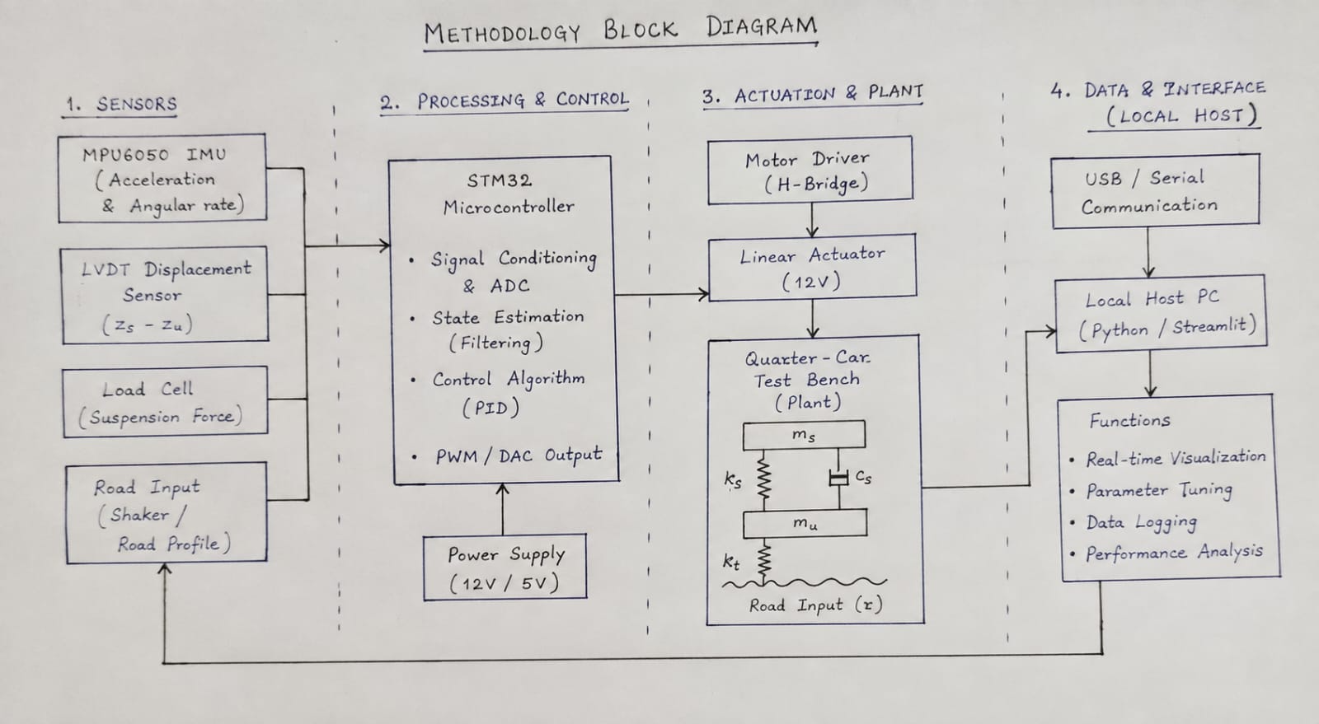
Methodology

Slide 9
Expected Outcomes
Functional Test Bench: Development of a physical single-wheel quarter-car test bench that accurately reproduces controlled suspension disturbances and vehicle-like vertical dynamics.
Active PID Control: Implementation of a real-time closed-loop PID controller on an STM32 microcontroller that successfully reduces sprung-mass vibration compared to passive conditions.
Interactive Dashboard: Creation of a local Streamlit host application for real-time telemetry visualization, controller tuning, and experiment monitoring.
Data-Logging Pipeline: Establishment of a reliable data-acquisition system that records sensor and actuator data for quantitative performance comparison.
System Validation: Successful validation of the test bench using step and harmonic road inputs to demonstrate a safe, repeatable, and cost-effective laboratory testing platform

Slide 10
Financial Arrangements
S.No | Items | Description | Cost
1 | STM32 Microcontroller | Primary real-time control unit | ₹800
2 | 12V Linear Actuator | Actuator for active suspension force | ₹2,500
3 | MPU6050 & Sensors | IMU and linear potentiometers | ₹600
4 | BTS7960 / L298N Motor Driver | High-current actuator driver | ₹600
5 | Structural Components | Springs, RC shocks, aluminum extrusions | ₹5,000
6 | Miscellaneous | Printing/report materials | ₹3,500
Grand Total | 13000

Slide 11
Duration
Duration (PHASE-1)
SL.NO. | TASK NAME | 2026
 |  | JUL | AUG | SEP | OCT | NOV | DEC
1 | Literature review | X | X | X | X | X | X
2 | Data collection & system analysis | X | X | X | X | X | X
3 | System Design and Development |  |  | X | X | X | X
4 | Prototype testing & installation |  |  |  |  | X | X
5 | Writing report | X | X | X | X | X | X
6 | Submission | X | X | X | X | X | X

Slide 12
Road Map for Phase-2
Dataset Utilization: Use the continuous data logged during Phase-1 physical testing to build a foundation for data-driven suspension analysis.
Machine Learning Integration: Develop and implement AI-based road-profile prediction and intelligent suspension control algorithms using the Phase-1 baseline data.
Advanced Controller Testing: Replace the baseline PID controller with advanced algorithms (such as adaptive, fuzzy, or optimal control) and evaluate them on the STM32 hardware.
Comparative Performance Analysis: Conduct systematic experiments comparing the new machine-learning-based active control against the passive and PID benchmarks established in Phase 1

Slide 13
References
1. Mahmoodabadi & Nejadkourki, “Optimal fuzzy adaptive robust PID control for an active suspension system,” Australian Journal of Mechanical Engineering, 2022.
2. Shafiei, “A review on PID control system simulation of the active suspension system of a quarter car model while hitting road bumps,” 2022.
3. Maradey Lázaro et al., “Optimal Control of an Active Suspension System Applying Distributed Parameter Simulation Test,” 2023.
4. Abut & Salkim, “Control of Quarter-Car Active Suspension System Based on Optimized Fuzzy Linear Quadratic Regulator Control Method,” 2023.
5. Sistla et al., “Design and implementation of passivity-based controller for active suspension system using port-Hamiltonian observer,” 2023.
6. Watanabe, Prasad & Sakai, “Delayed feedback active suspension control for chaos in quarter car model with jumping nonlinearity,” 2024.
7. Abbas & Youn, “Performance Improvement of Active Suspension System Collaborating with an Active Airfoil Based on a Quarter-Car Model,” 2024.
8. Wang et al., “Mechanism-data-driven control strategy for active suspension systems,” Advanced Engineering Informatics, 2025.
9. Meng et al., “Research on Active Suspension Control Based on Vehicle Speed Control Under Transient Pavement Excitation,” 2025.

Slide 14
THANK YOU

