Slide 1
MEDIA STREAMING WITH IBM CLOUD VIDEO STREAMING
Submitted by
Ravi Vishnu A
Department of Electronics and Communication Engineering
Anna University Regional Campus Coimbatore

Slide 2
Problem statement
Create a virtual cinema platform using IBM Cloud Video Streaming.Where users can upload and stream movies and videos on-demand.Define the virtual cinema platform, designing the user interface, integrating IBM Cloud Video Streaming services, enabling on-demand video playback, and ensuring a seamless and immersive cinematic experience.

Slide 3
Innovation
We are introducing the feature for users to form groups by inviting other users and they can share videos and chat among the groups to enhance the user experience.
In addition to it we are providing with the subscription option for users to access the cloud for uploading videos .
we also let the users to like, share and comment the videos and can download the videos to enjoy in offline.

Slide 4
Basic Tools used
HTML
CSS
Java sript
Php

Slide 5
Web page Features
Home page:
Contains login and settings page.
Contains Search bar and helps the user to explore all the contents.
Login/sign up page:
To create a new account and to enter the web page for existing users.
To segregate the premium account users, who can upload as well as enjoy then contents.
Settings page:
Contains user profile and bio
Contains history,Data management
Subscription page:
Allows user to pay and use the cloud features

Slide 6
Block Diagram
CLOUD PROVIDER
(IBM CLOUD)
CLOUD SERVER
Cloud Broker
MEDIA CONTENT
PROVIDER
PBRA
Demand forecasting
Android application
Demand Streaming
Media Viewer
Web application

Slide 7
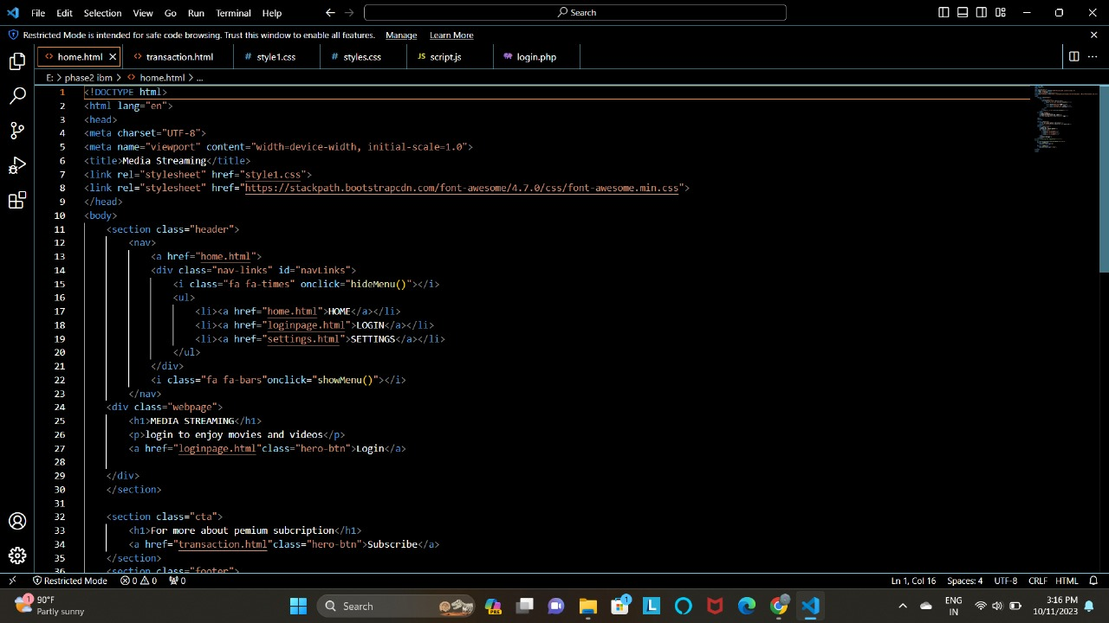
Model Prototype for developing web application

Slide 8
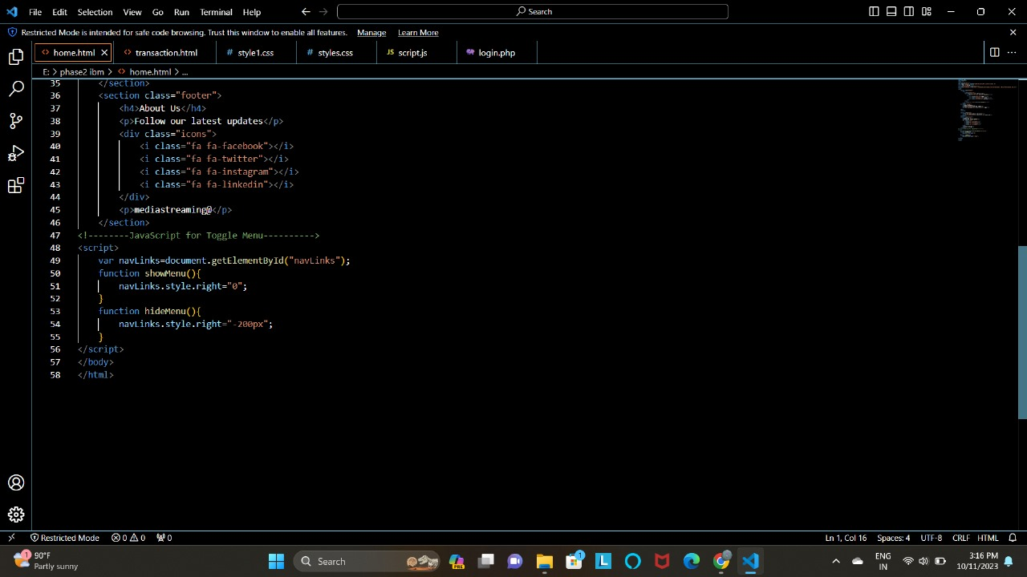
Model Prototype for developing web application

Slide 9
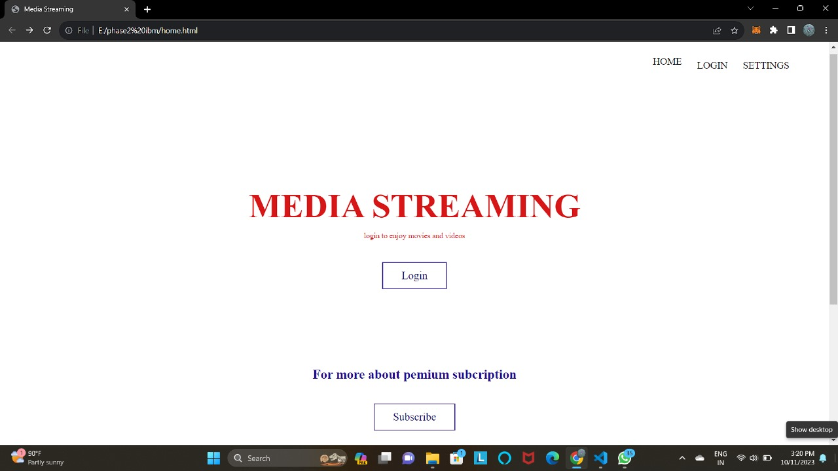
Model Prototype for developing web application

Slide 10
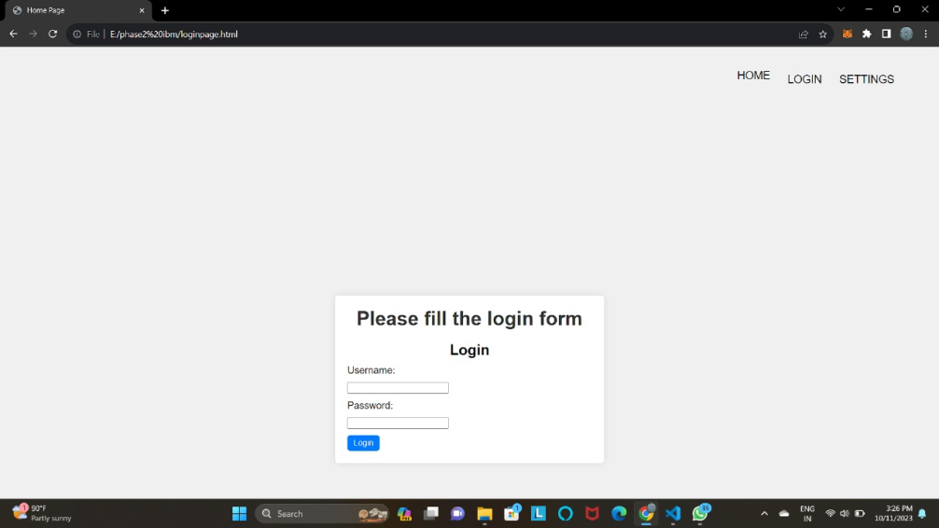
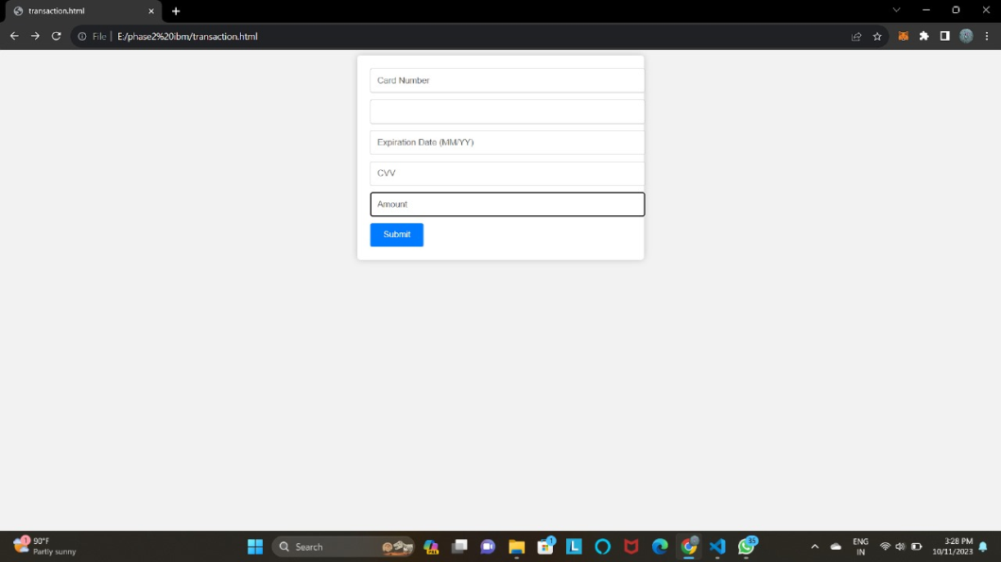
Model Prototype for developing web application
Login page
Subscription page

Slide 11
Conclusion
In Phase 2 we conclude the media streaming using IBM cloud video streaming platform creation is achieved using simple Web page features include home page, web page ,settings page and login/sign up page also further adding like live streaming, high quality video uploading, community chatting.Also we have working for the better appearance of web page for better user experience.

Slide 12
THANK YOU

