Slide 1
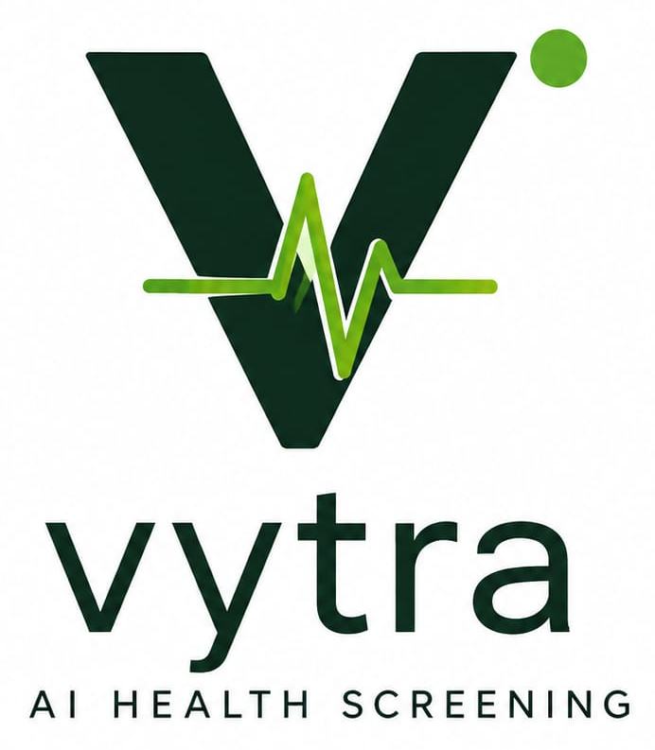
BRAND IDENTITY SYSTEM · 01
vytra
See Health. Detect Early.
Official lockup, mark, colour and naming. Use these files. Do not redraw the V, the leaf-pulse, or the wordmark.
SIH 2026 · Team VYTRA · Identity 1.0 · 13 Aug 2026 · Not a medical device

Slide 2
01 / MEANING
What the name holds
VYTRA = Vision + Vitality + Tracking + AI
Not a clinical claim
PITCH DECK ONLY · NEVER INSIDE THE WORKER APP, RESULT SCREEN, OR PDF
V
Y
T
R
A
Vision
Your health
Tracking
Recognition / Response
AI / Analysis
The camera is the sensor. We look at the eye, not a blood vial.
Built for the person in the house. Used by the worker in front of them.
Each visit becomes a dated, shareable note — not only a verbal hunch.
Recognise a colour signal. Respond with a referral, not a prescription.
On-device colour analysis. Not a cloud “AI doctor.”
VYTRA · Brand Identity 1.0 · See Health. Detect Early.
02

Slide 3
01 / MEANING
Brand line and naming
BRAND LINE
HOW THE NAME IS WRITTEN
“See Health. Detect Early.”
Logo / splash / home
Official PNG lockup. Never a homemade V.
SIH / college forms
VYTRA — unique, no college in the name.
Sentences in docs
VYTRA
Home, splash, title slide only. Never on the result screen or the referral PDF — those surfaces carry a medical disclaimer, not a slogan.
Fallback text only
vytra · Noto Sans Medium · lowercase
Never write
Vytra · VYTRA-AI · AnamoAI · MRCET_VYTRA
VYTRA · Brand Identity 1.0 · See Health. Detect Early.
03

Slide 4

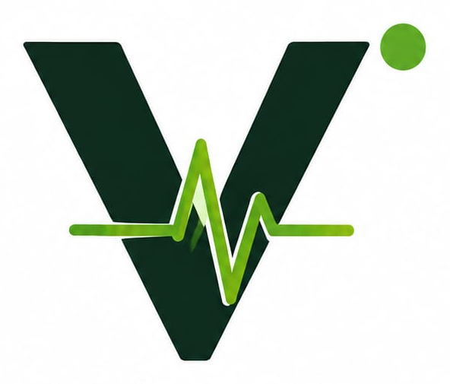

02 / LOGO SYSTEM
One mark. Four files.
PRIMARY LOCKUP
SYMBOL / MARK
APP ICON · LIGHT
APP ICON · DARK
vytra_logo_lockup.png
vytra_mark.png
VYTRA · Brand Identity 1.0 · See Health. Detect Early.
04

Slide 5
02 / LOGO SYSTEM
Primary lockup
USE ON
▸ Title slide of the SIH deck
▸ App splash and S01 / S02
▸ Poster and first screen
▸ PDF header — small only
NEVER ON
▸ A photograph or busy image
▸ A risk tile or result card
▸ Consent or PDF body
▸ Next to a homemade wordmark
Category line AI HEALTH SCREENING travels with this lockup only.
VYTRA · Brand Identity 1.0 · See Health. Detect Early.
05

Slide 6
02 / LOGO SYSTEM
Anatomy — do not separate the parts
Forest V
1
Primary letterform. #0E2A1C. Never outline, bevel, or redraw.
Leaf-pulse
2
Heartbeat + leaf in #6CA532. A clinical signal — not a diagnosis.
Living point
3
Lime dot, upper right. Clear space = the height of this dot.
Wordmark
4
lowercase vytra, same forest green. Do not set it in another font.
Category line
5
AI HEALTH SCREENING — title slide, splash, S01 only.
VYTRA · Brand Identity 1.0 · See Health. Detect Early.
06

Slide 7
03 / COLOUR
Two greens are the identity
Forest
Pulse
Soft
Paper
Ink
Muted
#0E2A1C
#6CA532
#E8F3DC
#FFFFFF
#0F172A
#475467
V, wordmark, headers
Leaf-pulse, dot, accent
Chips, selected state
Logo always sits here
Body text
Secondary text
Do not recolour the pulse to teal. The two greens are the identity.
Risk tokens are clinical UI only — never apply them to the mark. High #B42318 Moderate #B54708 Low #027A48 Unable #475467
VYTRA · Brand Identity 1.0 · See Health. Detect Early.
07

Slide 8
04 / USAGE
Where each line may appear
LINE / FILE
ALLOWED
FORBIDDEN
Mark + vytra lockup
Splash, S01, S02, PPT title, PDF header (small)
On a photograph or a risk tile
AI HEALTH SCREENING
Under the lockup on S01 / title slide
Result screen, PDF body, consent
See Health. Detect Early.
S01, S02, splash, under the lockup
Result screen, PDF
Vision + Vitality + Tracking + AI
Pitch deck and this book
Worker app
“vitality + diagnostics”
Designer archive only
Nowhere in the product
Dark app icon
Dark splash only
Do not invert the two greens
VYTRA · Brand Identity 1.0 · See Health. Detect Early.
08

Slide 9
04 / USAGE
Clear space, icons, mistakes
DO
DON’T
● Keep clear space equal to the height of the green dot.
● Do not outline, bevel, or add a drop shadow.
● Sit the logo on white or very near-white.
● Do not place the mark on a busy photograph.
● Use the official PNG. Do not redraw.
● Do not separate the pulse from the V.
● On dark grounds: white plate, or the dark app icon.
● Do not replace the pulse with a caduceus or red cross.
● Launcher = mark on a white rounded square.
● Do not invert or recolour the two greens.
● Adaptive icon: foreground = mark, background #FFFFFF. Safe zone 66%.
● Do not invent a second mark or an eye-only icon.
● No wordmark on the small app icon — it will collapse.
● Do not print “diagnostics” on any worker surface.
VYTRA · Brand Identity 1.0 · See Health. Detect Early.
09

Slide 10
05 / FILES
Ship these. Archive the rest.
FILE
ROLE
USE
vytra_mark.png
Symbol
App icon, splash mark, slide corner, favicon
vytra_logo_lockup.png
Primary lockup
Title slide, poster, first screen of the app
vytra_logo_official.png
Stacked official
Square crop of the same lockup
vytra_logo_for_slides.png
Slide lockup
Identical to the primary lockup
vytra_app_icon_light.png
Launcher / light
Adaptive / launcher on light
vytra_app_icon_dark.png
Dark splash
Dark splash only
vytra_logo_source.jpg
Archive only
Designer notes — do not ship
Artwork locked 12 August 2026. Do not redraw the V, the pulse, or the wordmark in another font.
VYTRA · Brand Identity 1.0 · See Health. Detect Early.
10

Slide 11
TEAM VYTRA · SIH 2026
See Health. Detect Early.
Offline smartphone screening aid for ASHA workers. Not a diagnosis. Not a medical device.
This screening result is not a medical diagnosis. It is a triage aid for trained health workers only. All results require confirmation by a qualified medical professional.
Identity 1.0 · 13 August 2026 · Artwork locked · Do not redraw

