Slide 1
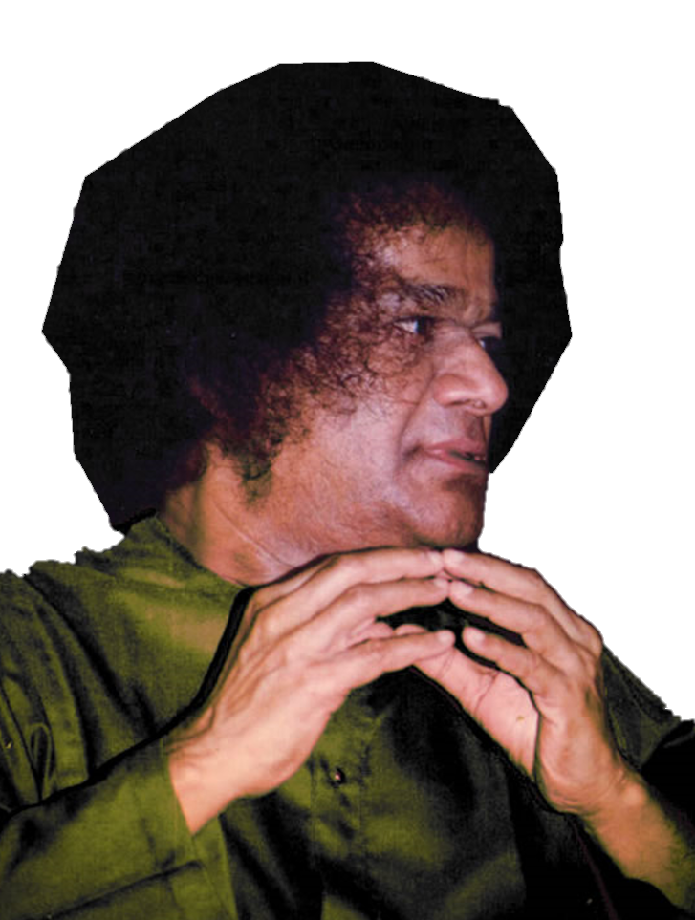
Offering our humble salutations
OM SRI SAI RAM
at the divine lotus feet.
1

Slide 2
Project Presentation
MDSC-404
Project Members
Project Guide
T. ROHIT VARMA
Y. RAVI SHANKAR
P. SUNIL KUMAR SIR
2

Slide 3
SEQUENTIAL
PATTERN
MINING
3

Slide 4
AGENDA
Problem Statement
Literature Review
Motivation
Methodology and Results explained-Data
Individual Contribution
New Measures for extracting actionable knowledge
Future Scope
Conclusion
1
4

Slide 5
PROBLEM STATEMENT
The basic problem gives an overview about the prediction of the next possible procedure
or even the set of procedures at once which are to be undergone by a patient.
A patient who visits the SSSIHMS Bangalore hospital has to undergo a set of procedures which are prescribed by the doctor as per the requirement and under such scenario it would be of great help for the doctors to make an estimate and predict the situation.
The stakeholders or particularly doctors require in hand knowledge to be specific of the
information with respect to the next possible procedures along with the proper action which should be performed on the patients belonging to different categorical age groups as well as places.
5

Slide 6
LITERATURE REVIEW
Machine Learning Concepts
Association Rule Mining
Sequential Patterns
These rules are generated for transactional
database
Generating different combinations of
sequential rules
Sequence Rules
These rules are generated for sequential
database
6

Slide 7
MOTIVATION
We have referred a research paper named
Combined pattern mining : From learned Rules to
Actionable Knowledge
BY
Yanchang Zhao, Huaifeng Zhang, Longbing Cao,
Chengqi Zhang, and Hans Bohlscheid, Australia
But as our data is a Time series data i.e. we keep getting data w.r.t Time.
So, this being considered the main reason we are working with Sequential
Rules as well as Sequential patterns.
From the learned rules we performed Combined pattern mining and we
generated actionable knowledge.
7

Slide 8
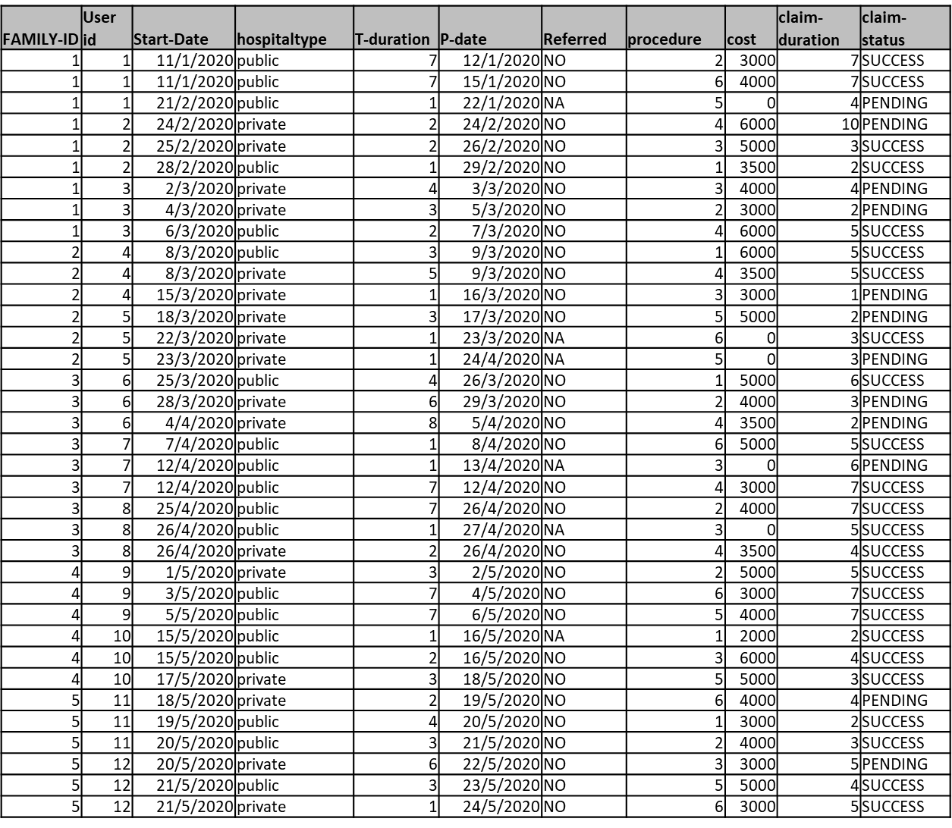
METHODOLOGY & RESULTS EXPLAINED
The Data
User-id,
start date,
p-date, procedure
8

Slide 9
CONTRIBUTIONS
1.Sequential rules from transaction data.
2. Combined sequential rules using aggregated data and transaction data.
9

Slide 10
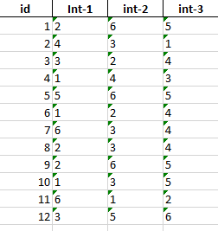
Converting Transactional Data to the Sequential Data
As it is a Time Series data, we have patient’s data arriving to the hospital at different dates
so initially we are aggregating the data for each patient by grouping all the dates of the
patient arrival to the hospital and this gives the sequence of procedures done to each patient by the doctor.
10

Slide 11
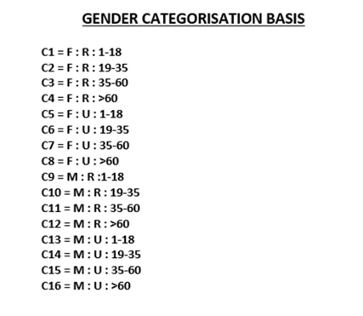
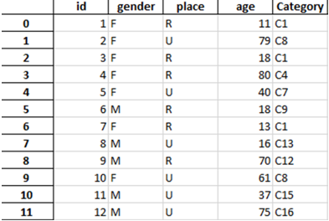
Aggregating the Data for leads in interesting measures
We are aggregating or combining the data of the patients based on the patients respective
age, place and gender from the data.
The general categorization is done based on the classification below which gives us all the
categories assigned attributes of the patients and this also leads us to some interesting
measures which are going to be very useful later on.
11

Slide 12
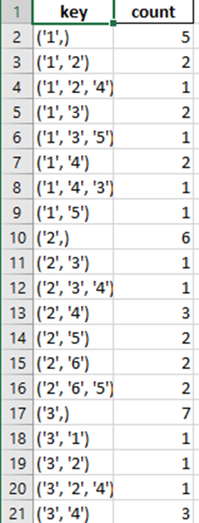
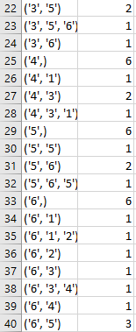
Generate and Test Method
We are generating the count for each sequence with
the combinations from the data and then getting the
proper count of each sequence.
We are generating the permutations of the data.
Check whether they are occurring sequentially or
not and remove them.
By this we are performing two optimizations
which is reducing the memory occupied and also the computation.
12

Slide 13
Generation of Sequential Rules with
required Interesting Measures.
The sequential rules are generated and of
the form
<E> ---> {Pi} where
<E> - Procedure undergone by patient
<P> - This represents Procedure part
eg : i =1,2,3,4,5,6.
Support
Confidence
Lift
13

Slide 14
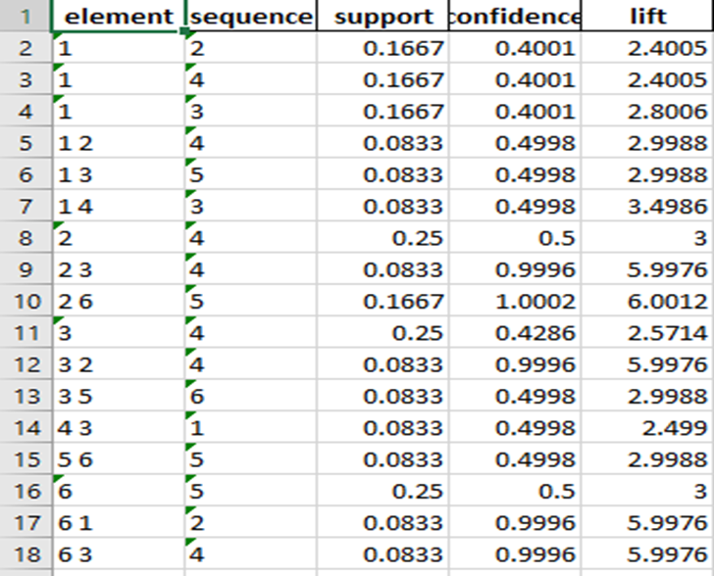
Pruning the Unnecessary Sequential Rules
We will be pruning unnecessary sequential rules which are
having less value in the
interesting measures.
14

Slide 15
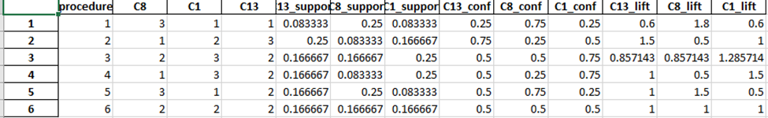
Sequences from Aggregated Data to Procedures and
Categories respective interesting measures
For each category <Ci> generate the sequential rules of the form <Ci> → <Pj> along with their interesting measures like
support, confidence and lift.
15

Slide 16
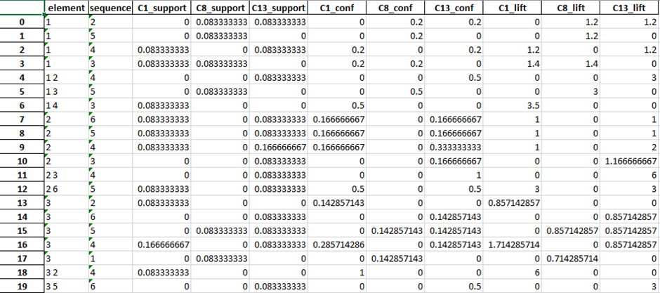
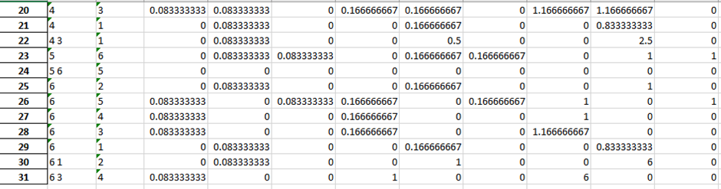
Combined Sequential Rules with Interesting Measures
16

Slide 17
New Interesting Measures for
generating Actionable knowledge
1. Individual-Category-lift (Category-wise)
Formulae
∏ lift (<Ci >→{Pj} / ∏ lift (<E>→{Pj}) +∏ lift (<Ci>→{Pj})
17

Slide 18
2. Individual-Sequence-lift(sequence-wise)
Formulae
∏ lift (<E >→{Pj} / ∏ lift (<E>→{Pj}) + ∏ lift (<Ci>→{Pj})
18

Slide 19
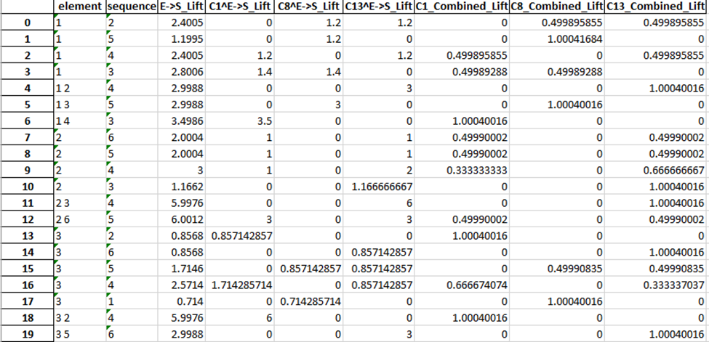
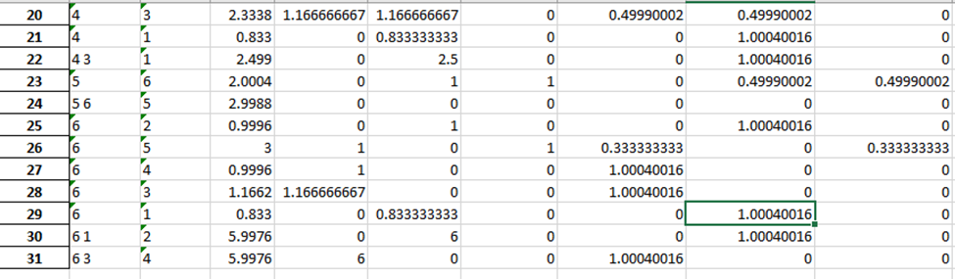
3. Combined Cumulative-lift (Category-wise)
Formulae:
∏ (lift (<Ci > ∧ <E>) → {Pj}) / ∏ lift (<E>→{Pj})
Combined Cumulative-lift Category-C8 to check whether procedure 1 is purchased is equal to
So, the result is 1.004 Since the lift > 1, The rule is interesting.
The actionable knowledge generated is as follows,
All the females above the age 60 living in urban areas tend to undergo procedure {1} if their initial choice is procedure {3} or procedure {6}.
19

Slide 20
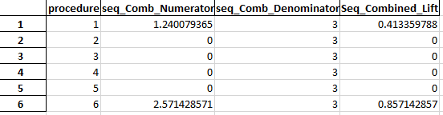
4. Combined Cumulative-lift (Sequence-wise)
Formulae
∏ (∑ (lift (<Ci >∧<E>)) → {Pj} / ∏ lift (<Ci>→{Pj})
As the lift here is found not to be > 1 anywhere so this combined sequence lift doesn’t give any result or any actionable knowledge is not generated.
So, we can less consider this outcome and proceed with the previous one by taking category into the consideration
20

Slide 21
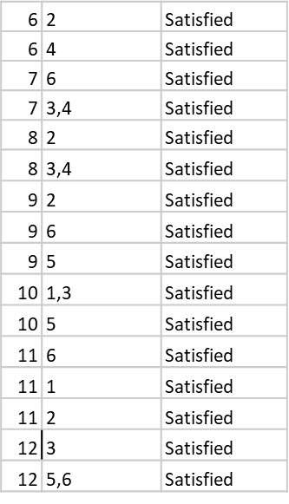
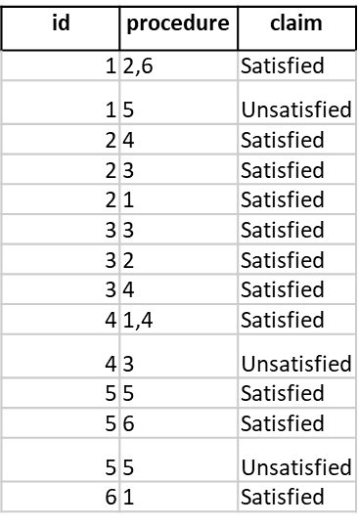
Sequential Classification for the Patient Data
Mainly we say that cost associated with the each procedure undergone by the patient is successful or not
This is done by using aggregated mean of each patient and this is aggregated as is time series data
We classify by having a threshold value to classify whether claim for patient is successful or not
21

Slide 22
FUTURE SCOPE
We can also take it further and also implement this by integrating with the Deep Learning Techniques such as RNN, LSTM, GRU, etc.
And with the help of this we can get the better accurate prediction and also can be implemented very easily with a smaller number of lines and also this is one step further for this project.
In the project we took each procedure as independent of each other but this may not be the same case in the real-world scenario.
22

Slide 23
CONCLUSION
So, basically finding out the best procedure to be selected after one is performed.
To check if it has the status as success or a failure and in how efficient way in the least number of procedures the patient’s health condition is well known.
Also reliably cost efficient. So, that he’ll get to know if he is to be operated or not.
The project is very much useful for the real-world scenario.
Hoping from this project the people will undergo only the required procedures.
New Learnings with respect to packages and concepts.
Platforms and Knowledge gained.
23

Slide 24
Stay safe – Stay healthy
THANK YOU
JAI SAI RAM
24

Slide 25
EXTRA MEASURES
element | sequence | support | confidence | lift | g | wLap | LS | Rss | MS | C1 | C2
1 | 2 | 0.1667 | 0.4001 | 0.8002 | 0.4 | 27.5 | 1.2 | 0.133 | 0.444 | 0.054 | 0.075
1 | 5 | 0.0833 | 0.1999 | 0.3998 | 0.308 | 21.154 | 0.686 | -0.367 | 0.333 | -0.021 | -0.15
1 | 4 | 0.1667 | 0.4001 | 0.8002 | 0.286 | 19.643 | 0.6 | -0.533 | 0.308 | -0.002 | -0.2
1 | 3 | 0.1667 | 0.4001 | 0.6859 | 0.364 | 27.273 | 1.12 | 0.086 | 0.4 | 0.029 | 0.043
1 2 | 4 | 0.0833 | 0.4998 | 0.9996 | 0.091 | 2.909 | 0.375 | -0.833 | 0.1 | -0.03 | -0.139
1 3 | 5 | 0.0833 | 0.4998 | 0.9996 | 0.1 | 3.2 | 0.429 | -0.667 | 0.111 | -0.033 | -0.125
1 4 | 3 | 0.0833 | 0.4998 | 0.8568 | 0.125 | 4.5 | 0.7 | -0.214 | 0.143 | -0.028 | -0.054
2 | 6 | 0.1667 | 0.3334 | 0.6668 | 0.4 | 36 | 1 | 0 | 0.4 | 0 | 0
2 | 5 | 0.1667 | 0.3334 | 0.6668 | 0.308 | 27.692 | 0.571 | -0.5 | 0.308 | 0.026 | -0.227
2 | 4 | 0.25 | 0.5 | 1 | 0.286 | 25.714 | 0.5 | -0.667 | 0.286 | 0.074 | -0.278
2 | 3 | 0.0833 | 0.1666 | 0.2856 | 0.364 | 35.455 | 0.933 | -0.048 | 0.364 | -0.013 | -0.026
2 3 | 4 | 0.0833 | 0.9996 | 1.9992 | 0.091 | 1.273 | 0.75 | -0.333 | 0.111 | -0.019 | -0.037
2 6 | 5 | 0.1667 | 1.0002 | 2.0004 | 0.1 | 3.2 | 0.429 | -0.667 | 0.111 | -0.033 | -0.125
3 | 2 | 0.0833 | 0.1428 | 0.2856 | 0.455 | 49.636 | 1.071 | 0.048 | 0.455 | 0.02 | 0.032
3 | 6 | 0.0833 | 0.1428 | 0.2856 | 0.455 | 49.636 | 1.071 | 0.048 | 0.455 | 0.02 | 0.032
3 | 5 | 0.1667 | 0.2858 | 0.5715 | 0.357 | 39 | 0.612 | -0.452 | 0.357 | 0.023 | -0.226
3 | 4 | 0.25 | 0.4286 | 0.8571 | 0.333 | 36.4 | 0.536 | -0.619 | 0.333 | 0.078 | -0.286
3 | 1 | 0.0833 | 0.1428 | 0.3427 | 0.455 | 45.818 | 0.893 | -0.086 | 0.455 | -0.022 | -0.057
3 2 | 4 | 0.0833 | 0.9996 | 1.9992 | 0.091 | 1.273 | 0.75 | -0.333 | 0.111 | -0.019 | -0.037
3 5 | 6 | 0.0833 | 0.4998 | 0.9996 | 0.143 | 4.571 | 0.75 | -0.167 | 0.167 | -0.028 | -0.05
4 | 3 | 0.1667 | 0.3334 | 0.5715 | 0.222 | 26 | 0.467 | -0.381 | 0.182 | 0.085 | -0.218
4 | 1 | 0.0833 | 0.1666 | 0.3998 | 0.25 | 24.75 | 0.417 | -0.467 | 0.2 | 0.137 | -0.311
4 3 | 1 | 0.0833 | 0.4998 | 1.1995 | 0.143 | 4 | 0.625 | -0.3 | 0.167 | -0.04 | -0.09
5 | 6 | 0.1667 | 0.3334 | 0.6668 | 0.143 | 20.571 | 0.25 | -0.5 | 0.1 | 0.411 | -0.35
5 6 | 5 | 0.0833 | 0.4998 | 0.9996 | 0.1 | 3.2 | 0.429 | -0.667 | 0.111 | -0.033 | -0.125
6 | 2 | 0.0833 | 0.1666 | 0.3332 | 0.455 | 39.273 | 1.25 | 0.167 | 0.5 | 0.077 | 0.102
6 | 5 | 0.25 | 0.5 | 1 | 0.357 | 30.857 | 0.714 | -0.333 | 0.385 | -0.019 | -0.153
6 | 4 | 0.0833 | 0.1666 | 0.3332 | 0.333 | 28.8 | 0.625 | -0.5 | 0.357 | 0.005 | -0.212
6 | 3 | 0.0833 | 0.1666 | 0.2856 | 0.417 | 39 | 1.167 | 0.119 | 0.455 | 0.046 | 0.065
6 | 1 | 0.0833 | 0.1666 | 0.3998 | 0.455 | 36 | 1.042 | 0.033 | 0.5 | 0.011 | 0.02
6 1 | 2 | 0.0833 | 0.9996 | 1.9992 | 0.143 | 2 | 1.5 | 0.333 | 0.2 | 0.048 | 0.067
6 3 | 4 | 0.0833 | 0.9996 | 1.9992 | 0.091 | 1.273 | 0.75 | -0.333 | 0.111 | -0.019 | -0.037

