Slide 1
Section-A
Approach

Slide 2
Data Pre-processing
Impute the Null Values
Convert the categorical columns to numerical
Converting the Social media columns as Relu Activation Function
Extracting the year and month from the PublishDate column

Slide 3
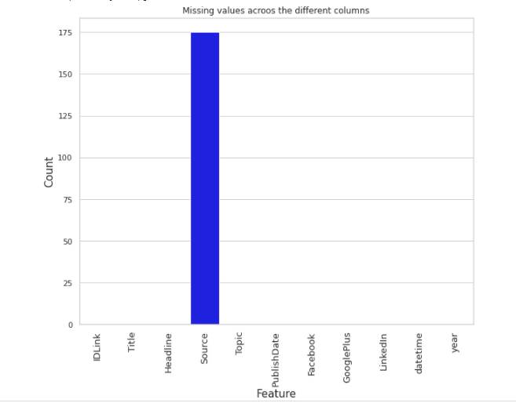
Fill Null values
Only one feature has null values which is Source Feature
It is a categorical column and I have used various techniques for imputing null value such as
Mode
Missing String
Forward fill
Backward fill

Slide 4
Categorical to Numerical
Title and Headline columns are converted to numeric using various techniques such as
Hash Encoding
Word2Vec Technique
Topic column is encoded using technique
One Hot encoding
Source Column is encoded using various techniques such as
Binary encoding
Frequency encoding
Top 10 categories One Hot encoding

Slide 5
Datetime and Social Media columns
Extracted year and month from the Publish Date column but removed the month feature as I observed a recurrence relation and this lead to slight decrease in score value
Converted the Social media feature values as the Relu activation function such as negative values are made to 0 and positive values are same

Slide 6
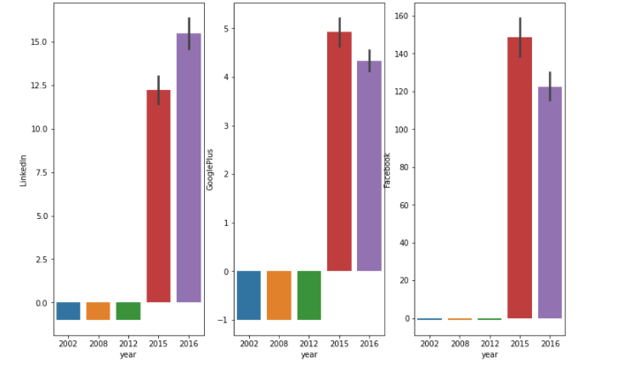
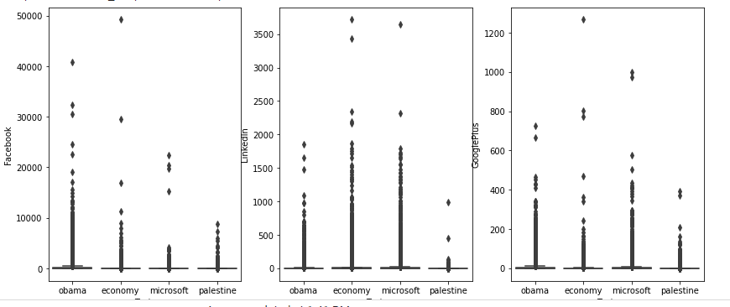
Quality Checks Performed/Errors found
All the outliers in the data are in the year 2015 and 2016

Slide 7
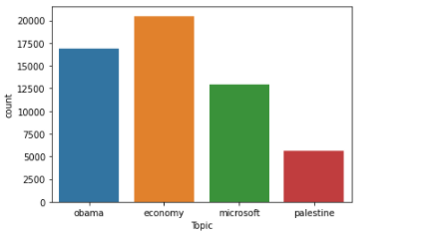
Key Observations/Trends
More news is on the Economy topic and less news on the topic Palestine and also news on economy has highest reachability on year 2016
The news on economy has high reachability on all the years on these 3 platforms

Slide 8
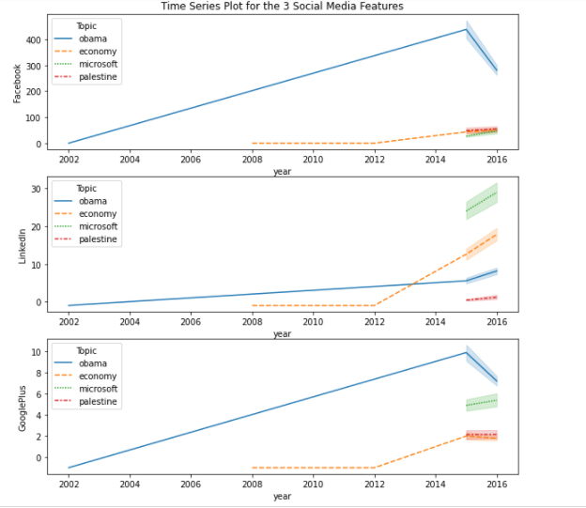
Key Observations
From this plot we can see that as the year increases the reachability for news on these topics on the 3 platforms increased gradually and decreased for some topics on the final year
News on some of these topics is not present in some years

Slide 9
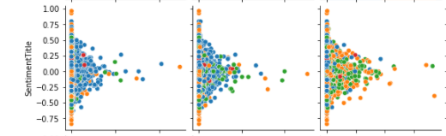
Key Observations
From this scatter plot we say that there is no linear relationship between independent and dependent variable
The four colours of dots includes the topics feature
Red – Palestine
Green – Microsoft
Orange – Economy
Blue - Obama

Slide 10
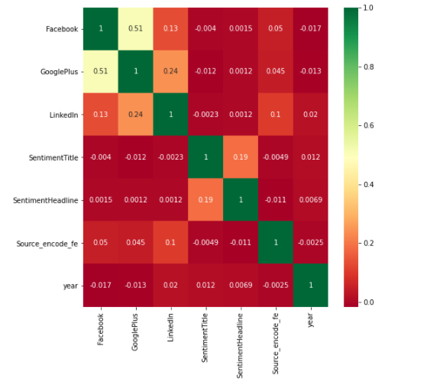
Most Significant variables in model

Slide 11
Model Choice
Cat Boost Algorithm
This is based on gradient boosting technique.
This algorithms is fast and also gives good performance
Artificial Neural Network
This works well for huge data and gives good performance
It has ability to identify the complex non linear patterns in the data

Slide 12
Section-B
Source Codes

Slide 13
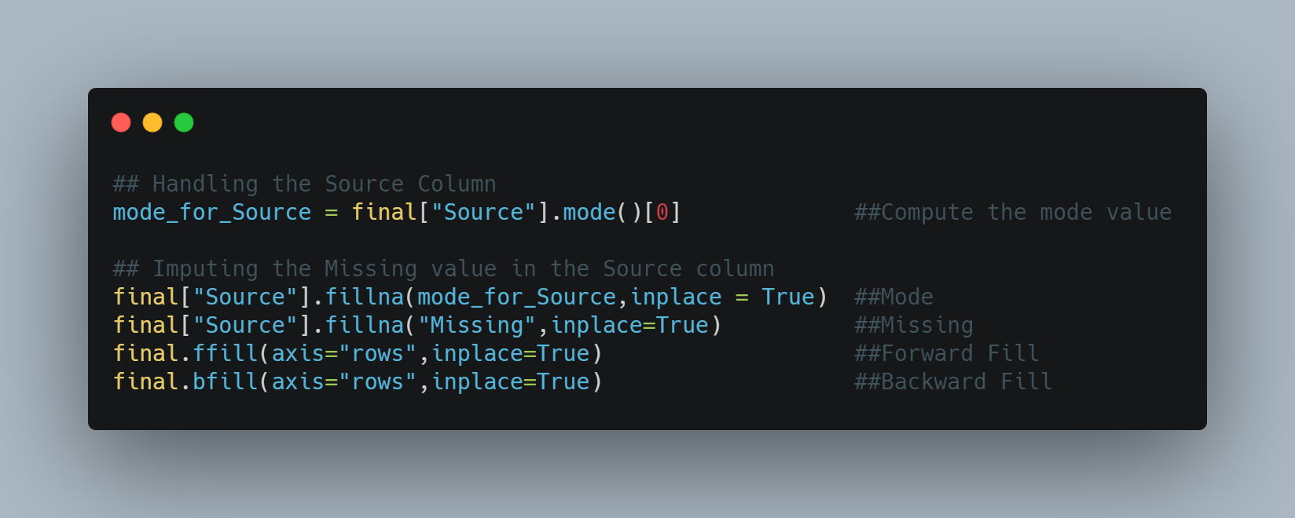
Source Feature Impute the Null Values

Slide 14
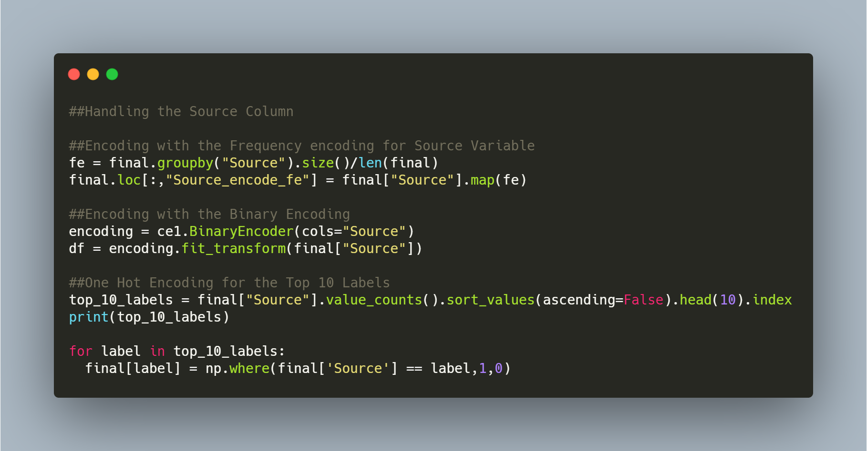
Encode the Source Feature

Slide 15
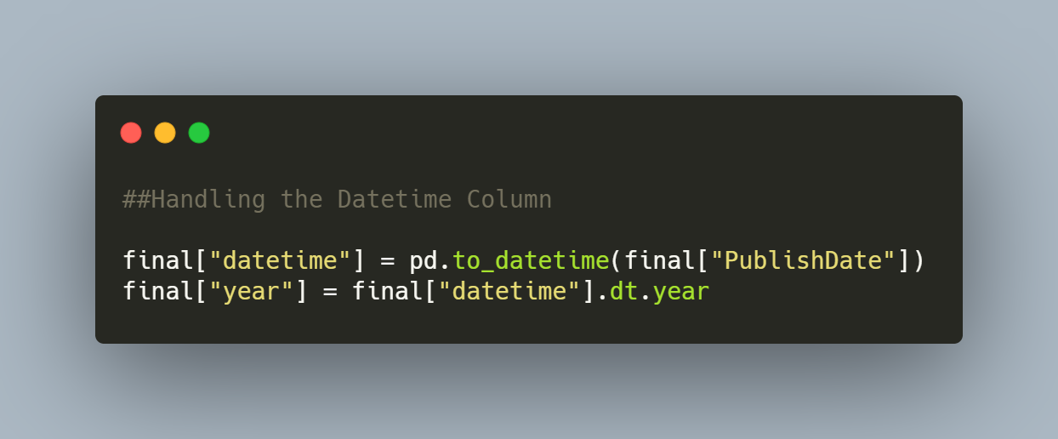
Publish Date Feature

Slide 16
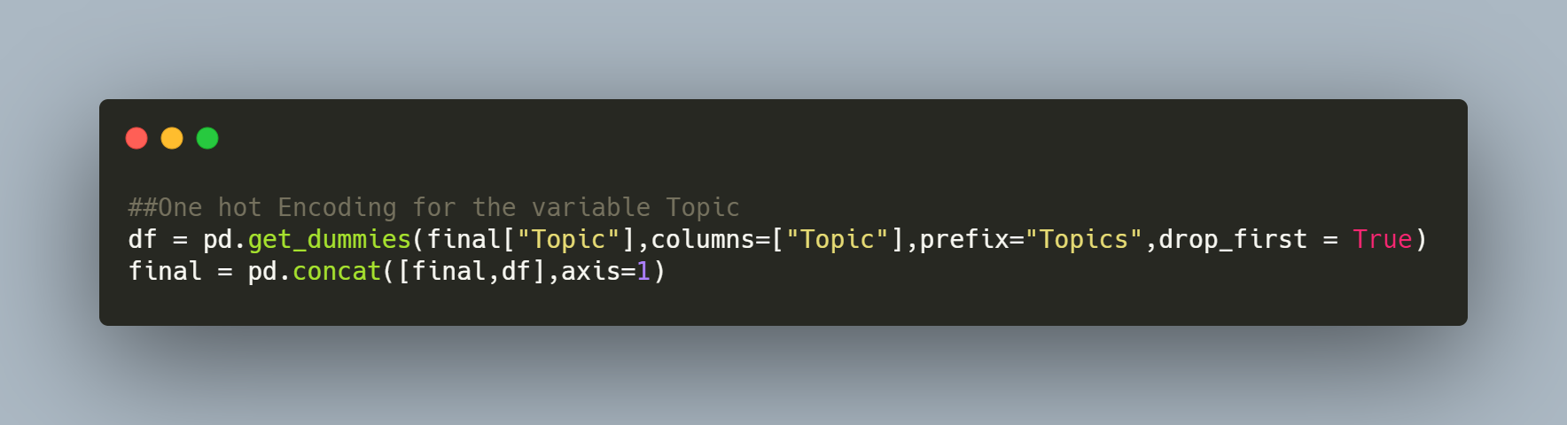
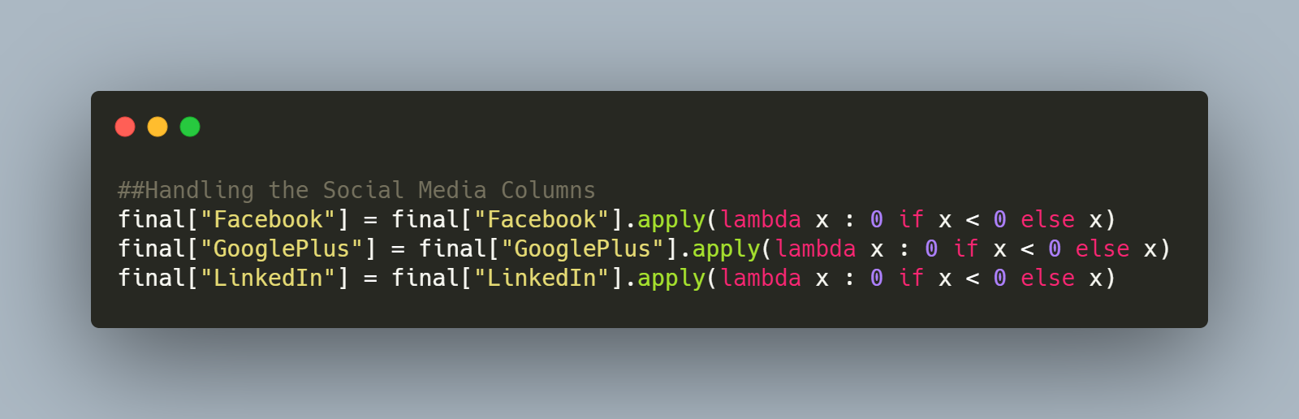
Topic , Social Media Features

Slide 17
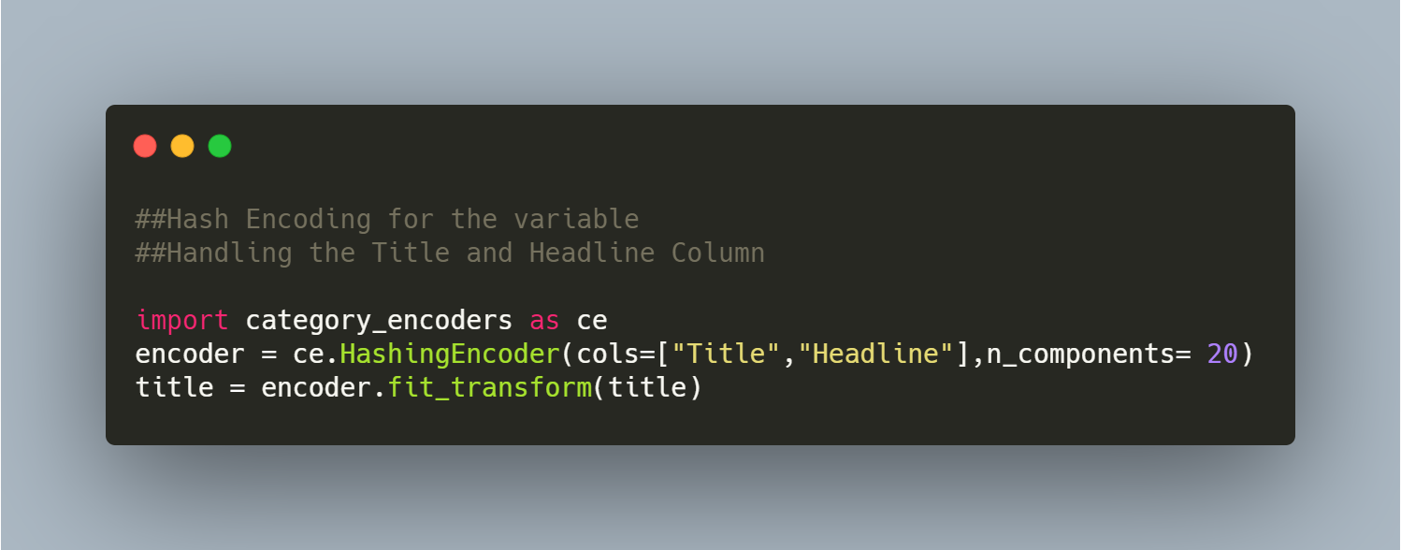
Title and Headline Feature

Slide 18
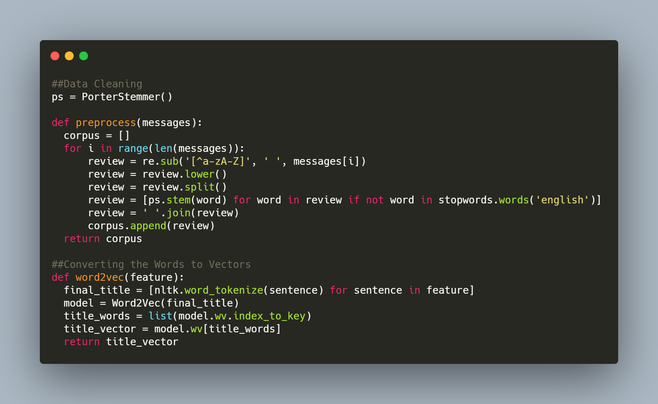
Title and Headline Feature Word2Vec Technique

Slide 19
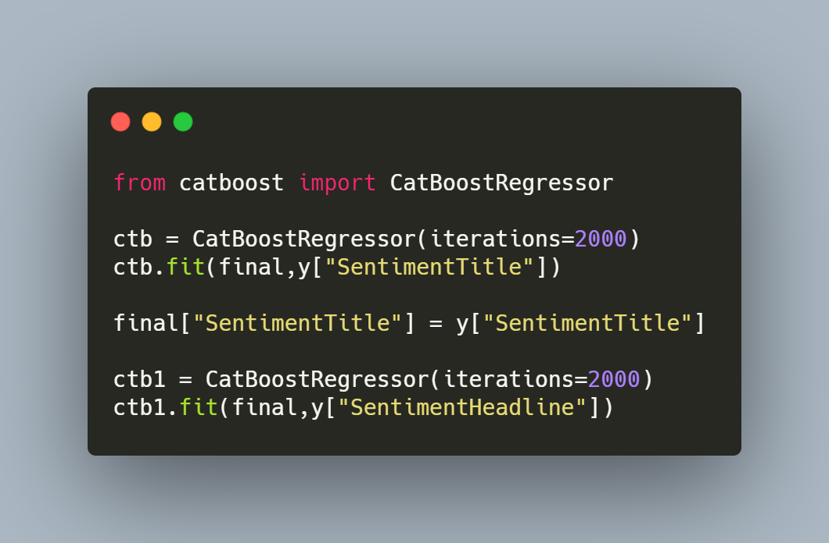
Model Choice
Cat Boost Algorithm

Slide 20
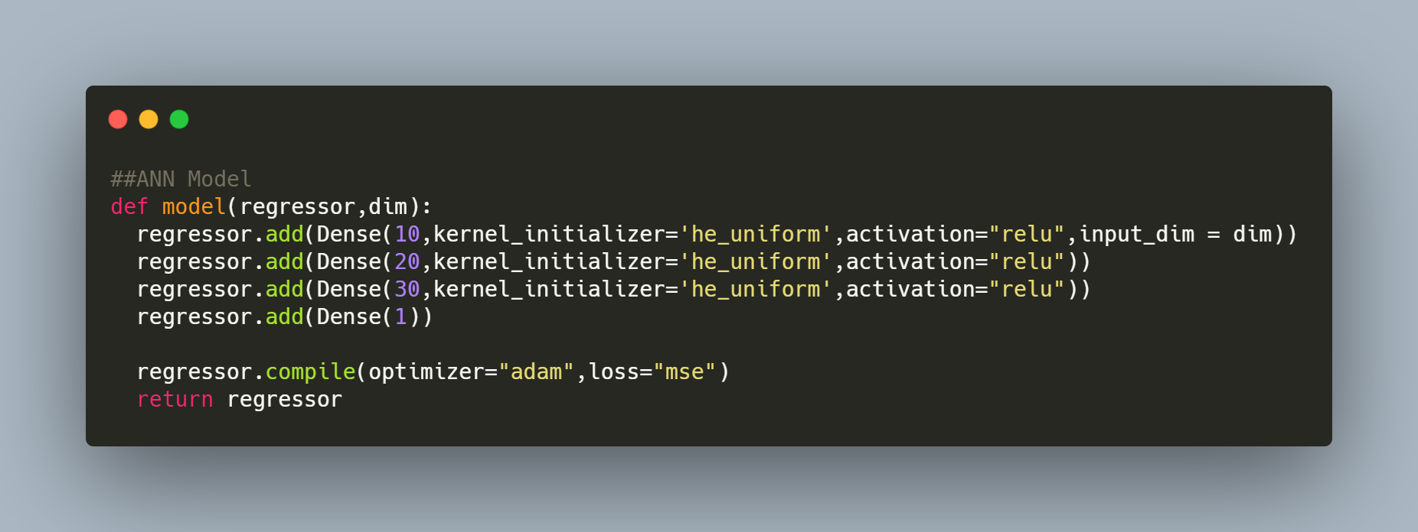
Artificial Neural Network

Slide 21
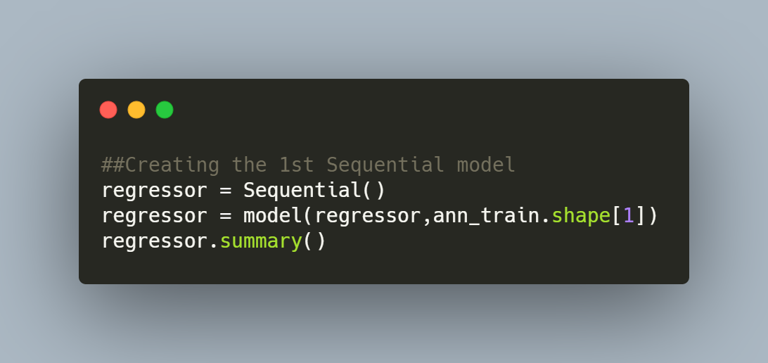
Sequential Model
The 2nd Sequential Model is also created in the same manner but there we have one extra feature which is Sentiment Title

Slide 22
Thank You

