Slide 1
Integrated Study of 1D Sensitivity Analysis and 2D FVM Laminar-Flow Simulation in Microfluidics: Blood vs. Water

Slide 2
Introduction to the problem
Microfluidic systems enable precise control of small-scale flows
→ key to biomedical and chemical applications.
Simulations help design efficient lab-on-chip devices
→ reducing experimental cost & trial-error cycles.
Flows often show non-Newtonian behavior, mixing, and droplet transport
→ require multi-dimensional models (1D–3D).
High-fidelity 2D/3D solvers (FVM, LBM) → accurate but computationally heavy.
1D models → fast but approximate.
Need: Find balance between model accuracy and computational speed.
Understanding how sensitive the flow outcomes are to model parameters (viscosity, flow rate, shear index, etc.) is essential to balance accuracy and speed.
Our goal:
Perform and analyse 1D simulations for multiple microfluidic use cases
Quantify sensitivity of flow outcomes to parameters
Simulate Pressure-driven flow in microchannels for: Water and Blood

Slide 3
Gaps in Existing Work (Motivation)
Need for Sensitivity Analysis in Simplified Microfluidic Models
Prior studies (including the reference paper) implemented 1D, 2D, and 3D simulations for non-Newtonian, mixing, and droplet flows.
While these models demonstrate scalability across abstraction levels, the relative influence of key parameters on system outputs was not quantified systematically
This limits understanding of:
  Which parameters dominate the flow response, and
  When 1D models are accurate enough to replace expensive 2D/3D simulations.
This work fills that gap by performing detailed sensitivity analysis on the 1D Non-Newtonian and Fluid-Mixing cases.

Slide 4
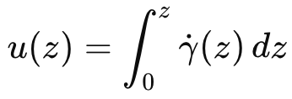
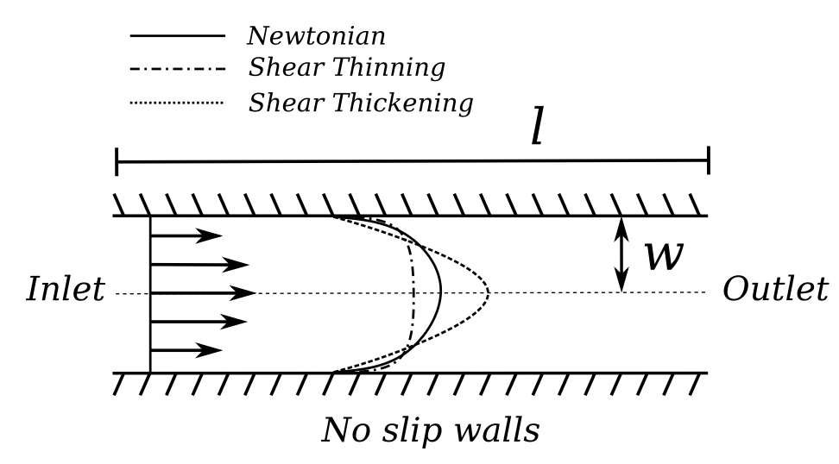
Methodology
1. Non-Newtonian Fluid Flow
Objective: Model shear-dependent flow (e.g., blood) through a rectangular microchannel.
Setup: Channel of 500 µm length, 100 µm width; uniform inlet velocity (10 mm/s), no-slip walls.
Physics: Viscosity varies nonlinearly with shear rate — modelled by the Carreau–Yasuda relation:
1D Model: Semi-analytical approach solving for local shear rate γ˙ (z) via root-finding and integrating velocity:
Outcome: Predicts flattened (shear-thinning) velocity profiles; computationally efficient vs. 2D/3D CFD.

Slide 5
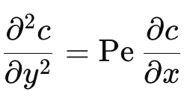
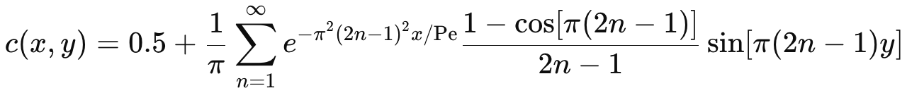
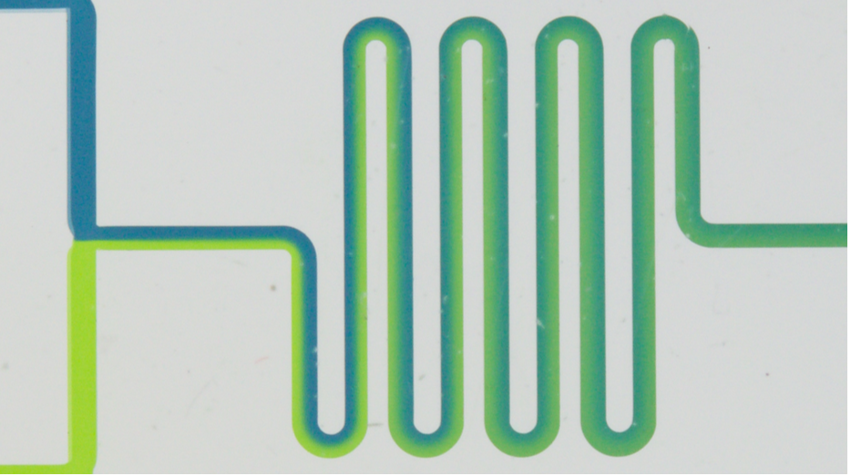
Methodology
2. Fluid Mixing
Objective: Predict diffusive mixing of two miscible fluids in a microchannel.
Setup: Straight channel (600 µm × 40 µm); left fluid C=1, right fluid C=0; no-slip walls.
Physics: Governed by 1D advection–diffusion equation:
where Pe = U*w/D (Peclet Number)
1D Analytical Solution: Fourier series representation for concentration evolution along the channel:
Outcome: Generates concentration profiles and computes the Absolute Mixing Index (AMI) for quantifying uniformity.
Fig: Flow mixing in a meandering channel

Slide 6
Methodology
3. Sensitivity Analysis Framework
Approach: 1-D semi-analytical solvers for Non-Newtonian and Fluid-Mixing cases
Stage 1 – Local (OAT) Sensitivity:
  Perturb each parameter by ±10 % (one-factor-at-a-time)
  Compute normalized finite-difference sensitivity
  Outputs → centerline velocity (Uₘₐₓ) and flow rate (Q)
Stage 2 – Global (Morris) Screening:
  Vary multiple parameters simultaneously using random trajectories
  Compute mean (μ*) and std (σ) of elementary effects
  Identify most influential & non-linear parameters
Applied to:
  Non-Newtonian blood flow (1-D Carreau–Yasuda solver)
  Fluid Mixing (1-D advection–diffusion solver)
Outputs:
  Sensitivity tables and tornado/scatter plots for U_{max} and Q (or AMI for mixing)
Notes:
Overall goal
Explain that you wanted to quantify which parameters most affect model outputs so future 2-D/3-D simulations or optimizations focus only on the critical ones.
2️⃣ Stage 1 (Local OAT)
Each rheological or transport parameter (μ₀, μᵢ, λ, a, n for Non-Newtonian; D, U, Pe for Mixing) is changed one at a time by ± Δ (≈ 10 %).
For each change, the solver recomputes Uₘₐₓ and Q.
Sensitivity coefficient used:
$$S_{p}=\frac{O\left(p+Δp\right)−O\left(p−Δp\right)}{2Δp}⋅\frac{p}{O_{base}}$$
This gives a unitless measure → “% change in output per % change in parameter.”
Results plotted as tornado charts for easy comparison.
It assumes the response is roughly linear and parameters don’t interact.
That’s why you need Stage 2 afterward.
3️⃣ Stage 2 (Global Morris)
Uses the Morris method = sample parameters over a grid of levels; compute “elementary effects” (EEs).
Statistics μ* (mean |EE|) → overall importance; σ → non-linearity / interactions.
Plotted μ*–σ scatter → parameters far from origin = most influential.
Provides a robust view beyond simple linear sensitivity.
4️⃣ Implementation details
Both scripts reuse the same 1-D Carreau–Yasuda or Mixing solvers from the paper’s repo.
Each run produces CSV files + plots (for Uₘₐₓ, Q or AMI).
1-D models chosen for speed and interpretability before attempting any 2-D validation.
5️⃣ Key takeaway for this slide
“We combined local (OAT) and global (Morris) analyses on the fast 1-D solvers to rank parameters and understand how rheological and transport properties drive flow and mixing behavior.”

Slide 7
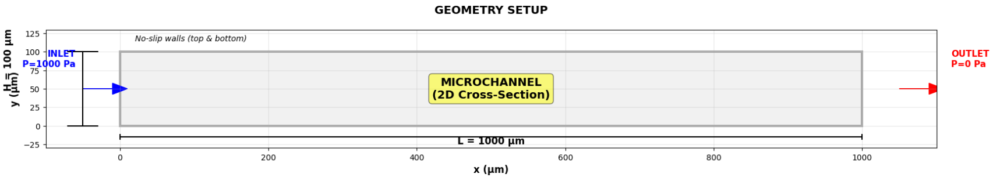
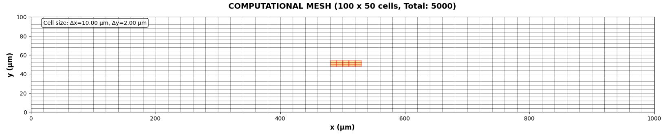
Methodology
4. Pressure driven flow for Water (low μ) and Blood (high μ)
Objective: Using a simplified 2D Navier-Stoles solver to simulate pressure-driven flow in a micro-channel.
Geometry & meshing:
Geometry: Defines the channel length (L = 1000μm) and height (H = 100 μm) in meters, Grid
Resolution: nx=100 cells in the x-direction and ny=50 cells in the y-direction.
Cell Size: Δx = L/nx and Δy = H/ny.
Fluids & BCs :
Water (μ= 0.001Pa.s) vs Blood μ= 0.0035 Pa.s)
Pressure Drop: ΔP = 1000 Pa (Driving force)
Walls: No-slip BC (u=0, v=0).
Notes:
Explain that a wider channel reduces diffusive overlap of species, hence higher AMI.
Emphasize that these trends can guide design — narrower channels enhance mixing.
Note that the global Morris analysis confirmed width as the key driver, consistent with intuition.

Slide 8
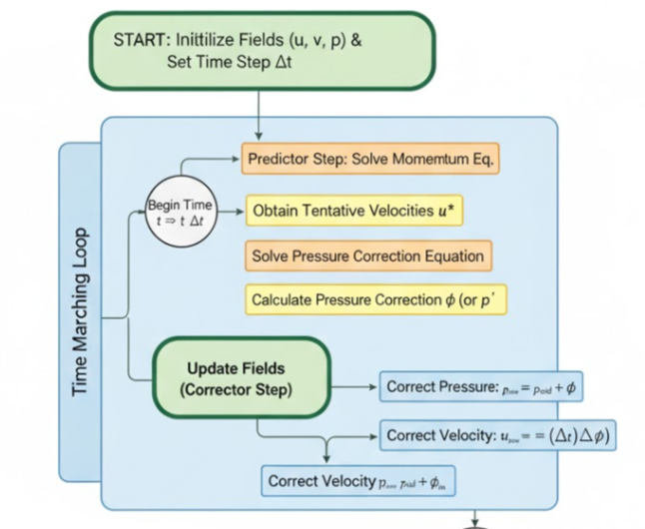


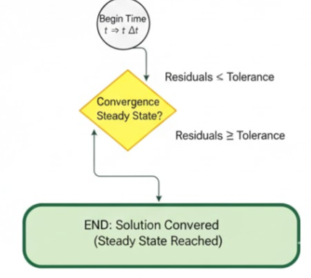

Numerical Methodology
Equation solved :
Momentum Conservation (Navier-Stokes)
Mass Conservation (Continuity)
The Pressure Poisson Equation (PPE)
Notes:
Explain that a wider channel reduces diffusive overlap of species, hence higher AMI.
Emphasize that these trends can guide design — narrower channels enhance mixing.
Note that the global Morris analysis confirmed width as the key driver, consistent with intuition.

Slide 9
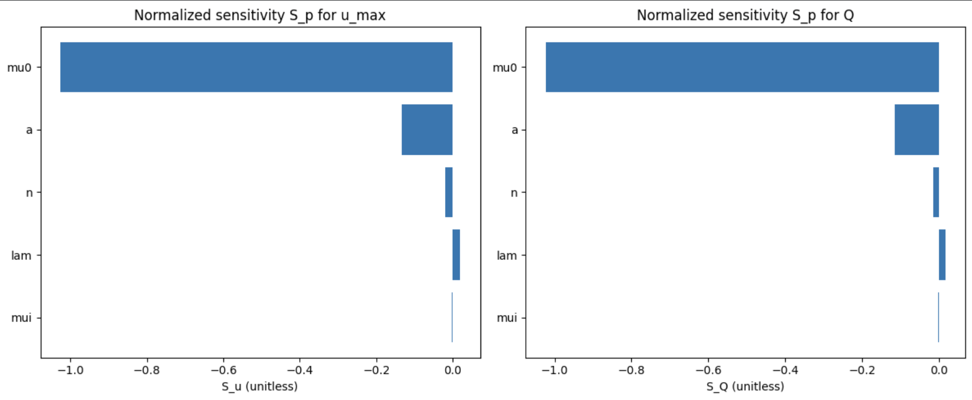
Results
Non-Newtonian Fluid Flow: Stage-1 (OAT) Sensitivity
Parameters analyzed: μ₀, μᵢ, λ, a, n
Outputs: centerline velocity (Uₘₐₓ) and volumetric flow (Q)
μ₀ (zero-shear viscosity) shows dominant negative sensitivity for both outputs
Indicates flow rate and velocity are mainly governed by μ₀, validating the dominance of bulk viscosity in low-Re, pressure-driven microflows
Notes:
Explain that “negative sensitivity” means increasing μ₀ decreases flow and velocity, as expected physically.
Highlight that small bars for λ and μᵢ confirm that time-constant and infinite-shear viscosity have little influence in laminar regime.
Conclude that μ₀ and a are the only significant levers for optimization.

Slide 10
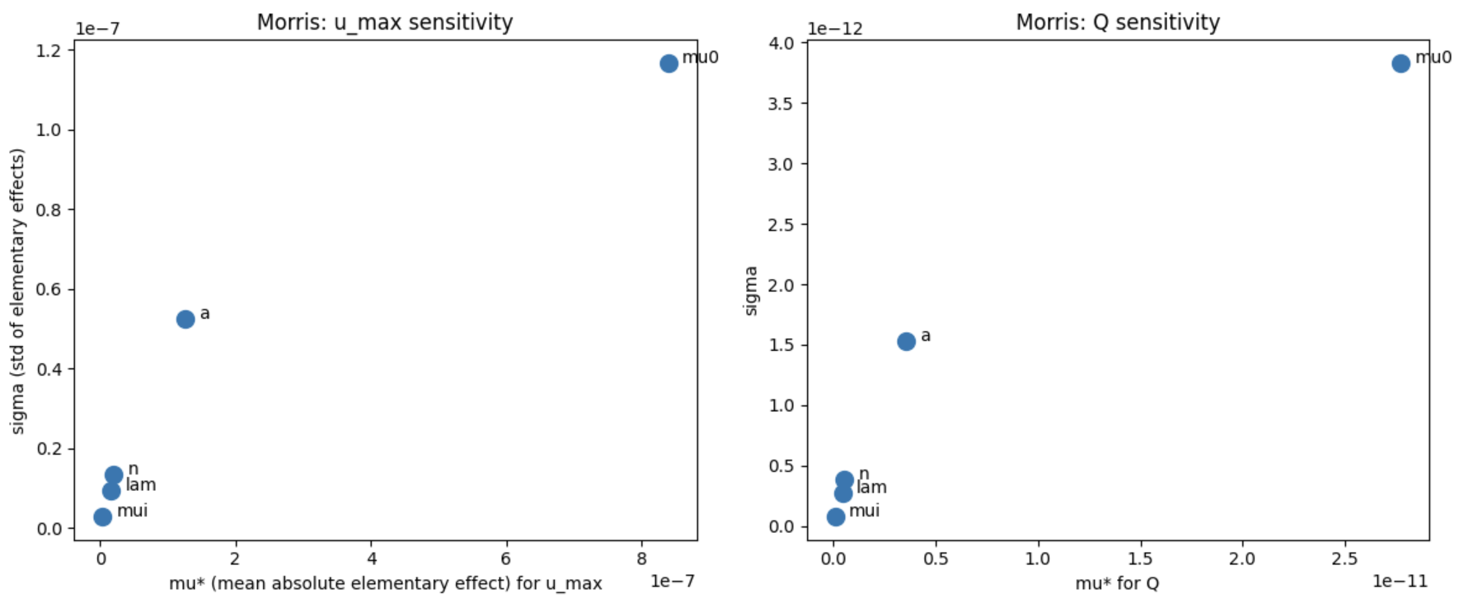
Results
Non-Newtonian Fluid Flow: Stage-2 Morris Sensitivity
Morris method used for global screening of parameter influence
μ* (mean effect) → overall importance; σ → non-linearity / interaction
μ₀ again shows highest μ*, confirming global dominance
Other parameters (μᵢ, λ, n) cluster near origin → low impact
Confirms robustness of Stage-1 findings and that μ₀ drives both Uₘₐₓ and Q.
Notes:
Point out that clustering near origin means those parameters have low sensitivity and little interaction effect.
Note that Stage-1 and Stage-2 are consistent — this strengthens confidence in 1D model fidelity.

Slide 11
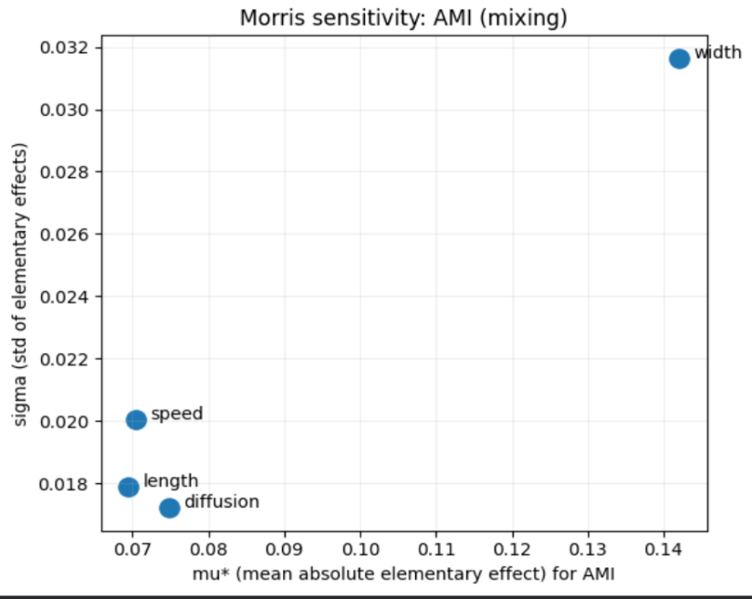
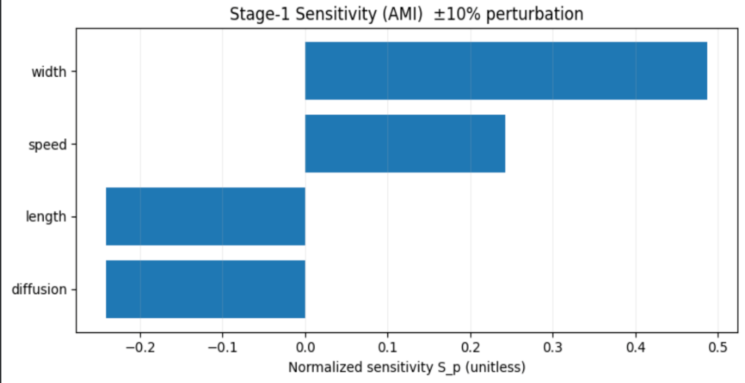
Results
Sensitivity Analysis – 1D Mixing in Microchannel
Parameters varied: speed (U), diffusion (D), length (L), and channel width (W)
Output metric: AMI (Absolute Mixing Index)
Stage-1: width and speed most influential; diffusion and length moderately negative
Stage-2 (Morris): width shows highest μ* and σ → key geometric driver
Interpretation:
  Increasing channel width → weaker mixing (higher AMI)
  Increasing speed reduces mixing efficiency due to shorter residence time
  Indicates geometric design (width) dominates over molecular parameters (D) in determining mixing performance
Notes:
Explain that a wider channel reduces diffusive overlap of species, hence higher AMI.
Emphasize that these trends can guide design — narrower channels enhance mixing.
Note that the global Morris analysis confirmed width as the key driver, consistent with intuition.

Slide 12
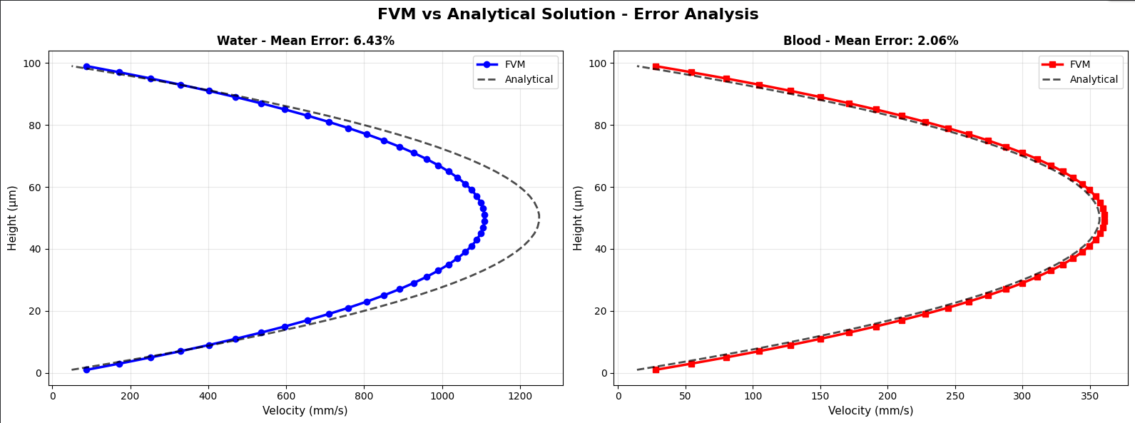
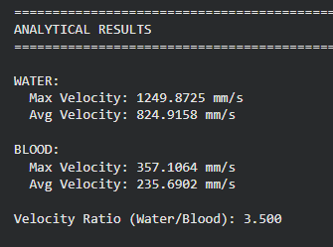
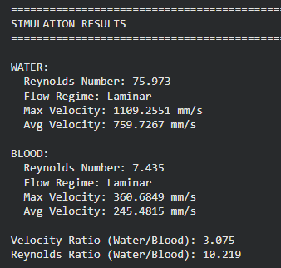
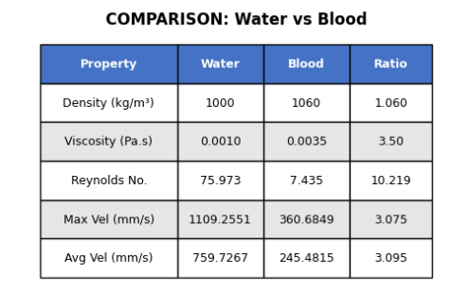
Results

Slide 13
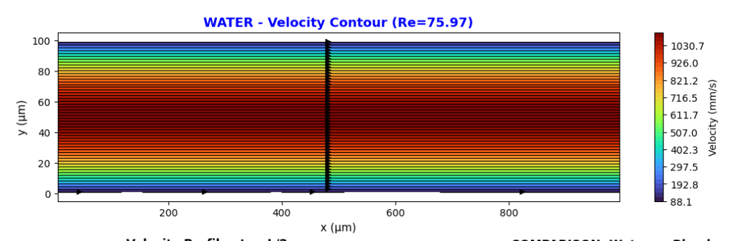
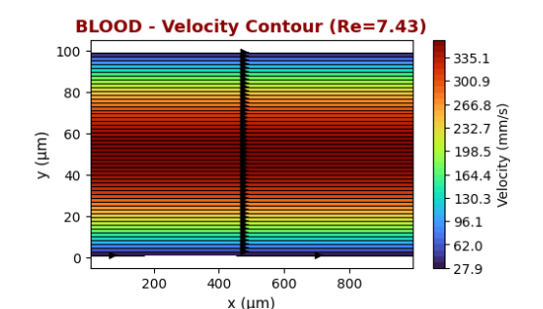
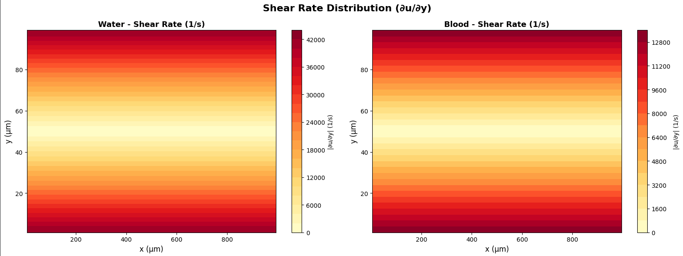
RESULTS

Slide 14
Conclusion
Developed and validated 1D solvers for Non-Newtonian and Mixing microfluidic cases
Performed two-stage sensitivity analysis (OAT + Morris)
μ₀ (zero-shear viscosity) – most critical for Non-Newtonian flow
Width and speed – dominant factors for Mixing efficiency
1D sensitivity results consistent and physically interpretable → provide a rapid, low-cost design tool
Future scope:
  Extend to 2D/3D validation and hybrid correction models
  Apply same framework to Droplet transport use case
  Automate parameter screening for microfluidic design optimization
Notes:
Reinforce that the study successfully fills the identified gap — quantifying parameter influence.
Mention that 1D models can quickly screen parameters before performing costly 2D/3D simulations.
End with a one-line takeaway:
“We demonstrated that even simple 1D abstractions can yield meaningful design insights when combined with systematic sensitivity analysis.”

Slide 15
Group Members
Aishwary Sharma: 2022CH11437 (Sensitivity Analysis)
Ravi Verma: 2022CH71498 (2D FVM Simulation)
Saroj Kumar Terai: 2019CH10127 (Report)
Chinmay Yadav: 2022CH71502 (Report)
Github link : https://github.com/Raviverma1498/cfd_simulation
Thank You!!

